Slide 2
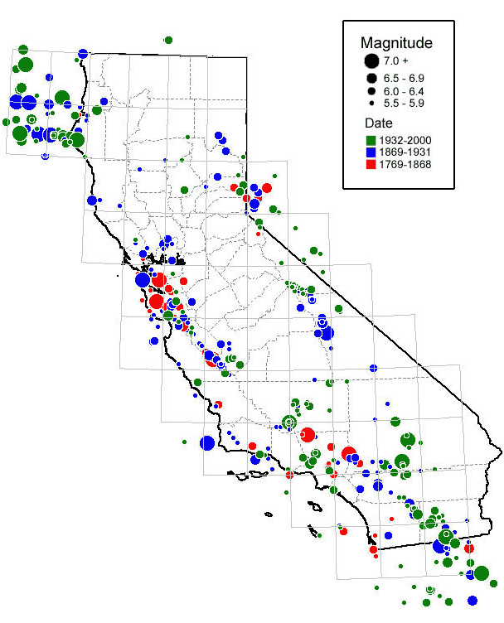
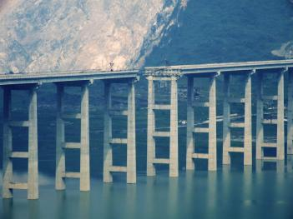
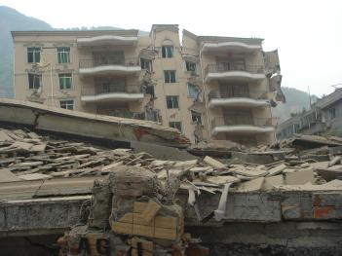
Earthquakes in CA
(From Wikipedia)
Notes:
Eartuquake is one of the most devastating disasters in nature, especially in Southern California. Numerical simulation is a valuable tool to unveil the underlying physics, predict ground motion amplitudes and alleviate seismic hazard.
gree or not, we are now standing on a place, that is slightly more dangerous than most other areas, at least in terms of earthquake hazard.
The left figure shows earthquakes with magnitudes larger than 5.5 in last 2.5 hundred years. 5.5, is not even small. The first earthquake I felt in US was a 5.7, north of Los Angeles.
The red circles are the oldest earthquakes, the blue ones less old, and the green ones occur in last 100 years. Even the strongest buildings can be destroyed.

Slide 3
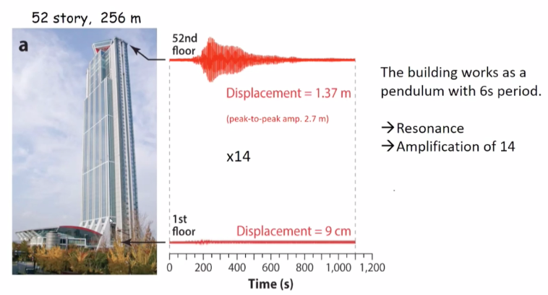
Frequency Matters
Courtesy of Kanamori, SSA2021

Slide 4

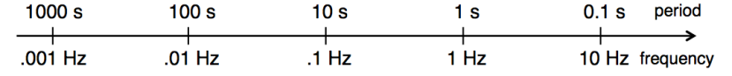
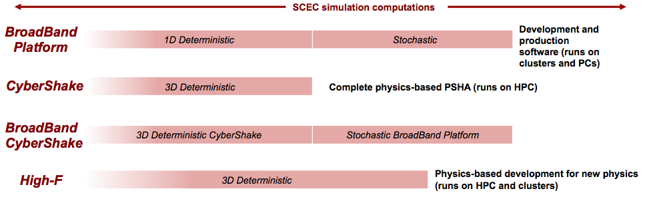
Earthquake - Frequency
Computational Cost
(from Goulet et al. 2016)
Notes:
Cybershake is a physics-based simulation platform from SCEC. It can generate the seismograms we need, which have frequency information. As Nan mentioned two weeks ago, frequency plays an important role in seismic hazard analysis. But for now Cybershake are used for simulations with frequency cut off at 1 Hz. For higher frequency, simulations are run in other projects, like Braodband and High_F

Slide 5
Site Response
Outcrop
Surface, Soil
m - km
Source
10-100s km
Notes:
Facing these challenges, we should first disassemble the problem. when an earthquake occurs, what actually happens?
We have a source , which contribute to the total energy and generates seismic waves. The energy carried by the seismic waves is absorbsed, scattered and reachs the local region. Generally we have some soft sediments here. The unfair thing is, though this part is 1000 times smaller, it still makes difference that is comparable to this long distance.
We define this as site response, which describe how the near-surface structure modifies the seismic waves when they travel upwards.

Slide 6
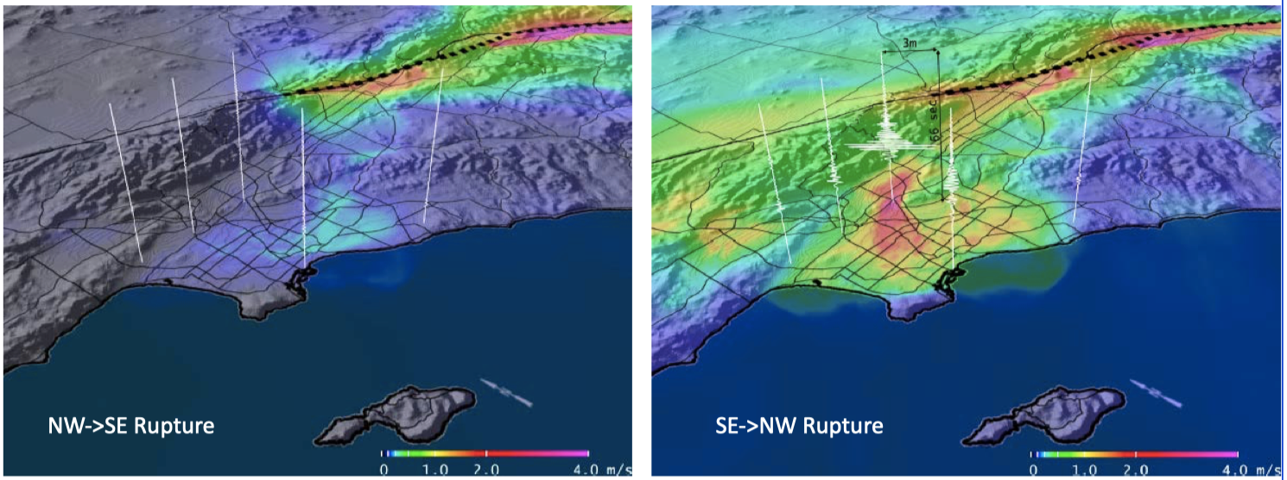
Olsen et al., GRL (2006)
Notes:
It’s important to study earthquake source for extreme events, including magnitude, rupture process, fault geology, and etc. For example, here is an M7.8 event rupturing the SAF. It shows peak ground velocity according to a 0.5 Hz linear simulation. It looks okay unless you live here, near Palm Springs? Unfortunately, the Peak ground velocity can reach about 4 m/s in this area, which is quite devastating.
However, what if earthquake ruptures in the other direction? People in Los Angeles now feel as bad as people in Palm Springs. This strong ground motion amplification is due to the channeling of seismic waves through the basins, and the presence of low-velocities in the basins.

Slide 7
Notes:
Another however, things are generally not as bad as seen at first glance. For extreme large deformation, another phenomenon may occur, that is plastic yielding. Basically, in elastic regime, the amount of deformation is linearly proportional to the force applied, then when the

