Slide 1
Car Auction Price Analysis
Table of Contents
Introduction
Load and Pre-process Data
Engineer New Feature
Model Training and Evaluation
Conclusion

Slide 2
Introduction
According to McKinsey’s report, the used-car market is more than twice size of the new car market in US. So, in order to better serve customers in used-car market, we want to investigate what features that a customer value most.
So using the car auction price dataset, I try to figure out what kind of used-cars that customers are willing to pay for a lot of money, i.e., what is the common characteristic of used-cars sold in low, medium, and high price.

Slide 3
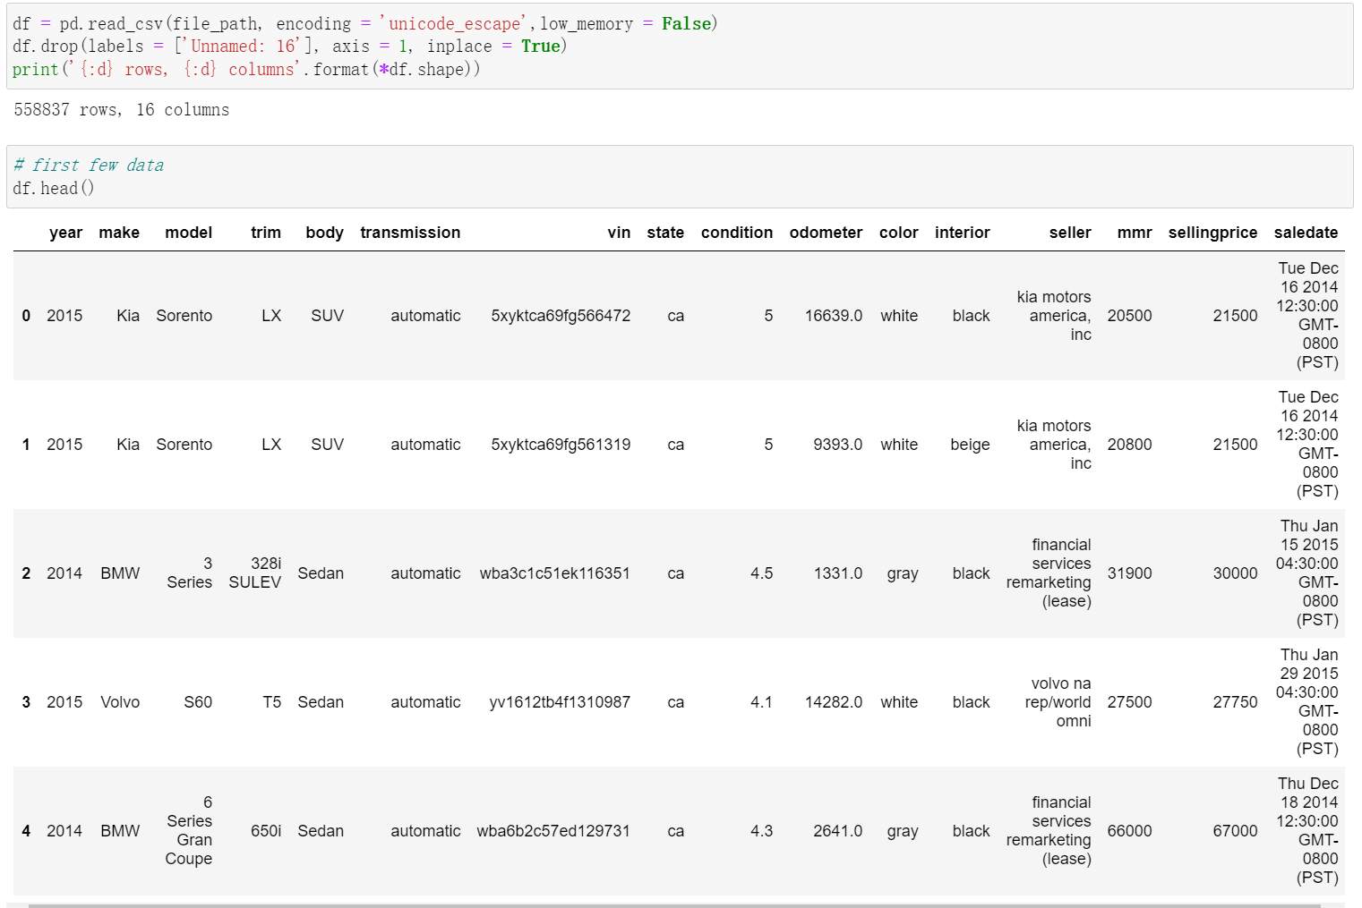
Load and Pre-process Data
This dataset contain 558837 rows and 16 columns. So, the number of observations is enough to conduct some analysis.
Before we jump into the model training, we want to take a look at each variable and see if all the record value are appropriate.
The next slide will explain the meaning of each variable.

Slide 4
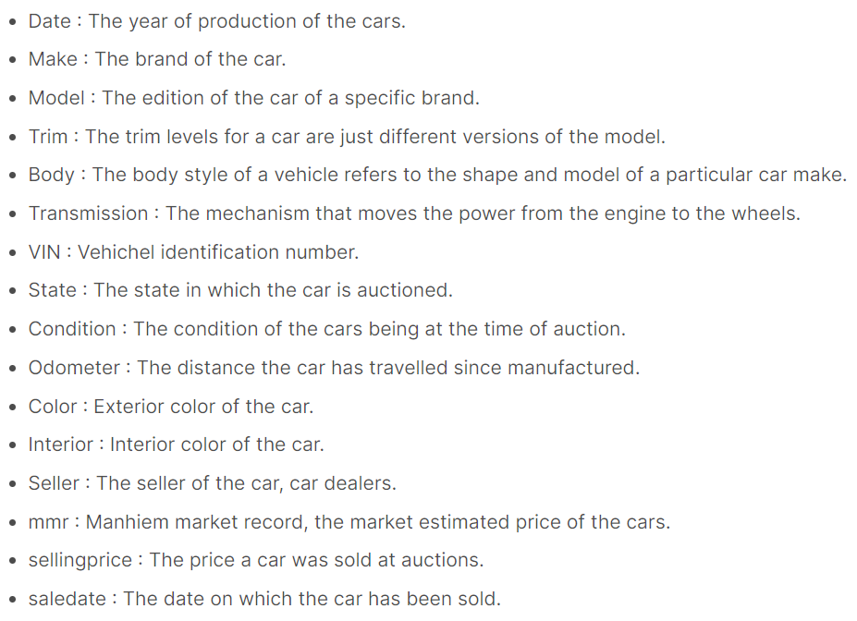
Data Dictionary

Slide 5
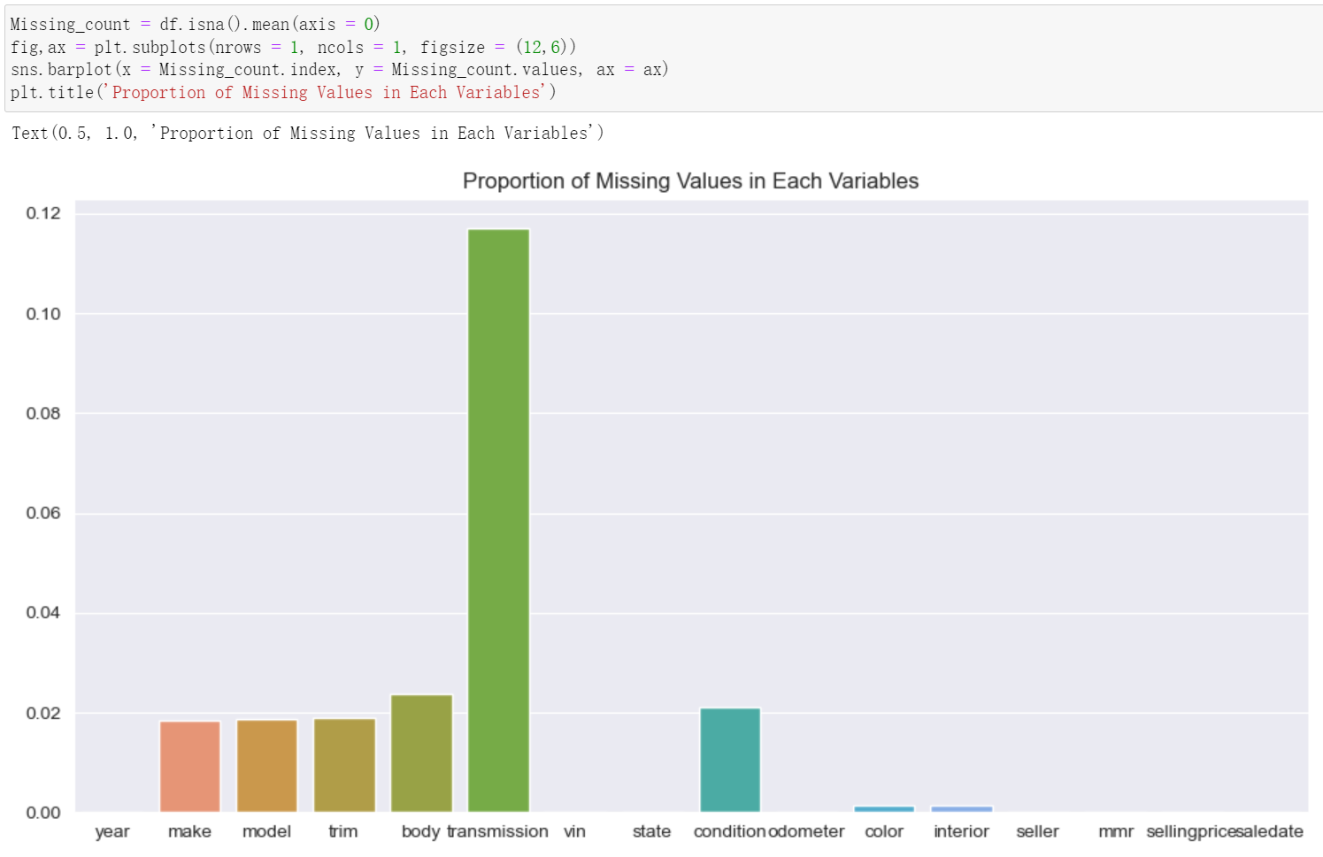
Missing Value
The graph shows the proportion of missing values in each variable. Note only transmission variable has considerable missing value, but still is not too high.
So to continue the analysis, we decide to remove those missing values.

Slide 6
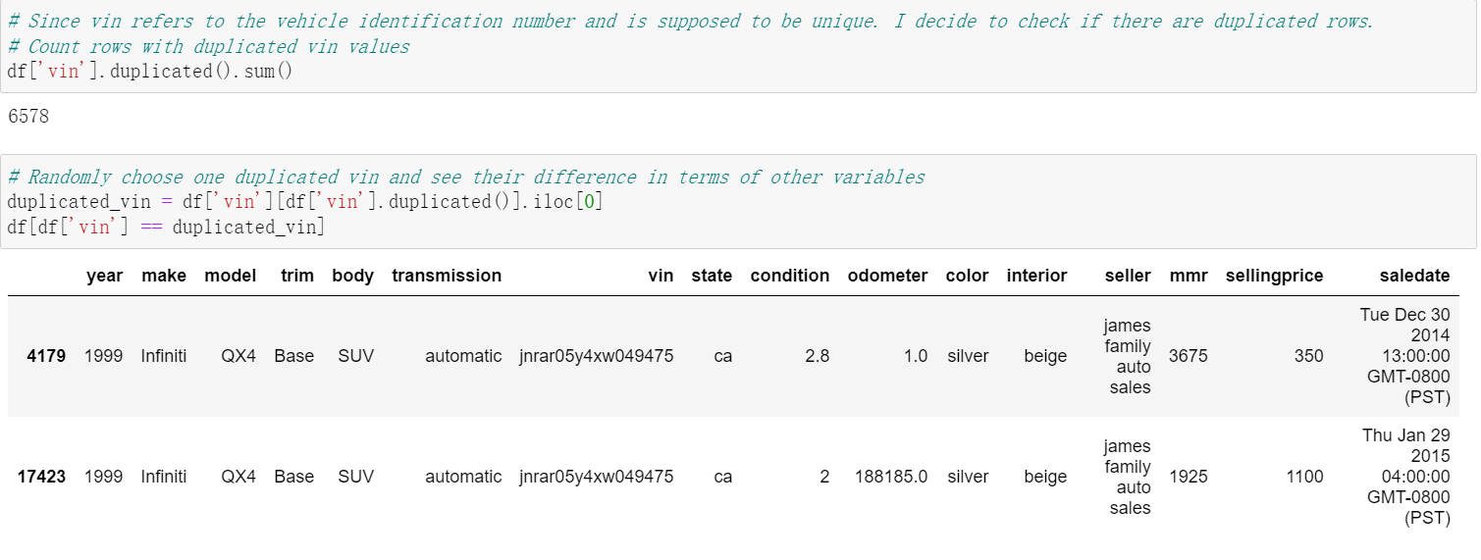
Vin Variable
Since vin refers to the vehicle identification number, it is supposed to be unique. But there are some duplicates.
Randomly choose one duplicated vin and see their difference in terms of other variables, we found they only different at sellingprice and saledate.
Since we want to predict the sellingprice. It may affect our analysis, I decide to drop the duplicated rows

Slide 7
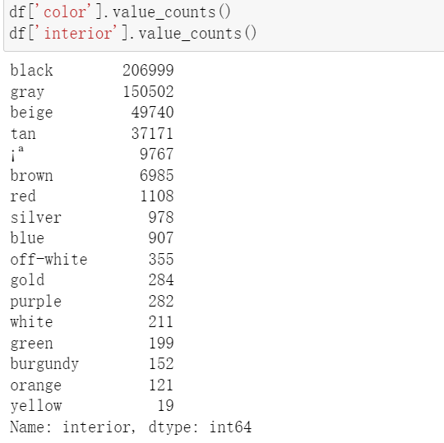

Color Variable
Note there are some strange value within color and interior variable, such as ¡ª. In the original data, it is the '-' (hyphen) value. This may refer to the unknown value. Thus, we want to replace '¡ª' with 'unknown'

Slide 8
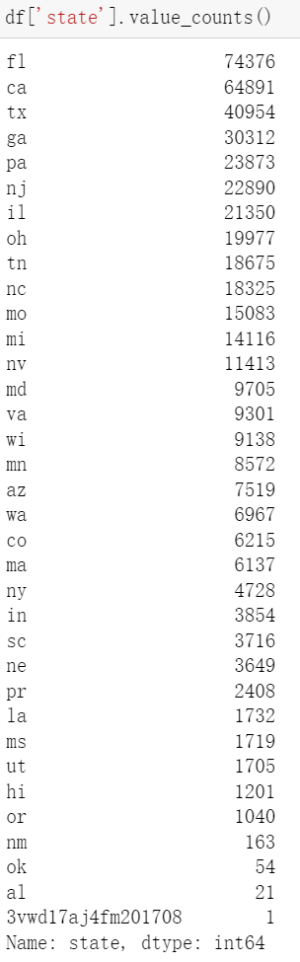
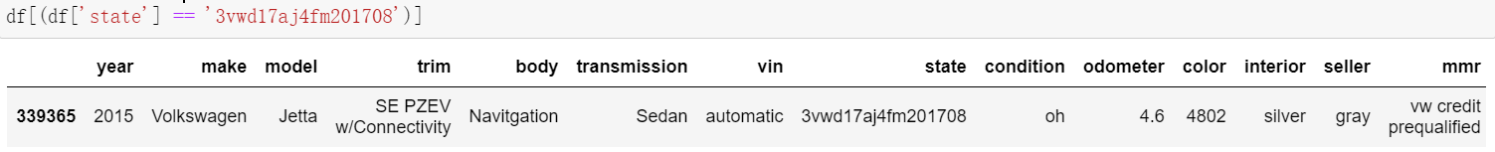
State Variable
Then we check the value of state variable. There is one strange value (3vwd17aj4fm201708) which is obviously not state name. It looks like value from vin variable.
By observing the row, it looks like all the value are shift one column to the right and this caused the problem. So we decide to drop the mismatched row.

Slide 9
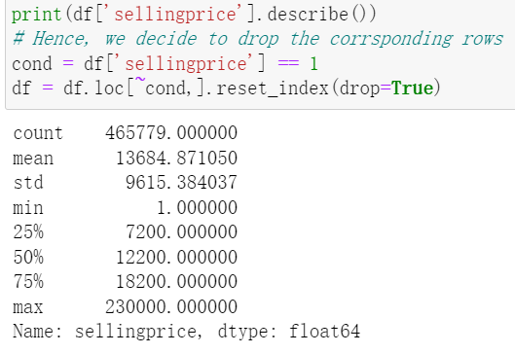
Sellingprice Variable
Note that the minimum value is 1, which is not reasonable to be a car selling price. Thus we decide to drop the corresponding rows.

Slide 10
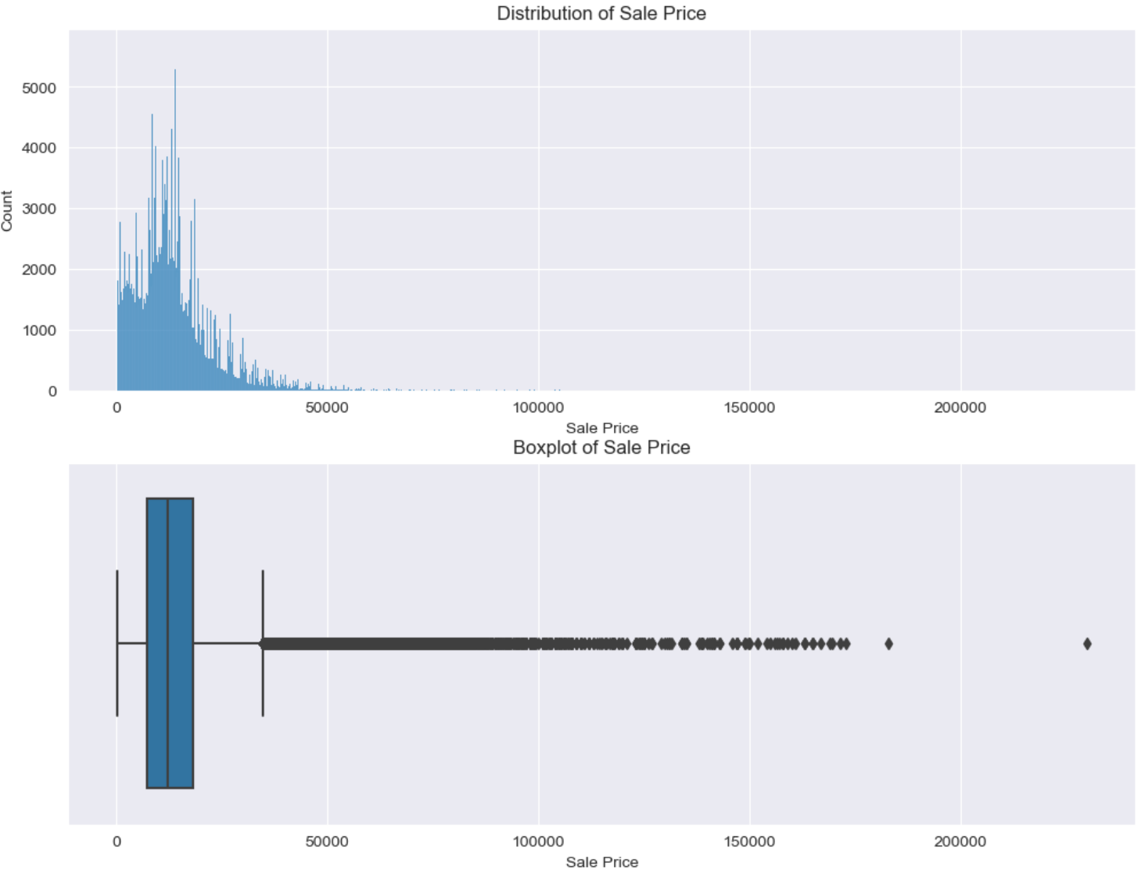
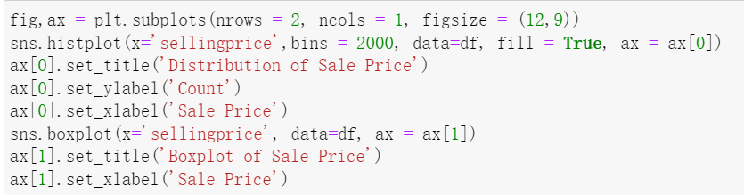
Distribution and Boxplot of Sellingprice Variable
We want to take a look at how cars’ sale price distributed

Slide 11
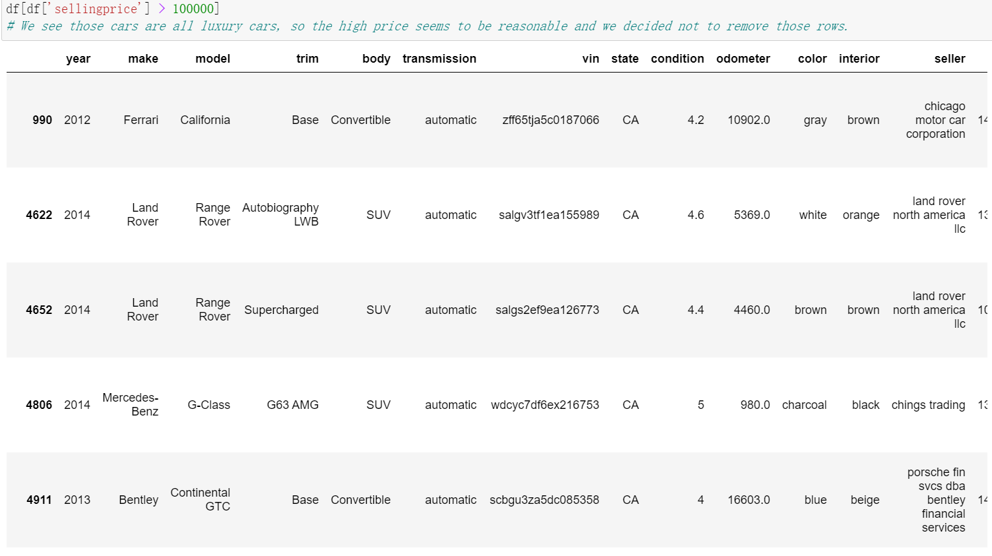
Sellingprice Variable
By observing the plots above, we found there are some extreme values which are far greater than the upper quantile. Thus, we want to look these rows in detail.
We can see those cars are all luxury cars, so the high price seems to be reasonable and we decided not to remove those rows.

Slide 12
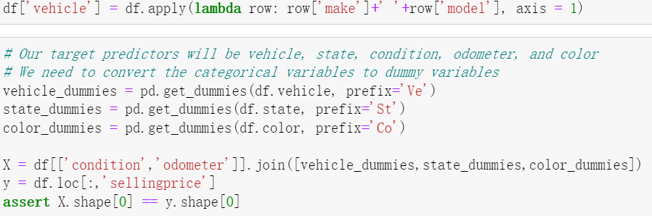
Engineer New Feature
We create a new feature called vehicle which is a combination of make and model features.
And we convert the categorical variables to dummy variables to prepare for the model training.
We used vehicle, state, condition, odometer, and color as predictor variables.

Slide 13
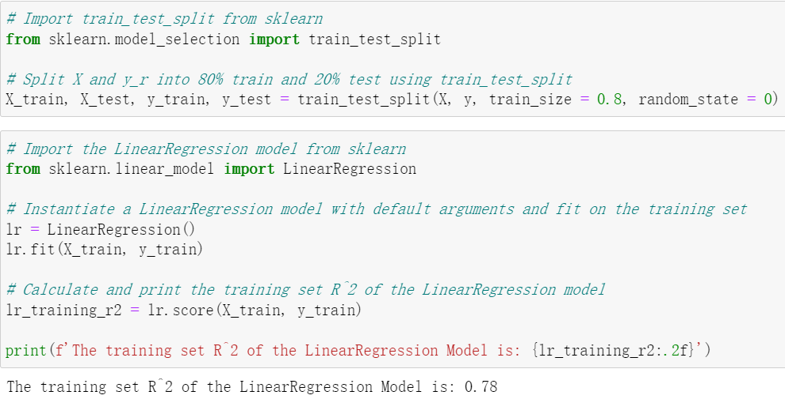
Model Training
Linear Regression
We split the data into 80% train and 20% test set. We build our model on the training set and print out the R^2 value of the model, which is 0.78.
This indicates that 78% variation of sellingprice can be explained by our model, which is a good result.

Slide 14
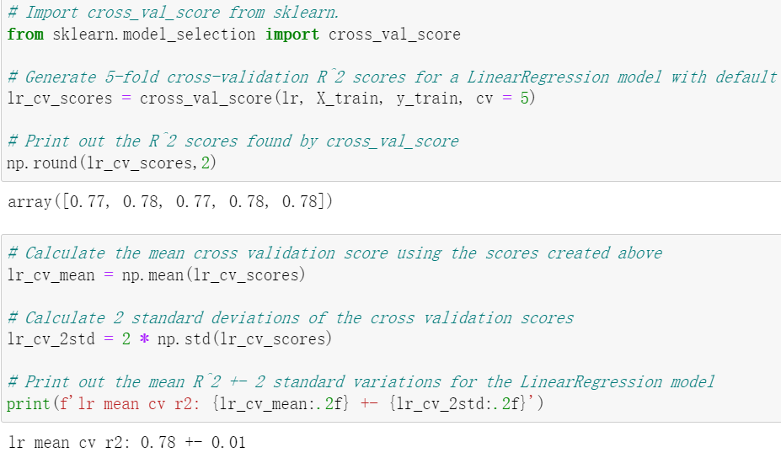
Model Evaluation
Cross-Validation
We used 5-fold Cross Validation to get a sense of variation of Linear Regression R^2 performance on the training set.
We can see that performance is pretty consistent for each fold.

Slide 15
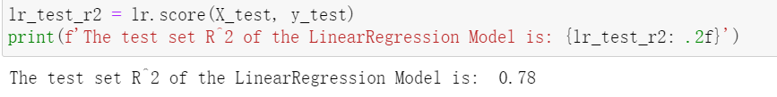
Model Evaluation
Evaluation on Test Set
Notice that the R^2 of the Linear Regression Model on test set is very close to the value on training set.
So, overfitting might not be a problem for Linear Model based on this result.

Slide 16
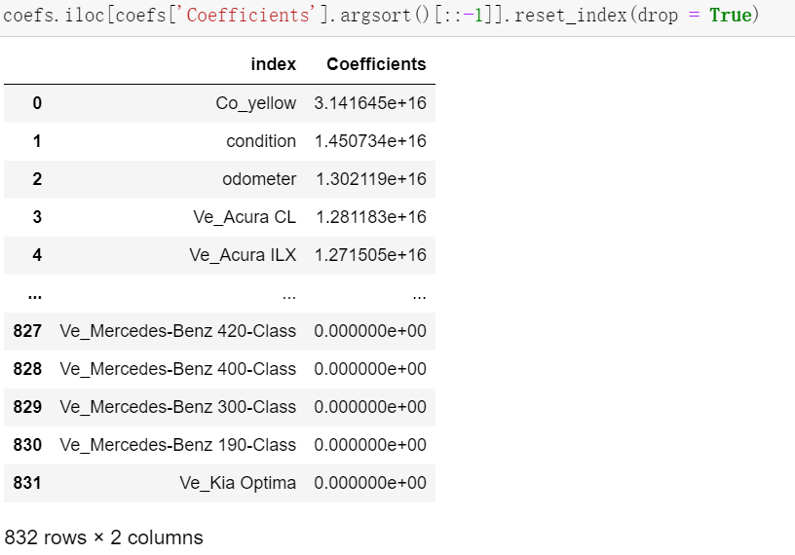
Model Evaluation
Which features are important?
In order to compare the importance of each feature, we first scaled the model so that comparing magnitude will be meaningful.
Then we retrieved the absolute value of coefficients for each feature and sort them in a descending order. As we can observe from the table, the top five most important features are Co_yellow, condition, odometer, Ve_Acural CL, and Ve_Acural ILX.

Slide 17
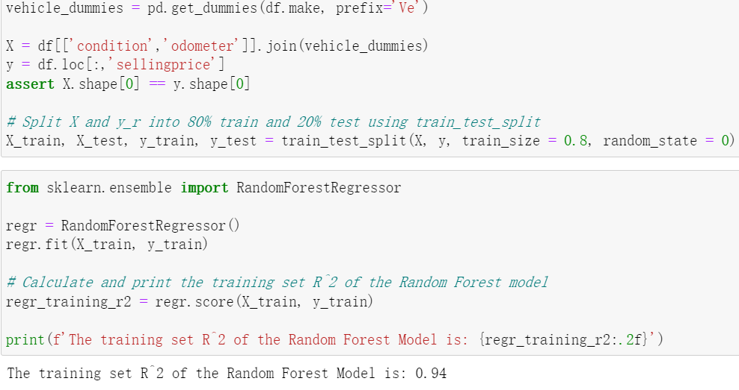
Model Training
Random Forest
We also want to use random forest algorithm and compare its performance with Linear Regression. Since there are hundreds of features, it will take a long time to fit the model. We decide to cut the features based on what we observed in Linear Regression. We will use condition, odometer, and make features.
The R^2 of the Random Forest Model on train set is 0.94, which is very high.

Slide 18
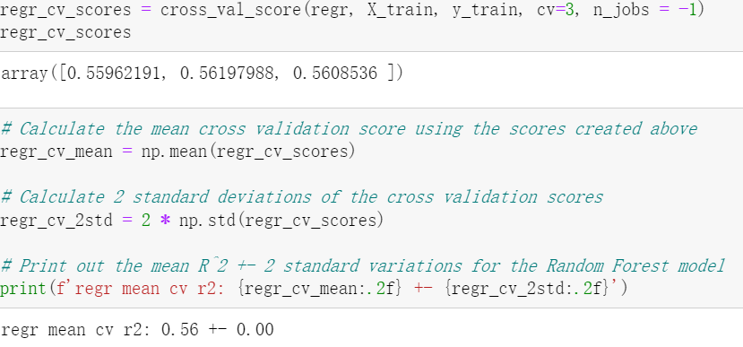
Model Evaluation
Cross-Validation
Again, we used 3-fold Cross Validation to get a sense of variation of Random Forest R^2 performance on the training set. The variation is almost 0.

Slide 19
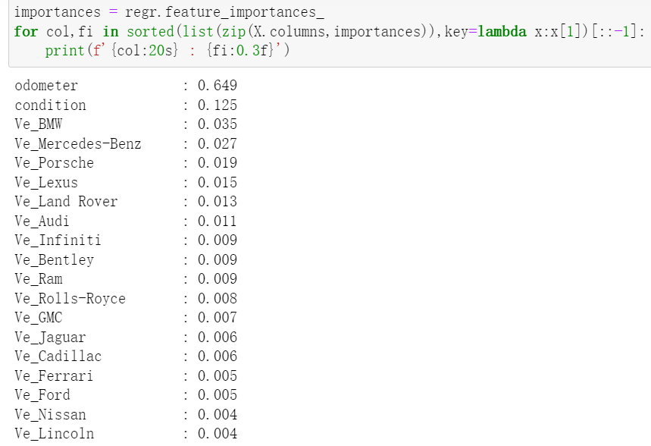
Model Evaluation
Which features are important?
For Random Forest Model, the top five most influential features are odometer, condition, Ve_BMW, Vw_Mercedes_Benz, Ve_Porsche.

Slide 20
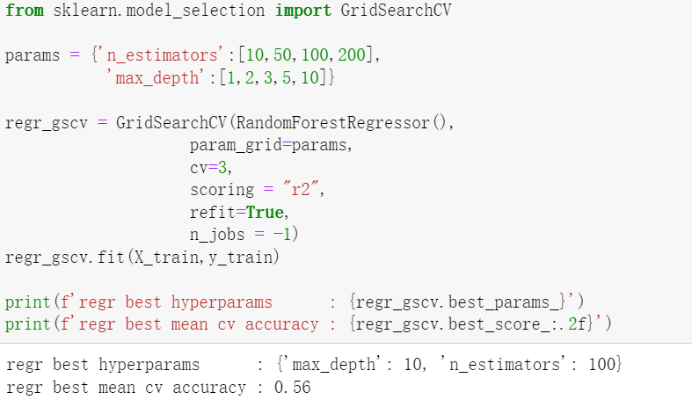
Model Evaluation
Hyperparameter Tuning
Next, we did some hyperparameter tuning. We want to find the optimal combination of n_estimators and max_depth hyperparameters such that can yield the maximum R^2 value.
We utilized GridSearchCV function and got the result that the best hyperparameters are max_depth to be 10 and n_estimators to be 100. We also had that the best R^2 value is 0.56.

Slide 21
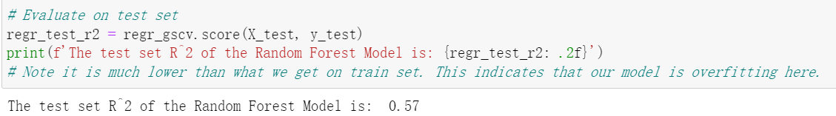
Model Evaluation
Evaluation on Test Set
We used the model with best hyperparameters and fit on the test set. We had that the R^2 of the Random Forest Model on test set is 0.57, which is far less than 0.94 of the train set. This indicates that our model is overfitting here.

Slide 22
Conclusion
From both linear model and random forest model, the features condition and odometer are important. And this is reasonable since car with better condition and less distance been travelled since manufactured usually can be sold with a good price.
Some interesting findings from linear model is that whether a car is yellow or not can determine its price to a large extend. This may can be explained by the fact that there are few yellow cars in vehicle market, so yellow cars usually have common attributes, such as made by luxury brand. Thus they tend to have similar auction price. And whether a car is Acura can also affect the price a lot. This may be due to the reason that Acura only manufactured cars of similar grade and thus have similar auction price.
Another surprising result is that random forest model has poor performance in terms of R^2, though we only used part of features trained in Linear Model. But this is because of the amount of time needed to fit the model. Besides, we also found overfitting issues in random forest model. Considering the time and overfitting issue, maybe linear model will be a better model here.

