Slide 1
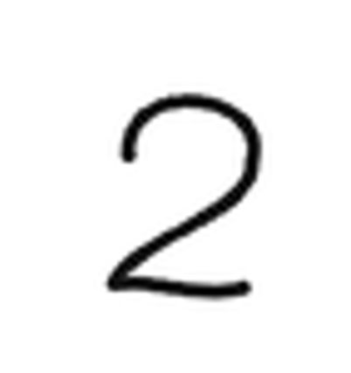
64
255 | 255 | 255 | 255 | 255 | 255 | 255
255 | 255 | 255 | 255 | 0 | 0 | 255
255 | 255 | 255 | 0 | 255 | 255 | 0
255 | 255 | 255 | 0 | 255 | 255 | 0
255 | 255 | 255 | 255 | 255 | 255 | 0
255 | 255 | 255 | 255 | 255 | 0 | 255
64
Data =
10
0 | 0 | 1 | 0 | 0 | 0 | 0 | 0 | 0 | 0
Label =
2
0 | 1 | 2 | 3 | 4 | 5 | 6 | 7 | 8 | 9

Slide 2
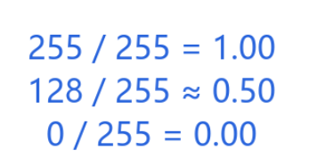
64
255 | 255 | 255 | 255 | 255 | 255 | 255
255 | 255 | 255 | 255 | 0 | 0 | 255
255 | 255 | 255 | 0 | 255 | 255 | 0
255 | 255 | 255 | 0 | 255 | 255 | 0
255 | 255 | 255 | 255 | 255 | 255 | 0
255 | 255 | 255 | 255 | 255 | 0 | 255
1 | 1 | 1 | 1 | 1 | 1 | 1
1 | 1 | 1 | 1 | 0 | 0 | 1
1 | 1 | 1 | 0 | 1 | 1 | 0
1 | 1 | 1 | 0 | 1 | 1 | 0
1 | 1 | 1 | 1 | 1 | 1 | 0
1 | 1 | 1 | 1 | 1 | 0 | 1
64
1 | 1 | 1 | 1 | 1 | . | . | .
64 x 64 = 4096

Slide 3
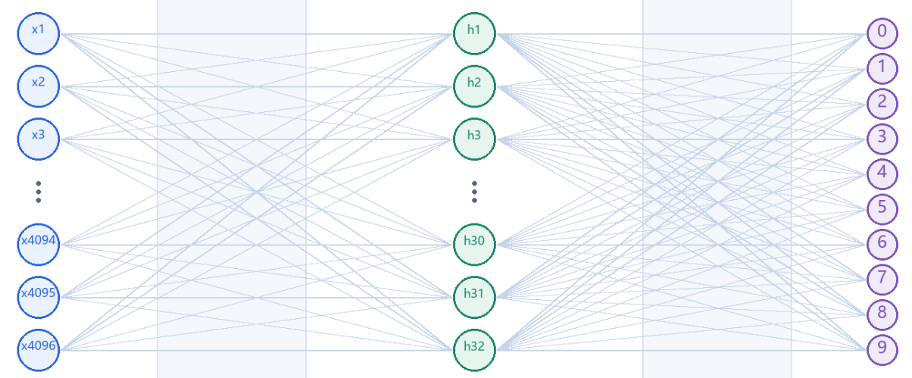
10
1 | 1 | 1 | 1 | 1 | . | . | .
0 | 0 | 1 | 0 | 0 | 0 | 0 | 0 | 0 | 0
2
64 x 64 = 4096
0 | 1 | 2 | 3 | 4 | 5 | 6 | 7 | 8 | 9
X
Y
y = x1 * w1_31 + x2 * w2_31 + … + x4096 * w4096_31 + b31
N = 4096 + 32 + 10 = 4138
Weights totally has 131,434

