Slide 1
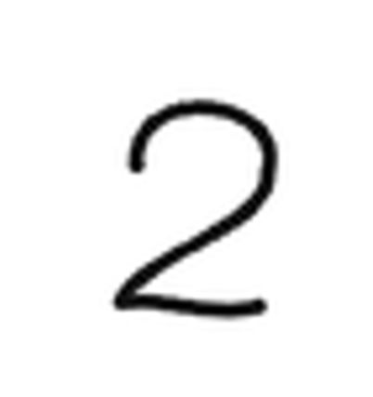
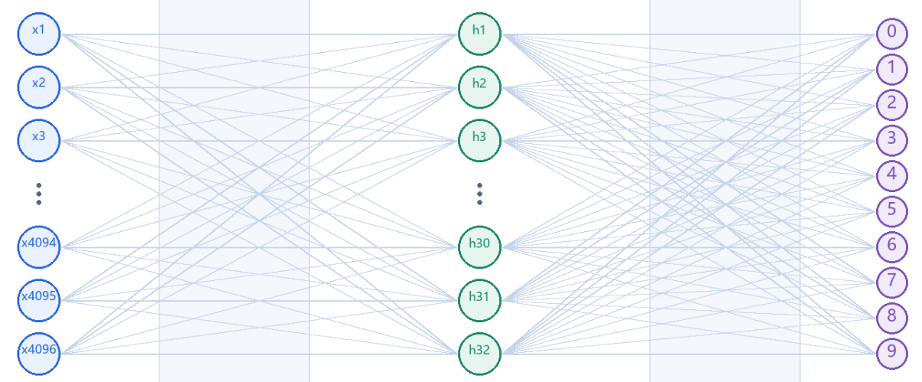
2
Array[64,64]
255 | 255 | 255 | 255 | 255 | 255 | 255
255 | 255 | 255 | 255 | 0 | 0 | 255
255 | 255 | 255 | 0 | 255 | 255 | 0
255 | 255 | 255 | 0 | 255 | 255 | 0
255 | 255 | 255 | 255 | 255 | 255 | 0
255 | 255 | 255 | 255 | 255 | 0 | 255
model = keras.Sequential([
keras.Input(shape=(4096,)),
keras.layers.Dense(32, activation="relu"),
keras.layers.Dense(10, activation="softmax"),
])

Slide 2
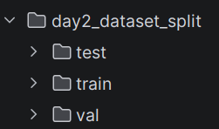
Step 1: dataset load
x_train, y_train = load_data(DATA_DIR / "train")
x_val, y_val = load_data(DATA_DIR / "val")
x_test, y_test = load_data(DATA_DIR / "test")
x_train, y_train
x_val, y_val
x_test, y_test
 | 0 | 1 | 2 | … | 18
x_train (img) | [255,255,…] | [255,255,…] | [255,255,…] |  | [255,255,…]
y_train (label) | 1 | 1 | 1 |  | 3
x_val | [255,255,…] | [255,255,…] | [255,255,…]

Slide 3
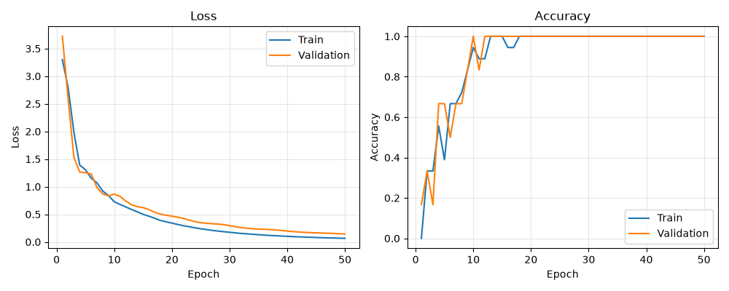
Step 4: training
history = model.fit(
x_train, y_train, validation_data=(x_val, y_val), epochs=EPOCHS, verbose=2,
)
x_train, y_train
x_val, y_val
history

Slide 4
Step 5: Evaluate on the test set and save the model.
print(f"Test accuracy: {model.evaluate(x_test, y_test, verbose=0)[1]:.2%}")
model.save(MODEL_PATH)
x_test, y_test
Test accuracy: 100.00%
MODEL_PATH = DAY3 / "weights.h5"

