Slide 1
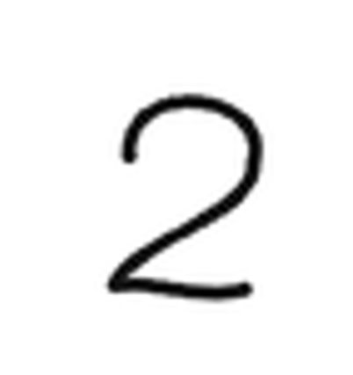
2
Array[64,64]
NN Model
255 | 255 | 255 | 255 | 255 | 255 | 255
255 | 255 | 255 | 255 | 0 | 0 | 255
255 | 255 | 255 | 0 | 255 | 255 | 0
255 | 255 | 255 | 0 | 255 | 255 | 0
255 | 255 | 255 | 255 | 255 | 255 | 0
255 | 255 | 255 | 255 | 255 | 0 | 255

Slide 2
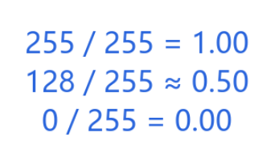
Step1
with Image.open(IMAGE_PATH) as image:
Step2
pixels = pixels / 255.0
Step3
x = pixels.reshape(1, 4096)
64
255 | 255 | 255 | 255 | 255 | 255 | 255
255 | 255 | 255 | 255 | 0 | 0 | 255
255 | 255 | 255 | 0 | 255 | 255 | 0
255 | 255 | 255 | 0 | 255 | 255 | 0
255 | 255 | 255 | 255 | 255 | 255 | 0
255 | 255 | 255 | 255 | 255 | 0 | 255
1 | 1 | 1 | 1 | 1 | 1 | 1
1 | 1 | 1 | 1 | 0 | 0 | 1
1 | 1 | 1 | 0 | 1 | 1 | 0
1 | 1 | 1 | 0 | 1 | 1 | 0
1 | 1 | 1 | 1 | 1 | 1 | 0
1 | 1 | 1 | 1 | 1 | 0 | 1
64
1 | 1 | 1 | 1 | 1 | . | . | .
64 x 64 = 4096

Slide 3
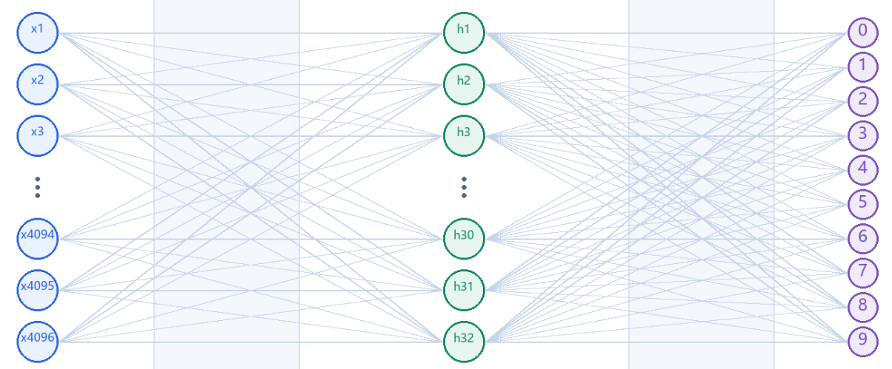
Step 4:
MODEL_PATH = STUDY / "day3_training_model" / "weights.h5"
model = keras.models.load_model(MODEL_PATH, compile=False)
0: 0.01%
1: 22.04%
2: 62.39%
3: 15.56%
4: 0.00%
5: 0.00%
6: 0.00%
7: 0.00%
8: 0.00%
9: 0.00%
X
Y
1 | 1 | 1 | 1 | 1 | . | . | .
Step 5:
probabilities = model.predict(x, verbose=0)[0]
print("\nStep 5 - Output probabilities for digits 0-9:")
for digit, probability in enumerate(probabilities):
print(f"{digit}: {probability:.2%}")

Slide 4
0: 0.01%
1: 22.04%
2: 62.39%
3: 15.56%
4: 0.00%
5: 0.00%
6: 0.00%
7: 0.00%
8: 0.00%
9: 0.00%
0: 0.01%
1: 22.04%
2: 62.39%
3: 15.56%
4: 0.00%
5: 0.00%
6: 0.00%
7: 0.00%
8: 0.00%
9: 0.00%
Step 6:
prediction = int(np.argmax(probabilities))
print(f"\nStep 6 - Prediction: {prediction}")
print(f"Confidence: {probabilities[prediction]:.2%}")

