Slide 1
Model (weights_0)
Training Procedure
Epoch 1 – data 0
Epoch 2 – data 0
Epoch 50 – data 0
Epoch 1 – data 1
Epoch 2 – data 1
Epoch 50 – data 1
Epoch 1 – data 2
Epoch 2 – data 2
Epoch 50 – data 2
Epoch 1 – data 18
Epoch 2 – data 18
Epoch 50 – data 18
Model (weights_1200)

Slide 2
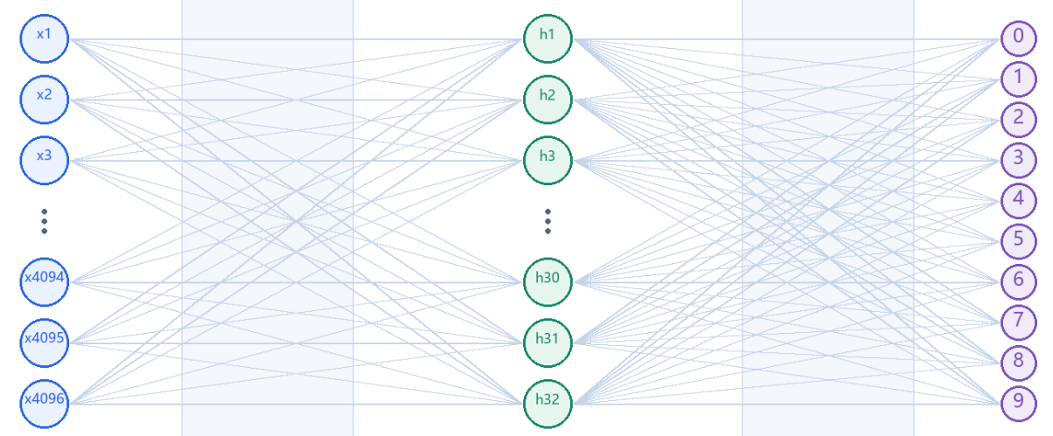
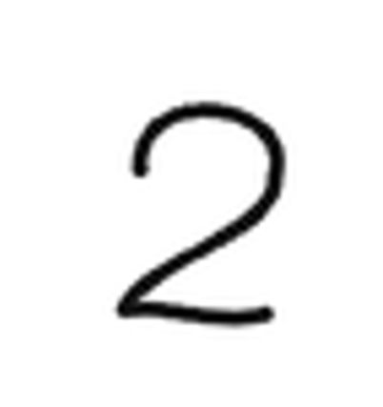
Epoch 1 – data 0
Step 3.2
Model (weights_0)
0: 0.01%
1: 22.04%
2: 62.39%
3: 15.56%
4: 0.00%
5: 0.00%
6: 0.00%
7: 0.00%
8: 0.00%
9: 0.00%
0: 0.00%
1: 0.00%
2: 100%
3: 0.00%
4: 0.00%
5: 0.00%
6: 0.00%
7: 0.00%
8: 0.00%
9: 0.00%
x = train_x[0]
scores = model(x)
score0
label0 = train_y[0]

Slide 3
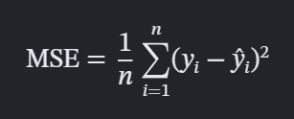
Epoch 1 – data 0
Step 3.3
0: 0.01%
1: 22.04%
2: 62.39%
3: 15.56%
4: 0.00%
5: 0.00%
6: 0.00%
7: 0.00%
8: 0.00%
9: 0.00%
0: 0.00%
1: 0.00%
2: 100%
3: 0.00%
4: 0.00%
5: 0.00%
6: 0.00%
7: 0.00%
8: 0.00%
9: 0.00%
loss0 = 1 / 10 * [(0.01% - 0.00%)^2 + …]
= 0.02142
score0
y0 = train_y[0]
loss = loss_fn(scores, y)

Slide 4
Epoch 1 – data 0
Step 3.4/5
Model (weights_0)
Model (weights_1)
loss0 = 0.02142
loss.backward() # 3.4: BP computes gradients for both layers.
optimizer.step() # 3.5: Update weights and biases.

Slide 5

Epoch 1 – data 1
Step 3.2
Model (weights_1)
0: 0.01%
1: 12.04%
2: 62.39%
3: 15.56%
4: 13.00%
5: 0.00%
6: 0.00%
7: 0.00%
8: 0.00%
9: 0.00%
0: 0.00%
1: 0.00%
2: 0.00%
3: 100.00%
4: 0.00%
5: 0.00%
6: 0.00%
7: 0.00%
8: 0.00%
9: 0.00%
x = train_x[1]
score1 = model(x)
score1
label1 = train_y[1]

Slide 6
Epoch 1 – data 1
Step 3.3
0: 0.01%
1: 12.04%
2: 62.39%
3: 15.56%
4: 13.00%
5: 0.00%
6: 0.00%
7: 0.00%
8: 0.00%
9: 0.00%
0: 0.00%
1: 0.00%
2: 0.00%
3: 100.00%
4: 0.00%
5: 0.00%
6: 0.00%
7: 0.00%
8: 0.00%
9: 0.00%
loss1 = 1 / 10 * [(0.01% - 0.00%)^2 + …]
= 0.11337
score1
y1 = train_y[1]
loss = loss_fn(scores, y)

Slide 7
Epoch 1 – data 1
Step 3.4/5
Model (weights_1)
Model (weights_2)
loss1 = 0.11337
loss.backward() # 3.4: BP computes gradients for both layers.
optimizer.step() # 3.5: Update weights and biases.

Slide 8
Epoch 1 – data 2
Keep running and update weights

Slide 9
Model (weights_0)
Epoch 1 – data 0
Epoch 2 – data 0
Epoch 50 – data 0
Epoch 1 – data 1
Epoch 2 – data 1
Epoch 50 – data 1
Epoch 1 – data 2
Epoch 2 – data 2
Epoch 50 – data 2
Epoch 1 – data 18
Epoch 2 – data 18
Epoch 50 – data 18
Model (weights_1200)

Slide 10
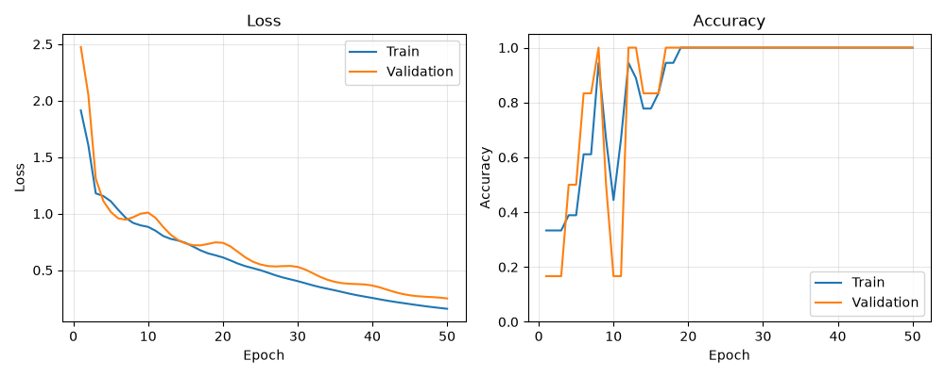
Training ideal target is reducing loss and increase accuracy

