Slide 1
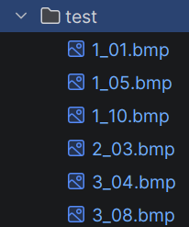
Accuracy Calculation Procedure
1_01.bmp | label: 1 | prediction: 1 | correct: True
1_05.bmp | label: 1 | prediction: 1 | correct: True
1_10.bmp | label: 1 | prediction: 1 | correct: True
2_03.bmp | label: 2 | prediction: 2 | correct: True
3_04.bmp | label: 3 | prediction: 3 | correct: True
3_08.bmp | label: 3 | prediction: 3 | correct: True
Test accuracy: 6/6 = 1.0000 (100.00%)
Accuracy = (1 + 1 + 1 + 1 + 1 + 1) / 6 -------------------- count total matched div total samples

Slide 2
Accuracy Calculation Procedure - Underfitting
=== Weights: weights_underfitting.h5 ===
1_01.bmp | label: 1 | prediction: 3 | correct: False
1_05.bmp | label: 1 | prediction: 2 | correct: False
1_10.bmp | label: 1 | prediction: 2 | correct: False
2_03.bmp | label: 2 | prediction: 2 | correct: True
3_04.bmp | label: 3 | prediction: 2 | correct: False
3_08.bmp | label: 3 | prediction: 2 | correct: False
Test accuracy: 1/6 = 0.1667 (16.67%)
Accuracy = (0 + 0 + 0 + 1 + 0 + 0) / 6 <-------------------- count total matched div total samples

Slide 3
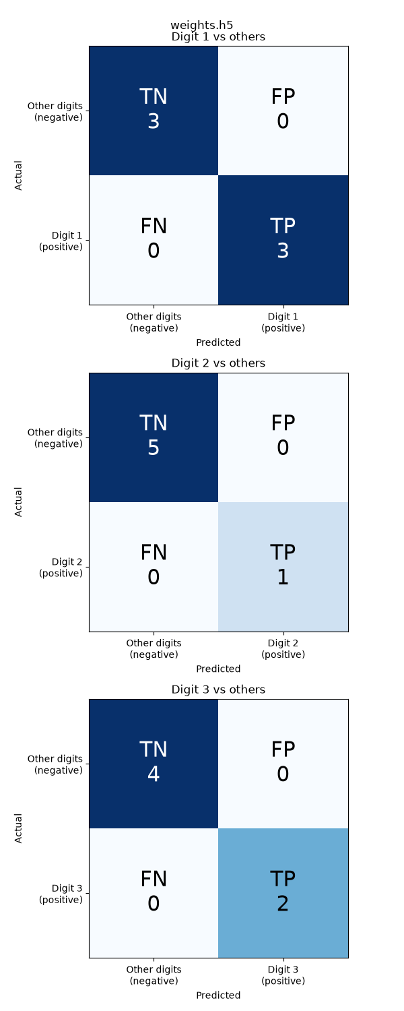
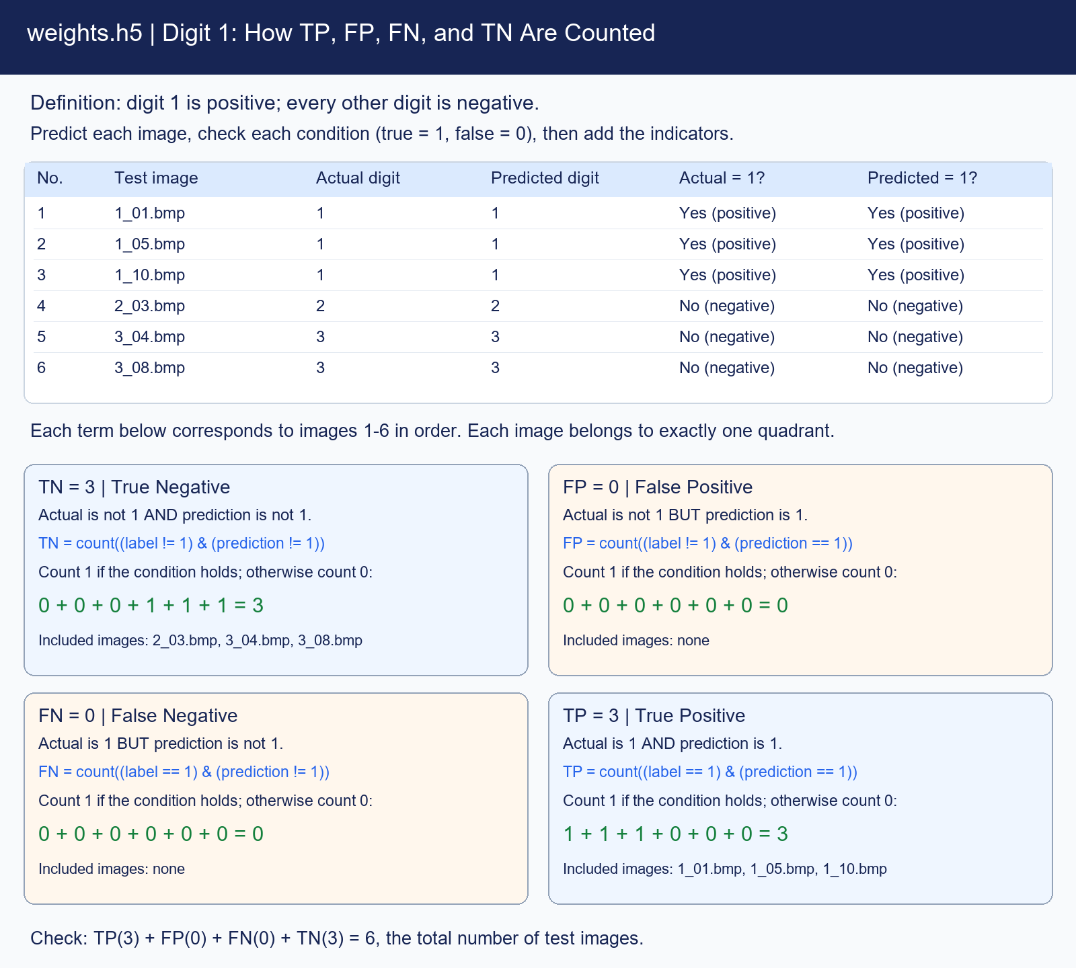
TP / TN / FP / FN should be calculated for each class (digit 1 to 3)
1
2
3

Slide 4
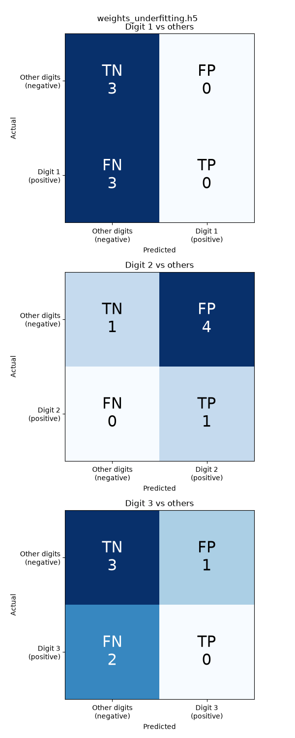
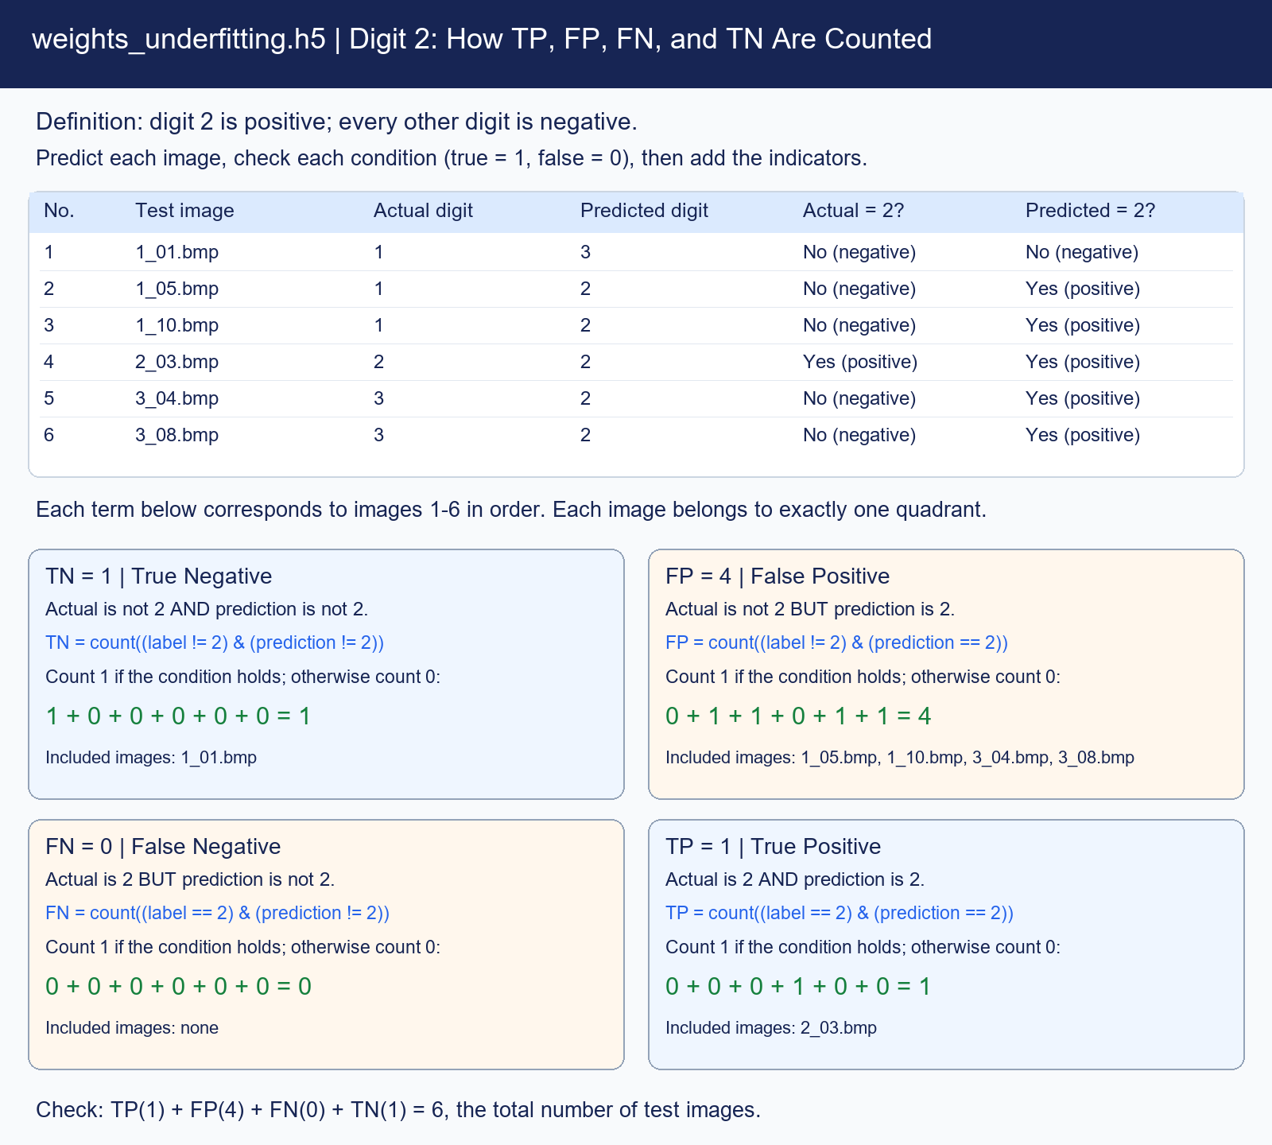
TP / TN / FP / FN should be calculated for each class (digit 1 to 3) - underfitting
1
2
3

Slide 5
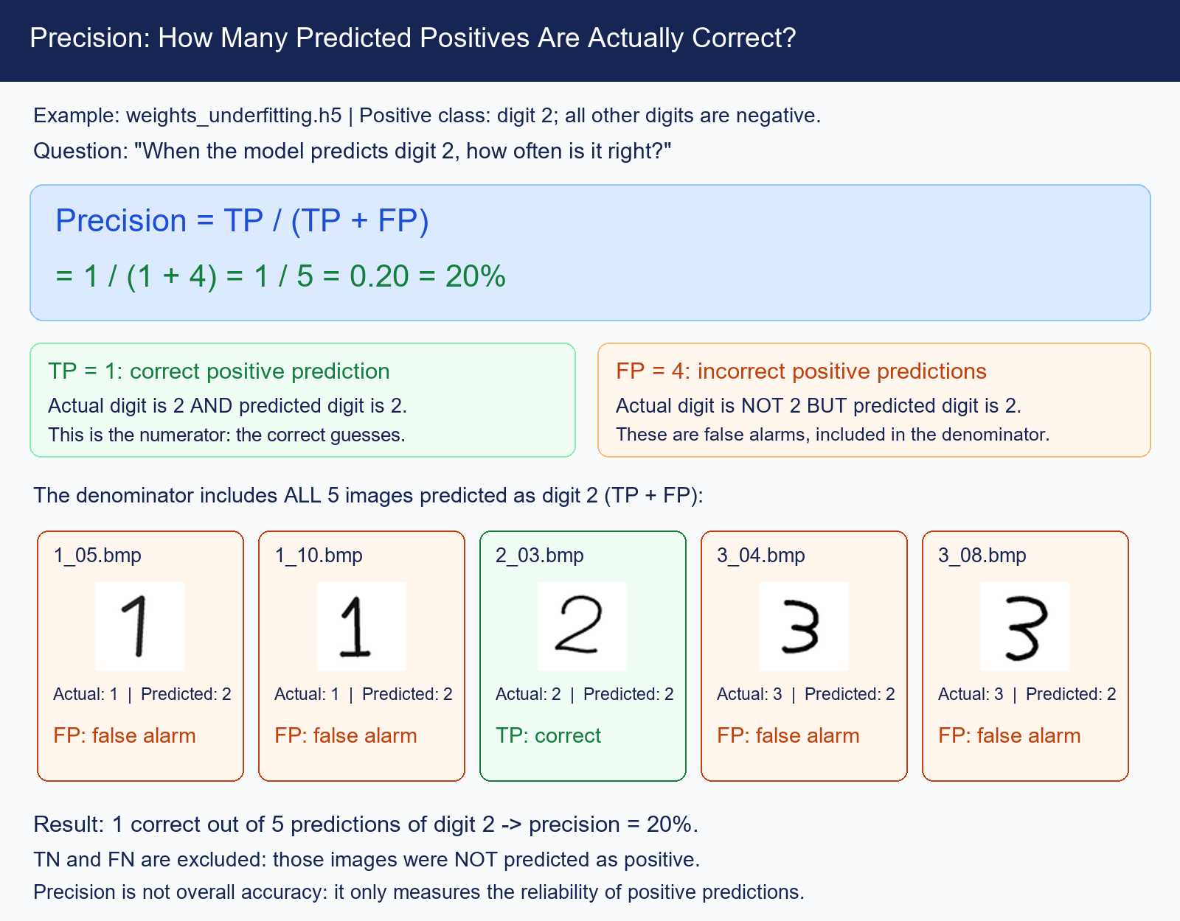
Precision
Digit | Precision
1 | 0.000
2 | 0.200
3 | 0.000
Macro | 0.067

Slide 6
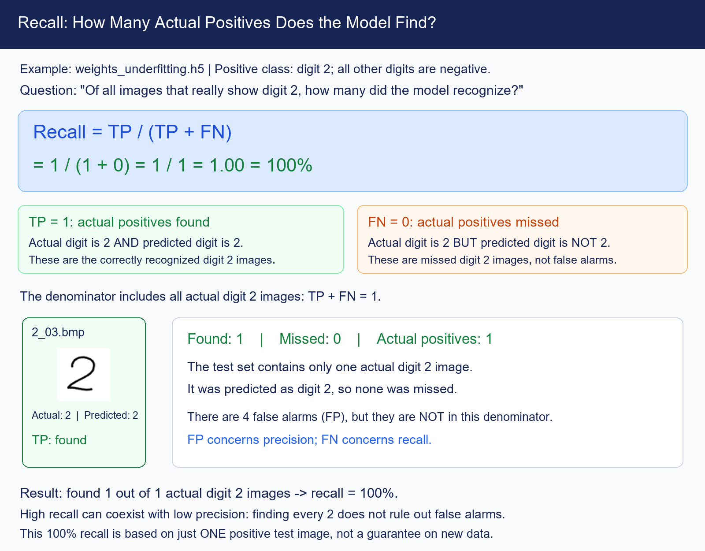
Recall
Digit | Recall
1 | 0.000
2 | 1.000
3 | 0.000
Macro | 0.333

Slide 7
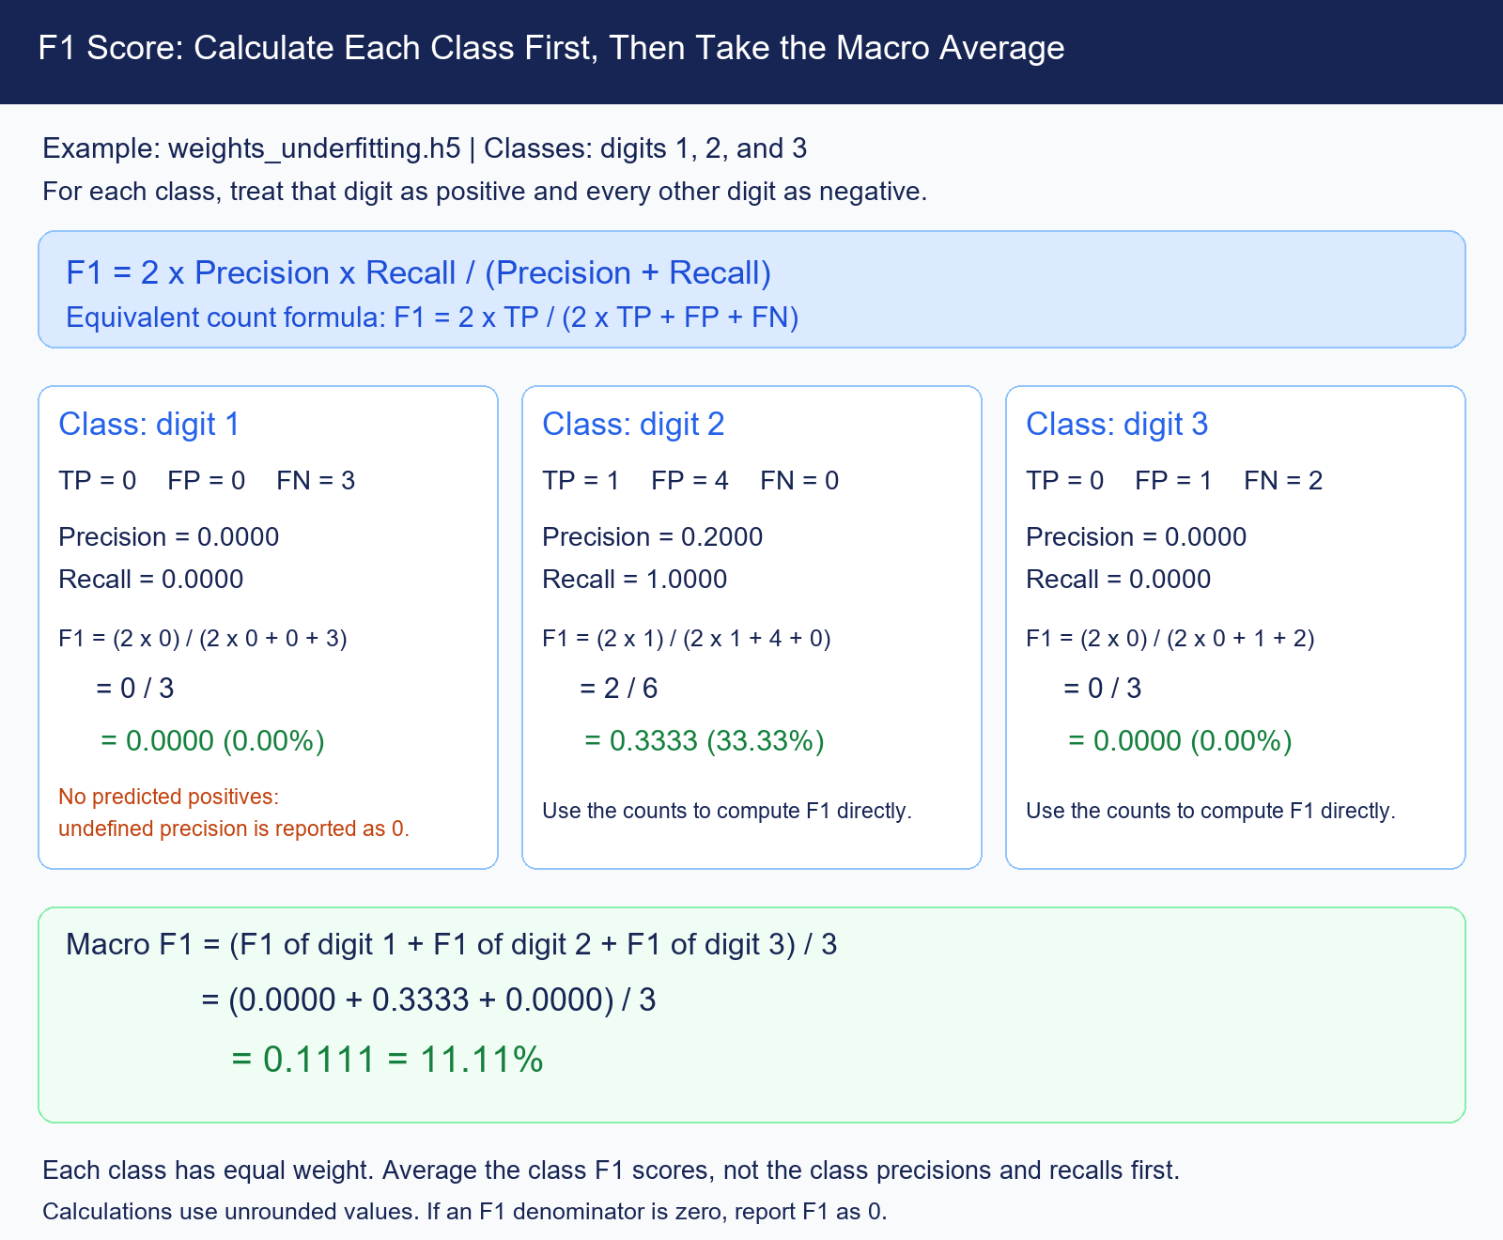
F1

Slide 8
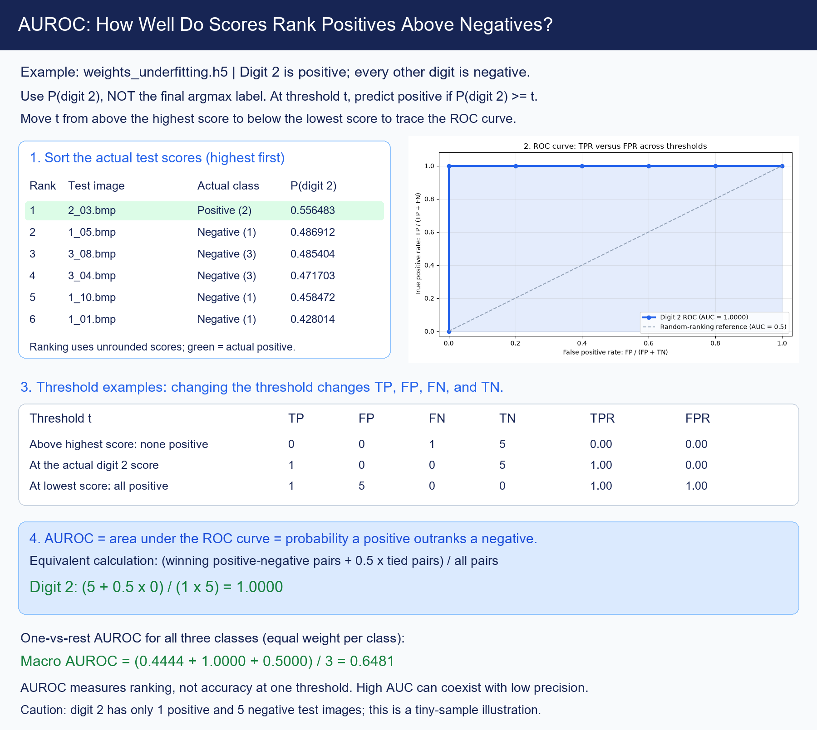
AUROC (not easy to understand)

Slide 9
