Slide 1
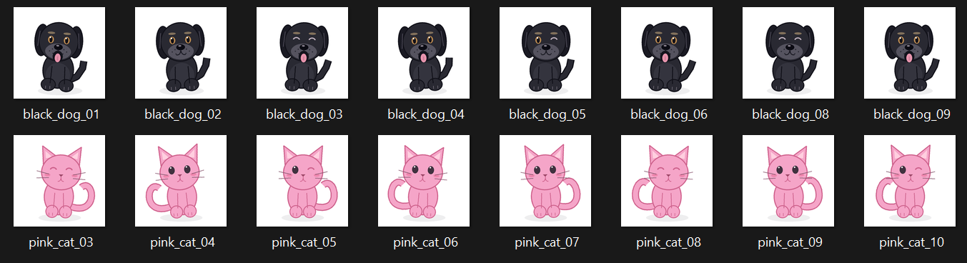

Cat vs Dog - 1
NN Model
Dog

Slide 2
Cat vs Dog - 2
Feature – 1 (long tie) Extract
1
CNN Model
Feature – 2 (up ear) Extract
0
cat
dog
Feature – N (xxx) Extract
1
CNN Model
Cat

