Slide 1
Linear Regression Project: Can we predict used car prices given historical data.
Zhi Wen Huang (DSE)

Slide 2
Data Scraping
www.Carfax.com
Beautiful Soup
Parse html and extract data of car information. (Year, make, model, mileage, etc…).
Selenium
Use to get next page of the inventory Carfax provided.
Storage
CSV file.

Slide 3
Exploratory Data Analysis
Data manipulation.
Too much unique data => Categorized them base on counts.
Data with different type => Convert them to strings.
Issue with numerical data => Regex to keep only values (ex. ‘Owners-2-Carfax’).
Added more features throughout the project.

Slide 4
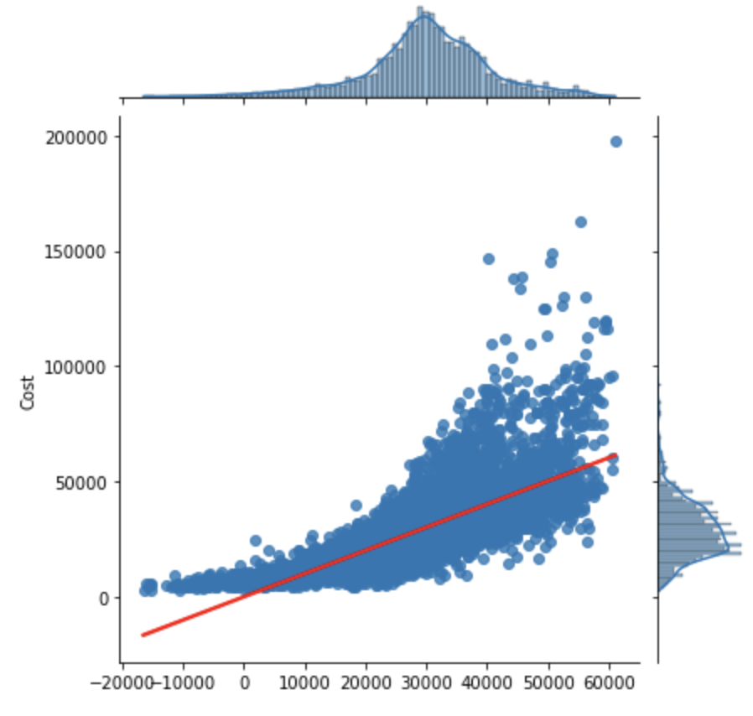
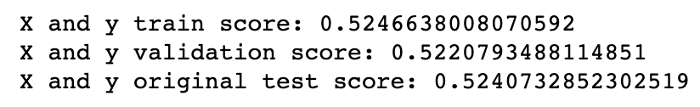
First Glance

Slide 5
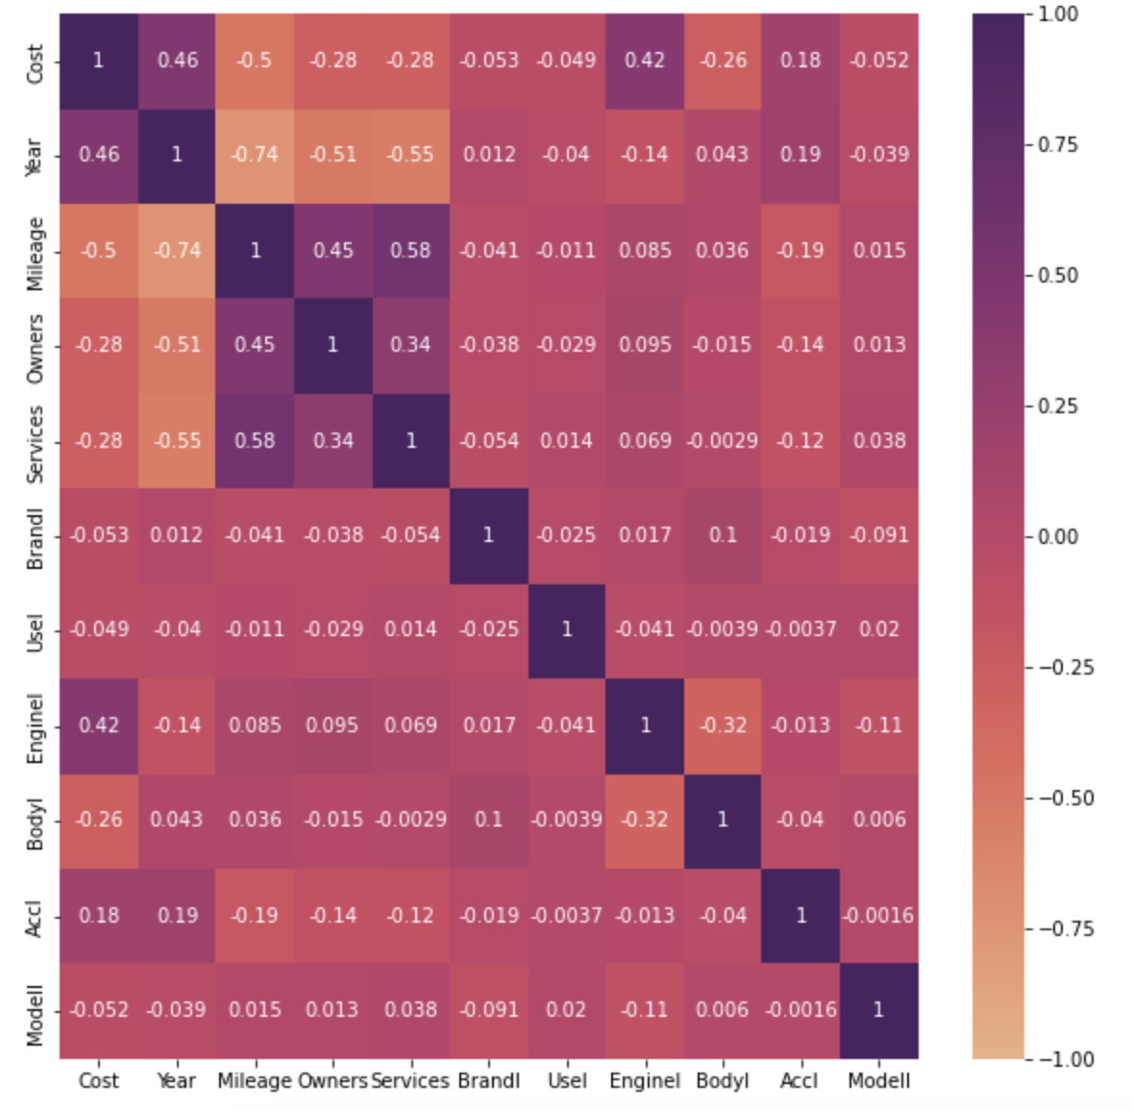
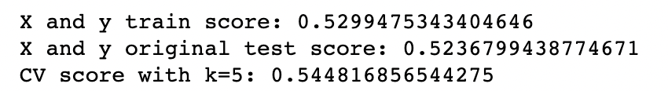
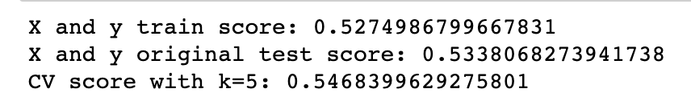
Heatmap
Strong correlation:
Year : Mileage = -0.74
Mileage / (2021– Year)
Moderately correlation:
Year : Owners = -0.51
Year : Services = 0.55
Mileage : Services = 0.58

Slide 6
Feature Engineering
Make: (Toyota, Nissan, Honda, etc…)
19 total dummies.
Model: (Rav_4, Altima, CR_V, etc…)
Too many.
Status: (Damage, Accident reported, Manufacturer buyback, etc…)
11.

Slide 7
Regularization
Lasso
Help finding the important features.
Other features that are zero out consider to remove.
LassoCV
Automated version of Lasso where K = 5.
To compare with my own Lasso.

Slide 8
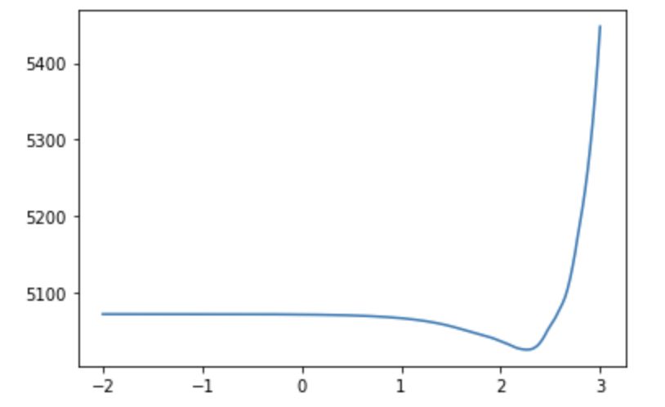


Remove Features
Lasso:
LassoCV

Slide 9
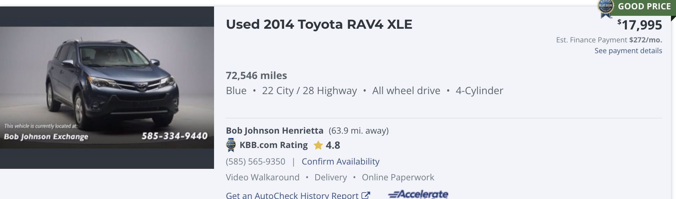
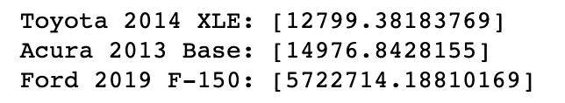
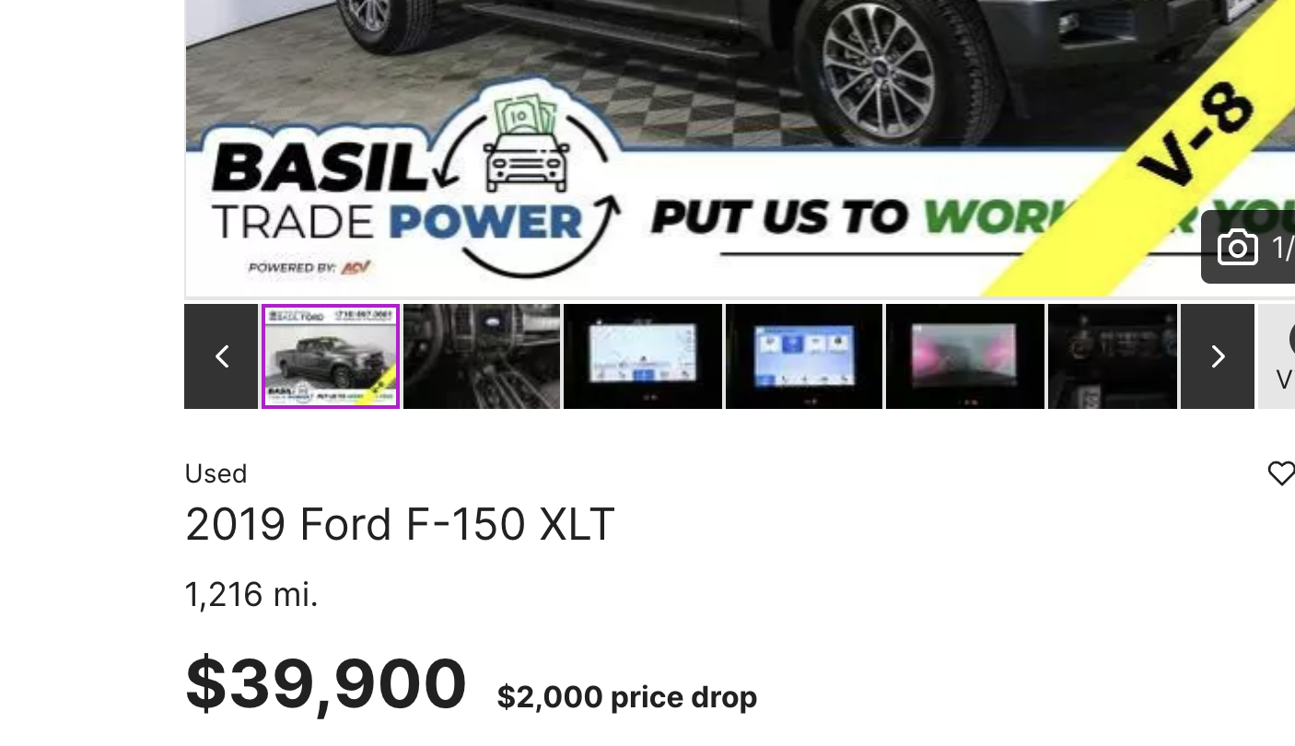
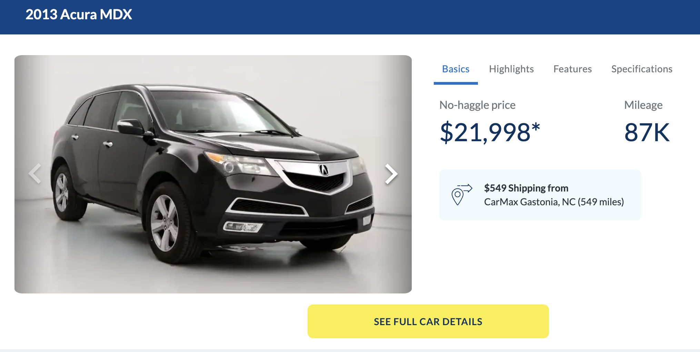
Predictions

Slide 10
Thank You!

