Slide 1
Women tech women yes Summer event
Zhi Wen huang

Slide 2
Goals
Get as much people to join the WTWY Summer gala.
Set up street teams near MTA subway stations to help people to register for the event.
Get information of their email and background.

Slide 3
strategy
Want to find heaviest traffic of MTA subway stations.
More people = more chances to get someone to join the Summer event.
Set street teams at the beginning of January till end of May.

Slide 4
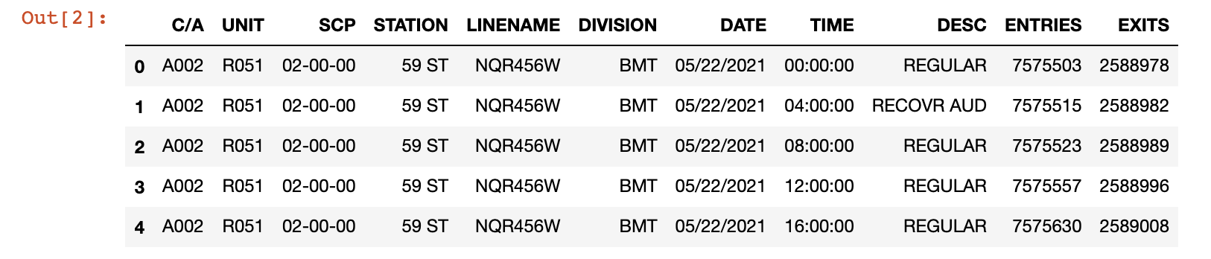
Data preparation
MTA Turnstile data from http://web.mta.info/developers/turnstile.html
Download data from 1/2021 to 5/2021.
Run SQL Queries of the table:

Slide 5
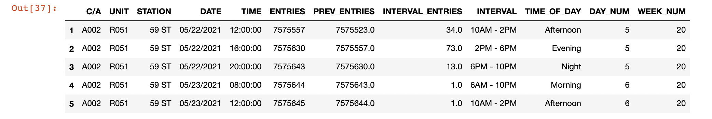
DATA preparation
Some modifications to data:

Slide 6
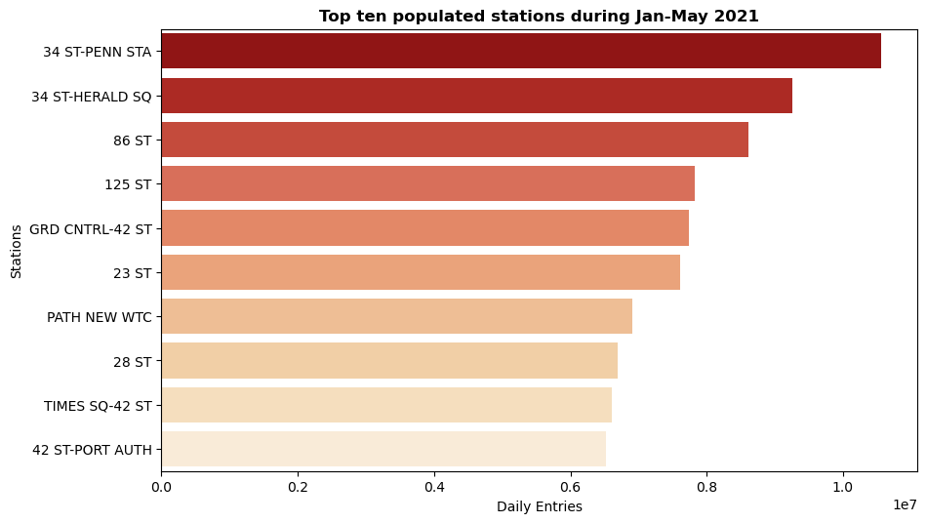
Results and visuals

Slide 7
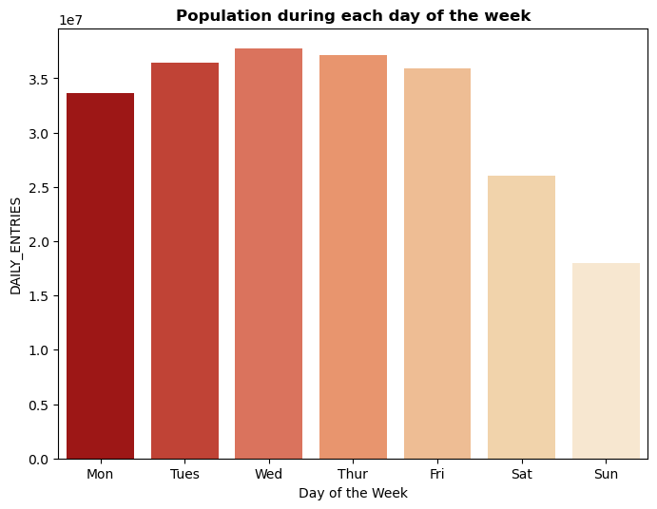
Results and visuals

Slide 8
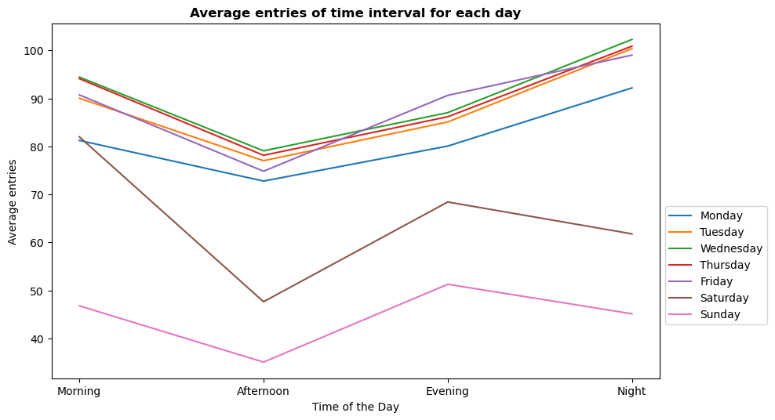
Results and visuals

Slide 9
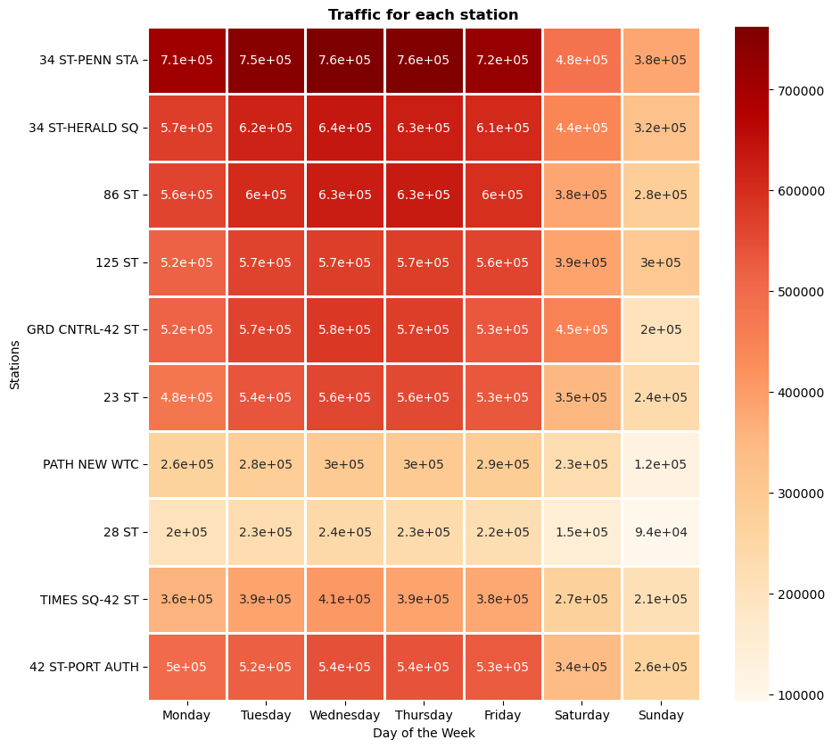
Results and visuals

Slide 10
Considerations
Top stations are very heavy traffic and could be chaotic.
Not all the people that uses the MTA subways are New Yorkers.

Slide 11
Conclusion
If space is not an issue:
We can set up teams on weekdays.
More teams on Wednesday and Thursday.
If space is an issue:
We can set up teams on afternoons of weekdays.

Slide 12
Future work
Data of tourist versus New Yorkers.
Location of popular tech industries.
Women men ratios of specific area.

