Slide 1
NLP Can Topic Modeling Help Recruiters?
Zhi Wen Huang

Slide 2
Topic Modeling
Latent Dirichlet Allocation (LDA)
KMean Cluster
Non-Negative Matrix Factorization (NMF)
T-SNE

Slide 3
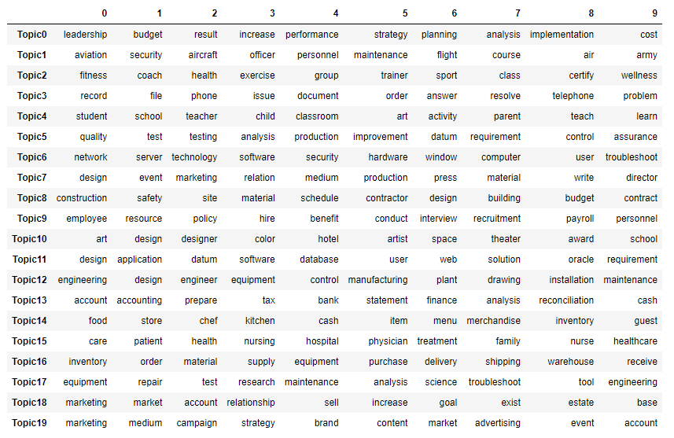
LDA and Visual
lda_visual

Slide 4
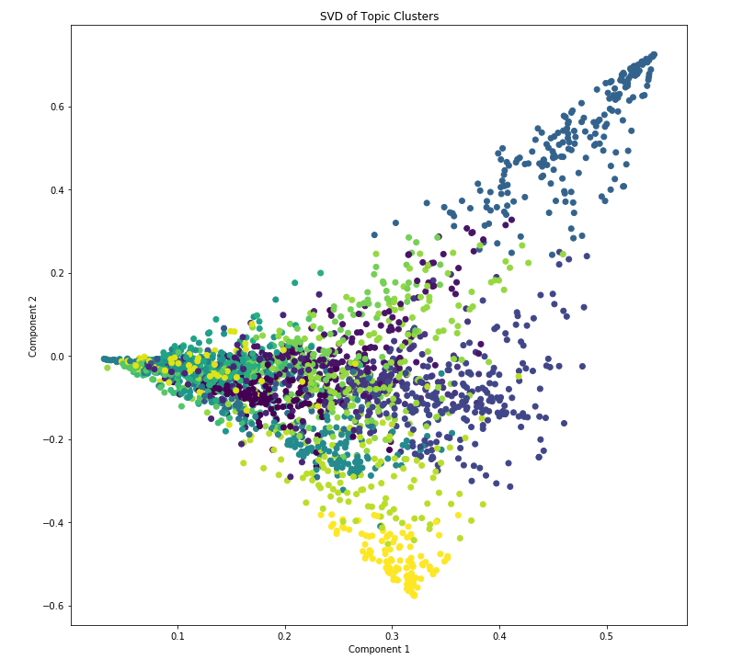
KMean and SVD
KMean:
Use LDA model output.
Predict cluster label.
SVD:
TruncatedSVD
Visualize

Slide 5
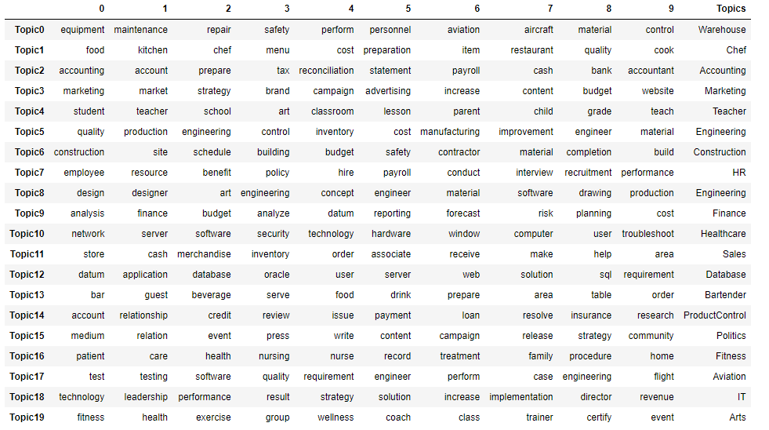
NMF and T-SNE
At a glance:

Slide 6
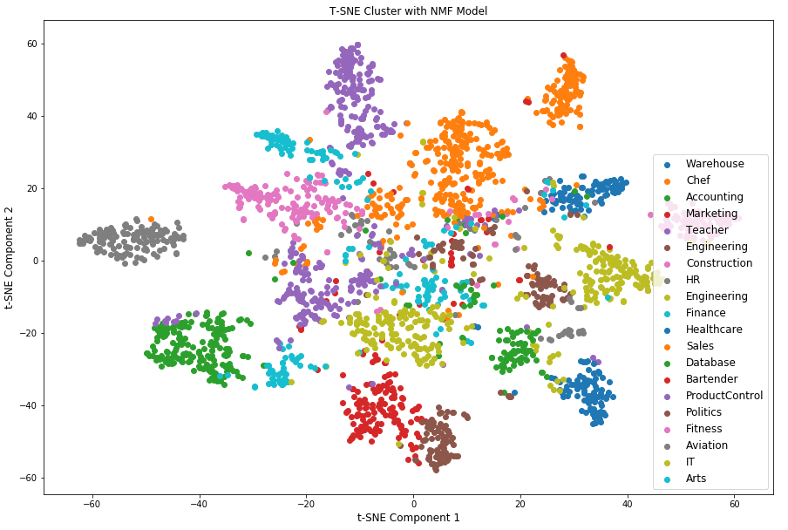
T-SNE Visual

Slide 7
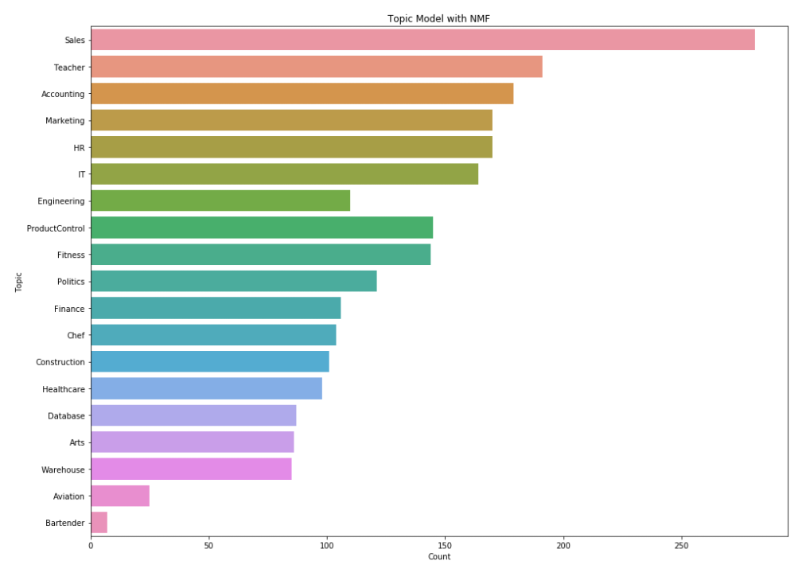
NMF Visual

Slide 8
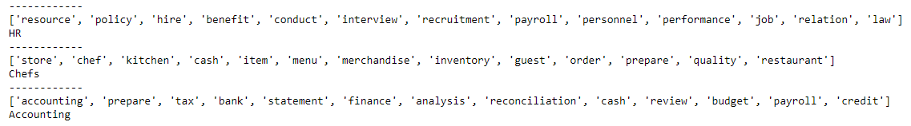
Accuracy
Managing schedules for interviews and deep search for potential worker.
Head chef for 8 years and cook over 100 dishes a day under fast paced environment.
Update company software on daily bases with tight weekly deadlines.

Slide 9
Bigger Text
"Objective : Competent, compassionate, and empathetic Staff Nurse with background experience in mental health. Meets responsibility in patient safety, medication safety, coordination of care, and prioritization. Works well under pressure, persistent, determined, and goal oriented. Emotional stability to cope with human suffering, emergencies and other stresses. Offering leadership qualities with a positive attitude. Motivated, hardworking, organized, focused and dedicated. To embrace a career opportunity where my healthcare background and education would be conducive to achieving all goals."

Slide 10
Thank You

