Slide 1
Data Exploration
Book Chapter 2

Slide 2
Outline
Data
Data types
Data representation
Attribute types
Data exploration
Data quality
Data preprocessing
Statistics
Visualization

Slide 3

Document Data
Each document is a collection of words

Slide 4
Transaction Data
A collection of transactions
Each transaction involves a set of items

Slide 5
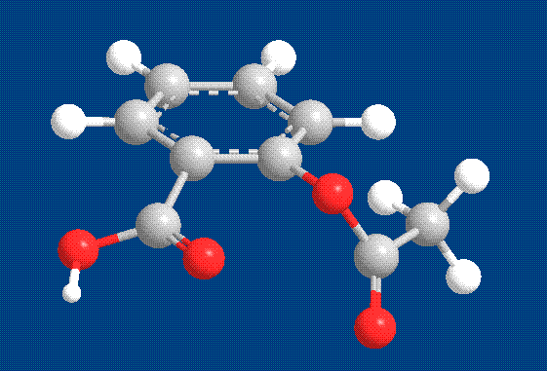
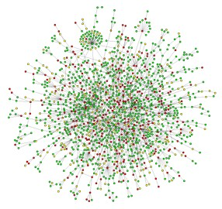

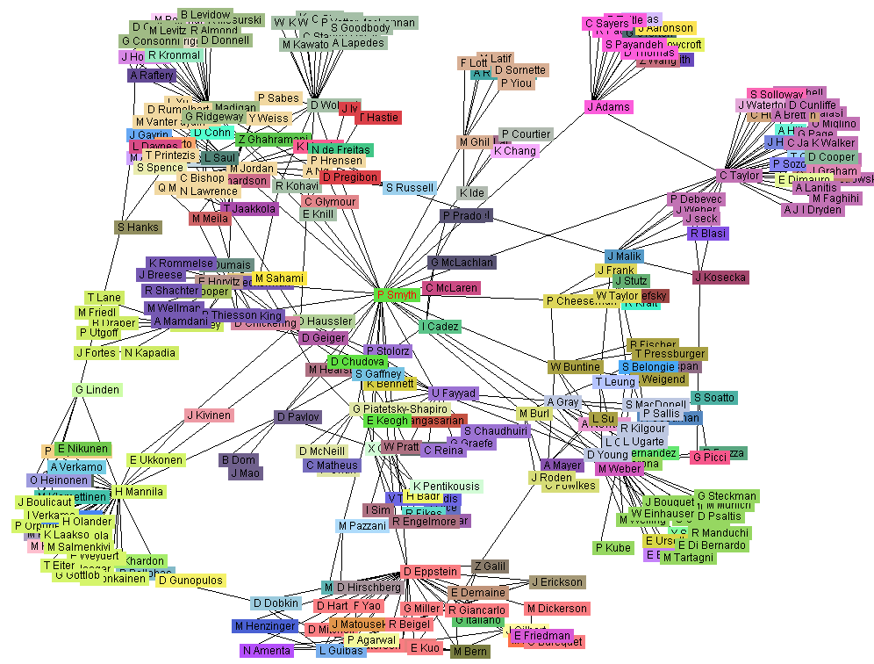
Graph Data
Aspirin
Yeast protein interaction network
Internet
Co-author network

Slide 6
Sequence Data
DNA Sequence

Slide 7
Spatial-Temporal Data
Average Monthly Temperature of land and ocean

Slide 8
Record Data
Data that consists of a collection of records, each of which consists of a fixed set of attributes

Slide 9
Data Matrix
Record data of numerical values can be represented by an m by n matrix, where there are m rows, one for each object, and n columns, one for each attribute
5.4 | 3.9 | 1.7 | 0.4
6.4 | 3.1 | 5.5 | 1.8
4.6 | 3.6 | 1 | 0.2
5.5 | 4.2 | 1.4 | 0.2
5.1 | 3.5 | 1.4 | 0.2
4.3 | 3 | 1.1 | 0.1
7.7 | 2.6 | 6.9 | 2.3
6.4 | 2.7 | 5.3 | 1.9
6 | 2.9 | 4.5 | 1.5
6.7 | 3.1 | 4.4 | 1.4

Slide 10
Data
Collection of data objects and their attributes
An attribute is a property or characteristic of an object
Examples: eye color of a person, temperature, etc.
Attribute is also known as variable, field, characteristic, dimension or feature
A collection of attributes describe an object
Object is also known as record, point, case, sample, entity, or instance
Attributes
Objects

Slide 11
Discrete and Continuous Attributes
Discrete Attribute
Has only a finite or countably infinite set of values
Examples: zip codes, counts, or the set of words in a collection of documents
Often represented as integer variables.
Note: binary attributes are a special case of discrete attributes
Continuous Attribute
Has real numbers as attribute values
Examples: temperature, height, or weight.
Practically, real values can only be measured and represented using a finite number of digits.
Continuous attributes are typically represented as floating-point variables.

Slide 12
Types of Attributes
There are different types of attributes
Nominal
Examples: ID numbers, eye color, zip codes
Ordinal
Examples: rankings (e.g., taste of potato chips on a scale from 1-10), grades, height in {tall, medium, short}
Interval
Examples: calendar dates, temperatures in Celsius or Fahrenheit.
Ratio
Examples: temperature in Kelvin, length, time, counts

Slide 13
Attribute Type
Description
Examples
Nominal
The values of a nominal attribute are just different names, i.e., nominal attributes provide only enough information to distinguish one object from another. (=, ≠)
zip codes, employee ID numbers, eye color, gender
Ordinal
The values of an ordinal attribute provide enough information to order objects. (<, >)
pain level, rating, grades, street numbers
Interval
For interval attributes, the differences between values are meaningful, i.e., a unit of measurement exists. (+, - )
calendar dates, temperature in Celsius or Fahrenheit
Ratio
For ratio variables, both differences and ratios are meaningful. (*, /)
temperature in Kelvin, monetary quantities, counts, age, mass, length, electrical current

Slide 14
Outline
Data
Data types
Data representation
Attribute types
Data exploration
Data quality
Data preprocessing
Statistics
Visualization

Slide 15
Data Quality Issue
Data in the real world is dirty
incomplete: lacking attribute values, lacking certain attributes of interest
e.g., occupation=“ ” (missing data)
noisy: containing noise, errors, or outliers
e.g., Salary=“−10” (an error)
inconsistent: containing discrepancies in codes or names, e.g.,
Age=“42” Birthday=“03/07/1997”
Was rating “1,2,3”, now rating “A, B, C”
discrepancy between duplicate records

Slide 16
Preprocessing
Handle missing values
Ignore the records with missing values
Estimate missing values
Remove outliers
Find and remove those values that are significantly different from the others
Resolve conflicts
Merge information from different data sources
Find duplicate records and identify the correct information

Slide 17
Prepare Data for Analysis
Sampling
Feature selection
Dimensionality reduction
Discretization

Slide 18
Sampling
Key principle
using a sample will work almost as well as using the entire data sets, if the sample is representative
A sample is representative if it has approximately the same property (of interest) as the original set of data

Slide 19
Types of Sampling
Simple Random Sampling
There is an equal probability of selecting any particular item
Sampling without replacement
As each item is selected, it is removed from the population
Sampling with replacement
Objects are not removed from the population as they are selected for the sample.
In sampling with replacement, the same object can be picked up more than once
Stratified sampling
Split the data into several partitions; then draw random samples from each partition

Slide 20

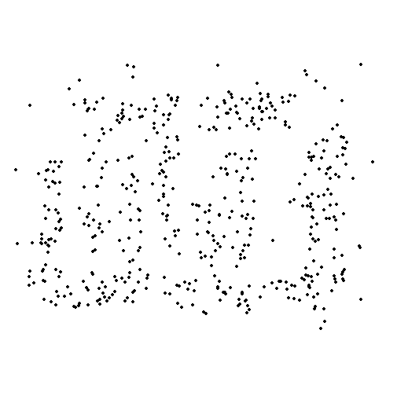
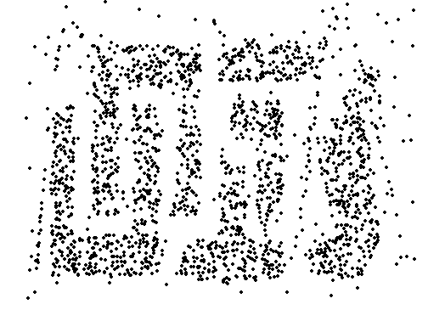
Sampling Rate
8000 points 2000 Points 500 Points
Progressive sampling: Keep increasing sample size until evaluation measurement value begins to level off.

Slide 21
Attribute Selection
Redundant attributes
duplicate much or all of the information contained in one or more other attributes
Example: purchase price of a product and the amount of sales tax paid
Irrelevant attributes
contain no information that is useful for the data mining task at hand
Example: students' ID is often irrelevant to the task of predicting students' GPA

Slide 22
Dimensionality Reduction
Goal is to reduce the number of attributes by creating a new set of attributes
x₂
e
x₁

Slide 23
Discretization
Binning
Convert numerical data into discrete data
Divides the range into N intervals
Equal width vs Equal frequency
Cluster values
Sorted data for price (in dollars): 4, 8, 9, 15, 21, 21, 24, 25, 26, 28, 29, 34
* Partition into 3 bins:
- Bin 1: 4, 8, 9, 15
- Bin 2: 21, 21, 24, 25
- Bin 3: 26, 28, 29, 34

Slide 24
Statistics: Center Measurement
Center measurement is a summary measure of the overall level of a dataset
Mean: Summing up all the observation and dividing by number of observations. Mean of 20, 30, 100 is (20+30+100)/3 = 50.
Median: The number lying at the midpoint among all numbers, such that there is an equal probability of falling above or below it. Median of 20, 30, 100 is 30.

Slide 25
Statistics: Variability Measurement
Variance: The variance of a set of observations is the average of the squares of the deviations of the observations from their mean. In symbols, the variance of the n observations x₁, x₂,…x_{n} is
Variance of 5, 7, 3? Mean is (5+7+3)/3 = 5 and the variance is
Standard Deviation: Square root of the variance. The standard deviation of the above example is 2.

Slide 26
Statistics: Frequency Distribution
Consider a data set of 26 children of ages 1-6 years. Then the frequency distribution of variable ‘age’ can be tabulated as follows:
Frequency Distribution of Age
Age | 1 | 2 | 3 | 4 | 5 | 6
Frequency | 5 | 3 | 7 | 5 | 4 | 2
Grouped Frequency Distribution of Age:
Age Group | 1-2 | 3-4 | 5-6
Frequency | 8 | 12 | 6

Slide 27
Frequency and Mode
The frequency of an attribute value is the percentage of time the value occurs in the data set
For example, given the attribute ‘gender’ and a representative population of people, the gender ‘female’ occurs about 50% of the time.
The mode of a an attribute is the most frequent attribute value
The notions of frequency and mode are typically used with discrete data

Slide 28
Visualization
Visualization is the conversion of data into a visual or tabular format so that the characteristics of the data and the relationships among data items or attributes can be analyzed or reported.
Visualization of data is one of the most powerful and appealing techniques for data exploration.
Humans have a well developed ability to analyze large amounts of information that is presented visually
Can detect general patterns and trends
Can detect outliers and unusual patterns

Slide 29
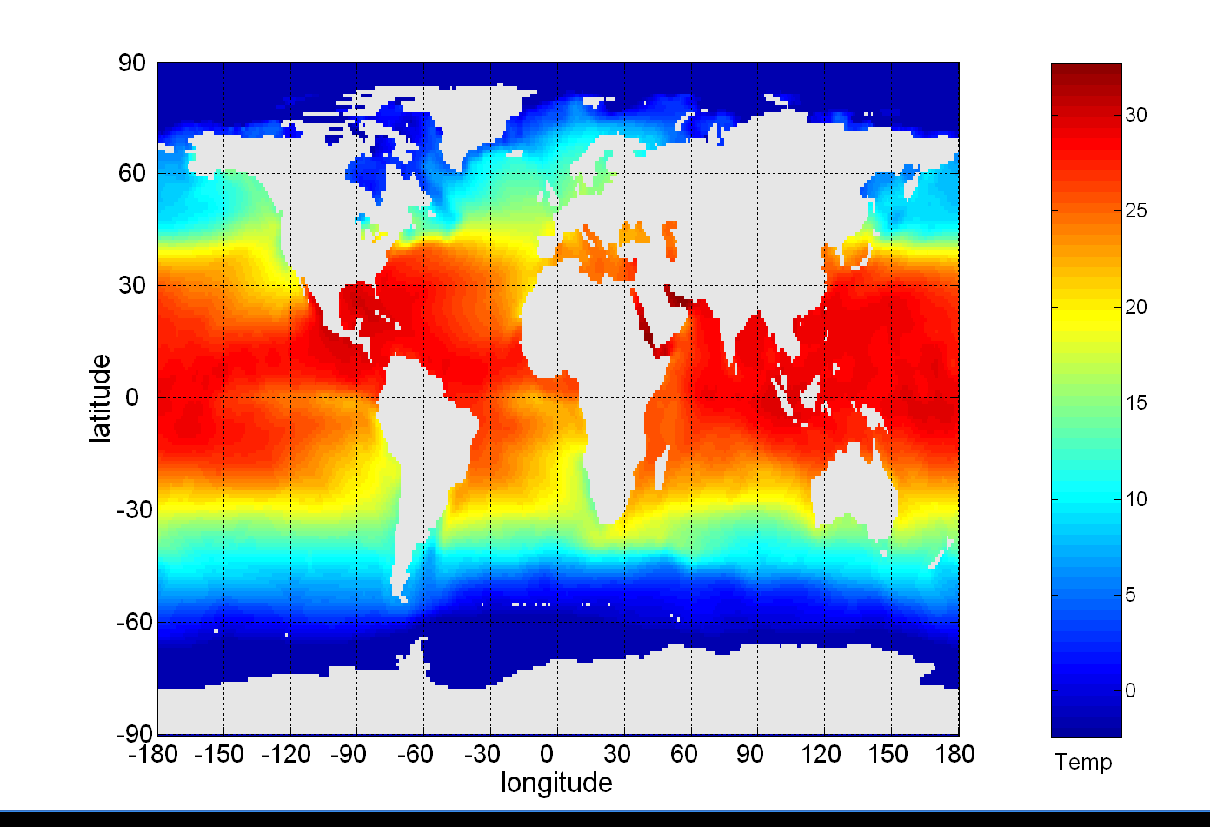
Example: Sea Surface Temperature
The following shows the Sea Surface Temperature (SST) for July 1982
Tens of thousands of data points are summarized in a single figure

Slide 30
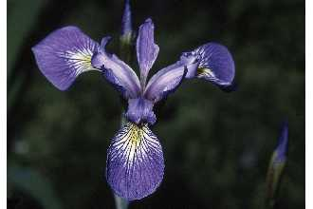
Iris Sample Data Set
Many of the exploratory data techniques are illustrated with the Iris Plant data set.
Four attributes
Sepal width and length
Petal width and length
Three flower types (classes):
Setosa
Virginica
Versicolour

Slide 31
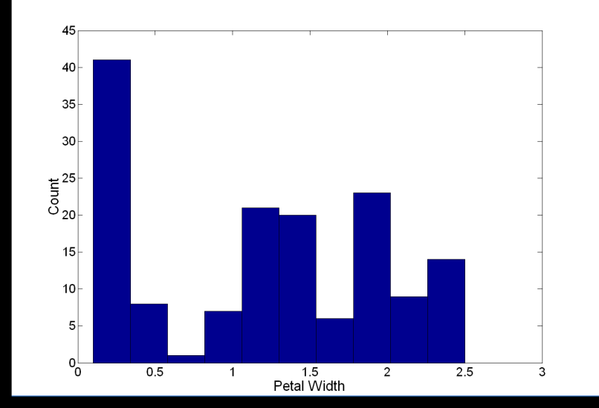
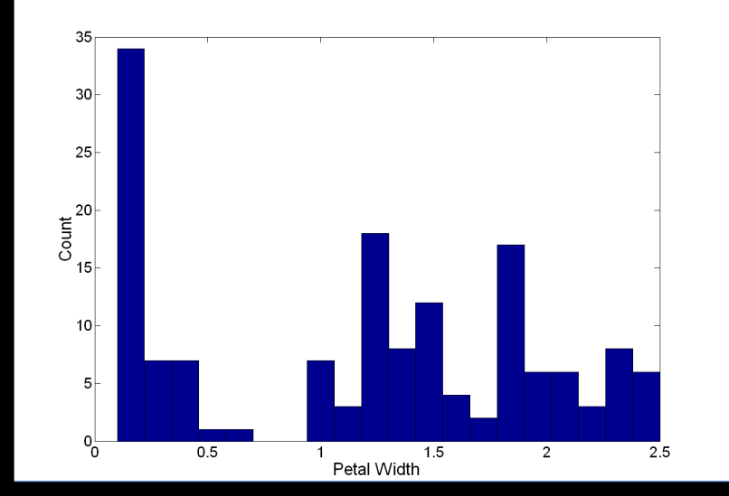
Histogram
Histogram
Usually shows the distribution of values of a single attribute
Divide the values into bins and show a bar plot of the number of objects in each bin.
The height of each bar indicates the number of objects
Shape of histogram depends on the number of bins
Example: Petal Width (10 and 20 bins, respectively)

Slide 32
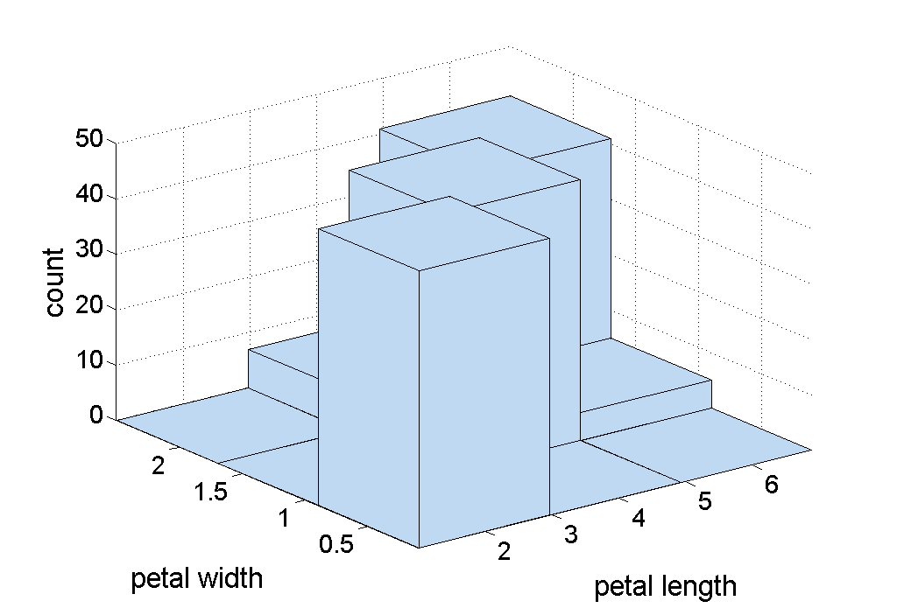
Two-Dimensional Histograms
Show the joint distribution of the values of two attributes
Example: petal width and petal length

Slide 33
Box Plots
Box Plots
Another way of displaying the distribution of data
Following figure shows the basic part of a box plot
outlier
90th percentile
75th percentile
50th percentile
25th percentile
10th percentile

Slide 34
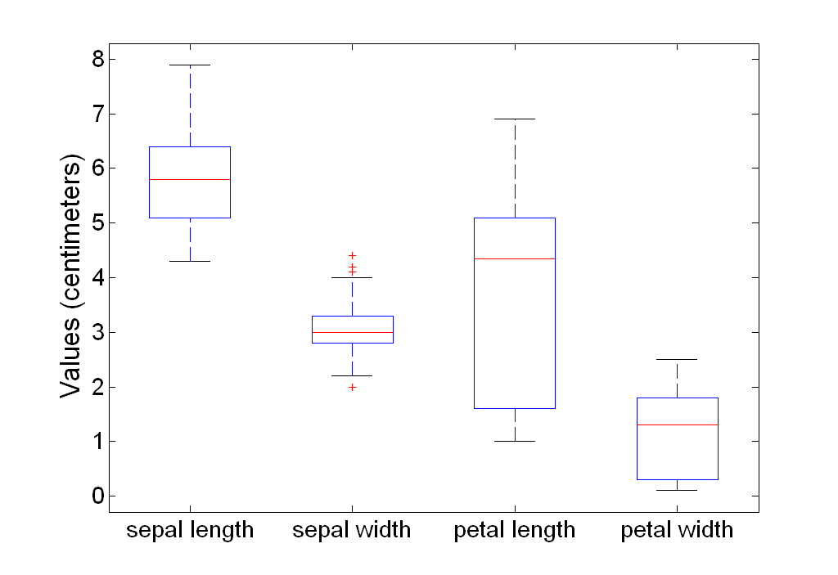
Example of Box Plots
Box plots can be used to compare attributes

Slide 35
Scatter Plots
Scatter plots
Attributes values determine the position
Two-dimensional scatter plots most common, but can have three-dimensional scatter plots
Often additional attributes can be displayed by using the size, shape, and color of the markers that represent the objects
It is useful to have arrays of scatter plots can compactly summarize the relationships of several pairs of attributes
See example on the next slide

Slide 36
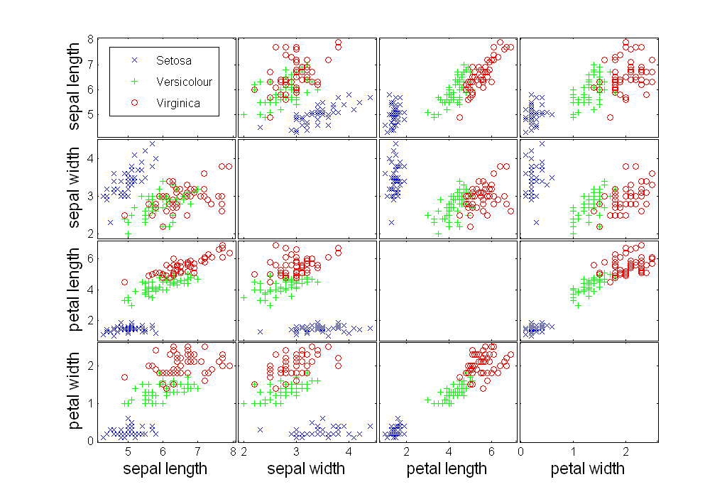
Scatter Plot Array of Iris Attributes

Slide 37
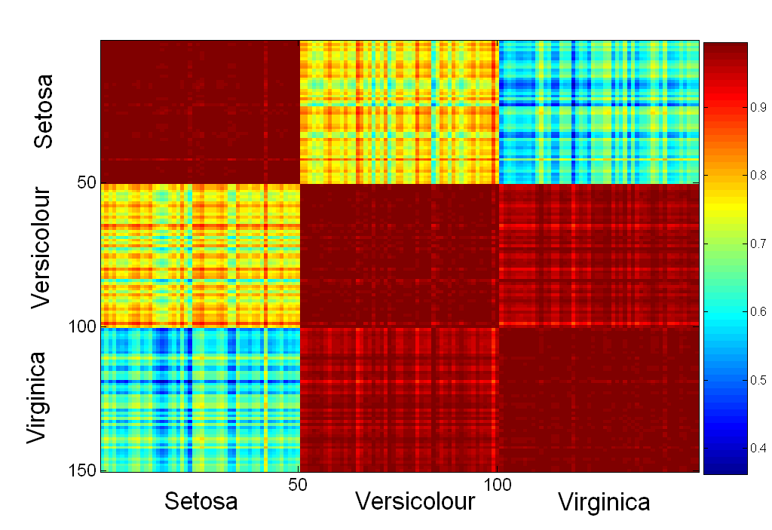
Visualizing Similarity Matrix

