Slide 1
Classifying Arrhythmia from ECG Data
Cris Bangaoil, Krishna Keshav, Helen Zhou, Zach Lighton

Slide 2
Problem Statement
Identify Abnormal Heartbeats / Arrhythmia from a digitized Electrocardiogram

Slide 3
Medical Terminology Overview
Ventricle: The lower two chambers of the heart
Atrium: The upper two chambers of the heart
“Supraventricular”: upper part of the heart (“supra-” = above)
Supraventricular premature beat
Atrial contractions triggered by ectopic foci rather than the sinoatrial node
Two types depending on origin: “atrial premature beats” and “junctional premature beats”
Premature ventricular contraction
Extra heartbeats that begin in one of your heart's two lower pumping chambers (ventricles)
Fusion of ventricular and normal beat
When electrical impulses from different sources act upon the same region of the heart at the same time, acting on the ventricular chambers

Slide 4
Data Source
https://www.kaggle.com/shayanfazeli/heartbeat
the MIT-BIH Arrhythmia Dataset
Number of Samples: 109446
Number of Categories: 5
EKG Sampling Frequency: 125Hz
Data Source: Physionet's MIT-BIH Arrhythmia Dataset
Classes: ['N': 0, 'S': 1, 'V': 2, 'F': 3, 'Q': 4]
'N' = Normal Heartbeat 'S' = Supraventricular premature beat 'V' = Premature ventricular contraction 'F' = Fusion of ventricular and normal beat 'Q' = Unclassifiable beat
Pre-split into training and testing ~80k records in training, ~20k records in testing
Classifications split the same in Training vs Testing

Slide 5
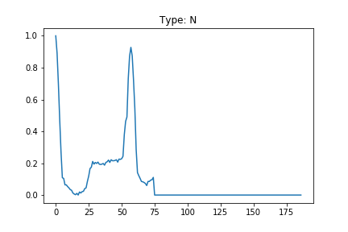
Normal Heartbeat example

Slide 6
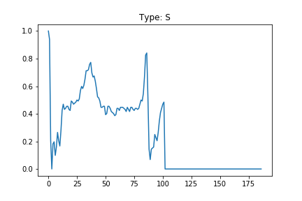
Supraventricular Premature Beat Example

Slide 7
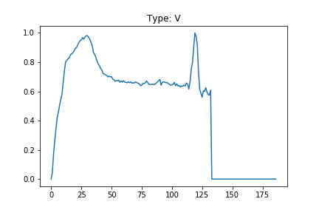
Premature Ventricular Contraction Example

Slide 8
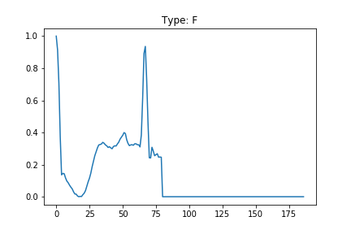
Normal/Ventricular Fusion Beat Example

Slide 9
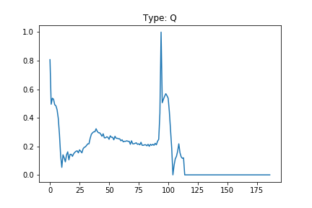
Unclassifiable Beat Example

Slide 10
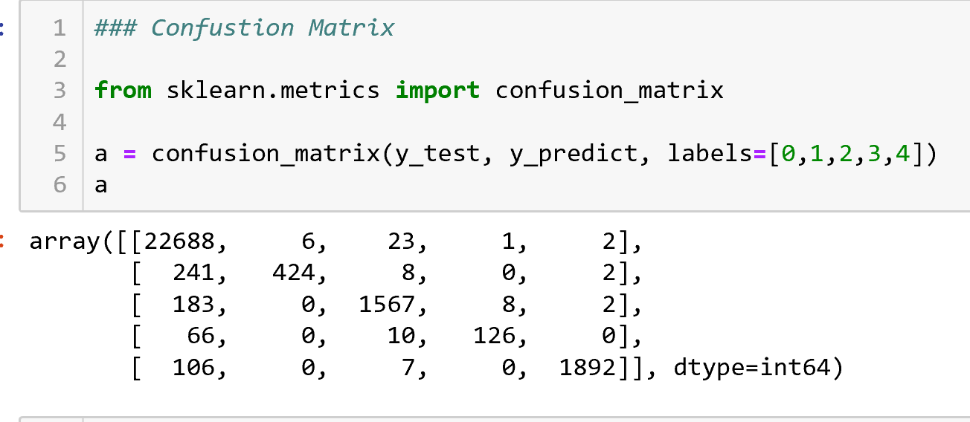
Random Forest Classifier
Merge Train and Test data source
Include categories 0-4
Use Sklearn train_test_split for random split
Accuracy: 0.976

Slide 11
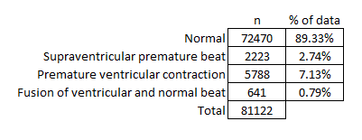
Training Deep Neural Network Model
Took out the “Unclassifiable” category
Keras Sequential
Activation: relu
Epochs = 100

Slide 12
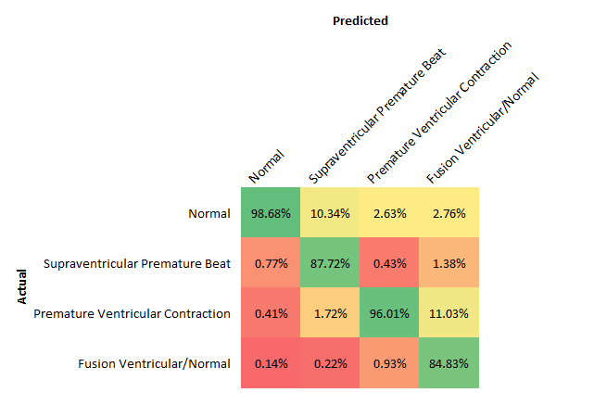
Evaluating the Model
Loss: .1368
Accuracy: .9814
As our confusion matrix shows, our model is good at predicting Normal and PVC - less so SPB and Fusion

Slide 13
Flask App Deploy
Upload a 1x187 .csv file with your EKG data for one beat (sampled at 125hz)
The machine will classify the heartbeat for you, giving a percentage likelihood of each of the categorizations
Still in progress:
Adding support for multiple formats/beats: single bad beat =/= arrhythmia diagnosis
Seeing how well it works with other EKG sample rates beyond 125hz
Beautifying input/output page

Slide 14
Demo

