Slide 1
Network Planning with Deep Reinforcement Learning
Hang Zhu
Varun Gupta, Satyajeet Singh Ahuja, Yuandong Tian, Ying Zhang, Xin Jin

Slide 2
Network planning problem
Critical step in dimensioning the backbone network to satisfy operational requirements
Cross-layer
Multi-phased
Failure-aware
IP layer
Short-term
Reliability
Optical layer
Long-term
Multiple failures
Notes:
Large content service providers usually operate a global network.
To meet the operational requirements, it’s a critical step in dimensioning the backbone network.
The network planning problem is extremely hard in practice.
First, it’s cross-layer.
We need to make decisions in both the IP layer and the optical layer to form a network plan.
Second, it’s a multi-phased, iterative process.
The planning process is done over the short-term and long-term horizons respectively
to generate short-term actionable signals for operational teams, while allowing optimal long-term network evolution strategy
Third, it’s failure-aware. We need to ensure the reliability of the backbone network under different failure scenarios.

Slide 3
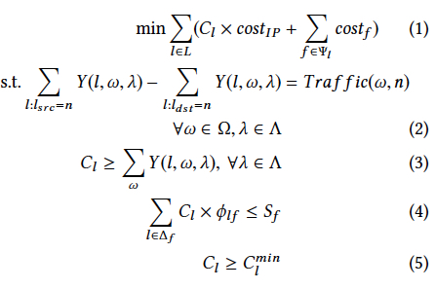
Existing approach
ILP problem
ILP solvers
Scalability issues
Human-designed heuristics to
trade optimality for tractability
Topology decomposition
Topology transformation
Failure selection
Notes:
Existing approach formulates the network planning problem as an Integer Linear Programming (ILP) problem
and feed it into some ILP solvers, such as Gurobi, CPLEX.
However, the ILP approach usually hits the limit of scalability in production-scale problems.
In such cases, people rely on heuristics to trade optimality for tractability.
We list some of them here.
First, Topology decomposition means the topology is decomposed into several smaller sub-topologies
and each sub-topology is solved with ILP separately.
Topology transformation aims to reduce the search space or the number of variables,
such as enlarging the capacity unit that can be added.
Failure selection means we only try to satisfy a subset of failure scenarios at a time, and add more failure scenarios until all the scenarios are added.
All of these heuristics aim to prune the search space to make the problem tractable.
It’s a tedious, time-consuming iterative process even for experts to find a good trade-off
between the optimality of the solution and the tractability of the ILP problem.

Slide 4
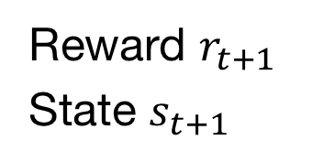
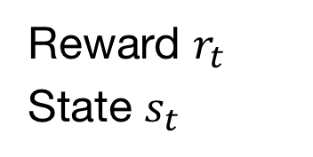
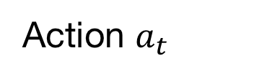
Why a deep RL-based approach?
Action $a_{t}$
RL agent
Environment
Reward $r_{t}$
State $s_{t}$
Reward $r_{t+1}$
State $s_{t+1}$
--------
Notes:
Our approach is revisiting this problem with a different take using deep reinforcement learning.
Someone may ask why RL can help solve the network planning problem.
As we know, a typical goal of RL is to train the RL agent to learn to take multiple actions in an environment
to maximize the accumulated reward it receives.
The environment provides the state as the input and reward as the feedback.

Slide 5
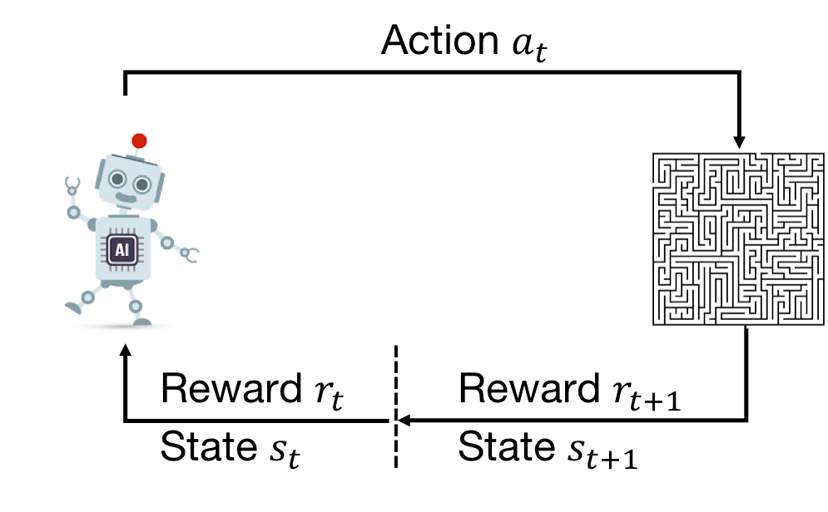
Why a deep RL-based approach?
RL is designed to solve multi-decision making problems
RL agent
Environment
RL automatically derives human-designed heuristics
Notes:
There are basically two characteristics that make network planning a good fit for RL.
First, network planning can be viewed as a problem where multiple decisions are made on the IP and optical layers.
And RL is designed to solve such a multi-decision making problem.
Second, the RL agent explores the search space and exploits the learned structure of the environment to optimize its policy.
This is similar to how humans design heuristics to take advantage of the network planning problem structure to solve the problem.
The real appeal here is that the RL agent can automatically do this and relieves humans from the tremendous efforts of developing the heuristics.

Slide 6
NeuroPlan: a deep RL-based approach
Notes:
So we build our approach Neuroplan with deep RL. The input of Neuroplan consists of five components

Slide 7
NeuroPlan: a deep RL-based approach
Notes:
The RL agent only needs to encode the network topologies.
The other four (traffic demand, failure scenarios, reliability policy and cost model) are handled by the plan evaluator.
The RL agent interacts with the plan evaluator to learn to generate network plans that minimize the network cost while satisfying the traffic demand under the reliability policy.

Slide 8
NeuroPlan: a deep RL-based approach
Notes:
After the learning process is completed, the RL agent outputs an initial plan for the first stage.

Slide 9
NeuroPlan: a deep RL-based approach
Notes:
At the second stage, the ILP solver finds the final plan in the pruned search space near the initial plan.
We will discuss such hybrid approach later

Slide 10
Adapting RL for network planning
Challenge 1: How to trade off between optimality and tractability
Challenge 2: How to design RL training process
Challenge 3: How to encode network topology
Notes:
There are mainly three challenges to adapt RL for network planning

Slide 11


Challenge 1: How to trade off between optimality and tractability
Solution: two-stage hybrid approach
search space
optimal
$$α_{1}$$
RL
$$α_{2}$$
Notes:
Challenge 1: how to trade off between optimality and tractability.
We can use the RL to find reasonably good solutions. But given the combinatorial nature of the problem,
it is both unpredictable and time-consuming for the RL to find the optimal solution directly.
So we use a two-stage hybrid approach which uses ILP to only search the space near the RL solution
after the RL process is terminated.
We use the relax factor α to control the size of the space to explore by ILP.
With a small alpha, the ILP solver may finish the second stage quickly.
While a large alpha allows ILP to explore larger space.

Slide 12
Challenge 2: How to design RL training process
Notes:
So how to design the RL training process to generate a feasible plan in the first stage.
This figure shows one trajectory during the training process.
The plan evaluator will decide if the current topology satisfies all the operational requirements.
If it is or the agent has taken a maximal number of actions, then the current trajectory will be terminated.
If not, the RL agent will intelligently select an IP link to augment its capacity.

Slide 13
Challenge 2: How to design RL training process
Action space: adding capacity to some link
Dense rewards: the cost of newly added capacity as the intermediate reward
Notes:
There are two optimizations we made in the training process.
First, we only allow adding capacity in action space.
Compared to an action space which allows both adding and reducing,
only allowing adding leads to a smaller action space and
a stable and simple training process.
Second, to train the agent effectively,
we use the cost of newly added capacity as the intermediate reward for each step to generate dense rewards.

Slide 14
Challenge 3: How to encode network topology
Structural pattern
Link features
Parallel links
Notes:
Then, challenge 3 is how the RL agent encodes the network topology
There are three factors that make it challenging. Structural pattern, link features and parallel links

Slide 15
Challenge 3: How to encode network topology
Message propagation between neighbor nodes
Structural pattern
GNN
Link features
Parallel links
Notes:
First, the network topology is actually a graph. To capture its structural pattern, we leverage graph nueral network(GNN) that
performs message propagation between neighbor nodes.

Slide 16
Challenge 3: How to encode network topology
Structural pattern
GNN
Link features
Node-link transformation
Parallel links
Notes:
While GNNs are most mature for handling node features, here we care about link features, which
Is link capacity. What’s more, there may be multiple parallel links between two nodes.
To deal with these, we propose a domain-specific node-link transformation.

Slide 17
Challenge 3: How to encode network topology
B
C
BC1
AB
BC2
A
CE
AD
D
E
DE
Before transformation
After transformation
Notes:
This example shows the input topology before transformation on the left and the output topology after transformation on the right
The node names show the corresponding relationship between nodes and links.
Then the capacity becomes node feature in the transformed topology.
The two parallel links BC1 and BC2 are mapped to two nodes in the transformed topology.

Slide 18

Evaluation
Optimality
Scalability
Sensitivity analysis
GNN layers
Relax factor
Hidden size of MLP
Maximum capacity unit
Implementation efficiency
https://github.com/netx-repo/neuroplan
Notes:
The evaluation consists of the optimality, scalability, sensitivity analysis and the implementation efficiency.
The code is publicly available at this github link.

Slide 19
Evaluation
Optimality
Scalability
Sensitivity analysis
GNN layers
Relax factor
Hidden size of MLP
Maximum capacity unit
Implementation efficiency
https://github.com/netx-repo/neuroplan
Notes:
In this talk, we will include the optimality and scalability

Slide 20
Optimality
Notes:
We compare NeuroPlan and ILP on small-scale problems to evaluate the optimality of NeuroPlan.
We also report the results of Neuroplan's first-stage.

Slide 21
Optimality
Notes:
We vary the original capacities of a topology A to create multiple synthetic problems, (including 0%, 25%,50%,75%, and no change).
The problem is harder with a smaller original capacities.

Slide 22
Optimality
Notes:
The cost results are normalized with the results of ILP on each topology.

Slide 23
Optimality
NeuroPlan produces (near) optimal solutions
for small-scale problems.
Notes:
Comparing the red bars with the green bars, we see that NeuroPlan

Slide 24
Scalability
Notes:
NeuroPlan can overcome the scalability issue encountered by ILP.
In this figure, we compare the results of First-stage, NeuroPlan, ILP-heur and ILP for five topologies.
ILP-heur integrates hand-designed heuristics into ILP to trade optimality for tractability.
For faithful comparison, we use the same heuristic setups used in the production network.

Slide 25
Scalability
Notes:
The cost results are normalized to that of ILP-heur on each topology.

Slide 26
Scalability
Notes:
The crosses indicate that ILP fails to scale to large topologies.

Slide 27
Scalability
NeuroPlan outperforms ILP-heur on large topologies and avoids human efforts to tune the heuristics.
Notes:
NeuroPlan outperforms ILP-heur on large topologies and avoids human efforts to tune the heuristics.

Slide 28
Conclusion
NeuroPlan: a deep RL-based approach to solve the network planning problem
Use GNN and a domain-specific node-link transformation to encode topologies
Leverage a two-stage hybrid approach to find the final solution
Avoid human efforts to trade off between optimality and tractability
Notes:
To conclude, NeuroPlan is a deep RL-based approach to solve the network planning problem.
It uses graph nueral network and a domain-specific node-link transformation to encode network topologies,
and leverages a two-stage hybrid approach to find the final solution.
By doing so, it avoids human efforts to trade off between optimality and tractability in the current approach.

Slide 29
Thanks!
E-mail address: hzhu@jhu.edu

