Slide 1


Runtime Recovery of Web Applications under Zero-Day ReDoS Attacks
Zhihao Bai, Ke Wang, Hang Zhu, Yinzhi Cao, Xin Jin
Presented by Zhihao Bai (zbai1@jhu.edu)
Notes:
Hello, everyone. Today I will present our work, RegexNet, which is a system for runtime recovery of web applications under zero-day ReDoS attacks.
Here, ReDoS means Denial of Service attacks exploiting the super-linear matching time of regular expressions.

Slide 2


Regular expression (regex) is widely used
HTTP GET request
Client
Server
Notes:
Regular expressions is a fundamental tool in computer software.
It is widely used in web services to manipulate, validate, and scrape user data.
Let’s consider a scenario where a client sends a HTTP GET request to the server.

Slide 3
Regular expression (regex) is widely used
GET / HTTP/1.1
Host: example.com
Accept: application/xml
Content-Type: text/html; charset=UTF-8
…
Client
Server
Notes:
There are many headers in the HTTP request.
Different regular expressions are applied to different headers.
For example, Content-Type header is used to indicate the media type of the resource.

Slide 4
Regular expression (regex) is widely used
GET / HTTP/1.1
Host: example.com
Accept: application/xml
Content-Type: text/html; charset=UTF-8
…
Linear time
Match
regex:
charset=([\w\-]+)
Result:
UTF-8
Client
Server
Notes:
We can use a simple regular expression to extract the encoding scheme, which is “UTF-8” here.
Typically, it takes linear time to match the regular expression with respect to the input length.
However, in practice, if the regular expression is badly designed, it might take super-linear time for a carefully crafted input to match the regular expression.

Slide 5
Regular expression Denial of Service (ReDoS)
Super-linear time
GET / HTTP/1.1
Host: example.com
Accept: application/xml
Content-Type: text/html; charset=UTF-8
…
Match
(?: charset|encoding)\s*=\s*[‘”]? *([\w\-]+)
regex:
charset=([\w\-]+)
Result:
UTF-8
Client
Server
Notes:
For example, this regular expression is also used to extract the encoding scheme, which is from a popular JavaScript module.
The labeled part introduces a vulnerability, which could be used to create an input that takes quadratic time to match the regular expression.
Consequently, when the attacker adds such input into the HTTP request, it will take too much time to match and blocks other requests on the server.
This attack is known as regular expression denial of service attacks, or ReDoS.

Slide 6
ReDoS is a serious problem
34-minute outage of StackOverflow^{[1]}
Caused by an unknown ReDoS vulnerability
13,723 vulnerable libraries^{[2]}
2% of all libraries in npm and PyPI
339 popular websites^{[3]}
Most of them have more than 100,000 popularity
[1] https://stackstatus.net/post/147710624694/outage-postmortem-july-20-2016
[2] Davis, James C., et al. "The impact of regular expression denial of service (ReDoS) in practice: an empirical study at the ecosystem scale." Proceedings of the 2018 26th ACM joint meeting on European software engineering conference and symposium on the foundations of software engineering. 2018.
[3] Staicu, Cristian-Alexandru, and Michael Pradel. "Freezing the web: A study of ReDoS vulnerabilities in JavaScript-based web servers." 27th USENIX Security Symposium (USENIX Security 18). 2018.
Notes:
The ReDoS problem is serious now.
In 2016, StackOverflow experienced a 34-minute outage, which is caused by an unknown ReDoS vulnerability.
A large-scale study in 2018 analyzed more than 400,000 libraries for Node.js and Python.
They found more than 10,000 vulnerable libraries, which accounts for 2% of all libraries in npm and Python Package Index.
Another study in 2018 analyzed the 10,000 most popular modules for Node.js in the npm to search for vulnerabilities and explored nearly 3,000 popular websites based on Express framework.
They observed 339 websites among them suffering from ReDoS vulnerability, and most of these websites have more than 100,000 popularity.

Slide 7



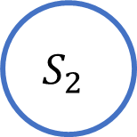
ε-NFA is used to match regex
a*a*b
a
a
$$ε$$
$$S_{1}$$
$$ε$$
$$S_{2}$$
b
Start
Accept
Notes:
So, why does such input take so much time to be matched?
It is caused by the technique we use to match the regular expression, which is nondeterministic finite automata with epsilon moves.
Let’s consider a simple regular expression, /a*a*b/ and its corresponding automata.
It has a start state and an accept state.
If we can find a path from the start to the accept state with a given string, then this string is accepted.
Otherwise, if we explore all the possible paths and cannot arrive at the accept state, then this string is not accepted.

Slide 8
String “a” is not accepted by (a*a*b)
a*a*b
a
a
$$ε$$
$$S_{1}$$
$$ε$$
$$S_{2}$$
b
Start
Accept
a
Notes:
Let’s see an example, string “a”.
We start from the start state and transfer to state 1.
Here we have 2 choices.
We first try to cycle on the state 1 with the character ‘a’.
However, we stops at state 2 and cannot arrive at the accept state.
Thus, we go back to the state 1 and try another path.
We transfer to the state 2 through the epsilon move.
Unfortunately, we stops here again.
In conclusion, we have explored all the paths, and the string “a” cannot be accepted by this regular expression.

Slide 9
Regular expression Denial of Service (ReDoS)
a*
a*
b
a
a
$$ε$$
$$S_{1}$$
$$ε$$
$$S_{2}$$
b
Start
Accept
aaaaaaaaa
Notes:
When the string becomes longer, the search space for possible paths will also be large.
Consequently, it will take much time to refuse the input string, even several minutes or hours.

Slide 10
Regular expression Denial of Service (ReDoS)
a*
a*
b
a
a
Malicious payload obeys certain underlying pattern!
$$ε$$
$$S_{1}$$
$$ε$$
$$S_{2}$$
b
Start
Accept
Deep learning
aaaaaaaaa
[4] Wüstholz, Valentin, et al. "Static detection of DoS vulnerabilities in programs that use regular expressions." International Conference on Tools and Algorithms for the Construction and Analysis of Systems. Springer, Berlin, Heidelberg, 2017.
Notes:
Our key insight is that malicious payloads triggering ReDoS attacks have to obey certain underlying patterns, which stay invariant during content manipulation across different attacks targeting the same vulnerable regular expression.
For example, we repeat the character ‘a’ for many times here.
This observation is also supported by previous work.
Such pattern motivate us to detect ReDoS attacks by deep learning methods.

Slide 11


Threat model
Malicious request
Adversary
Server
Vulnerable regex
Notes:
Then we describe our threat model.
It considers a website hosting a web service as a potential victim.
The victim may deploy a vulnerable regular expression to match against incoming HTTP requests.
The adversary is the client of the web server, which sends requests with malicious content for ReDoS attacks.
We classify ReDoS attacks into two categories, reflected and stored, based on the adversary’s behaviors.

Slide 12
Threat model: reflected ReDoS
Malicious request
Adversary
Server
Vulnerable regex
Notes:
First, a reflected ReDoS adversary keeps sending malicious requests to the vulnerable web server.

Slide 13

Threat model: stored ReDoS
Malicious Request
Adversary
Server
Database
Benign request
Malicious Content
Client
Vulnerable regex
Notes:
Second, a stored ReDoS adversary just sends one malicious request to the vulnerable web server and then the request or part of the contents are stored at the server side.
Then, when a benign user sends a request to the server, the stored contents are fetched and matched against a vulnerable regular expression, leading to a ReDoS attack.
The outage of StackOverflow is this type of ReDoS attack.

Slide 14
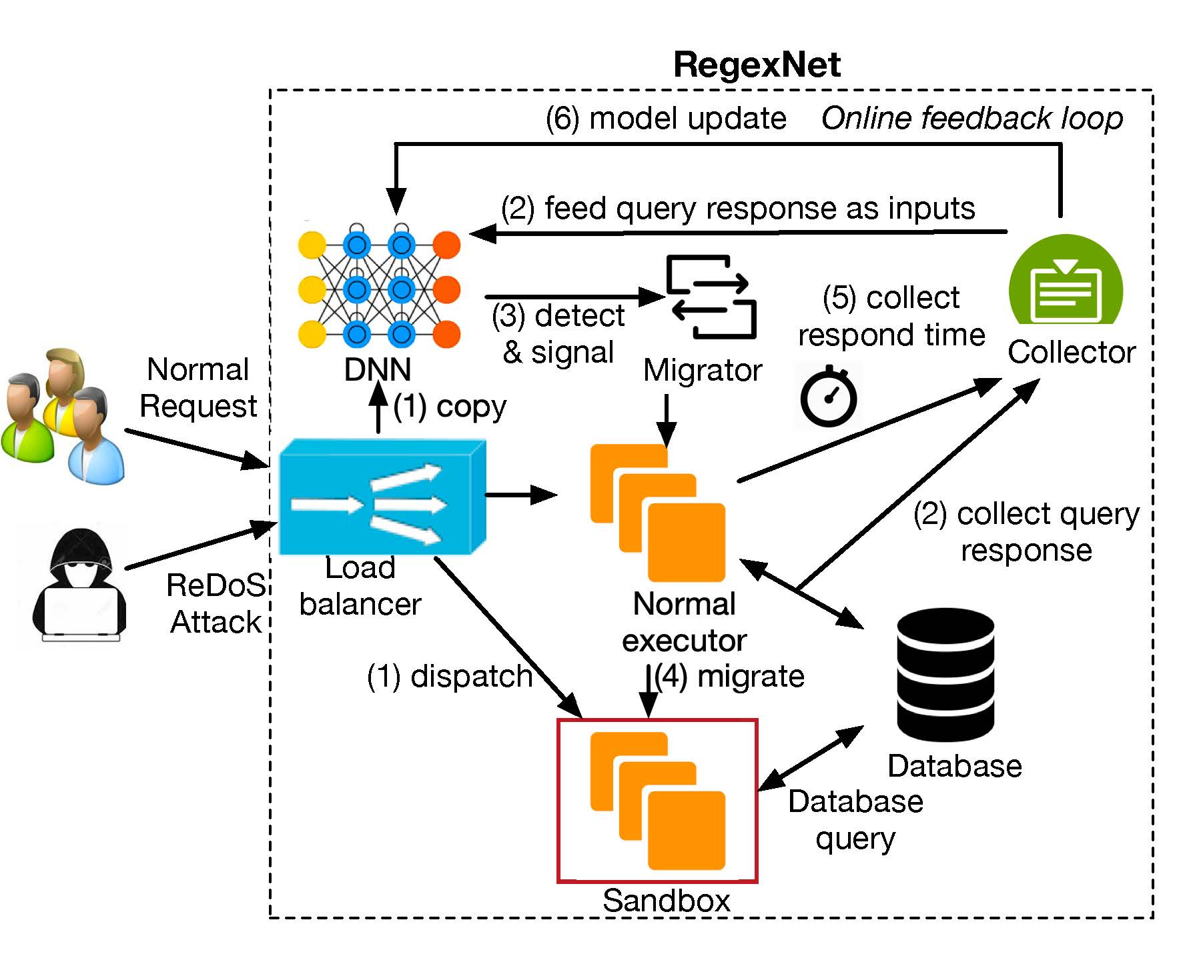
RegexNet Overview
Effective
Responsive
Resilient
Low-overhead
Scalable and fault-tolerant
Notes:
Next, we present our system, RegexNet, which is a payload-based runtime recovery system for web services.
It has the following goal.
Effective. The system should recover a web service to process of requests from normal clients after a zero-day ReDoS attack and provides comparable throughput and latency.
Responsive. The system should quickly react to a zero-day ReDoS attack and minimize the downtime of the web service caused by the attack.
Resilient. The system should be resilient to different ReDoS attack types.
And we also requires the system to be low-overhead, scalable and fault-tolerant.
This figure shows the architecture of RegexNet.
RegexNet relies on an online feedback loop to train a customized DNN model, leverages the model to detect malicious ReDoS requests, and then isolates them to separate sandboxes to mitigate their impact on web services.

Slide 15
DNN-based detection model
Embedding
layer
Conv1d
layer
Spatial
Pyramid
Pooling
layer
Fully
Connected
layer
Notes:
The core of RegexNet is the DNN-based detection model.
Our model consists of 4 layers.
First, we feed the input into an embedding layer, because it can turn the input characters into dense vectors.
These vectors contain information of characters and is important to the convergence of the DNN.
Second, we perform 1-dimensional convolution operation on the embedded vectors.
Such a convolutional layer is able to extract local information from the sequence of characters, and it is also computationally efficient.
Third, we choose a spatial pyramid pooling layer that draws the feature maps from the output of the convolutional layer, and then pools the features in arbitrary regions to generate fixed length representations for the fully-connected layer.
Finally, we choose a fully-connected to capture useful patterns from a global perspective.

Slide 16

Detect malicious requests
Client
Load Balancer
Server
Notes:
The next question is, how can we use the DNN model to detect attacks?
Here is a typical scenario.
The client sends requests to the load balancer, and the load balancer forwards the requests to the servers.

Slide 17

Detect malicious requests
Client
Load Balancer
Detector
Server
(An optional design with high overhead)
Notes:
A trivial design is to put the DNN model in front of the server.
The requests are classified by the detector and forwarded to the server only when they are classified as “benign”.
However, such design added the overhead of classification into the latency.

Slide 18
Detect malicious requests
Client
Load Balancer
Server
Copy
Notify
Detector
Notes:
Thus, RegexNet uses a different design.
The load balancer forwards requests to the server directly.
At the same time, the load balancer copies the request to the detector.
If the request is benign, then the detector does nothing.
If the request is classified as malicious, the detector will notify the server to handle it.
This design does not impose any latency overhead on benign requests in normal scenarios, because requests are classified in parallel with normal processing at the web servers.

Slide 19
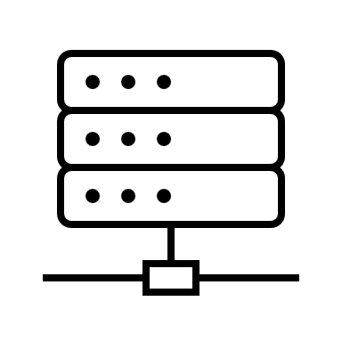
Request migration
Migrate
Client
Load Balancer
Server
Sandbox
Detector
Notes:
When the server is notified, it migrates potentially malicious requests to sandboxes.
Because the classifier cannot guarantee 100% accuracy, there could be false positives.
In other words, benign requests might be labeled as malicious.
To avoid dropping such misclassified requests, we migrate all potentially malicious requests to the sandbox, which is an elastic bounded fraction of server instances.
While such requests might experience larger latency, they are still executed.

Slide 20

Training the DNN model
Client
Load Balancer
Server
Sandbox
Report
Update
Detector
Data
Collector
Notes:
RegexNet provides both an offline-trained model and an online update procedure.
The offline training is used to bootstrap the DNN model with a training dataset.
It is mainly used to defend against known attacks.
The online training is used to refine the model with real-time measurements to adapt to both known and unknown attacks.
When the server is processing requests, it will store requests and their processing time, and reports to the data collector.
The data collector builds the training dataset with these data.
If the latency of a request exceeds a threshold, it is categorized as “malicious”.
After collecting the data, RegexNet trains the DNN model and update the detector after the convergence.
This is main design of RegexNet, and you can find more details about RegexNet in the paper, such as scalability and fault tolerance.

Slide 21
Implementation
About 2,000 lines of code
https://github.com/netx-repo/RegexNet
Load balancer
Customized HAProxy
Server
Node.js application with C++ shim layer
Detector
Python with PyTorch framework
Notes:
We have implemented a system prototype of RegexNet with a total of about 2,000 lines of code.
It is open-sourced at GitHub.
The load balancer is based on HAProxy, which is a widely-used open-source software load balancer.
The server is based on Node.js applications, and RegexNet adds a shim layer in C++ to handle migrations and measure latencies.
The detector, which is responsible for detecting and training, is implemented with PyTorch framework in Python.

Slide 22
Evaluation
How resilient is RegexNet against various ReDoS attacks?
How fast is RegexNet in recovering web service under ReDoS attacks?
How does RegexNet compare with state-of-the-art reactive defense?
How effective is RegexNet under different malicious loads and message sizes?
What is the accuracy of RegexNet’s DNN model especially with an imbalanced or polluted training set?
Notes:
In the evaluation section, we evaluate RegexNet with a wide variety of real-world ReDoS attacks.
Our evaluation aims to answer the following research questions.
How resilient is RegexNet against various ReDoS attacks?
How fast is RegexNet in recovering web service under ReDoS attacks?
How does RegexNet compare with state-of-the-art reactive defense?
How effective is RegexNet under different malicious loads and message sizes?
What is the accuracy of RegexNet’s DNN model especially with an imbalanced or polluted training set?

Slide 23
Evaluation
How resilient is RegexNet against various ReDoS attacks?
How fast is RegexNet in recovering web service under ReDoS attacks?
How does RegexNet compare with state-of-the-art reactive defense?
How effective is RegexNet under different malicious loads and message sizes?
What is the accuracy of RegexNet’s DNN model especially with an imbalanced or polluted training set?
Notes:
In this presentation, we will show the results for the first two questions, and you can find others in our paper.

Slide 24
Methodology
Environment
AWS
Metrics
Throughput
Latency
Recovery time
Network Traffics
Benign requests: Apache benchmark
Malicious requests: Python program that sends crafted HTTP requests
Notes:
Before discussing the evaluation, I will describe our methodology.
The experiments are conducted on AWS.
We use CPU instances for the client, load balancer and servers, and GPU instance for the detector.
To evaluate the performance of the system, we use 3 metrics, throughput, latency and recovery time.
As for the network traffics, we use Apache benchmark for benign requests.
To simulate web services with vulnerabilities, we insert vulnerable regular expressions into the application, and send malicious requests with a Python program that adds attacking content into the HTTP request.

Slide 25
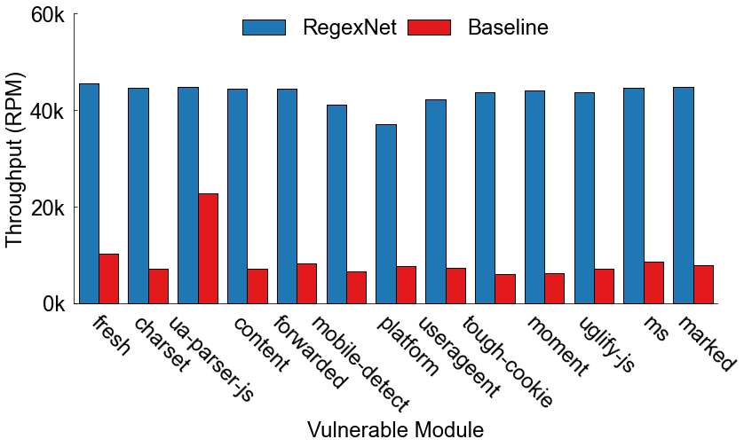
Throughput under various ReDoS attacks
Notes:
In the first experiment, we evaluate the resiliency of RegexNet with different vulnerable Node.js modules.
They are collected from previous works and public databases.
This figure shows the performance under ReDoS attacks.
The blue bars, which are throughput with RegexNet, are close to normal throughputs.
On the contrary, the red bars, which are throughput without RegexNet, shows significant decrease under ReDoS attacks.

Slide 26
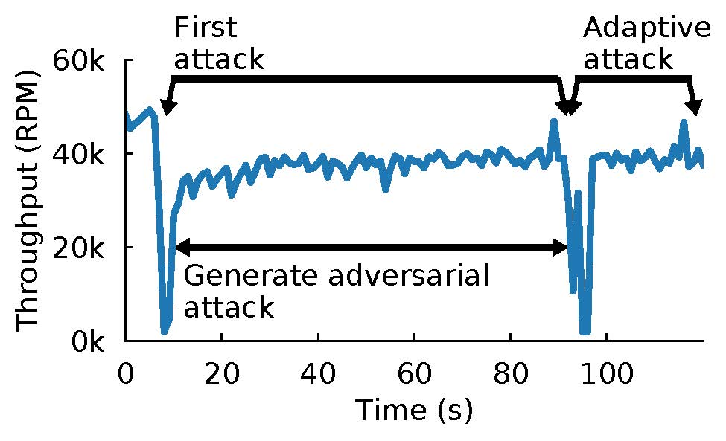
Throughput under adaptive attacks
Notes:
In the second experiment, we also evaluate the resiliency of RegexNet, but under adaptive attacks.
We consider the model as a whitebox, and then generate adversarial requests for a vulnerable regular expression.
As shown in ther figure, the adversary first launches the attack, making the throughput drop to almost 0.
RegexNet quickly collects the malicious requests to train its model and recovers the throughput in several seconds.
Next, the adversary starts to generate an adaptive attack using a white-box, gradient-based approach, and successfully creates one after about 1 minute.
This adversarial example brings the throughput down to almost 0 again, but RegexNet quickly recovers the web service and restores the system to the original throughput within several seconds.

Slide 27
Throughput under adaptive attacks
RegexNet is resilient against
all kinds of ReDoS attacks.
Notes:
In conclusion, RegexNet is resilient against all kinds of ReDoS attacks.

Slide 28
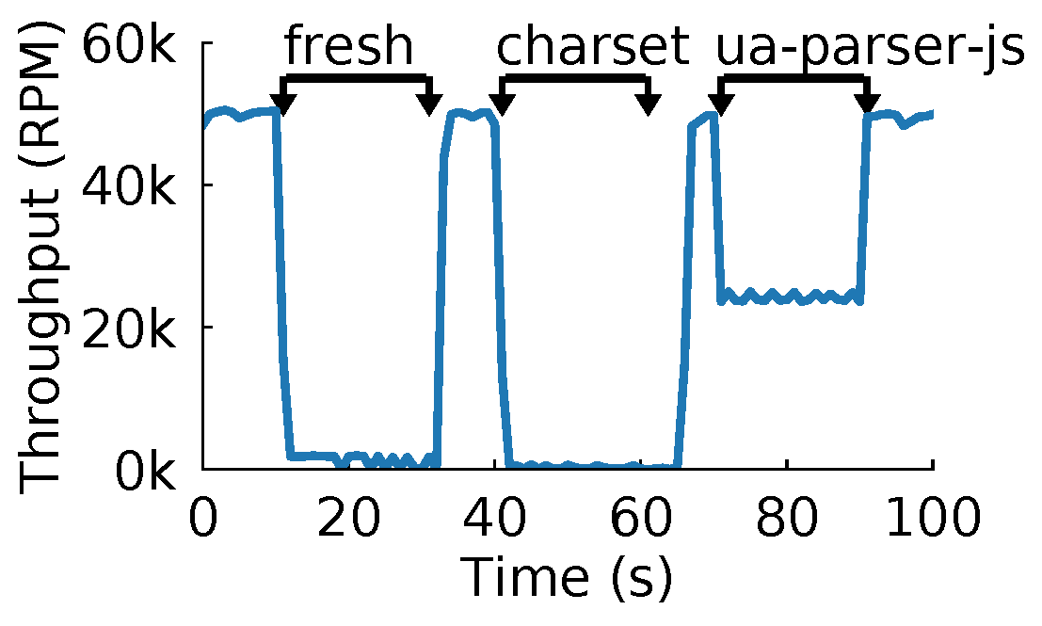
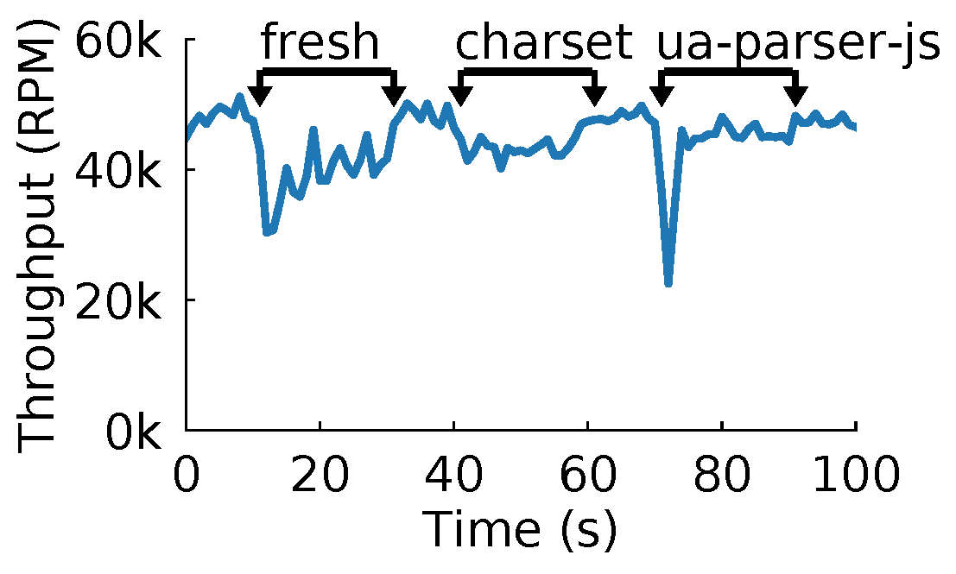
Recovery time under unknown ReDoS attacks
Baseline
RegexNet
Notes:
In the third experiment, we evaluated responsiveness of RegexNet, especially those unknown ones.
The adversary launches a dynamic ReDoS attacks targeting three different ReDoS vulnerabilities.
The left figure shows the system throughput without RegexNet.
We can see that the throughput drops significantly when the adversary generates malicious requests.
The right figure shows the system throughput with RegexNet online training.
With the online feedback loop, RegexNet can quickly learn the patterns of all three attacks in several seconds, and the throughput recovers to normal level.
The performance can be even better when combined with offline training.

Slide 29
Recovery time under unknown ReDoS attacks
Baseline
RegexNet
RegexNet can quickly recover web services.
Notes:
This result shows that RegexNet can quickly recover web services under zero-day ReDoS attacks within a minute.

Slide 30
Summary
Propose RegexNet, a ReDoS recovery system for web services
Leverage a learning model
Design an online feedback loop
Update model constantly
Implement a system prototype
Demonstrate its effectiveness
Notes:
In conclusion, we propose RegexNet, the first payload-based, automated ReDoS recovery system for web services.
It leverages a learning model to classify requests and recover websites after zero-day ReDoS attacks.
We design an online feedback loop for RegexNet.
It collects training data at runtime, continuously trains its model online, and automatically updates its model to classify and migrate requests, in face of adaptive, unknown attacks.
We implement a system prototype of RegexNet and demonstrate its effectiveness, responsiveness, and resiliency with experiments on a testbed with a wide variety of real-world ReDoS attacks.

Slide 31
Thank you!
Contact: zbai1@jhu.edu
Open source: https://github.com/netx-repo/RegexNet
Notes:
Thank you!

