Slide 1


Runtime Recovery of Web Applications under Zero-Day ReDoS Attacks
Zhihao Bai, Ke Wang, Hang Zhu, Yinzhi Cao, Xin Jin
Presented by Zhihao Bai (zbai1@jhu.edu)
Notes:
Hello, everyone. This is our work, RegexNet.

Slide 2


Regular expression (regex) is widely used
HTTP GET request
Client
Server
Notes:
Regular expression is widely used in web services to process user data.

Slide 3
Regular expression (regex) is widely used
GET / HTTP/1.1
Host: example.com
Accept: application/xml
Content-Type: text/html; charset=UTF-8
…
Client
Server
Notes:
Regular expression is widely used in web services to process user data.

Slide 4
Regular expression (regex) is widely used
GET / HTTP/1.1
Host: example.com
Accept: application/xml
Content-Type: text/html; charset=UTF-8
…
Linear time
Match
Regex:
charset=([\w\-]+)
Result:
UTF-8
Client
Server
Notes:
Regular expression is widely used in web services to process user data.

Slide 5
Regular Expression Denial of Service (ReDoS)
Super-linear time
GET / HTTP/1.1
Host: example.com
Accept: application/xml
Content-Type: text/html; charset=UTF-8
…
Match
Regex: (?: charset|encoding)\s*=\s*[‘”]? *([\w\-]+)
Input: “charset= ”
RegEx:
charset=([\w\-]+)
Result:
UTF-8
Client
Server
Notes:
However, carefully crafted input might trigger super-linear matching time for badly-designed regular expressions, which leads to ReDoS.

Slide 6
ReDoS is a serious problem
34-minute outage of StackOverflow^{[1]}
Caused by an unknown ReDoS vulnerability
13723 vulnerable libraries^{[2]}
2% of all libraries in npm and PyPI
339 popular websites^{[3]}
Most of them have more than 100,000 popularity
[1] https://stackstatus.net/post/147710624694/outage-postmortem-july-20-2016
[2] Davis, James C., et al. "The impact of regular expression denial of service (ReDoS) in practice: an empirical study at the ecosystem scale." Proceedings of the 2018 26th ACM joint meeting on European software engineering conference and symposium on the foundations of software engineering. 2018.
[3] Staicu, Cristian-Alexandru, and Michael Pradel. "Freezing the web: A study of ReDoS vulnerabilities in JavaScript-based web servers." 27th USENIX Security Symposium (USENIX Security 18). 2018.
Notes:
The ReDoS problem is serious now.

Slide 7
Regular Expression Denial of Service (ReDoS)
Super-linear time
Input: “charset= ”
Malicious payload obey certain underlying pattern!
GET / HTTP/1.1
Host: example.com
Accept: application/xml
Content-Type: text/html; charset=UTF-8
…
Match
Regex: (?: charset|encoding)\s*=\s*[‘”]? *([\w\-]+)
Input: “charset= ”
RegEx:
charset=([\w\-]+)
Result:
UTF-8
Deep learning
Client
Server
Notes:
Our key insight is that malicious payloads triggering ReDoS attacks must obey certain underlying patterns like repeated substrings.
This motivates us to leverage deep learning methods.

Slide 8
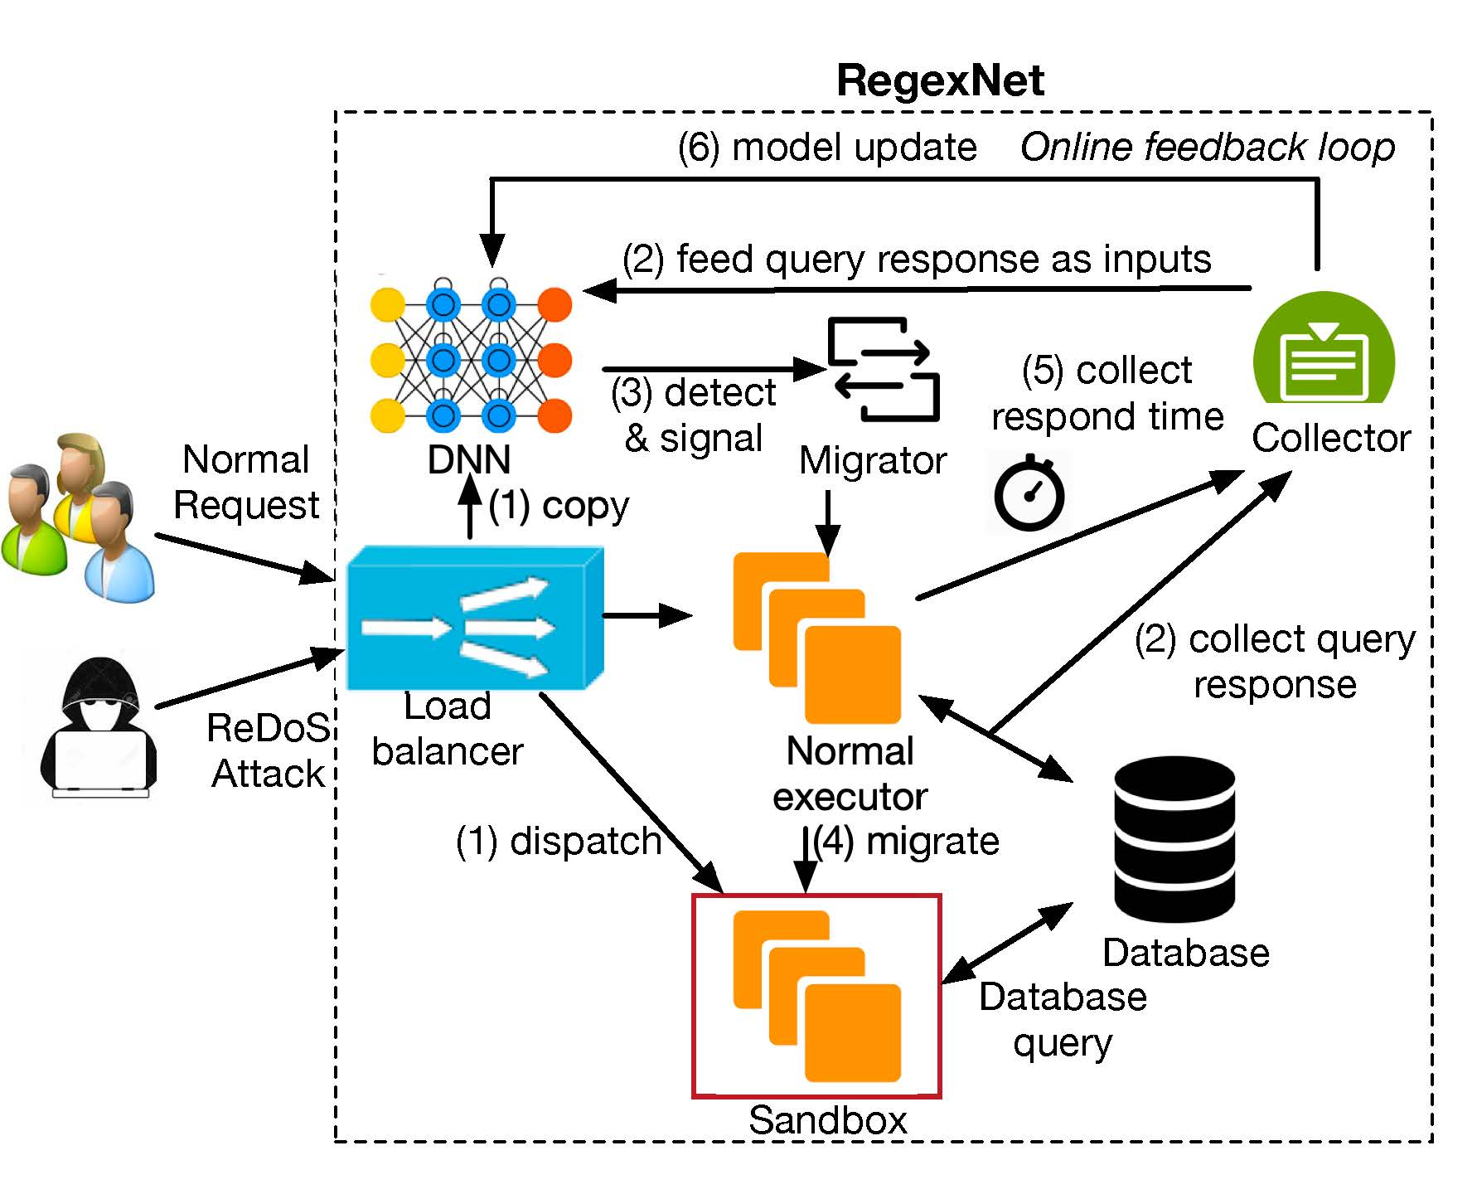
RegexNet: a payload-based runtime recovery system for web services
Effective
Responsive
Resilient
Low-overhead
Scalable and fault-tolerant
Notes:
We present our system, RegexNet.

Slide 9

RegexNet components
Client
Load Balancer
Server
Notes:
RegexNet relies on an online feedback loop to train the model, leverages the model to detect malicious requests, and then isolates them to separate sandboxes.

Slide 10


Training the DNN model with real-time measurements
Client
Load Balancer
Server
Report
Update
Detector
Data
Collector
Notes:
RegexNet relies on an online feedback loop to train the model, leverages the model to detect malicious requests, and then isolates them to separate sandboxes.

Slide 11
Detect malicious requests by the DNN model
Client
Load Balancer
Server
Copy
Notify
Detector
Data
Collector
Notes:
RegexNet relies on an online feedback loop to train the model, leverages the model to detect malicious requests, and then isolates them to separate sandboxes.

Slide 12
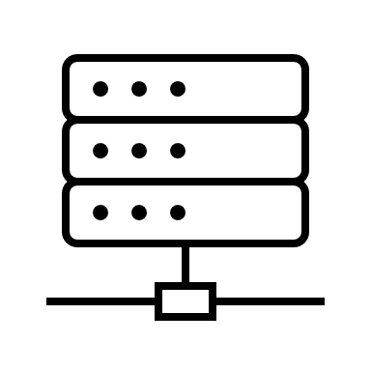
Migrate potentially malicious requests to the sandbox
Migrate
Client
Load Balancer
Server
Sandbox
Detector
Data
Collector
Notes:
RegexNet relies on an online feedback loop to train the model, leverages the model to detect malicious requests, and then isolates them to separate sandboxes.

Slide 13
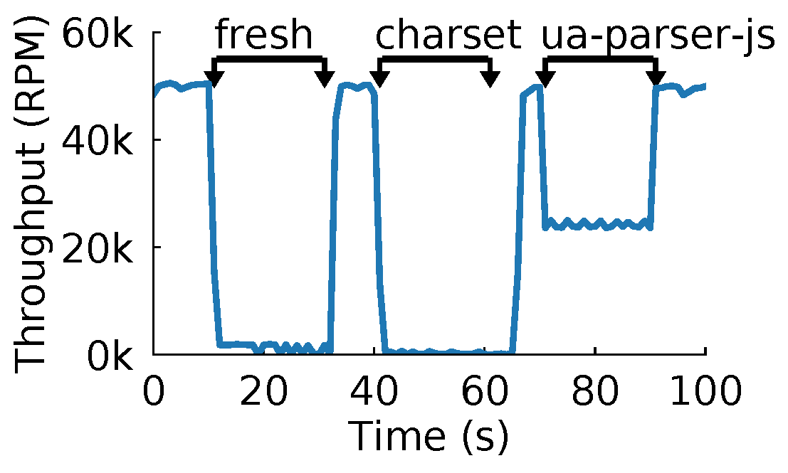
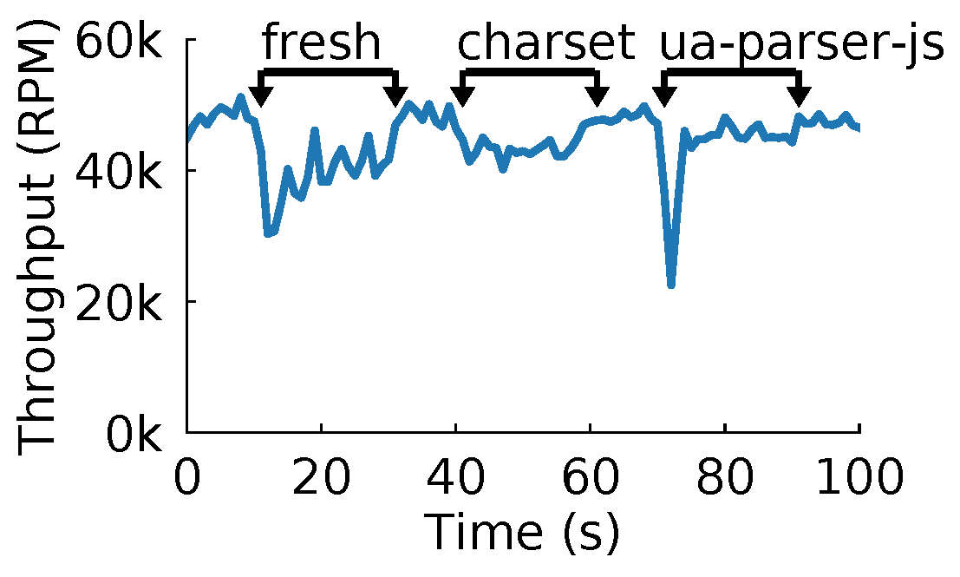
Recovery time under unknown ReDoS attacks
Baseline
RegexNet
Notes:
This experiment shows the system performance under ReDoS attacks.
The right figure with RegexNet shows normal throughput and short recovery time.

Slide 14
Thank you!
Contact: zbai1@jhu.edu
Open source: https://github.com/netx-repo/RegexNet
Notes:
Thank you!

