Slide 1
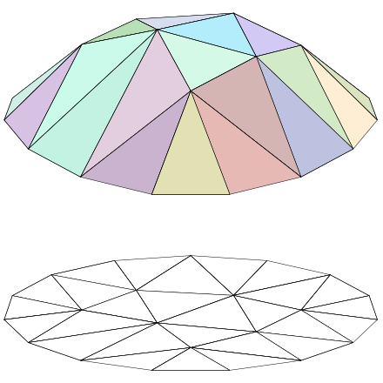
Effect of simple operations on the Linear Regions of Continuous Piece-wise Linear Functions
Haojun Zhu
Section of Mathematics, EPFL
Master semester project (8 ECTS)
supervisors: Alexis Goujon, Shayan Aziznejad

Slide 2
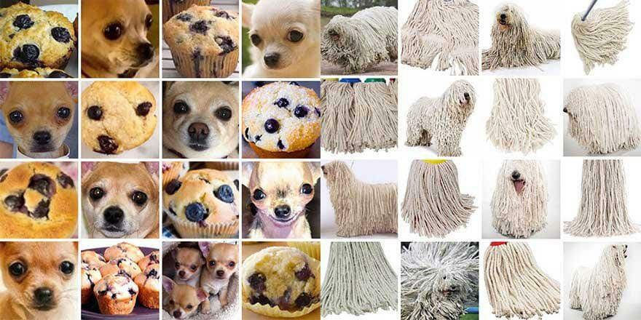

Introduction
The application of deep neural networks is a great success.
Image classification
Reinforcement learning

Slide 3
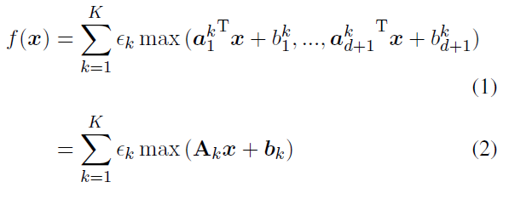



Introduction
Generalized Hinging Hyperplane(GHH):
with $x∈ℝ^{d}$, $A_{k}∈ℝ^{\left(d+1\right)×d}$ and $b_{k}∈ℝ^{d+1}$
Example of the linear regions in the input domain for

Slide 4
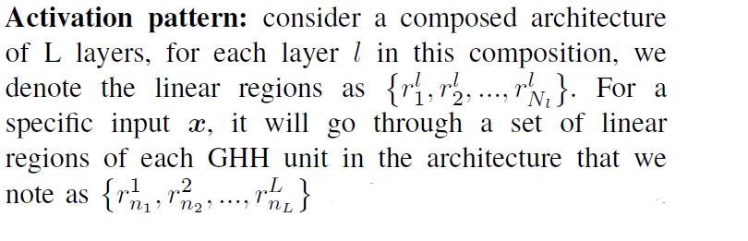
Introduction
Linear regions: areas in the input domain where the gradients are identical
or more formally, a linear region is a subset of the input domain that have the same activation pattern, and the activation patterns are different between distinct linear regions

Slide 5
Model
Implementation
Norm of gradient

Slide 6
Implementation
Input is represented by a sequence of grid points;
GHH functions are represented by a feedforward neural net with 2 linear layers and 1 maxout layer in between

Slide 7


Implementation
by the gradient
input domain represented by a grid
example of the linear regions of a CPWL function in 2D (a single GHH unit, with K=3)

Slide 8
A word about notations
$GHH_{1d}^{2}$: a GHH unit with 1-dimensional input that returns a 2-dimensional output
$GHH_{2d}^{2}$: a GHH unit with 2-dimensional input that returns a 2-dimensional output

Slide 9
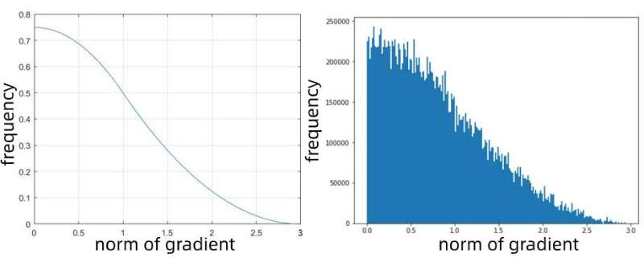
Norm of gradient
A test for a single GHH unit in 1D, when K=3.
On the left, it shows the theoretical result of the distribution of the norms of gradient; on the right, it’s the result of our experiments.

Slide 10
Composed CPWL functions
Number of linear regions
Saturation problem
Scaling factors
Lipschitz constant

Slide 11
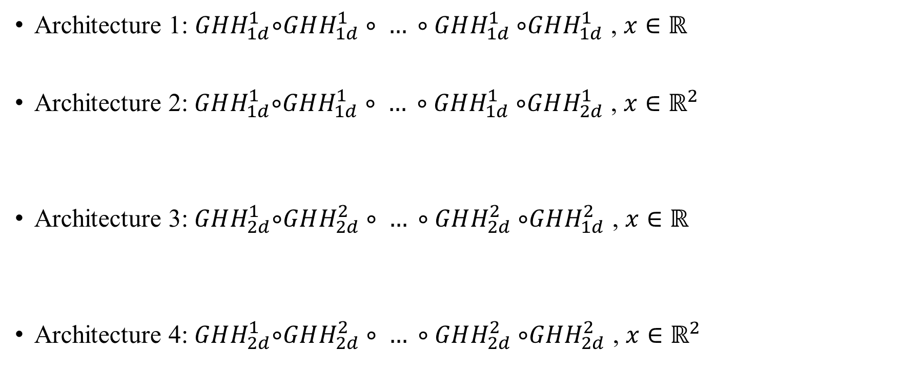
Composed CPWL functions
Architecture 1: $GHH_{1d}^{1}$∘$GHH_{1d}^{1}∘ … ∘GHH_{1d}^{1}$∘$GHH_{1d}^{1}$ , $x∈ℝ$
Architecture 2:$GHH_{1d}^{1}$∘$GHH_{1d}^{1}∘ … ∘GHH_{1d}^{1}$∘$GHH_{2d}^{1}$ , $x∈ℝ^{2}$
Architecture 3:$GHH_{2d}^{1}$∘$GHH_{2d}^{2}∘ … ∘GHH_{2d}^{2}$∘$GHH_{1d}^{2}$ , $x∈ℝ$
Architecture 4:$GHH_{2d}^{1}$∘$GHH_{2d}^{2}∘ … ∘GHH_{2d}^{2}$∘$GHH_{2d}^{2}$ , $x∈ℝ^{2}$
……
……
……
……

Slide 12
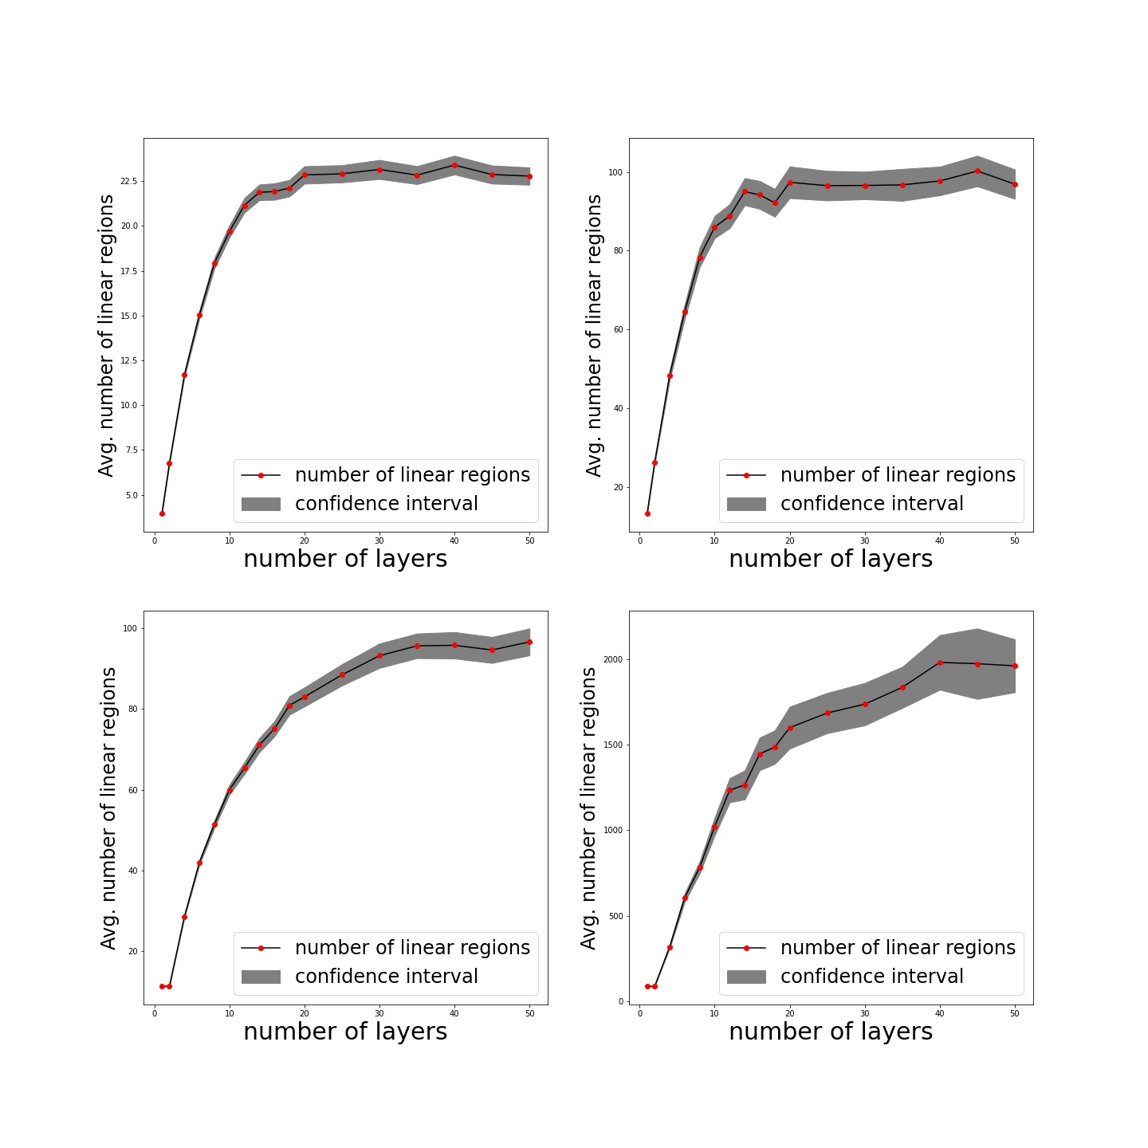
Number of linear regions

Slide 13
Number of linear regions
Observation: for the 4 pre-defined composed models, the number of linear regions all increases slowly or stops increasing when the number of layers becomes large.

Slide 14
Saturation problem
Possible reasons:
the step size is not small enough
the size of the window of the input domain is not large enough
the image of the previous layers are more unlikely to fall into different linear regions of the next layers when the number of layers becomes large

Slide 15
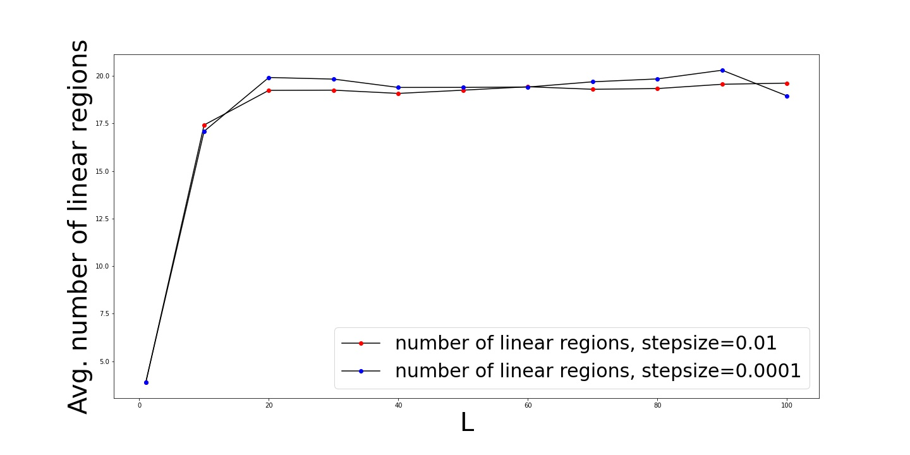
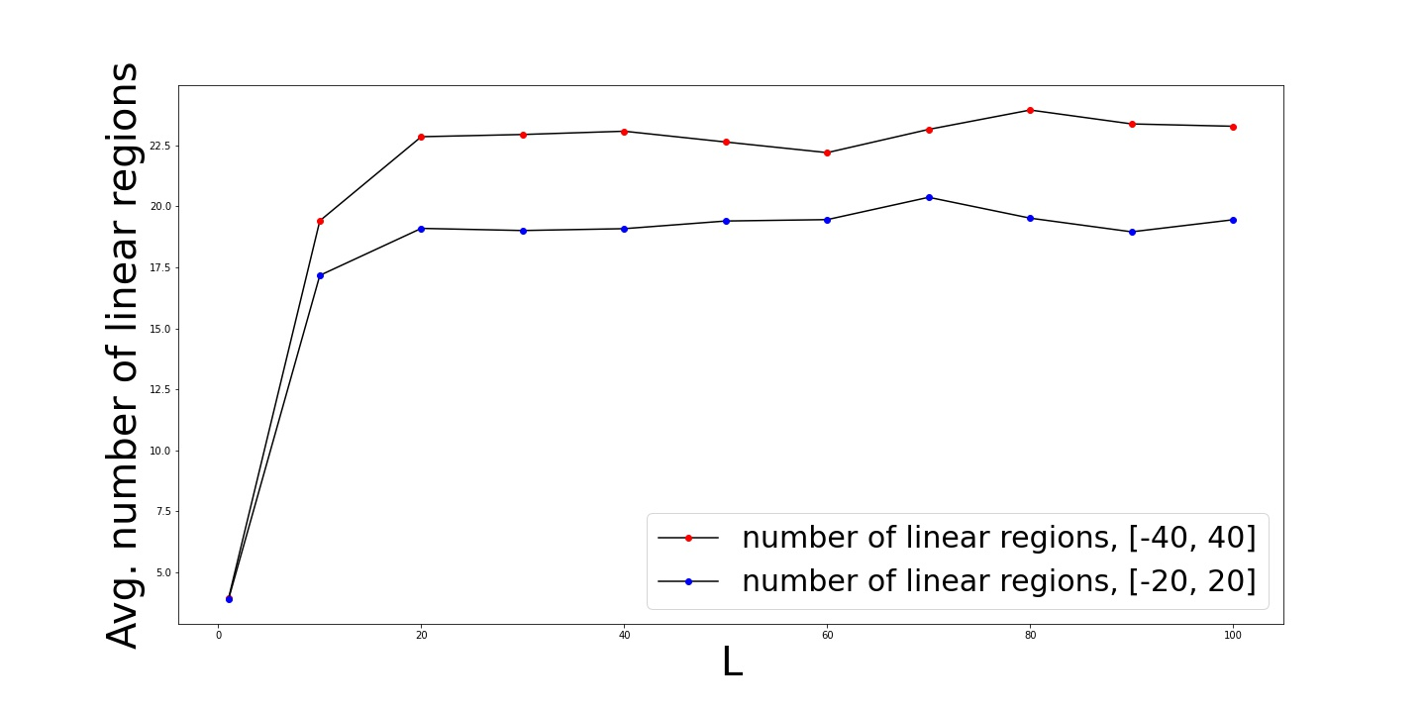
Saturation problem

Slide 16
Saturation problem
For the smallest step size we tested, the step size is not the main reason for the saturation.

Slide 17
Saturation problem
For the smallest step size we tested, the step size is not the main reason for the saturation.
The size of the window is not the main reason for the saturation.

Slide 18
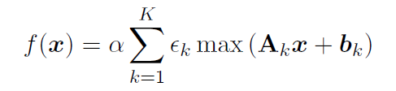
Scaling factors
Modify the GHH model by multiplying a factor $α.$
Test with different values of $α$(0.1, 0.5, 1.0, 5.0, 10.0).

Slide 19
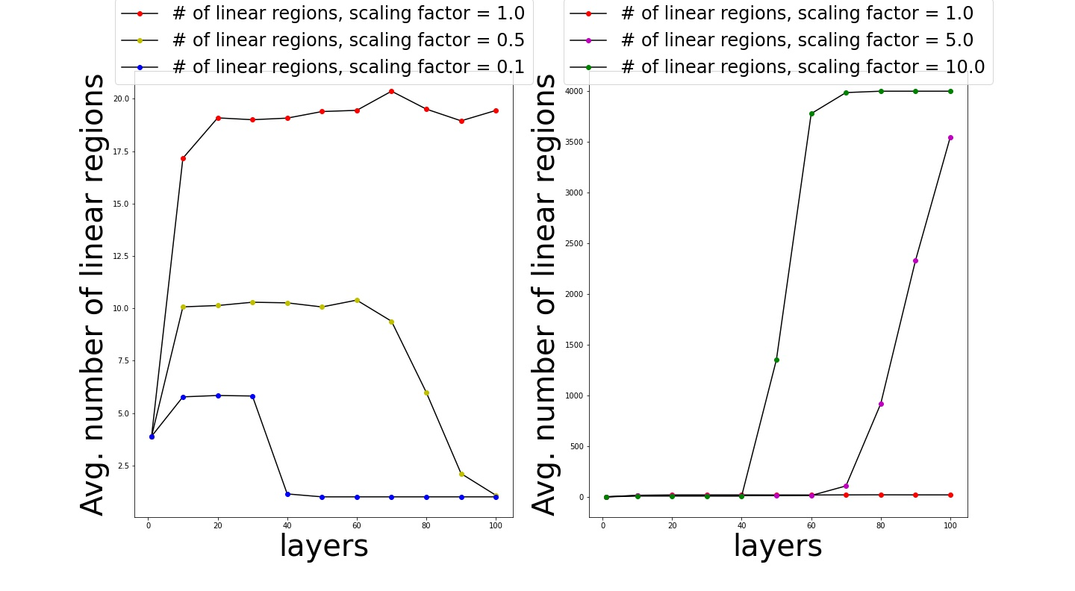
Scaling factors
Potential problem of the implemented grid method, due to the computational issue.

Slide 20



Lipschitz constant
Estimation of the Lipschitz constant:
$x ε$𝔾 (𝔾 is the 1D grid),
$x ε {\text{𝔾}}^{2}$ (${\text{𝔾}}^{2}$ is the 2D grid),

Slide 21
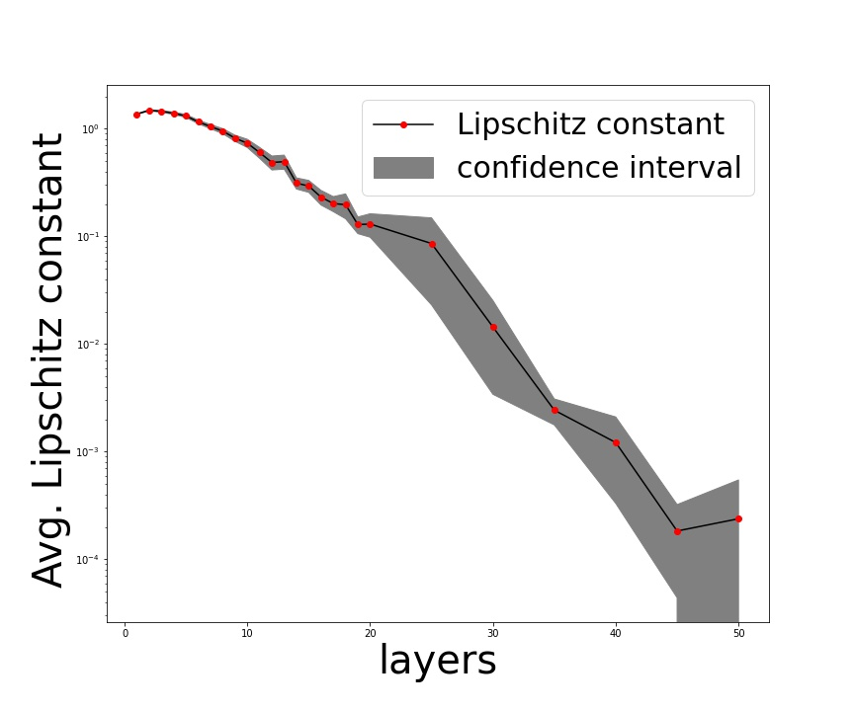
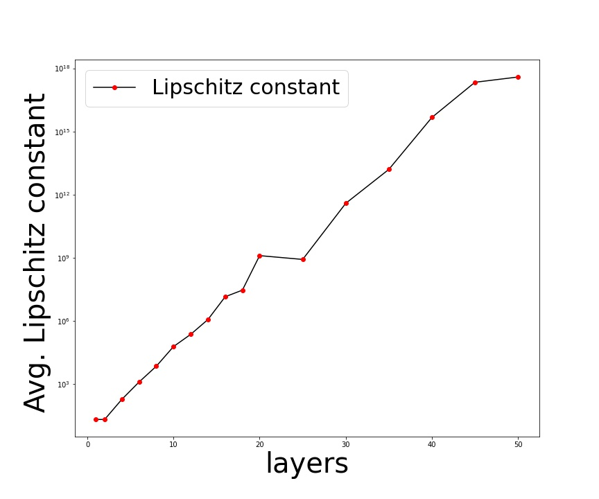
Lipschitz constant
2 types of behavior for the Lipschitz constants among the 4 architectures

Slide 22
Summary
Number of linear regions and Lipschitz constant
Further works

Slide 23
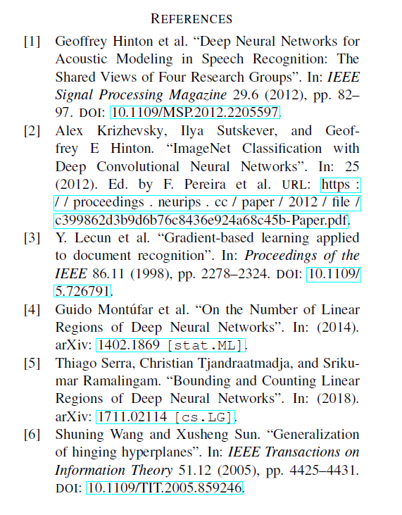

Slide 24
Thanks!

