Slide 1
Introduction to R and Git
Presenter: Jessica Krepel

Slide 2
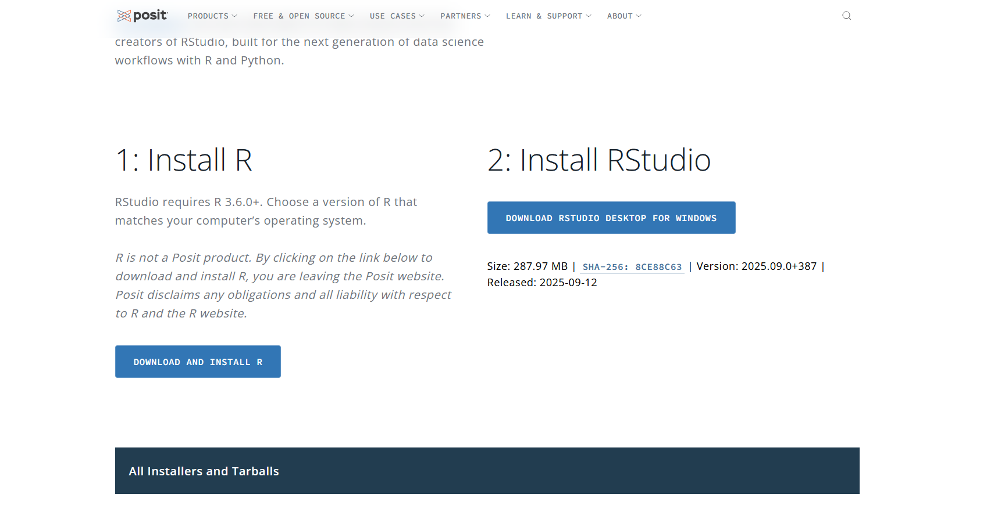
Install R and R Studio
Download from: https://posit.co/download/rstudio-desktop/

Slide 3
Information searching and further learning
?help:
      Type ? and the name of the function, that you need information about, into R
    Google:
      In many cases, someone else had the same question before, and asked it in respective platforms (e.g. Stack Overflow)
      Other informative internet pages have content on R programming
Ask an AI tool like chatGPT
For internet sources and AI tools, always double check the correctness (look at result)
Open-source books:
      R for Data Science: https://r4ds.had.co.nz/
      R for Data Science, second edition: https://r4ds.hadley.nz/

Slide 4
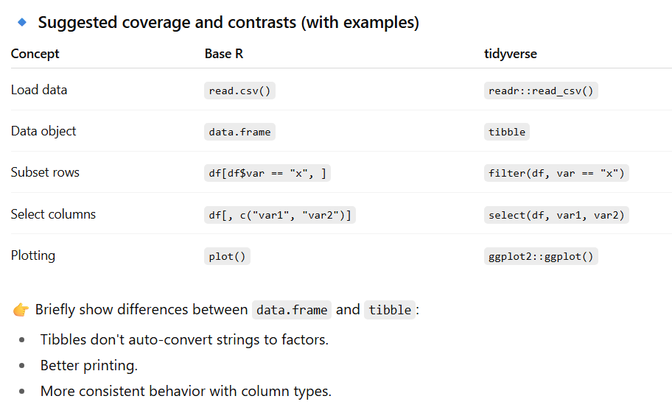
Data wrangling: Base R versus the Tidyverse Package
More: Syntax equivalents: base R vs Tidyverse
https://tavareshugo.github.io/data_carpentry_extras/base-r_tidyverse_equivalents/base-r_tidyverse_equivalents.html

Slide 5
Rmd scripts
Generate
      Word documents
      PDF documents
      HTML documents
      Presentations (PDF, HTML, PowerPoint): generate graphics directly into presentation
      Dashboards: flexdashboard
R Markdown internet page:
https://rmarkdown.rstudio.com

Slide 6
Programming rules
Why it‘s important to reduce duplication
  It’s easier to see the intent of your code, because your eyes are drawn to what’s different, not what stays the same.
  It’s easier to respond to changes in requirements. As your needs change, you only need to make changes in one place, rather than remembering to change every place that you copied-and-pasted the code.
  You’re likely to have fewer bugs because each line of code is used in more places.

