Slide 1


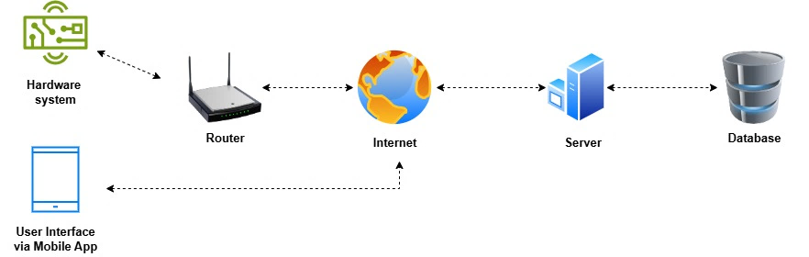
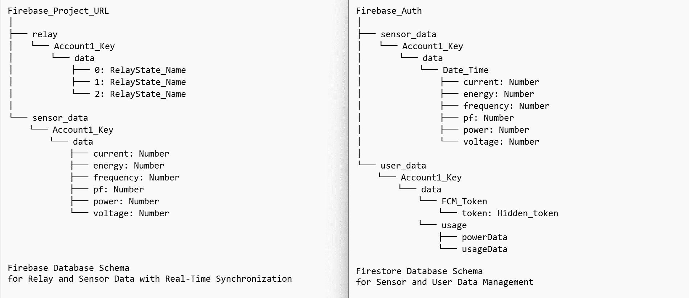
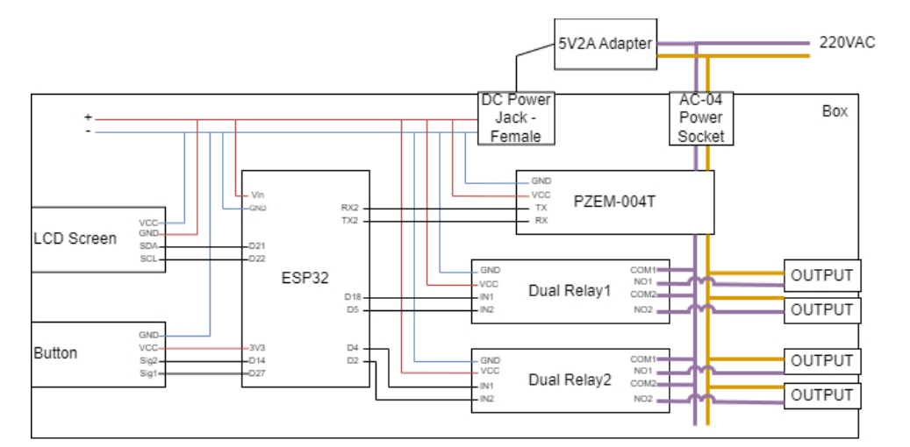
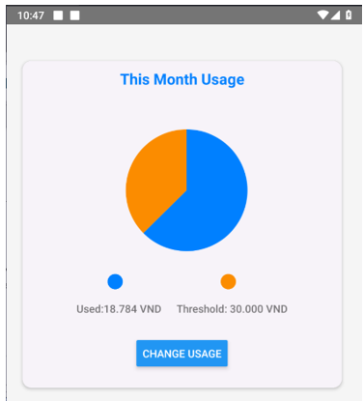
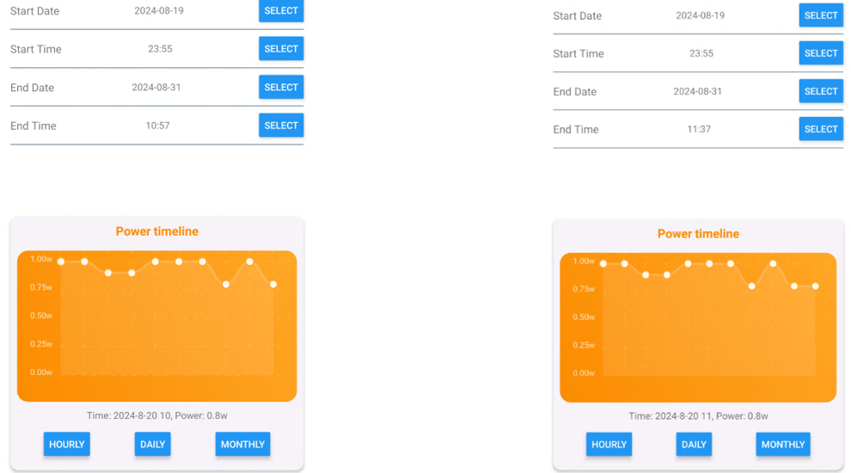
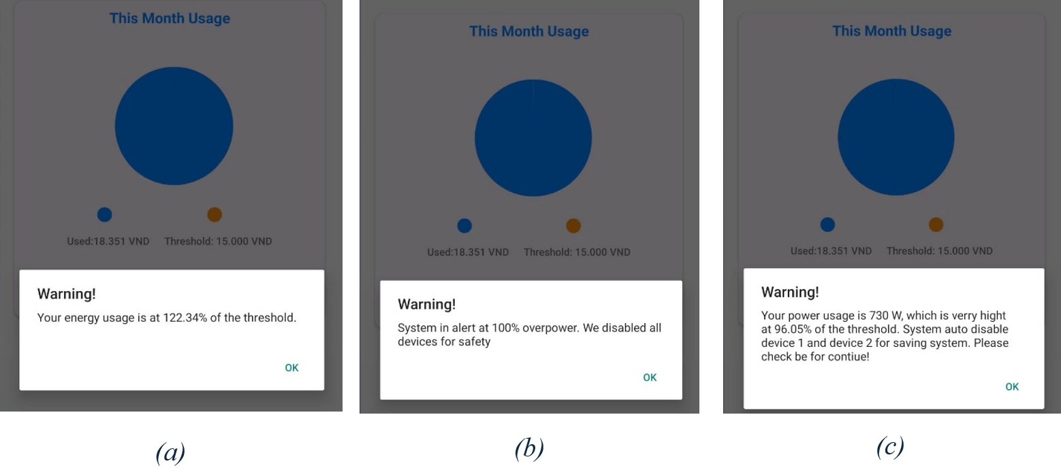
THE 3nd THEMATIC WORKSHOP ON "IOT SOLUTIONS FOR SMART CITIES" (SCIOT-2025)
Email: sciot@ptit.edu.vn
Website: https://ptit.edu.vn
THE 1st THEMATIC WORKSHOP ON IOT SOLUTION FOR SMART CITIES
Ha Noi, Vietnam, March 12, 2025
POSTER CODE: SC00x
SMART ELECTRICAL ENERGY MANAGEMENT AND MONITOR SYSTEM APPLY IN HOUSEHOLDS
Nguyen Van A¹, Nguyen Van B¹, Nguyen Van C^{1,*}
¹Posts and Telecommunications Institute of Technology, 96A Tran Phu Street, Ha Dong Ward, Hanoi, Vietnam
*Corresponding Author: (Phone: +84 97 882 xxxx; Email: trưởng nhóm@ptit.edu.vn)
ưertyui
ABSTRACT
The steady depletion of fossil fuel supplies is causing a shift to clean and renewable energy sources. However, there are several serious issues with the increasing reliance on electricity to run most human activities, such as energy scarcity, increased electricity prices, and safety hazards related to electrical system failures and power overloads. These problems put households under financial strain and increase the likelihood of electrical fires, which can seriously endanger public safety and cause significant property damage. This study introduces a system designed to monitor real-time energy usage through sensors and identify irregularities in consumption. The system also generates alerts for potential overloads, enabling homeowners to take proactive measures to prevent accidents. Implementation of this solution has demonstrated notable improvements in energy efficiency, reduced electricity expenses, and enhanced household safety. While initially developed for individual homes, the system has the flexibility to be scaled for broader residential applications, offering an effective and practical method for managing energy in daily life.
INTRODUCTION
SYSTEM ARCHITECTURE
The rising number of energy-consuming devices strains power grids, which are often not equipped to handle the surge in demand. As a result, users need to monitor, control, and optimize their energy consumption effectively. How can the current grid be centralized into a system that meets user demand?
Thousands of fires are reported each year due to electrical malfunctions, often caused by faulty appliances, aging infrastructure, and overloaded circuits.
As the adoption of renewable energy increases, addressing these risks is essential to ensure the safety and reliability of both renewable energy systems and the existing power infrastructure.
The project seeks to address these gaps by offering a scalable solution capable of real-time monitoring, proactive safety measures, and potential for integration into larger smart home ecosystems.
DATABASE
HARDWARE DESIGN
RESULTS AND DISCUSSION
CONCLUSION
The hardware setup includes an ESP32, energy sensors, relays, and an LCD in a compact enclosure with a separation plate for safety. While well-organized, tightly packed wiring complicates maintenance. Improvements like cable management, better insulation, and ventilation are recommended to enhance safety and prevent overheating. The design limits future upgrades, and a transparent LCD cover could improve usability.
Tested between 10:47 and 10:49, the system successfully updated real-time usage data. It manages power efficiently, issuing warnings at 80% usage, shutting down two outputs at 90%, and turning off all outputs at 100% to prevent overload. A similar mechanism ensures electrical safety for current thresholds. The system effectively prevents excessive power consumption, enhancing reliability.
The Smart Electrical Energy Management and Monitoring System offers an innovative solution for optimizing energy usage in households. By providing real-time data on energy consumption, the system helps homeowners identify inefficiencies, reduce electricity costs, and enhance overall household safety. It also empowers users to monitor and control their energy use remotely via a mobile app, ensuring convenience and accessibility. Furthermore, the system's ability to detect electrical faults proactively enhances safety by preventing potential hazards. With its scalability, the system is adaptable to various environments, supporting broader efforts in energy conservation and sustainability. As the demand for energy-efficient solutions grows, this system is a crucial step towards building smarter, more sustainable households.

