Slide 1
Personal Information
Management
A local command-line PIM for notes, tasks, events and contacts
COMP3211 · Group 89
Frozen implementation · 4d3508d
Notes:
Source: docs/srs/SRS.md; docs/reports/code-freeze.md. Group number 89 supplied by the user. Full frozen SHA: 4d3508db0447a3ac6346a2a2789da89208f88fd5. Speaker: MEMBER_A.

Slide 2
Creating a PIR
FR-03 / Task fields
A task needs a description and a local deadline.
COMMAND
add task "draft" "2026-10-01 09:00"
OBSERVED IN THE FROZEN CLI
Created task 2
id: 2
type: task
description: draft
deadline: 2026-10-01 09:00
02 / 06
Notes:
Sources: docs/srs/SRS.md FR-03, FR-09; docs/manuals/User_Manual.md §§3–4; media/demo/demo-expected-output.txt. Speaker: MEMBER_A.

Slide 3
Defining a search criterion
FR-26 / One search command defines and runs the criterion
search (type = "task" && deadline < "2026-10-02 00:00")
|| text contains "memo"
Parentheses group the task and deadline test.
&& requires both conditions; || accepts either branch.
Quoted literals are required. The parser builds criterion objects; it does not run Python input.
03 / 06
Notes:
Sources: docs/srs/SRS.md FR-26, FR-28, FR-29, FR-31, FR-33, FR-34, FR-36; docs/manuals/User_Manual.md §5; frozen src/model/search.py. Speaker: MEMBER_B.

Slide 4
Searching for PIRs
FR-27 / Evaluate against the current collection
The compound criterion matches two of the four records:
1 | note | memo
2 | task | draft
FR-39 / Results appear in increasing ID order
After updating task 2 and deleting note 1, a saved snapshot restores three records. The next new note receives ID 5.
04 / 06
Notes:
Sources: docs/srs/SRS.md FR-27 and FR-39; media/demo/demo-expected-output.txt; docs/manuals/User_Manual.md §8. Speaker: MEMBER_C.

Slide 5
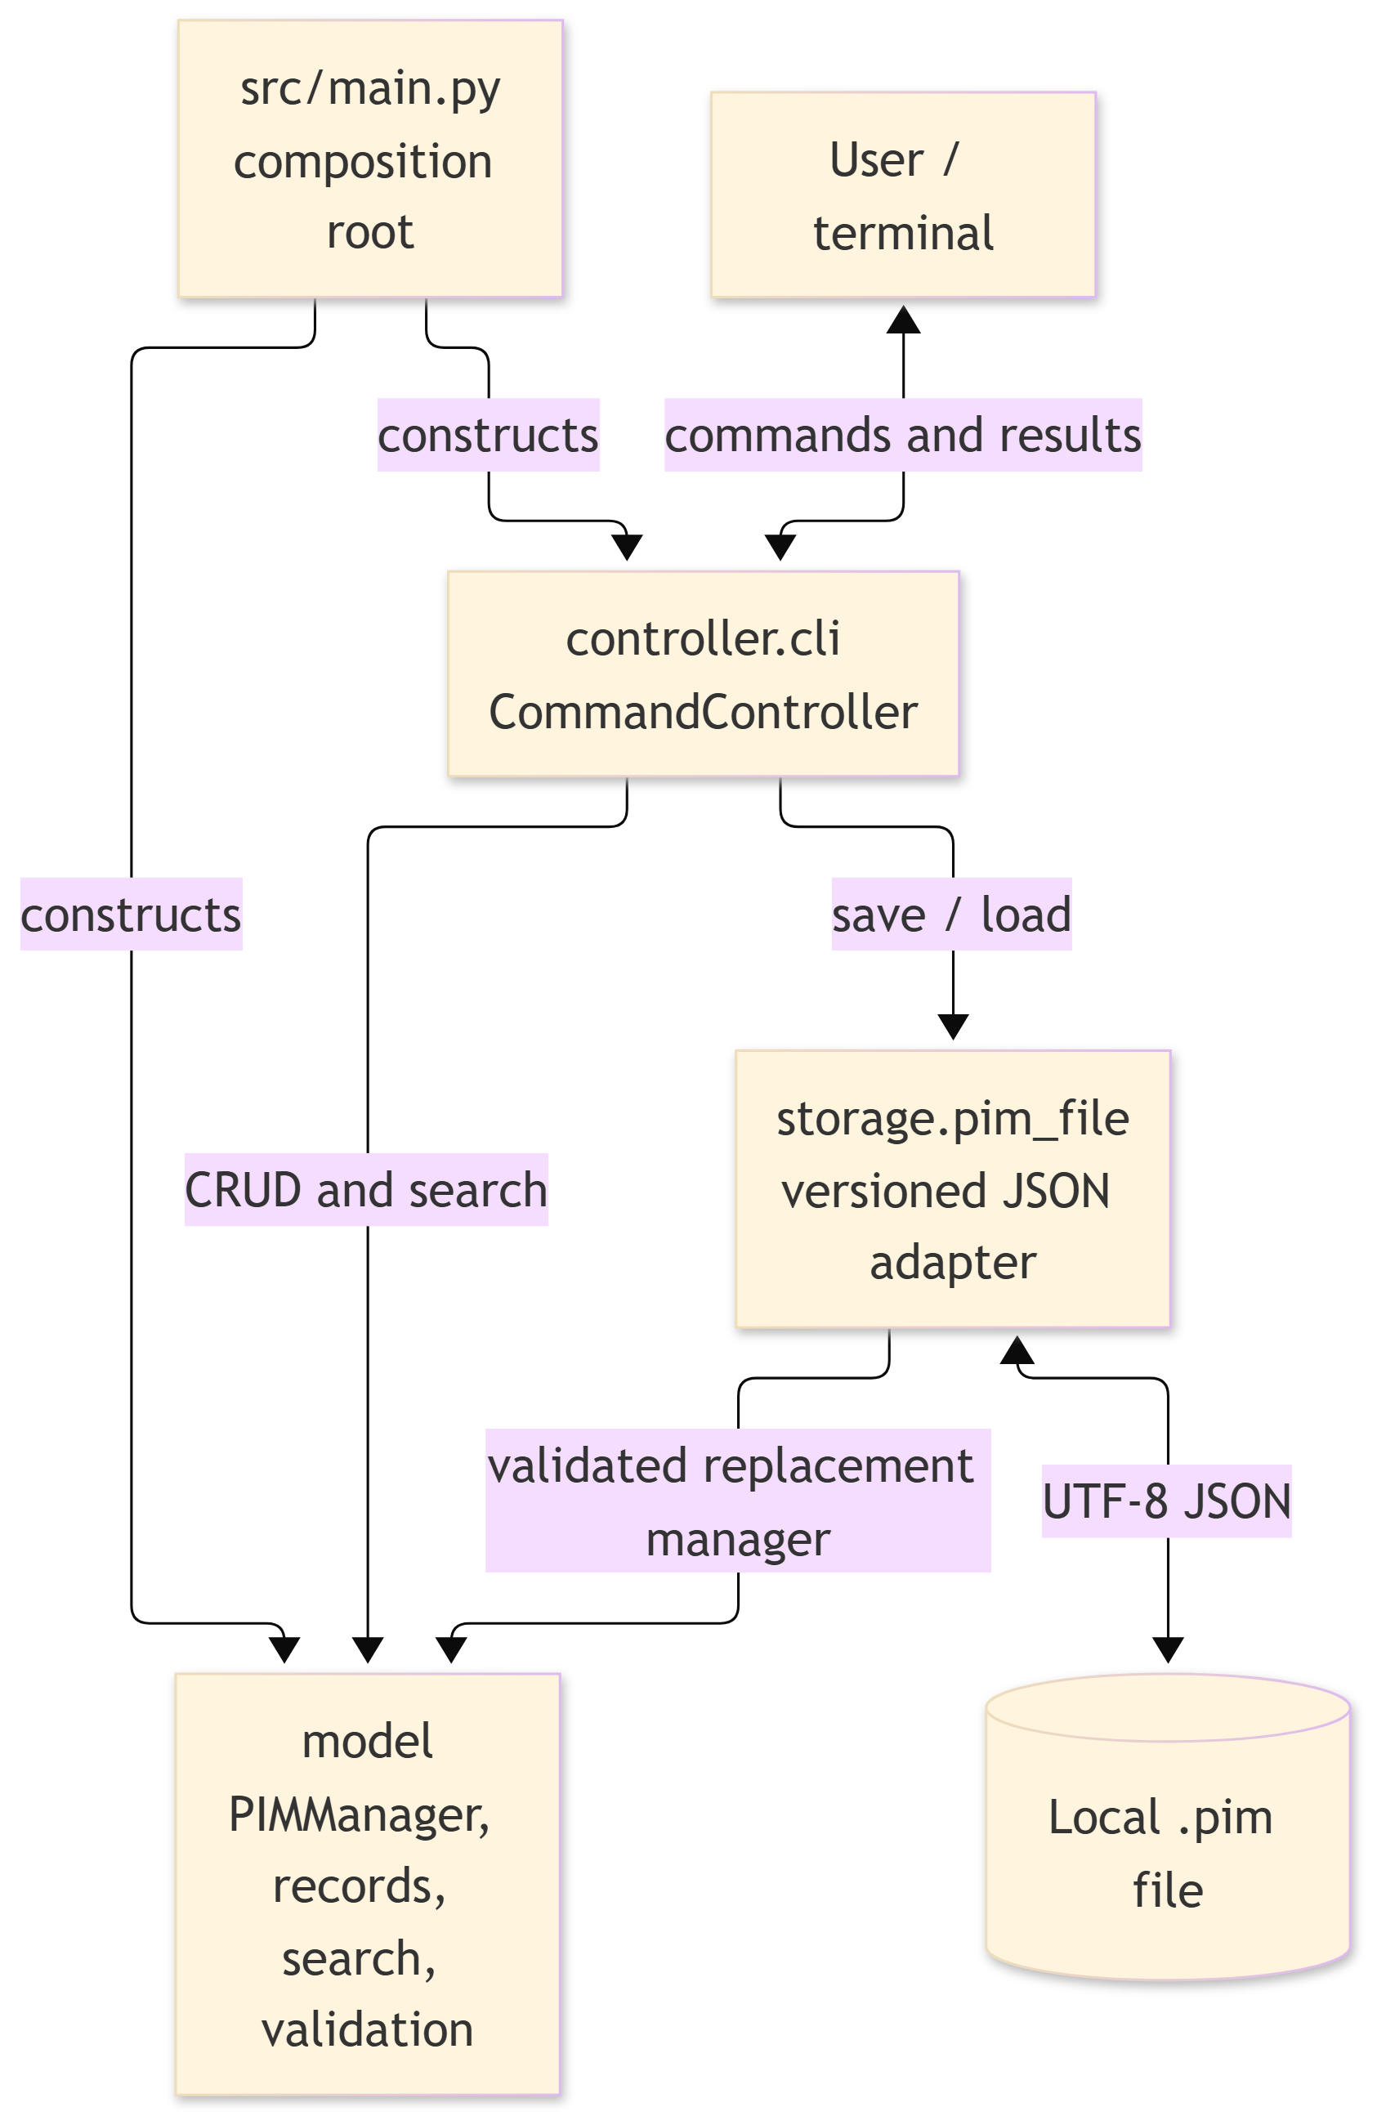
Architecture and components
CommandController
Terminal commands and output
PIMManager + model
Records, ID allocation, validation and search
storage.pim_file
Versioned .pim save and fully validated load
The model has no terminal or file I/O.
05 / 06
Notes:
Sources: docs/design/Design_Document.md §§2–3 and its architecture diagram; frozen src/main.py, src/controller/cli.py, src/model, src/storage/pim_file.py. Speaker: MEMBER_D.

Slide 6
Lesson from unit testing
FINDING
Deep valid search expressions exceeded Python's recursion limit.
CHANGE
Regression tests led to iterative parsing and evaluation.
WP04 EVIDENCE
33 tests passed · 411/430 model lines covered · 95.58%
Python 3.11 is a target that has not yet been verified.
06 / 06
Notes:
Sources: docs/reports/integration-test-log.md, docs/reports/code-freeze.md, docs/reports/model-coverage-raw.txt and Test_Coverage.md. Speaker: MEMBER_D. Python 3.11 remains unverified.

