Slide 1
Attack Traceback
08
Kai Bu
kaibu@zju.edu.cn
http://list.zju.edu.cn/kaibu/netsec2022

Slide 2
Attack Detected!

Slide 3
Attack From Where?

Slide 4
Attack From Where?
does source IP address say it all?

Slide 5
Attack From Where?
remember IP spoofing?

Slide 6
Attack From Where?
remember IP spoofing?
does ingress filtering filter them all?

Slide 7
Ingress Filtering
How to find packet origin?
Ingress filtering policy:
ISP only forwards packets with legitimate source IP
ISP
Internet
Notes:
Packet enter internet via ISP

Slide 8
Ingress Filtering
Implementation challenges:
All ISPs need to do this — requires global coordination:
If 10% of networks don’t implement, there’s no defense;
No incentive for an ISP to implement — doesn’t affect them;
Ingress filtering policy:
ISP only forwards packets with legitimate source IP
Notes:
Packet enter internet via ISP

Slide 9
Ingress Filtering
Implementation challenges:
As of 2017 (from CAIDA):
33% of autonomous systems allow spoofing;
23% of announced IP address space allow spoofing;
Ingress filtering policy:
ISP only forwards packets with legitimate source IP
Notes:
Packet enter internet via ISP

Slide 10

Let Transit Routers Help!
To remember where you come from
is part of where you’re going.
~ Anthony Burgess

Slide 11
IP Traceback
Goal
given set of attack packets
determine path to source
How
change routers to record info in packets

Slide 12
IP Traceback
Goal
given set of attack packets
determine path to source
How
change routers to record info in packets
Assumptions
trusted routers
sufficient packets to track
stable route from attacker to victim

Slide 13
IP Traceback
Write path into packets
router adds its own IP address to packet
victim reads path from packet
Deterministic Packet Marking

Slide 14
IP Traceback
Write path into packets
router adds its own IP address to packet
victim reads path from packet
Limitations
requires space in packet
path can be long
no extra fields in current IP format (changes to packet format too much to expect)

Slide 15
IP Traceback
Sample and Merge
store one link in each
packet;
router probabilistically
stores own address;
fixed space regardless of
path length;
Probabilistic Packet Marking
A₁
A₂
A₃
A₄
A₅
R₆
R₇
R₈
R₉
R₁₀
R₁₂
V

Slide 16
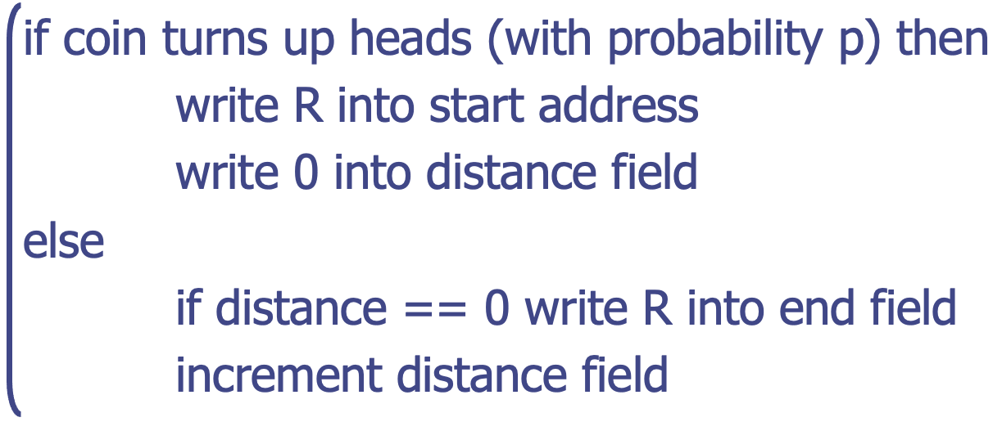
IP Traceback
Edge Sampling: fields into packet
edge: start and end IP addresses
distance: no. of hops since edge stored
Marking procedure of router R

Slide 17
IP Traceback
Packet received
R₁ receives packet from source or another router;
packet contains space for start, end, distance;
packet
s
e
d
R₁
R₂
R₃

Slide 18
IP Traceback
Begin writing edge
R₁ chooses to write start of edge;
sets distance to 0;
packet
R₁
0
R₁
R₂
R₃

Slide 19
IP Traceback
Finish writing edge
R₂ chooses not to overwrite edge;
distance is 0: write end of edge, increment distance to 1;
packet
R₁
R₂
1
R₁
R₂
R₃

Slide 20
IP Traceback
Increment distance
R₃ chooses not to overwrite edge;
distance>0: increment distance to 2;
packet
R₁
R₂
2
R₁
R₂
R₃

Slide 21
IP Traceback
Increment distance
R₃ chooses not to overwrite edge;
distance>0: increment distance to 2;
What if traceback fields are tampered with…
packet
R₁
R₂
2
R₁
R₂
R₃

Slide 22
ICMP Traceback
iTrace
Each router samples one of packets it is forwarding and copies the contents and adjacent routers’ info into an ICMP traceback message
Router uses HMAC and X.509 digital certificate for authenticating traceback messages
Router sends ICMP traceback messages to the destination

Slide 23
ICMP Traceback
iTrace
Each router samples one of packets it is forwarding and copies the contents and adjacent routers’ info into an ICMP traceback message
Router uses HMAC and X.509 digital certificate for authenticating traceback messages
Router sends ICMP traceback messages to the destination

Slide 24
ICMP Traceback
iTrace
Require all the routers transmitting attack traffic be enabled with iTrace to construct an entire attack path
yet ICMP packets are usually filtered… because of ICMP Ping Flood Attack…

Slide 25
ICMP Traceback
iTrace
Require all the routers transmitting attack traffic be enabled with iTrace to construct an entire attack path
yet ICMP packets are usually filtered… because of ICMP Ping Flood Attack…
yet not all packets are sampled on every hop

Slide 26
Path Validation
PoC: Proof of Consent
certify the provider’s consent to carry traffic along the path
PoP: Proof of Provenance
allow upstream nodes to prove to downstream nodes that they carried the packet

Slide 27
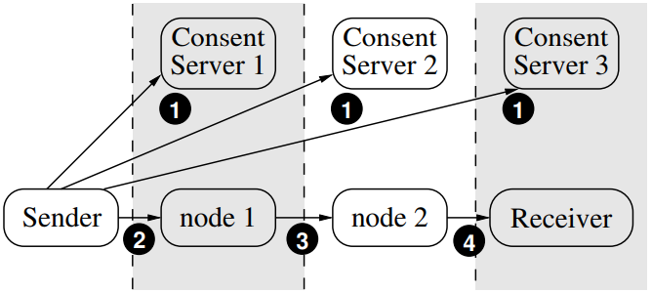
Path Validation

Slide 28
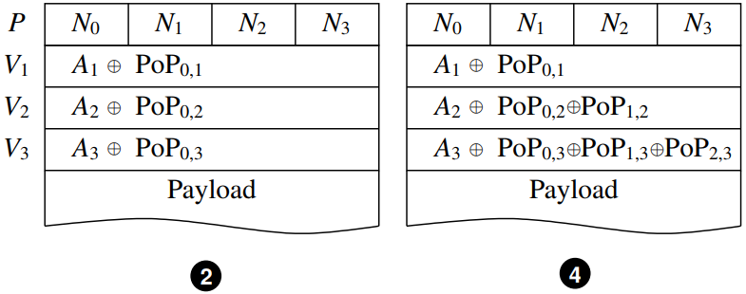
Path Validation
https://cs.nyu.edu/~mwalfish/papers/icing-conext11.pdf

Slide 29
how frequent is attack?
should every packet be always marked?

Slide 30
how frequent is attack?
should some packet be always sampled?

Slide 31
Let Transit Routers Help!
only when needed

Slide 32
Link Testing
Traceback from the router closest to the victim
Determine the upstream link that is used to carry out the attack traffic
Recursively apply the previous technique until the attack source is reached
https://books.google.ca/books?id=cxdNEAAAQBAJ
Notes:
https://books.google.ca/books?id=cxdNEAAAQBAJ&pg=PA121

Slide 33
Link Testing
Traceback from the router closest to the victim
Determine the upstream link that is used to carry out the attack traffic
Recursively apply the previous technique until the attack source is reached
Has to take effect while the attack is in progress
Notes:
https://books.google.ca/books?id=cxdNEAAAQBAJ&pg=PA121

Slide 34
Link Testing
Traceback from the router closest to the victim
Determine the upstream link that is used to carry out the attack traffic
Recursively apply the previous technique until the attack source is reached
Input Debugging
Controlled Flooding
Notes:
https://books.google.ca/books?id=cxdNEAAAQBAJ&pg=PA121

Slide 35
Input Debugging
Find attack signature, the common feature contained in all attack packets
Communicate the attack signature to the upstream router, which then filters attack packets and determines the port of entry
Recursively apply the previous technique on the upstream routers until reaching the attack source

Slide 36
Input Debugging
Find attack signature, the common feature contained in all attack packets
Communicate the attack signature to the upstream router, which then filters attack packets and determines the port of entry
A considerable management overhead at the ISP level to communicate and coordinate the traceback

Slide 37
Controlled Flooding
Need collaborative hosts
Force the hosts to flood the links to upstream routers
Since buffer on victim is shared by all incoming links, flooding the link carrying out attack leads to drops of attack packets
Recursively apply the previous technique on the upstream routers until reaching the attack source

Slide 38
Controlled Flooding
Need collaborative hosts
Force the hosts to flood the links to upstream routers
Since buffer on victim is shared by all incoming links, flooding the link carrying out attack leads to drops of attack packets
Require an accurate topology map High overhead given multiple attacking sources (e.g., DDoS)

Slide 39
post-attack traceback?
link testing requires ongoing attack…

Slide 40
Let Transit Routers Help!
log packets on routers to support query

Slide 41
Logging-Based Traceback
Routers store packet logs
Victim queries the closest routers about packet appearance of attack packets
The router containing attack packets recursively query upstream routers until reaching the attack source

Slide 42
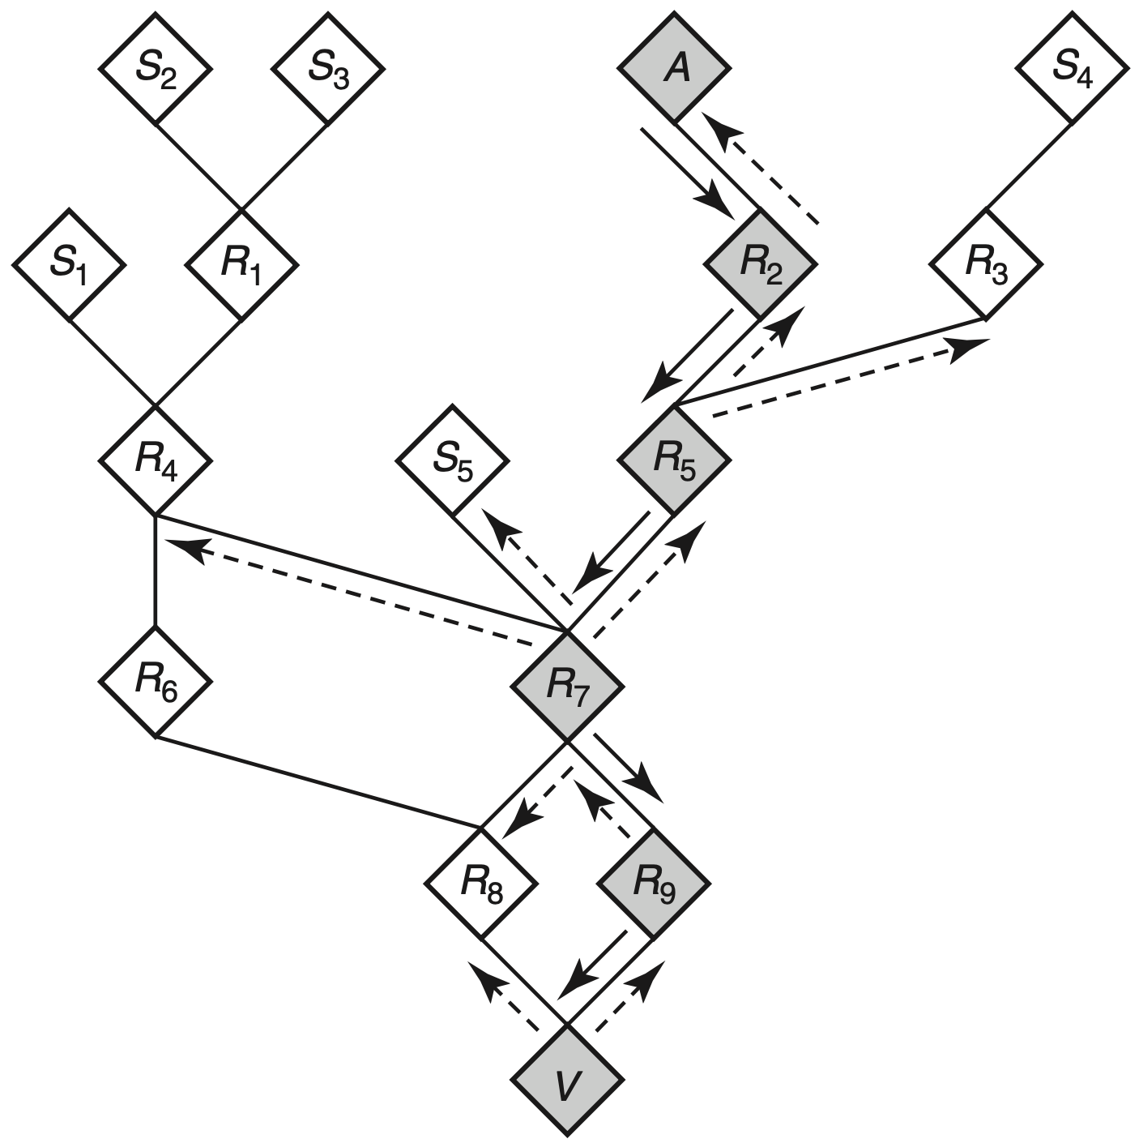
Logging-Based Traceback
yes
see packet P?
see packet P?

Slide 43
Logging-Based Traceback
what packet data to log?
yes
see packet P?
see packet P?

Slide 44
Logging-Based Traceback
Raw packets? high storage overhead on routers
Hash of invariant content per packet? still high storage overhead given high traffic rate

Slide 45
Logging-Based Traceback
Raw packets? high storage overhead on routers
Hash of invariant content per packet? still high storage overhead given high traffic rate
How to efficient memership query?

Slide 46
Bloom Filter
Effeficent set memership query using multiple hashes per set elements
Use a bitmap, a bit of which is set of one element is hashed to this position

Slide 47
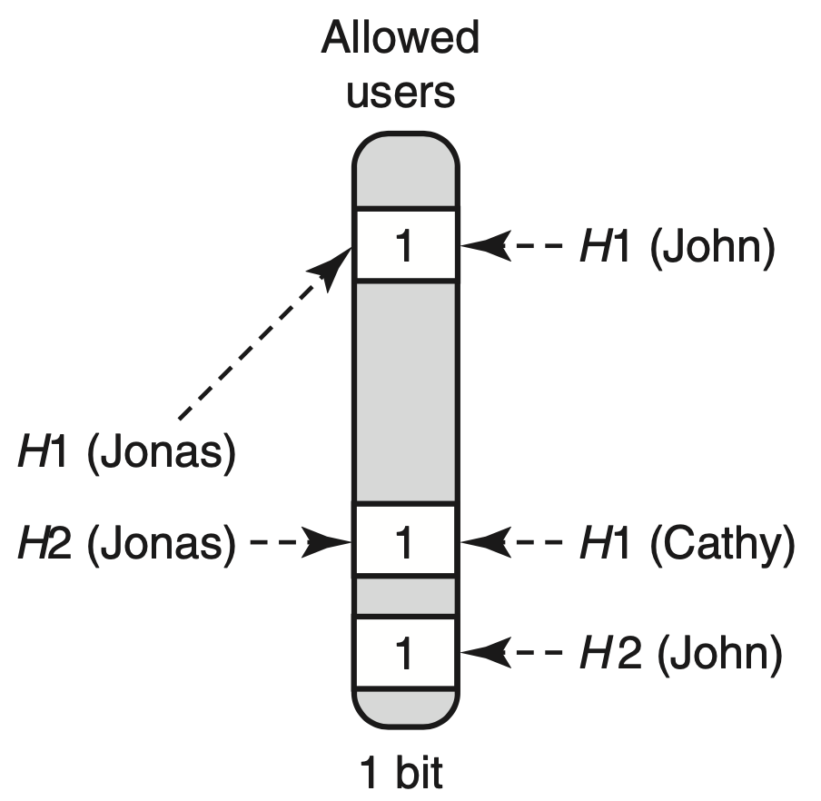
Bloom Filter
Is Cathy an allowed user?

Slide 48
Bloom Filter
Is Jonas an allowed user?

Slide 49
Bloom Filter
Is John an allowed user?

Slide 50
Bloom Filter
Is Cathy an allowed user?
No False Negative:
For users not in,
not all hashed positions are set.

Slide 51
Bloom Filter
Is Jonas/John an allowed user?
Yet False Positive:
For users with all
hashed positions being set,
users are not necessarily in.
Notes:
The equation is not as complicated as it may appear: (1 - 1/m)^{kn} is the probability that any bit is not set, given n elements that each hashes k times to any of m bit positions. Finally, to get a false positive, all of the k bit positions hashed onto by the ID that causes a false positive must be set.

Slide 52
Bloom Filter
Is Jonas/John an allowed user?
Yet False Positive:
m-size bitmap,
n members,
k hash functions:
Notes:
The equation is not as complicated as it may appear: (1 - 1/m)^{kn} is the probability that any bit is not set, given n elements that each hashes k times to any of m bit positions. Finally, to get a false positive, all of the k bit positions hashed onto by the ID that causes a false positive must be set.

Slide 53
Bloom Filter
Hash invariant content of packets
Ver
HLen
TOS
Total Length
Identification
D
F
M
F
Fragment Offset
TTL
Protocol
Checksum
28
bytes
Source Address
Destination Address
Options
First 8 bytes of Payload
Remainder of Payload

Slide 54
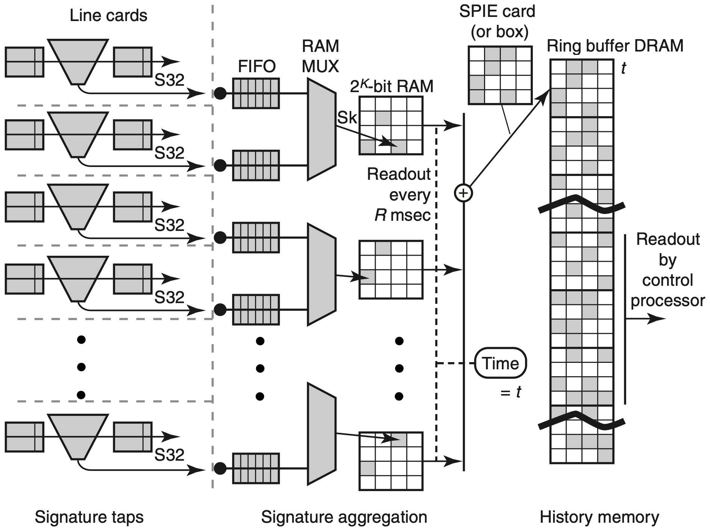
SPIE System:
Source Path Isolation Engine

Slide 55
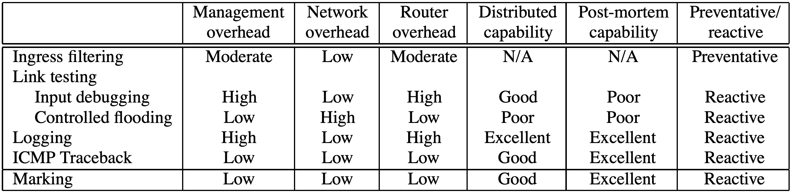
Performance Comparison
https://dl.acm.org/doi/10.1145/347057.347560

Slide 56
?

Slide 57
were routing protocols modified…

Slide 58
Readings
Practical Network Support for IP Traceback
by Stefan Savage et al.
Network Security Know It All
by James Joshi

Slide 59
Thank You
be on the road
Notes:
Run your own race.

