Slide 1


Slide 2
GCC是多种语言的编译器
GCC是自由的编译器
GCC是跨平台的编译器
GCC是流行的编译器

Slide 3
GNU project C and C++ Compiler
GNU Compiler Collection

Slide 4
//File: helloworld.c
#include <stdio.h>
int main()
{
printf("Hello world! I'm from gcc.\n"); return 0;
}
gcc –o helloworld helloworld.c

Slide 5
gcc –o helloworld helloworld.c
gcc –O0 –o helloworld helloworld.c
gcc –O1 –o helloworld helloworld.c
gcc –O2 –o helloworld helloworld.c
gcc –O3 –o helloworld helloworld.c

Slide 6

gcc –o helloworld helloworld.c
gcc –g –o helloworldG helloworld.c

Slide 7
//File: hello2main.c
#include "hello2function.h"
int main()
{
hello2function();
return 0;
}
//File: hello2function.h
void hello2function();

Slide 8
//File: hello2function.c
#include <stdio.h>
void hello2function()
{
printf("Say hello, gcc.\n");
}

gcc –o hello2 hello2main.c

Slide 9

gcc –o hello2 hello2main.c hello2function.c
hello2main.c
./
hello2function.c
hello2function.h

Slide 10
hello2main.c
hello2function.c
./
inc
hello2function.h
gcc –o hello2 hello2main.c hello2function.c

Slide 11
gcc –I./inc –o hello2 hello2main.c hello2function.c
gcc –I/home/kaseihi/hello2/inc –o hello2 hello2main.c hello2function.c
gcc –I/usr/include/gsl –o hello2 hello2main.c hello2function.c

Slide 12
gcc –o helloworld helloworld.c
gcc –E helloworld.c > helloworld_pp.c
预处理
//File: helloworld.c
……
int __attribute__((__cdecl__)) printf (const char *, ...) __attribute__ ((__format__ (__printf__, 1, 2)));
……
int main()
{
printf("Hello world! I'm from gcc.\n"); return 0;
}

Slide 13
gcc –o helloworld helloworld.c
gcc –S helloworld.c
.file "helloworld.c"
.def ___main; .scl 2; .type 32; .endef
.section .rdata,"dr"
LC0:
.ascii "Hello world! I'm from gcc.\0"
.text
.globl _main
.def _main; .scl 2; .type 32; .endef
_main:
leal 4(%esp), %ecx
andl $-16, %esp
pushl -4(%ecx)
pushl %ebp
movl %esp, %ebp
pushl %ecx
subl $4, %esp
call ___main
movl $LC0, (%esp)
call _puts
movl $0, %eax
addl $4, %esp
popl %ecx
popl %ebp
leal -4(%ecx), %esp
ret
.def _puts; .scl 2; .type 32; .endef
汇编

Slide 14
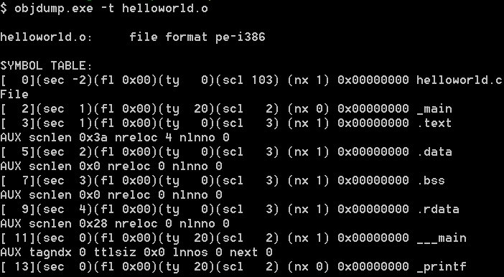
gcc –o helloworld helloworld.c
gcc –c helloworld.c
编译

Slide 15
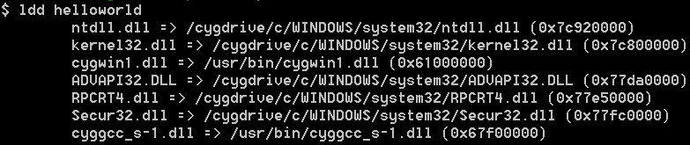
gcc –o helloworld helloworld.c
gcc –o helloworld helloworld.o
链接

Slide 16
预处理
汇编
链接
编译
Make

