Slide 1
Conditioned Diffusion Model for Image Super-Resolution
Zijian HE
A59002893

Slide 2

Introduction
DDPM: Denoising Diffusion Probabilistic Models
Conditional DDPM (SR3)
Training
Randomly add noise to images (1~2000) steps
UNet takes noisy images, regresses the noise
Inference
Generate noise, get posterior distribution of y_t-1 with reconstructed y_0.
Repeat T times, until reach y_0
Pair inputs of original and low-res image (y,x)
X is concatenated with noisy y to guide reverse process

Slide 3
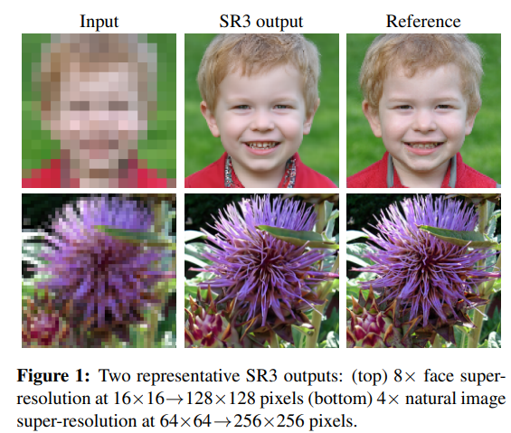
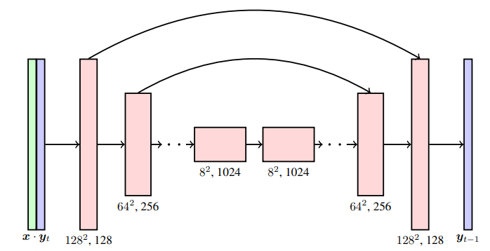
SR3: Super-Resolution via Iterative Refinement
Saharia, C., Ho, J., Chan, W., Salimans, T., Fleet, D. J., & Norouzi, M. (2022). Image super-resolution via iterative refinement. IEEE Transactions on Pattern Analysis and Machine Intelligence.

Slide 4


Proposed improvement
Smaller model and less training
Reduce model size with less parameters.
Batch size from 238 to 4.
Achieve similar results as official implementation
Modify loss function and Lr scheduler
Hybrid objective with Variational lower bound to makes posterior variance trainable (learning blending factor)
Linear warm-up Lr schedule to improve performance.

Slide 5

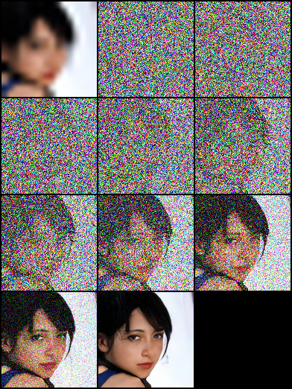
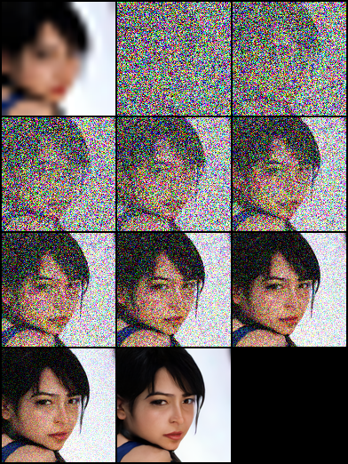
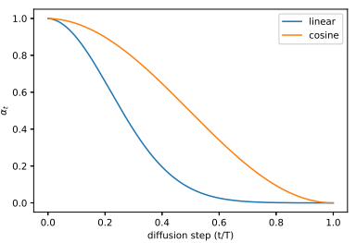
Proposed improvement
Modify noise schedule
Cosine noise schedule
Cosine noise schedule with linearity in the middle and smaller change when t near 0 and T
Preserve more details at early reverse process.

Slide 6

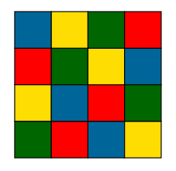

Proposed improvement
Attention near input layer
Calculate attention matrix for low resolution image before concatenation.
Worse performance because SR is a global task.
K
V
Q

Slide 7


Proposed improvement
Residual prediction task
Change objective of Unet to predict residual between low- and high-resolution images.
Potentially easier to train.
Residual connection of low res image
Add low resolution images to bottleneck layers.

Slide 8
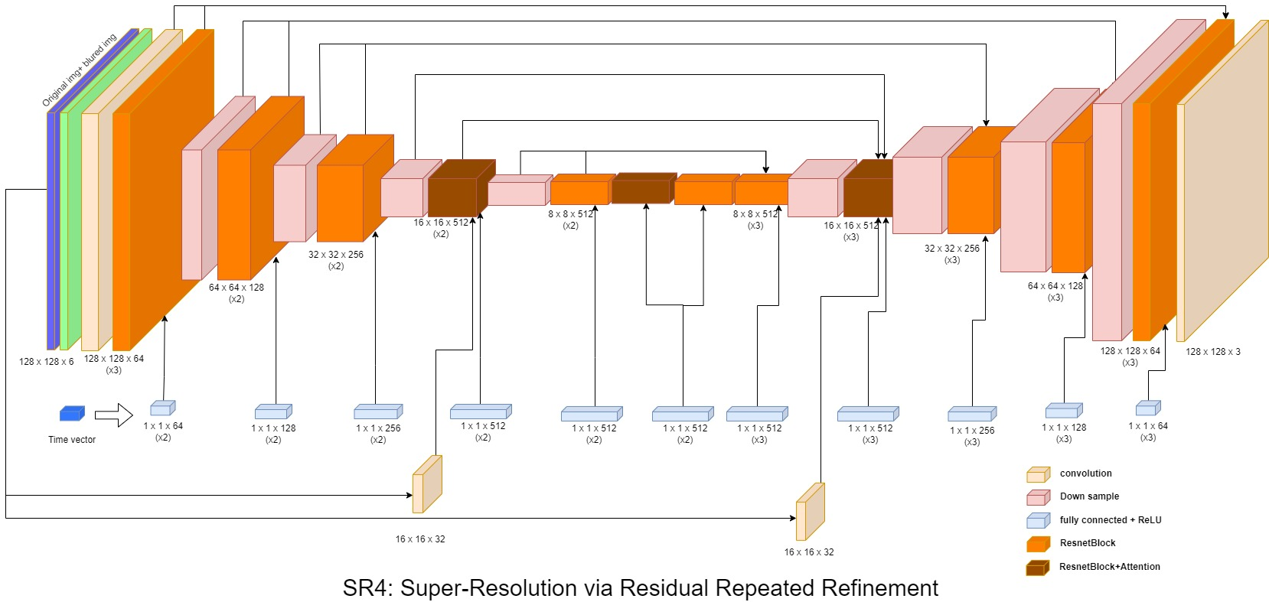
Proposed UNet

Slide 9
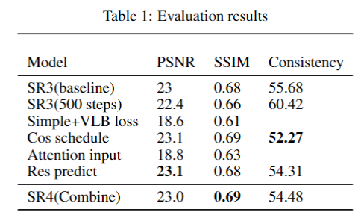
Results
Consistency metric measure between down-sampled SR and LR image
FID not useful for face generation task
Best diffusion model obtained with (cosine schedule residual prediction task and input residual connection)
SR4 achieve high scores and provide richer details due to residual prediction

Slide 10
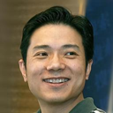
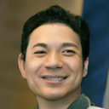



Results
Reference
Baseline(SR3)
Cos schedule
Res predict
SR4

Slide 11
Conclusion
Conditional DDPM should extract more information from auxiliary input (low resolution image)
Diffusion steps can be greatly reduced without compromise of quality (cosine schedule)
Learning the residual between low and high resolution images provide more details and converge faster.

