Slide 1
Singapore House Renting

Slide 2



Catalogue
Analytics &
Insights
Quantitative
Validation
Data Source

Slide 3
Data Source
Webpages
Complementary Data from
Data.gov.sg
Web-Scraped Data (60k)
Parsing & Cleaning
Feature Engineering
Final Data (45k)
* Complementary Data includes information about MRT, School, Hawker Center, Supermarket, Shopping mall in SG

Slide 4
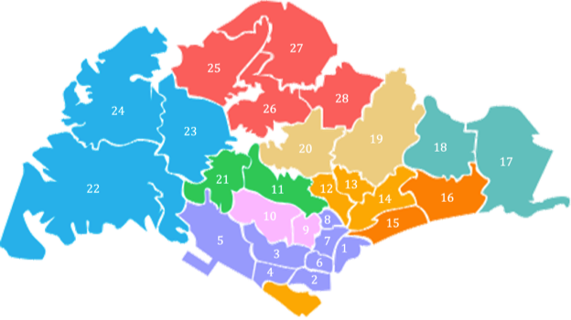
Analytics & Insights
45497
number of records
5
types of houses
27
postal code districts
5305 S$
average renting price
3900 S$
median renting price
25%
Percentile rank of 3000 S$

Slide 5
Analytics & Insights
On Power BI

Slide 6
Analytics & Insights
Distance to downtown, nearest shopping mall, nearest MRT station has a significant negative effect on house renting price, while distance to hawker centers and supermarkets don’t.
Houses along blue and redline usually have higher renting prices, houses near transition stations have higher per-sqft renting prices.
The more MRT stations are around a house, the higher per-sqft renting price it will have.
International schools have a stronger effect on the house renting price than primary schools.

Slide 7
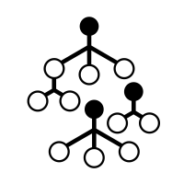
Quantitative Validation
1. Are features in our data helpful for explaining or predicting house renting price?
145 S$
average error
(out-of-sample)
5305 S$
average renting
price
price prediction
performance
/
price-per-sqft
prediction
performance
0.12 S$
average error
(out-of-sample)
4.04 S$
average renting
price-per-sqft
random
forest
/

Slide 8
Quantitative Validation
2. What are some of the most powerful features in explaining and predicting renting price?
price
prediction
price-per-sqft
prediction
- area
- distance-to-downtown
- distance-to-shop
- area
- distance-to-downtown
- distance-to-shop
- distance-to-MRT
- house type
random
forest

Slide 9

Quantitative Validation
3. What are the quantified effects of features on renting price?
feature | effect (S$)
area | +2.26
bedroom num | +624
MRT distance | -650
shop distance | -283
downtown distance | -208
International school distance | -86
lasso
regression

