Slide 1
Policy Learning for Malaria Control
Team Hzk
Presentor Huang ZiKuan

Slide 2
Outline
Problem definition
Background
GA
Q-learning
Solution

Slide 3
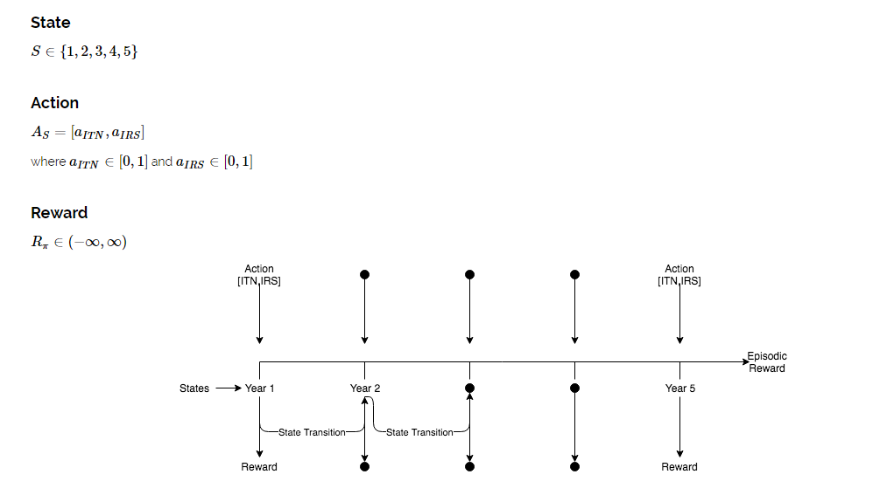
Problem Definition
Input = [ [0.5,0.4] , [0.3,0.7] ,…… ]
output = [ 101 , 0 , 53 , …… ]

Slide 4
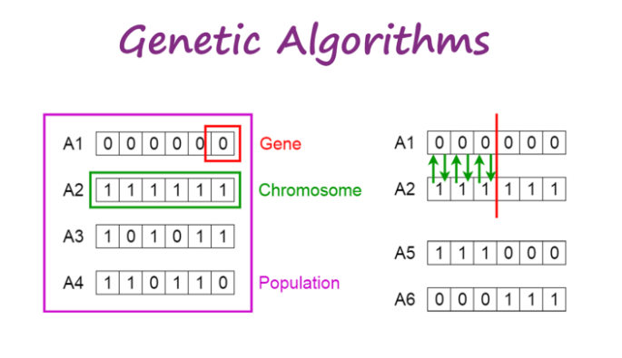
Background - GA

Slide 5
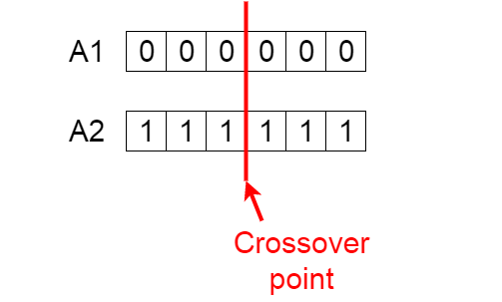
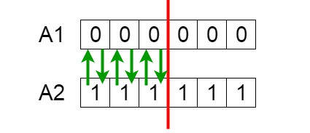
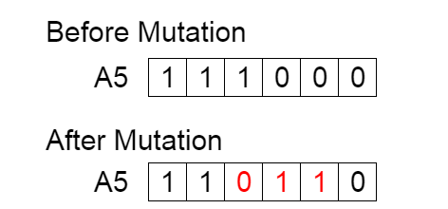

Slide 6
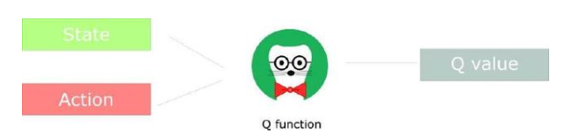
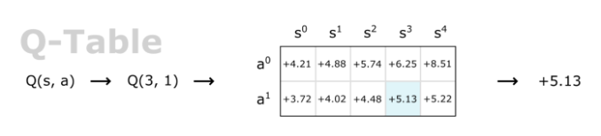
Background – Q-learning

Slide 7
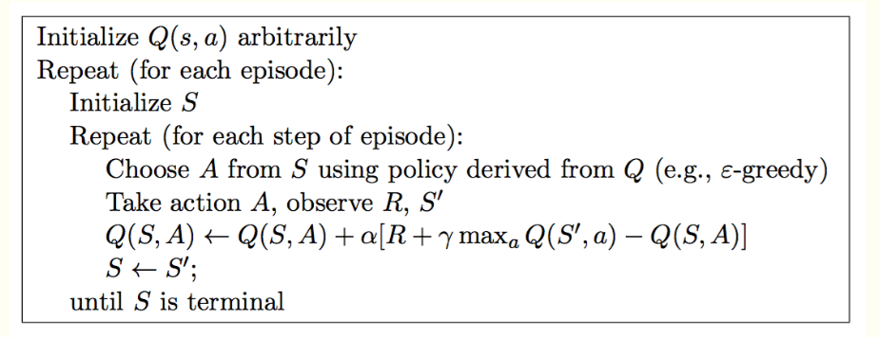
Background – Q-learning

Slide 8
Overall
environment about this competition
20 opportunities to interact with the environment
Unreachable final evaluation environment when submitting final solution
Find high score policy
Q-learning
Reduce search space
Final submission
GA

Slide 9
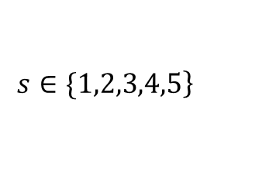
Collect high score strategy
Q-learning
State:
Action:
Run 1000 epochs
collect high performance policy
SARSA is a more stable
DQN is not work
Q-learning
Genetic algorithm

Slide 10
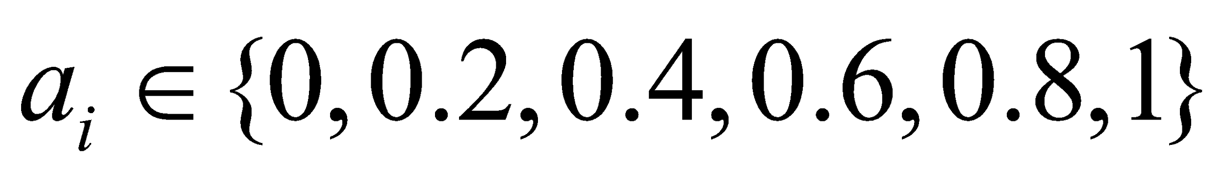
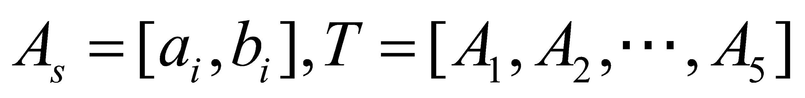
Collect high score strategy
Genetic algorithm
Initialization:
Run 200 epochs
collect high performance policy
Mutate operation:
Random
Change x to 1-x
Crossover operation:
Q-learning
Genetic algorithm

Slide 11
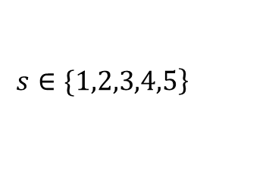
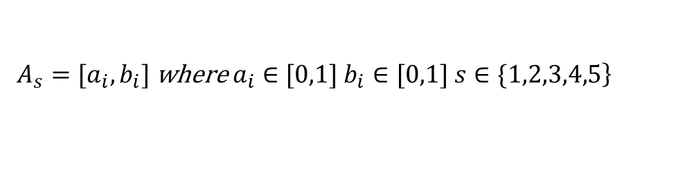
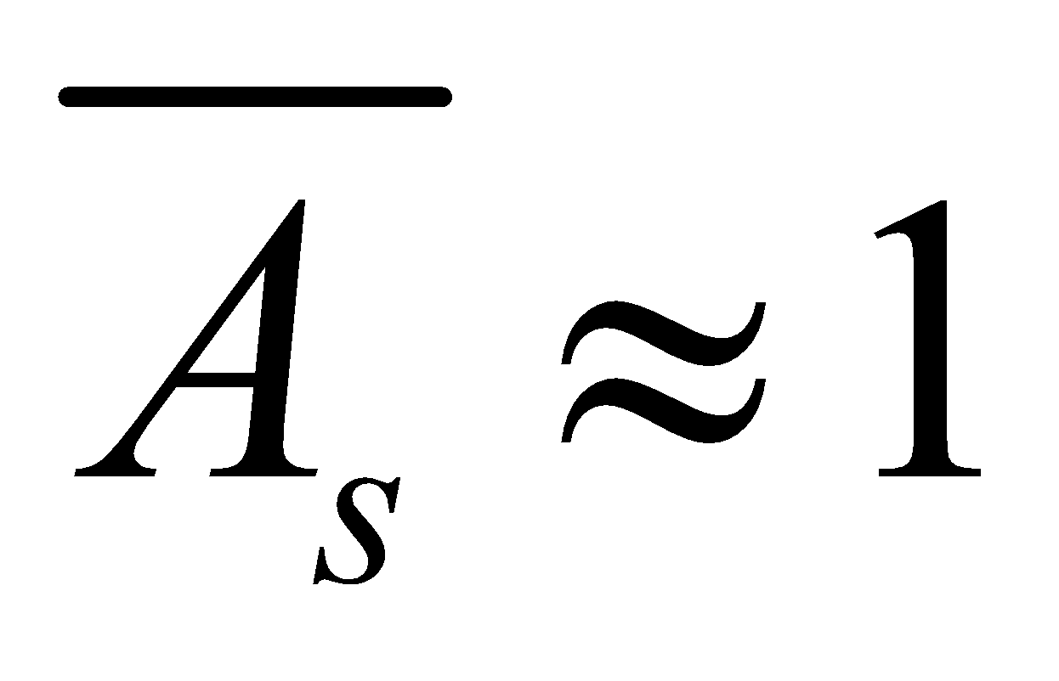
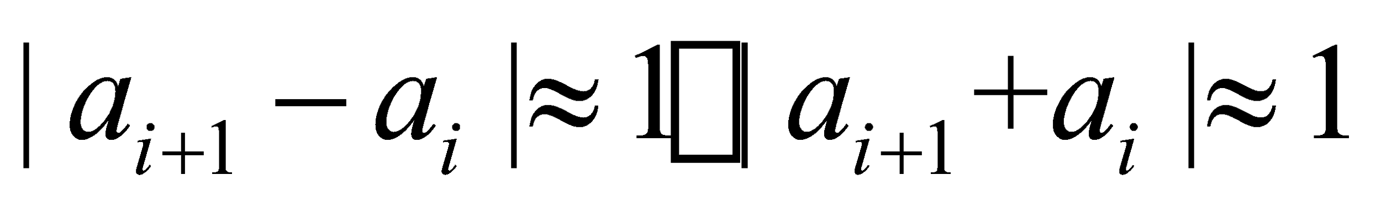
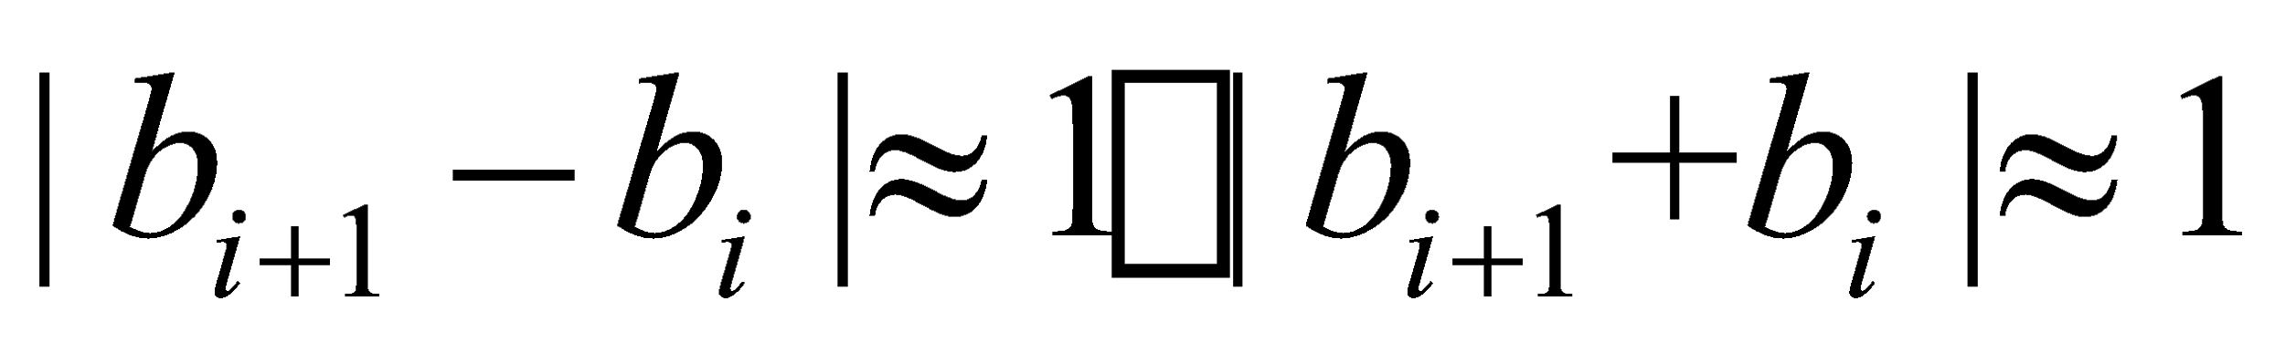
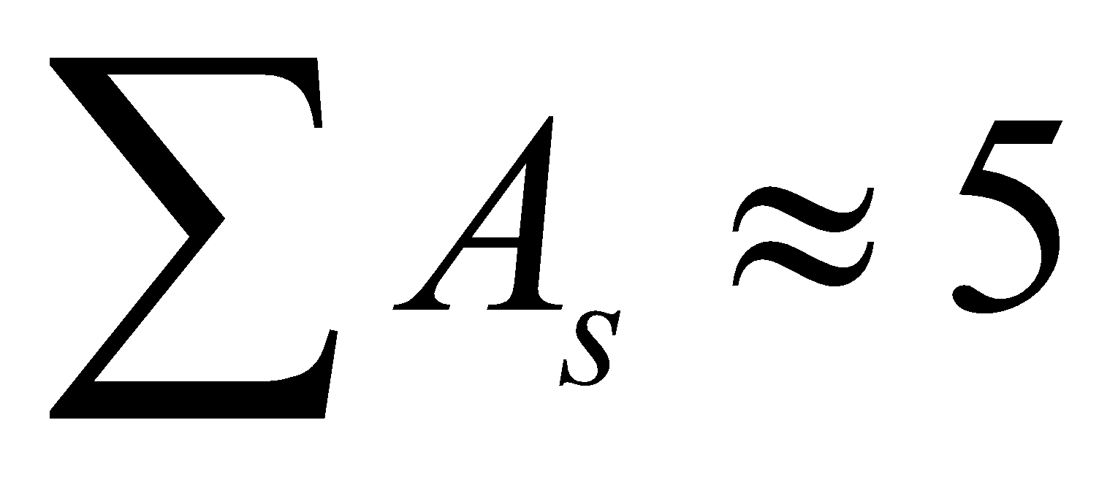
Analyze high performance policy
1: [0.6, 0.2], 2: [0.0, 1.0], 3: [1.0, 0.0], 4: [0.0, 0.8], 5: [0.6, 0.8]
1: [0.2, 1.0] , 2:[1.0, 0.0] , 3:[0.0, 1.0] ,4: [0.7,0.0], 5:[0.0,0.5]
1: [1.0, 0.0], 2: [0.0, 0.8], 3: [1.0, 0.2], 4: [0.4, 0.2], 5: [0.0, 1.0]
………………
State:
Action:
We find:

Slide 12
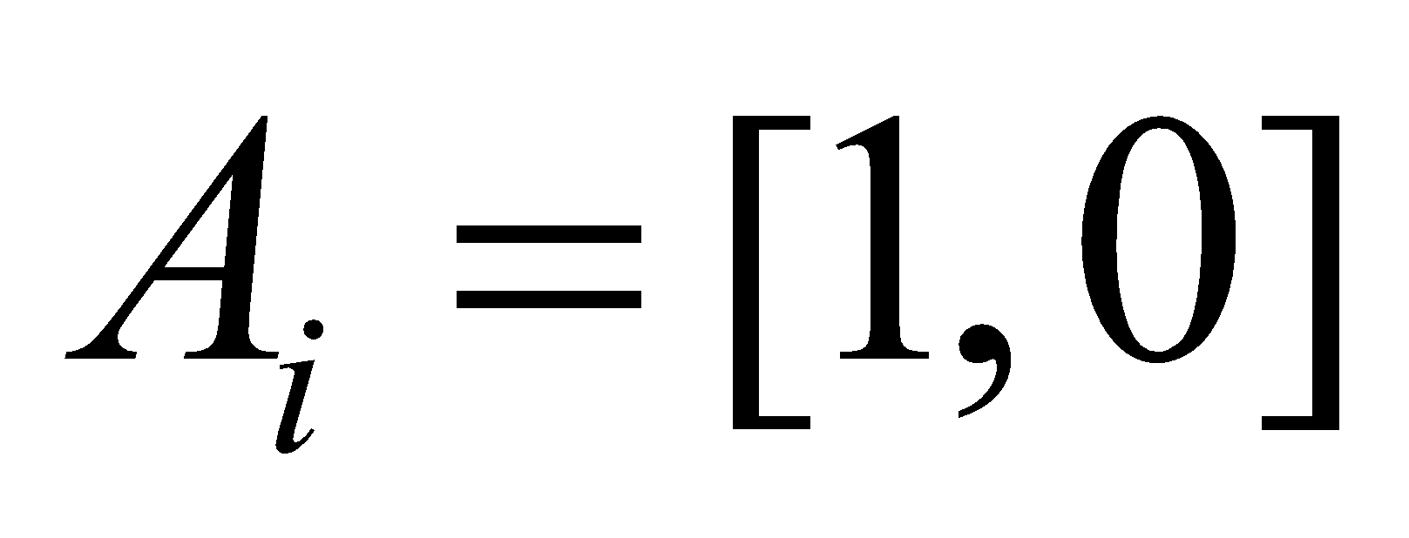
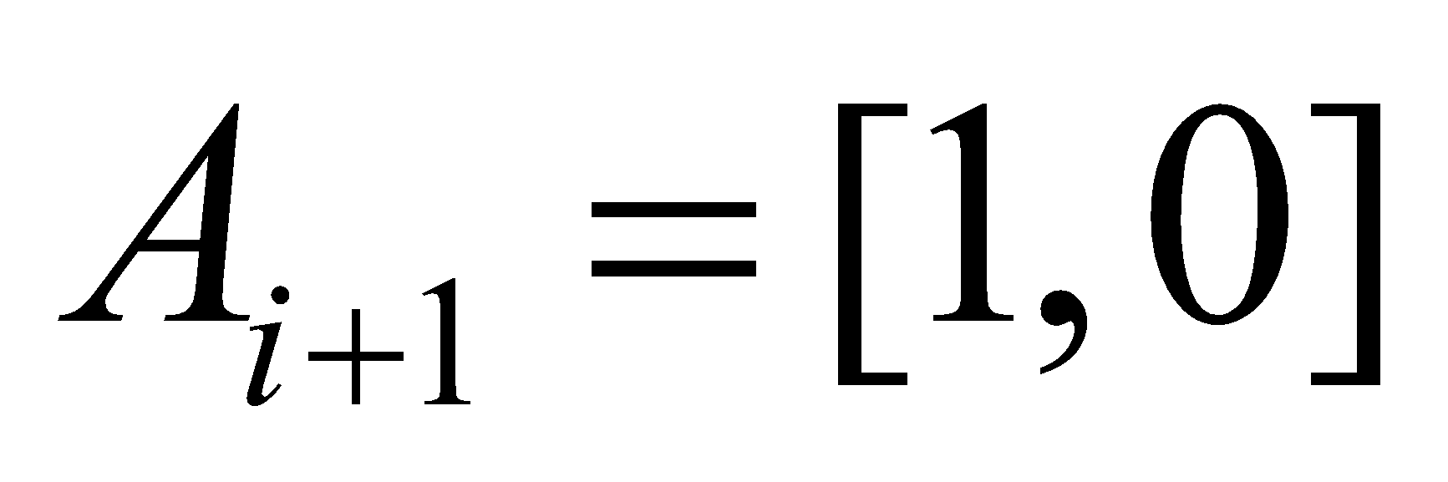
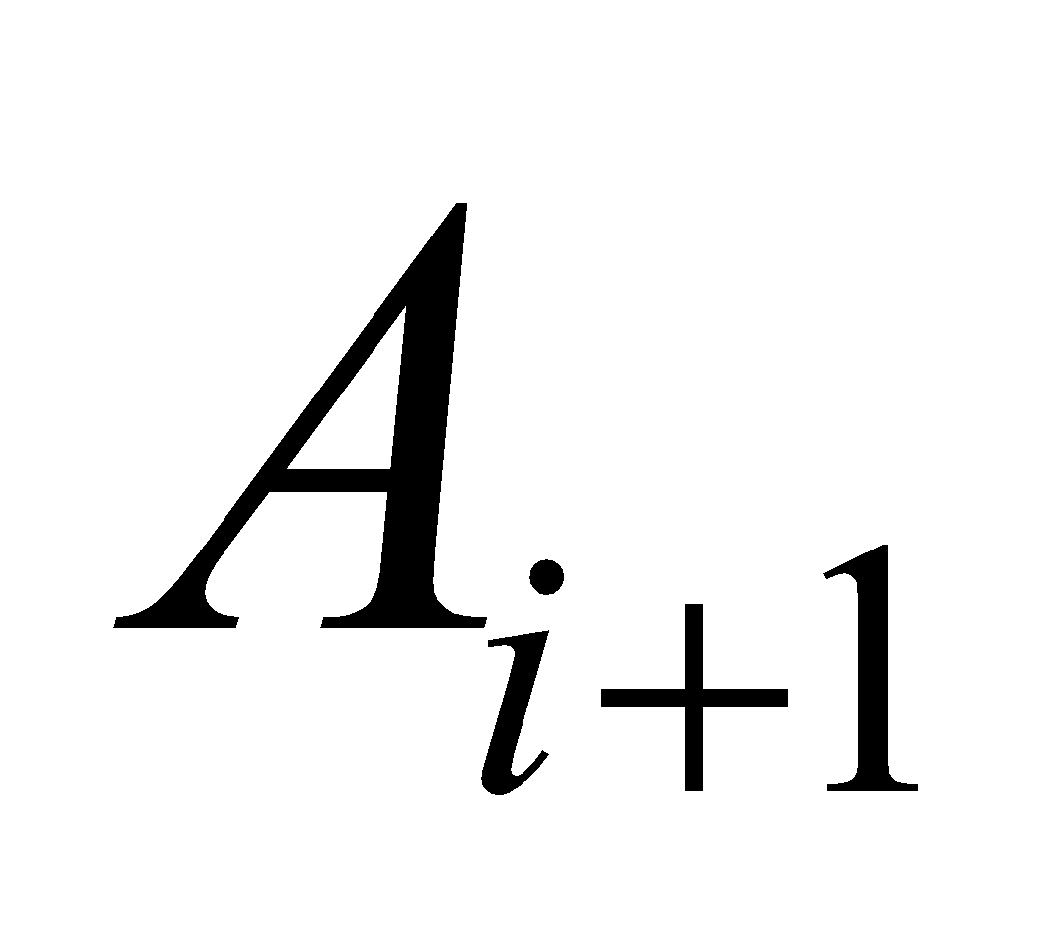
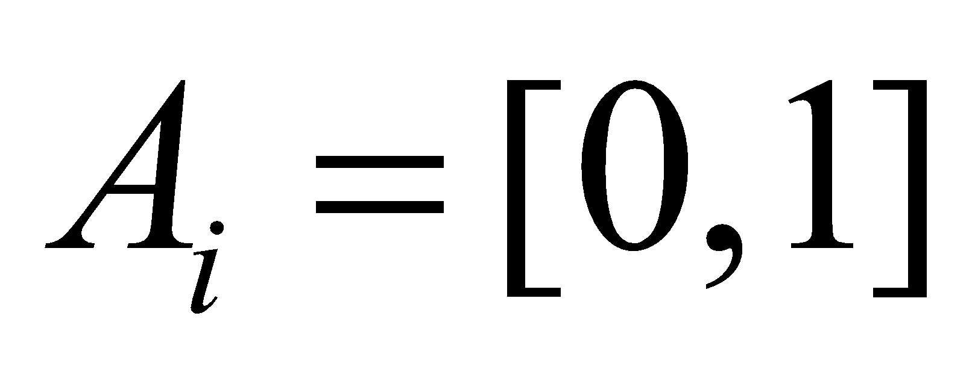
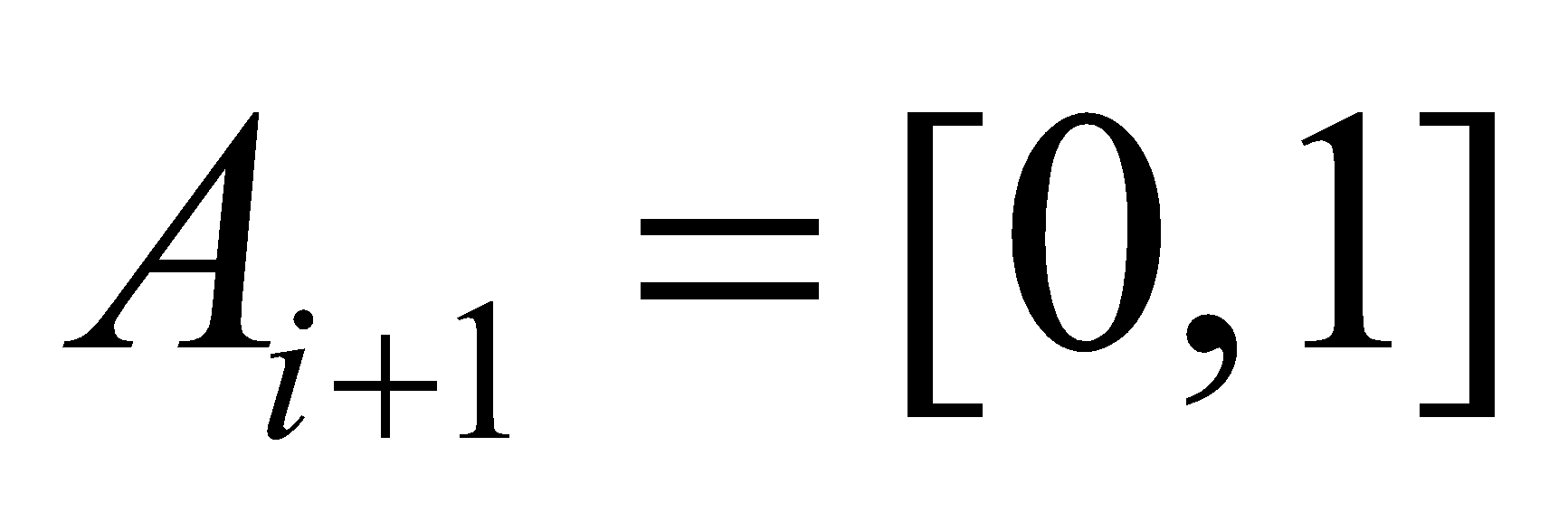
Analyze high performance policy
Test environment by hands
when , , the reward of will be 0
when , , the reward of will be 0
when , , the reward of will be 100
when , , the reward of will be 100
Policy similar to [x,0],[0,x],[x,0],[0,x],[x,0] can get high score

Slide 13
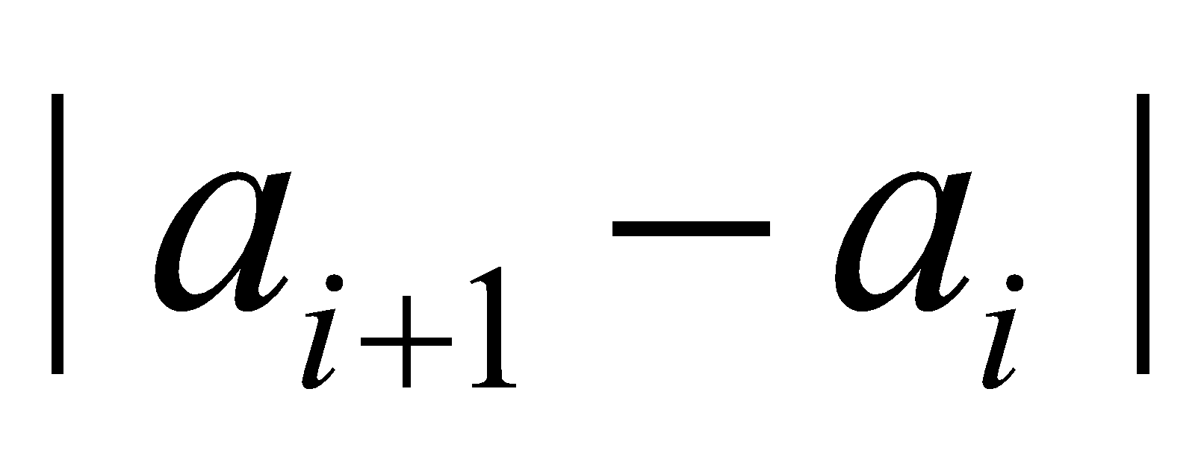
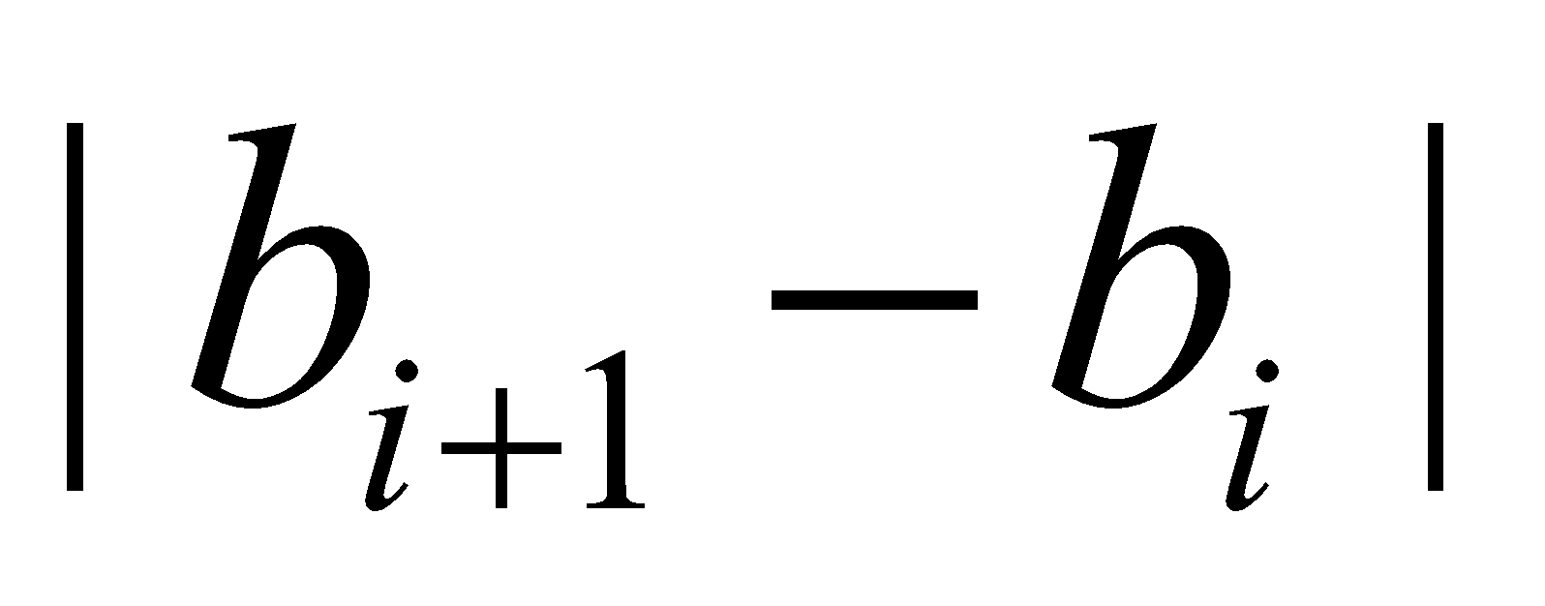
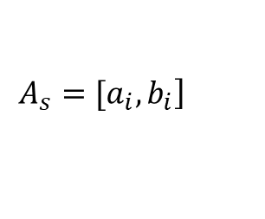
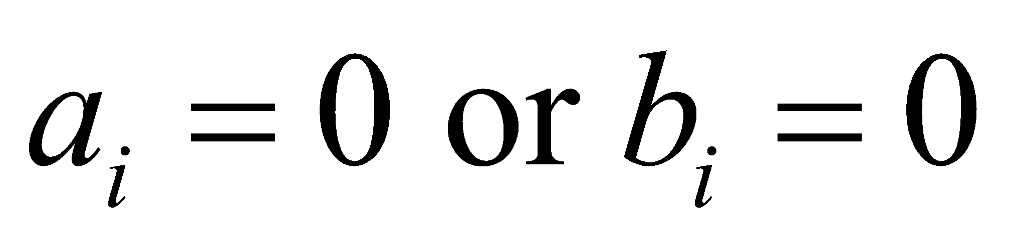
Reduce search space
For Q-learning , We have these ideas:
Set initialization
Check random policy bigger than 0.6, so as
Set more possibility to choose random policy at first epochs
For each , we can set to reduce search space, So the policy can look like [?,0],[0,?],[?,0],[0,?],[?,0]

Slide 14

Reduce search space
For GA , We have these ideas:
Set initialization
For mutate operation, force
For crossover operation, we only change order of
Notes:
it’s hard to combine Q-learning and GA together, so we made a tricky submission which randomly select best policy from Q-learning and GA
<number>

