Slide 1
AI Adoption Guidelines
Hicham Zmarrou, Phd
Jody Boelen

Slide 2
A Typical Journey of AI Adoption

Slide 3

1
Enterprise ChatGPT AI
2
Delivery of more complex solutions
Use Cases:
Writing emails.
Summarizing text.
Transcribing and analyzing conversations.
Solution:
Deploy a secure, enterprise-specific ChatGPT-like bot through Azure OpenAI or Microsoft Copilot .
The bot is dedicated to the organization and hosted within the customer’s tenant (Copilot or Azure OpenAI powered Bot).
Governance:
A central team oversees governance, ensuring security, scalability, reusability, Responsible AI practices, cost management, and chargeback mechanisms.
Departments like IT, HR, and Procurement need Enterprise ChatGPT functionality to interact with their own data.
Data must be converted to vectors and stored in vector databases before use.
Building this capability requires software development skills and technical expertise.
Implementation relies on tools like Copilot Studio, Azure AI Search, and Azure OpenAI.
A central team manages and develops these capabilities for the organization.
Through each implementation, the central team gains valuable experience in data processing, integration patterns, and domain-specific requirements.
End users receive a ready-to-use RAG chatbot for accessing their department's data
4
Evolving role of the central AI team
3
From solution provider to capability enabler
The central team evolves into a Center of Excellence (CoE), expanding beyond platform delivery to strategic leadership.
They actively collect and analyze new use cases across the organization to drive platform capabilities, particularly in emerging areas like AI agents.
The team stays at the forefront of AI innovation by (Evaluating new industry practices, Adopting cutting-edge techniques, Implementing emerging technologies)
Strategic partnerships become crucial as they (Collaborate with Azure Platform teams on infrastructure; Work with CISO to define GenAI security frameworks; Develop comprehensive security approaches)
Knowledge sharing becomes a key focus through (Community building initiatives; Training programs; Educational resources ; Best practice documentation)
This CoE model ensures the organization remains innovative while maintaining governance and security standards
Demand for AI-powered data solutions is growing exponentially across the organization.
The central team cannot scale to deliver individual solutions for every use case request.
Instead of direct delivery, the team shifts to providing reusable capabilities:
RAG-as-a-Service solutions
Complete AI platforms with pre-configured tools
These platforms include all necessary software and infrastructure components.
Product teams in different business lines can now independently build and deploy their own use cases.
This transformation changes the central team's role from solution provider to capability enabler, allowing for better organizational scaling.

Slide 4
1
Initial chatbots/agents
2
Adoption of Copilot Studio
Use Cases:
IT Helpdesk
HR chatbot
Solution:
Copilot Studio, mostly starting with “classic” bots, relatively low amount of GenAI.
Governance:
Depends on the organization’s Power Platform footprint, can range from no governance and working in the default environment to fully governed environments.
Copilot studio is being used for more than just the simple internal use-cases. Customer service/external facing bots are built using classic/scripted topics.
GenAI features are being explored, often starting with internal use-cases. Starting with easy-to-use data sources such as SharePoint or simple file uploads.
Integrations with engagement hubs and other front-ends become more important.
Use-cases are still quite isolated, but the bigger use-cases have a dedicated development team, often consisting of content writers and developers.
Governance for Copilot Studio starts to play a bigger role, especially around the GenAI features.
4
Collaboration with the other teams
3
More complex use-cases
The ownership of products/tools becomes more defined.
Collaboration with the Power Platform CoE for platform specific governance and configuration, such as DLP, development lifecycle and allowing genAI features.
Collaboration with the central AI team for help with more complex use-cases, like custom RAG that will be consumed by Copilot Studio.
Copilot Studio is one of the products considered by the central AI team for new use-cases, with the original Copilot Studio dev team becoming the knowledge owner of the product.
The initial use-cases help the organization to recognize the strengths and weaknesses of Copilot Studio, which often starts the extensibility with Azure conversation, with integrations like CLU, AI Search and Azure OpenAI.
The above requires more AI knowledge and is often provided by a different team than the Copilot Studio team. A more holistic view of the AI capabilities is required to make the proper decision about the services.

Slide 5
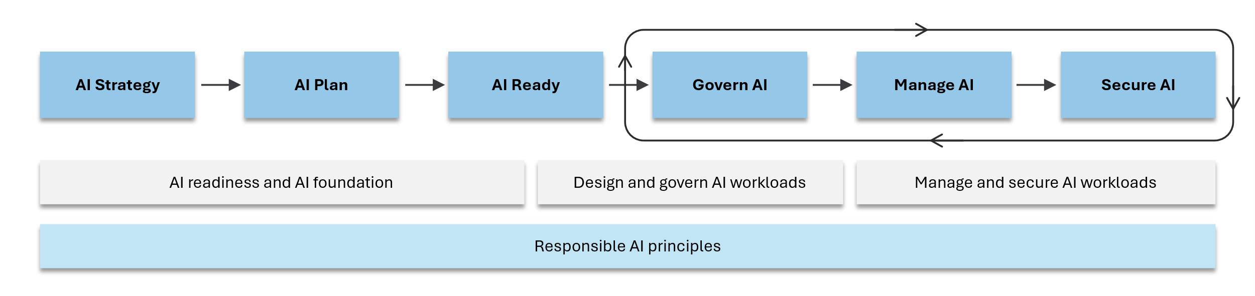
Microsoft Cloud Adoption Framework for AI

Slide 6
Strategic Planning
Technical Implementation
Operational Execution
AI Strategy
AI Ready
Technology selection
AI Plan
Govern AI
Use case identification
Microsoft Cloud Adoption Framework for AI
A Comprehensive Guide to Integrating AI into Organizations
Responsible AI principles
Manage AI
Skills assessment
.
Secure AI
Data strategy
.
.
Manage AI operations

Slide 7
Creating an AI center of excellence
1
Our responsibility to maintain the highest levels of operational excellence, professional integrity and best-in-class quality strengthens our position as a global market.
Identifying AI use cases
2
Identifying use cases is essential for aligning AI efforts with organizational goals, prioritizing impactful solutions, and ensuring measurable success
AI Business Strategy
Enhancing individual efficiency and improving business processes
3
Microsoft's dual AI strategy combines Copilot-driven productivity tools with business process automation to transform workplace efficiency.
Setting AI targets (goals, objectives, and success metrics)
4
Establishing these targets is crucial for driving AI adoption effectively and ensuring that AI projects align with overall business objectives

Slide 8
.
AI Center of Excellence (AI CoE)
Innovation and Research
Foster a culture of continuous AI innovation.
Support research into emerging AI technologies.
Encourage experimentation and prototyping of new AI solutions.
.
Purpose
Guide AI adoption organization-wide.
Align AI projects with strategic business goals.
6
1
Governance, Processes & Metrics
Ensure compliance with AI governance.
Address risks related to privacy, ethics, and security.
Monitor AI implementation for effectiveness.
Key Responsibilities
Discover AI opportunities.
Choose suitable AI solutions.
Track AI project outcomes.
5
AI CoE
2
Activities
Implement AI-driven solutions.
Build organization-wide AI capabilities and skills.
Facilitate knowledge sharing and training.
Focus Areas
Boost individual productivity.
Optimize business operations.
4
3

Slide 9

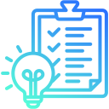



Approaches for identifying AI use cases
Identifying use cases is a critical phase in adopting AI and building capabilities because it ensures alignment between AI initiatives and organizational goals. By focusing on specific challenges and opportunities, organizations can prioritize efforts with the highest impact, optimize resource allocation, and minimize risks. Clear use cases provide a roadmap for implementation and capability building, helping to define objectives, success metrics, and technical requirements. This structured approach not only accelerates adoption but also fosters organizational buy-in, ensuring that AI solutions deliver measurable value and support long-term growth.
Look for automation opportunities
Evaluate Feasibility and Readiness
Focus on repetitive tasks, data-heavy operations, or areas with high error rates
Aim to improve efficiency and reduce operational costs
Assess the technical and organizational readiness for AI implementation.
Ensure access to clean, high-quality data for effective AI solutions.
Evaluate the availability of skilled personnel or partners to develop and maintain AI systems.
Conduct a cost-benefit analysis to prioritize use cases with high ROI potential.
Conduct an organizational assessment
Explore industry-specific use cases
Set AI targets for each identified use case
Gather input from various departments
Identify challenges and inefficiencies that AI could address
Document current workflows to find areas where AI can automate tasks or provide insights
Utilize AI architectures in the Azure Architecture Center for insights
Research how other businesses in your industry are using AI
Stay informed about emerging AI technologies and applications relevant to your sector
Define a goal (general purpose)
Specify an objective (desired outcome)
Establish a success metric (quantifiable measure)

Slide 10
Enhancing individual efficiency
Improving business processes
AI Agents for Workflow Automation: Generative AI drives efficiency by automating complex, unstructured processes.
Streamlining Repetitive Tasks: Nongenerative AI, such as machine learning, is ideal for analyzing structured data and automating repetitive tasks
Custom Solutions with Azure AI: Leverage Azure’s PaaS and IaaS for tailored AI-driven workflows.
Expanding AI Capabilities: Generative AI enables dynamic content creation and advanced decision-making.
Generative AI fosters productivity and enhances customer experiences
Microsoft Copilots (SaaS solutions) are recommended for this purpose
Examples include Microsoft 365 Copilot, role-based Copilots,
and in-product Copilots

Slide 11
Setting AI targets
A general purpose for the AI initiative
Example: Enhance customer support efficiency.
Goal
Setting AI targets is crucial for adoption. For each use case, define a goal (purpose), an objective (desired outcome), and a success metric (performance measure). This approach ensures proper solution selection, quick value realization, and alignment with business objectives, maximizing AI's impact.
The desired outcome of the AI implementation
Example: Reduce average response time for customer inquiries by 50%.
Objective
A quantifiable measure to evaluate the AI's performance
Example: Achieve an average response time of under 1 minute and maintain a 90% customer satisfaction rate within the first six months.
Success metric

Slide 12
Overview of Microsoft AI solutions (SaaS, PaaS, IaaS)
1
Our responsibility to maintain the highest levels of operational excellence, professional integrity and best-in-class quality strengthens our position as a global market.
AI decision tree for selecting appropriate solutions
AI Technology Strategy
2
Identifying use cases is essential for aligning AI efforts with organizational goals, prioritizing impactful solutions, and ensuring measurable success
Factors to consider skills, data readiness, and budget
3
Microsoft's dual AI strategy combines Copilot-driven productivity tools with business process automation to transform workplace efficiency.

Slide 13
Overview of Microsoft AI solutions
SaaS
PaaS
IaaS
Microsoft 365 Copilot for enterprise-wide productivity Role-based Copilots for specific business functions In-product Copilots for Microsoft products Copilot Free/Pro for individual use Copilot Studio for building custom agents | Azure AI Foundry and Azure OpenAI for building RAG applications Azure Machine Learning or Microsoft Fabric for training ML models Azure AI services for consuming analytical AI models | Azure (GPU) Virtual Machines Azure Kubernetes Service for organizations needing more control and customization

Slide 14
Buy AI software services (SaaS)
Microsoft Copilots | Description | User | Data needed | Skills required | Main cost factors
Microsoft 365 Copilot | Use Microsoft 365 Copilot for an enterprise-wide solution that automates work in Microsoft 365 apps and provides an enhanced-security way to chat with business data in Microsoft Graph. | Business | Yes | General IT and data management | License
Role-based Copilots | Use Microsoft Copilot for Security and role-based agents for Microsoft 365, such as Microsoft 365 Copilot for Sales , Microsoft 365 Copilot for Service , and Microsoft 365 Copilot for Finance , to enhance productivity for specific business roles. Role-based agents include Microsoft 365 Copilot for Sales, Microsoft 365 Copilot for Service, and Microsoft 365 Copilot for Finance. | Business | Yes | General IT and data management | Licenses or Security Compute Units (Copilot for Security
In-product Copilots | Use Copilots to enhance productivity within Microsoft products. Products with in-product Copilots include GitHub, Power Apps, Power BI, Dynamics 365, Power Automate, and Azure. | Business and individual | Yes | None | Free or subscription
Copilot Free or Pro | Use the free version for browser-based access to Azure OpenAI models. Use Copilot Pro for better performance and more capacity. | Individual | No | None | None for Copilot Free or subscription for Copilot Pro
Extensibility tools for Microsoft 365 Copilot | Customize (extend) Microsoft 365 Copilot with more data (knowledge) via Microsoft Graph connectors or capabilities (skills) via declarative agents. To build declarative agents, use extensibility tools such as Copilot Studio (SaaS development), agent builder, Teams toolkit in VS Code (pro-code option), and Sharepoint. |  |  | Data management, general IT, or developer skills | Microsoft 365 Copilot license
Copilot Studio | Use Copilot Studio to build test and deploy agents in a SaaS authoring environment. | Developer | Yes | Using a platform to connect data sources, mapping out prompts, and deploying copilots to various locations | License

Slide 15
Build AI workloads with Azure AI platforms (PaaS)
AI goal | Microsoft solution | Data needed | Skills require | Main cost factors
Build RAG and AI agents applications with a code-first platform | Azure AI Foundry or Azure OpenAI | Yes | Selecting models, orchestrating dataflow, chunking data, enriching chunks, choosing indexing, understanding query types (full-text, vector, hybrid), understanding filters and facets, performing reranking, engineering prompt flow, deploying endpoints, and consuming endpoints in apps | Compute, number of tokens in and out, AI services consumed, storage, and data transfer
Fine-tune generative AI models | Azure AI Foundry | Yes | Preprocessing data, splitting data into training and validation data, validating models, configuring other parameters, improving models, deploying models, and consuming endpoints in apps | Compute, number of tokens in and out, AI services consumed, storage, and data transfer
Train and inference machine learning models by using your own data | Azure Machine Learning or Microsoft Fabric | Yes | Preprocessing data, training models by using code or automation, improving models, deploying machine learning models, and consuming endpoints in apps | Compute, storage, and data transfer
Consume nongenerative AI models in applicationsns | Azure AI services | Yes | Picking the right AI model, securing endpoints, consuming endpoints in apps, and fine-tuning as needed | Use of model endpoints consumed, storage, data transfer, compute (if you train custom models)

Slide 16
Bring your own models with infrastructure services (IaaS)
AI goal | Microsoft solution | Data needed | Skills require | Main cost factors
Train and inference your own AI models. Bring your own models to Azure. | Azure Virtual Machines or Azure Kubernetes Service | Yes | Infrastructure management, IT, program installation, model training, model benchmarking, orchestration, deploying endpoints, securing endpoints, and consuming endpoints in apps | Compute, compute node orchestrator, managed disks (optional), storage services, Azure Bastion, and other Azure services used

Slide 17
Overview of Microsoft AI solutions (SaaS, PaaS, IaaS)
1
Our responsibility to maintain the highest levels of operational excellence, professional integrity and best-in-class quality strengthens our position as a global market.
AI decision tree for selecting appropriate solutions
AI Technology Strategy
2
Identifying use cases is essential for aligning AI efforts with organizational goals, prioritizing impactful solutions, and ensuring measurable success
Factors to consider skills data readiness, and budget
3
Microsoft's dual AI strategy combines Copilot-driven productivity tools with business process automation to transform workplace efficiency.

Slide 18
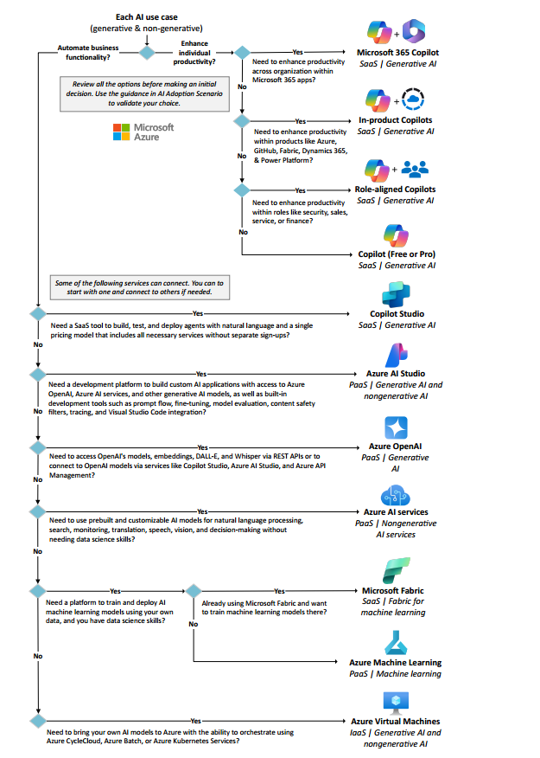

Slide 19
Overview of Microsoft AI solutions (SaaS, PaaS, IaaS)
1
Our responsibility to maintain the highest levels of operational excellence, professional integrity and best-in-class quality strengthens our position as a global market.
AI decision tree for selecting appropriate solutions
AI Technology Strategy
2
Identifying use cases is essential for aligning AI efforts with organizational goals, prioritizing impactful solutions, and ensuring measurable success
Factors to consider skills, data readiness, and budget
3
Microsoft's dual AI strategy combines Copilot-driven productivity tools with business process automation to transform workplace efficiency.

Slide 20
Factors to consider
Skills
Data readiness
Budget
SaaS: Requires minimal technical skills; suitable for organizations with limited AI expertise. PaaS: Demands varying levels of technical proficiency, from beginner to advanced. IaaS: Necessitates advanced skills in both infrastructure management and AI development. | SaaS: Often uses existing enterprise data or requires minimal data preparation. Data labelling required for M365 copilot. PaaS: Typically needs more extensive data preparation and management. IaaS: Offers the most flexibility but requires a comprehensive data strategy. | SaaS: Lower upfront costs but includes ongoing subscription fees. PaaS: Usage-based pricing that varies based on consumption. IaaS: Higher initial costs due to infrastructure setup but can provide better cost control for specific needs.

Slide 21
Example AI strategy Exercise
AI use case | Goals | Objectives | Success metric | AI approach | Microsoft solution | Data needs | Skill needs | Cost factors | AI data strategy | Responsible AI strategy
Internal app document-processing workflow | Automate business process | Reduce costs | Increased completion rate | Analytical AI, RAG | Azure AI services - Document Intelligence | Standard documents | RAG and cloud app development | Estimated usage | Define data governance for internal documents and plan data lifecycle policies. | Assign AI accountability and ensure compliance with data handling policies.
Inventory management and product purchasing | Automate business process | Reduce costs | Shorter shelf life of inventory | Machine Learning, Train own models | Azure Machine Learning | Historical inventory and sales data | Machine learning and app development | Estimated usage | Establish governance for sales data and detect and address biases in data. | Assign AI accountability and comply with financial regulations.
AI-powered incident response | Automate business process | Reduce costs | Minimizes costs associated with delays, Better resource utilization | RAG, Chatbot | Azure AI services – Azure AI Studio | Descriptions of past incidents or failures. Resolutions and corrective actions taken. | AI engineering, Apps development | Estimated usage | Define data governance for incident data

Slide 22
1
Establish data governance:
Data Strategy
2
Plan the data lifecycle
3
Data as Agents memory

Slide 23
Assess AI skills and maturity
1
Evaluate current capabilities and identify gaps.
Prioritize use cases
2
Focus on high-value, feasible AI projects.
AI Plan
Integrate AI into operations while aligning with business goals
3
Create proof of concept (PoC)
Test AI use cases on a smaller scale.
4
Implement Responsible AI
Ensure ethical, secure, and compliant AI practices.
5
Estimate delivery timelines
Ensure ethical, secure, and compliant AI practices.

Slide 24
Skill Acquisition:
Upskill Existing Talent:
Provide training programs (e.g., Azure AI Fundamentals, Azure AI Engineer Associate).
Encourage continuous learning through workshops and certifications.
Recruit AI Professionals:
Hire experts in model development, generative AI, or AI ethics.
Collaborate with educational institutions to access fresh talent.
Partner with Experts:
Leverage Microsoft partners for AI, data, and Azure expertise.
Use the Microsoft Partners Marketplace to address skill shortages.
Goal:
Ensure the organization has the necessary skills to adopt and scale AI.
Build a skilled AI team capable of handling diverse AI projects.
Assess AI skills and maturity
Level 01
Level 02
Level 03
Level 04
Basic AI understanding, minimal data
Experience with AI model selection and deployment, small datasets.
Proficiency in prompt engineering, data preprocessing, and grounding data for indexing.
Advanced AI/machine learning expertise, including infrastructure management and complex workflows
Skills: AI model selection, deployment, and basic data preprocessing.
Use Cases: Custom analytical AI workloads, generative AI chat apps.
Skills: Advanced data chunking, query processing, Apps development, and model fine-tuning.
Use Cases: Generative AI apps with RAG, Agentic workflows training machine learning models.
Skills: Basic AI concepts, integrating data sources, mapping prompts.
Use Cases: Azure quick starts, Copilot Studio apps.
Skills: Infrastructure management, orchestration, Apps development and performance optimization.
Use Cases: Large-scale generative AI apps, Agentic AI, custom machine learning workflows.

Slide 25

Prioritize use cases
Opportunity and solution space templates
Problem space
Solution Space
Need for AI
Use case card
1. Which is the issue you want to solve with Generative AI?
Which AI capabilities could be used to solve the issue?
The current incident response process is time-consuming and heavily reliant on manual intervention. The operations team spends significant hours troubleshooting and resolving cloud incidents, leading to delays and operational inefficiencies.
Retrieval-Augmented Generation (RAG): To query a database of historical incidents, troubleshooting guides, and engineering documents.
LLM: To understand and generate human-like responses for incident reports.
Root Cause Analysis Models: To analyse retrieved data and generate comprehensive root cause reports.
2. Which product/process is affected by the use case?
2. What is the desired output of the AI solution?
Process: Incident response and resolution process.
Capability: Cloud operations and incident management within the IT infrastructure.
The AI solution should provide accurate and actionable root cause analysis reports for cloud incidents, enabling the operations team to resolve issues more efficiently.
3. Use story How does the use interact with the AI solution
3. What data is needed to let an AI to achieve this?
The Generative AI solution will automate the identification of root causes and provide actionable insights to the operations team, reducing the time and effort required to resolve incidents.
Historical incident data, troubleshooting guides, engineering documents, and logs from Azure Monitor.
Annotated datasets for training the root cause analysis model.
Access to real-time cloud service metrics and logs for ongoing incident management.

Slide 26
Prioritize use cases
AI use case Canvas
Team/Department: Cloud PlatformTeam____ Use case owner : John Smit
Description of use case including AI capability
Solution Play
The aim of this use case is to automate and enhance the incident response capabilities and processes, part of the IT operations framework. Incident response is a critical component of the organization's operational resilience, aligned with the broader objective of improving cloud service reliability and efficiency. This use case directly contributes to the IT Modernization and Automation theme of the organization's business strategy.
SaaS
UC Description
UC Description
PaaS
IaaS
How does the use case play into the data/business strategy
What is the estimated business value (e.g saving, additional revenue)? Please state your assumption
What is the estimated cost of running this Advanced Analytics solution during its lifecycle
This use case leverages Generative AI to automate cloud incident management. By analyzing historical data and real-time metrics, the AI identifies root causes and provides actionable recommendations, reducing resolution time from hours to minutes. This enhances operational efficiency, minimizes downtime, and allows the team to focus on strategic tasks, ensuring reliable and secure cloud services.
The estimated cost of resolving a cloud incident manually is approximately 20 euros per incident, including operational hours and potential downtime costs. Automating the resolution of 50,000 incidents annually is expected to save the organization 5 million euros over the next 5 years, factoring in reduced resolution time, minimized downtime, and improved operational efficiency.
Value
Please use the AI Value Realization tool to estimate the cost of the AI solution
Value
For the following statements please insert a value between 5 (fully agree) and 0 (not agree at all). If you can’t judge the statement, please count 0 point
Data/Infrastructure
Score
Solution/Method
Score
Processes/systems
Score
Know-how
Score
1. We have access to the right technology
1. We know tech resources guide us towards a solution for this problem
4
1. No/few processes need to be changed
5
1. Required technology know-how is available
1
5
2. We have access the required data
2. A similar problem has been already solved by other teams/companies via AI
2. No/few systems have to be adjusted
2. Required domain know-how is available
5
4
5
3
Ease of implementation
3. We have production data pipeline place
3
3. The ease implementation score related to the solution play (SaaS vs PaaS vs IaaS)
4
3. No/few organizational changes have be made
5
3. Required trainings can be executed within a reasonable time
3
13
12
15
7
Data Technology Score
Solution score
Processes/systems score
Know-how score
How long does the development of the use case take until verified PoC?
Overall score Ease of implementation
Max (65)
50
< 02 months
+5 points
02 - 03 months
+03 points
> 03 months
0 points

Slide 27
1
What is an AI PoC?
2
Select the Right Opportunity
Choose high-value projects matching AI maturity
Focus on internal projects first
Minimize customer-facing risk
Establish testing foundation
Conduct A/B testing
Gather baseline data
Validates feasibility of AI use cases
Tests potential value at smaller scale
Reduces implementation risk
Provides real-world insights
Enables iterative refinement
Getting Started with Azure
3
4
Getting Started with Azure
Utilize Azure quick start guides (1, 2, 3, 4, 5, 6, 7 , 8)
Follow step-by-step deployment instructions
Create basic AI applications
Learn platform capabilities
Practice deployment and cleanup
Build organizational familiarity
Start small, think big
Learn from internal deployments
Use structured testing
Leverage Azure resources
Iterate based on results

Slide 28
Implementing Responsible AI
Define your Responsible AI Principles
Core Implementation Processes
Microsoft's Planning Tools
Regulatory compliance Alignment with organizational values Integration of ethical frameworks Protection of user rights | Governance (Policy creation, Risk identification, Compliance documentation, Ethical standards setting) Management (MLOps/GenAIOps), Deployment oversight, Continuous monitoring, Cost optimization, Model production management Security: Regular assessments, System protection, Confidentiality, Integrity, Availability; Threat mitigation: Adversarial attacks; Data breaches | AI Impact Assessment Template Human-AI eXperience Toolkit Responsible AI Maturity Model Workload Team Guidelines

Slide 29
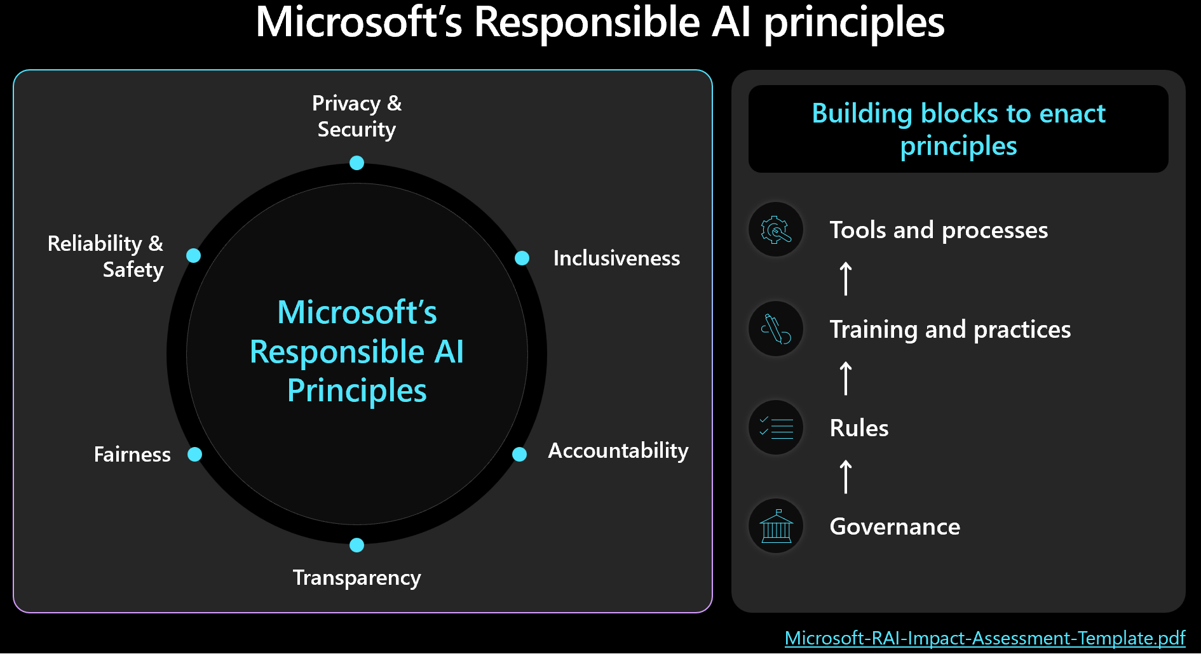
Microsoft's Responsible AI framework

Slide 30
Building an AI environment
1
Evaluate current capabilities and identify gaps.
Choosing an appropriate architecture
2
Focus on high-value, feasible AI projects.
AI Readiness
Architecting scalable AI infrastructure for Enterprise success
3
Utilizing AI design areas
Test AI use cases on a smaller scale.
4
Establishing AI reliability
Ensure ethical, secure, and compliant AI practices.
5
Implementing AI governance
Ensure ethical, secure, and compliant AI practices.

Slide 31
1
AI Reliability
2
AI Governance
Separation of internet-facing and internal workloads
Policy application to management groups
Deployment in workload subscriptions
Multi-region hosting for redundancy
Service availability confirmation
Quota and capacity evaluation
Performance optimization
Business continuity planning
Networking
3
4
AI Foundation
DDoS Protection for internet-facing workloads
On-premises connectivity (Azure ExpressRoute or VPN Gateway)
DNS resolution services
Network access controls and monitoring
Azure Firewall and Web Application Firewall implementation
Azure landing zone utilization
Resource hierarchy segmentation
Jumpbox for AI development management
AI Gateway (Azure API management)

Slide 32
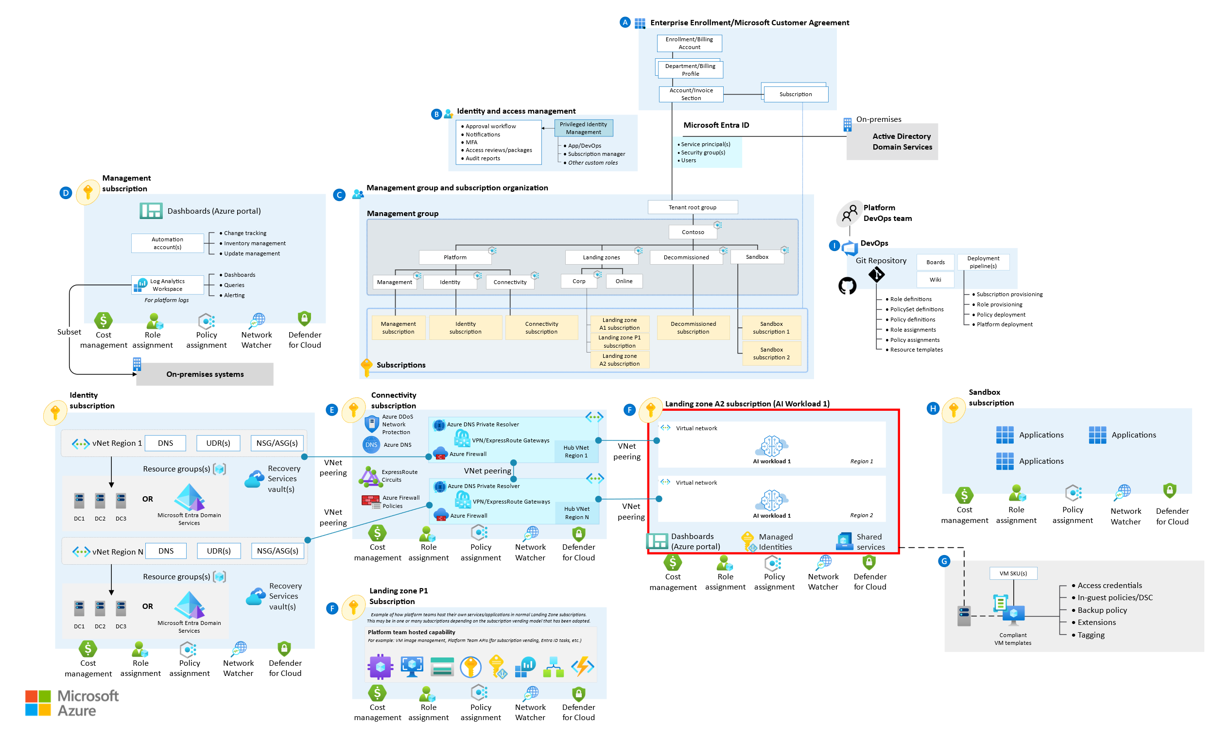
Establish an AI foundation: Azure AI Landing Zone

Slide 33
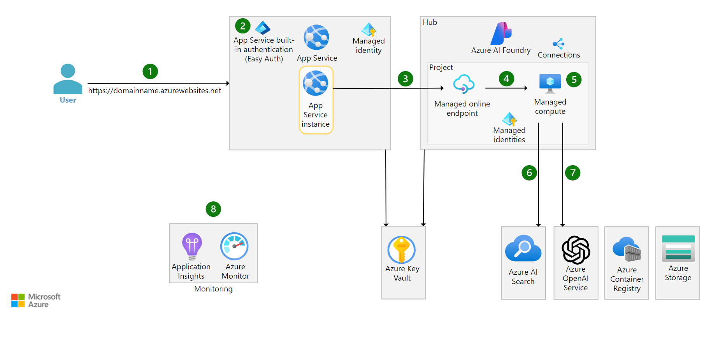
Baseline/sample Architecture for RAG with Azure AI services

Slide 34
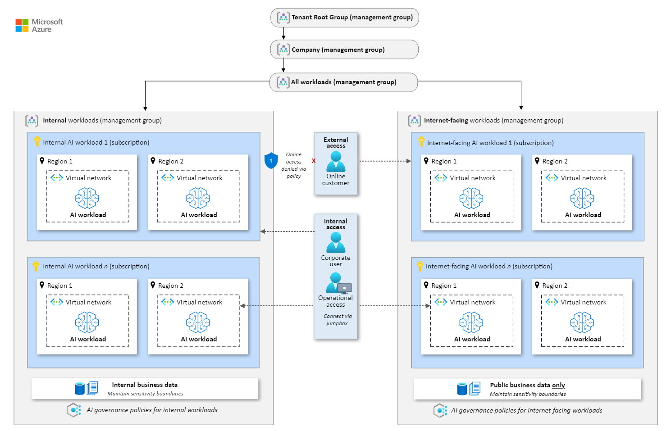
Build an AI environment

Slide 35
Assess AI organizational risks
1
Evaluate current capabilities and identify gaps.
Document AI governance policies
2
Focus on high-value, feasible AI projects.
Govern AI
3
Enforce AI governance policies
Test AI use cases on a smaller scale.
4
Monitor AI organizational risks
Ensure ethical, secure, and compliant AI practices.

Slide 36
1
Assess AI Organizational Risks
2
Document AI Governance Policies
Selecting and onboarding models
Using third-party tools and data
Maintaining and monitoring models
Regulatory compliance
User conduct
AI integration and replacement
Understand AI workloads
Use Responsible AI principles to identify risks
Identify AI risks and external dependencies
Assess integration risks
Enforce AI Governance Policies
Monitor AI Organizational Risks
3
Automate policy enforcement where possible
Manually enforce AI policies
Use workload-specific governance guidance
4
Establish procedures for ongoing risk evaluation
Develop a measurement plan
Quantify and qualify AI risks
Document and report measurement outcomes
Establish independent review processes

Slide 37
Responsible AI principles
Responsible AI Principle | Definition | Risk Assessment Question
AI Privacy and Security | AI workloads should respect privacy and be secure. | How might AI workloads handle sensitive data or become vulnerable to security breaches?
Reliability and Safety | AI workloads should perform safely and reliably. | In what situations could AI workloads fail to operate safely or produce unreliable outcomes?
Fairness | AI workloads should treat people equitably. | How could AI workloads lead to unequal treatment or unintended bias in decision-making?
Inclusiveness | AI workloads should be inclusive and empowering. | How might certain groups be excluded or disadvantaged in the design or deployment of AI workloads?
Transparency | AI workloads should be understandable. | What aspects of AI decision-making could be difficult for users to understand or explain?
Accountability | People should be accountable for AI workloads. | Where could accountability be unclear or difficult to establish in the development or use of AI?

Slide 38
Examples of Document AI governance policies
AI governance policy area | AI governance policy recommendations
Define policies for selecting and onboarding models | Establish policies for selecting AI models. Policies should outline criteria for choosing models that meet organizational values, capabilities, and cost constraints. Review potential models for alignment with risk tolerance and intended task requirements. Onboard new models with structured policies. A formal process for model onboarding maintains consistency in model justification, validation, and approval. Use sandbox environments for initial experiments, then validate and review models in the production catalog to avoid duplication.
Define policies for using third-party tools and data | Set controls for third-party tools. A vetting process for third-party tools safeguards against security, compliance, and alignment risks. Policies should include guidelines for data privacy, security, and ethical standards when using external datasets. Define data sensitivity standards. Keeping sensitive and public data separate is essential for mitigating AI risks. Create policies around data handling and separation. Define data quality standards. A "golden dataset" provides a reliable benchmark for AI model testing and evaluation. Establish clear policies for data consistency and quality to ensure high performance and trustworthy outputs.

Slide 39
Example AI risk mitigations
Risk ID | AI Risk | Mitigation | Policy
R001 | Noncompliance with data protection laws | Use Microsoft Purview Compliance Manager to evaluate data compliance. | The Security Development Lifecycle must be implemented to ensure that all AI development and deployment complies with data protection laws.
R002 | Unexpected costs | Use Microsoft Cost Management to track CPU, GPU, memory, and storage usage to ensure efficient resource utilization and prevent cost spikes. | Monitoring and optimization of resource usage and automated detection of cost overruns must be used to manage unexpected costs.

Slide 40
1
Managing AI Operations
Evaluate current capabilities and identify gaps.
AI Deployment Management
2
Focus on high-value, feasible AI projects.
3
AI Endpoint Sharing
Test AI use cases on a smaller scale.
Manage AI
4
AI Model Management
Ensure ethical, secure, and compliant AI practices.
AI Cost Management
5
Focus on high-value, feasible AI projects.
6
AI Data Management

Slide 41
1
Managing AI Operations
2
AI Deployment Management
Adopt AI operational frameworks (MLOps, GenAIOps)
Standardize AI development tools
Use sandbox environments for experimentation
Establish CI/CD pipelines for deployment
Workload-team management for faster development
Shared management for increased governance
AI Center of Excellence to lead approach decisions
AI Endpoint Sharing
AI Model Management
3
Share endpoints only within a single workload
Avoid sharing when governance and model needs vary
Consider rate limits and quota limitations
4
Establish governance structure (AI CoE)
Define AI measurement baseline
Implement continuous monitoring
Retrain models as needed

Slide 42
5
AI Cost Management
6
AI Data Management
Follow service-specific best practices
Monitor and maximize billing efficiency
Set up automated cost alerts
Use Azure APIM for granular chargeback
Ensure data pipeline integrity
Manage data sensitivity changes
Ensure vector stores and data store consistency
AI Business Continuity
7
Multi-region deployments
Test and validate DR plans
Version control changes to AI sytems

Slide 43
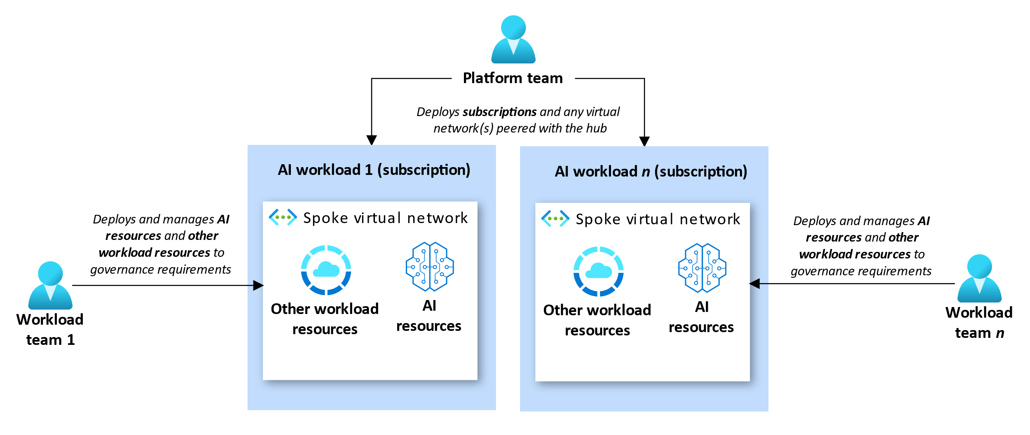
Manage AI deployment: Workload-team management of AI resources

Slide 44
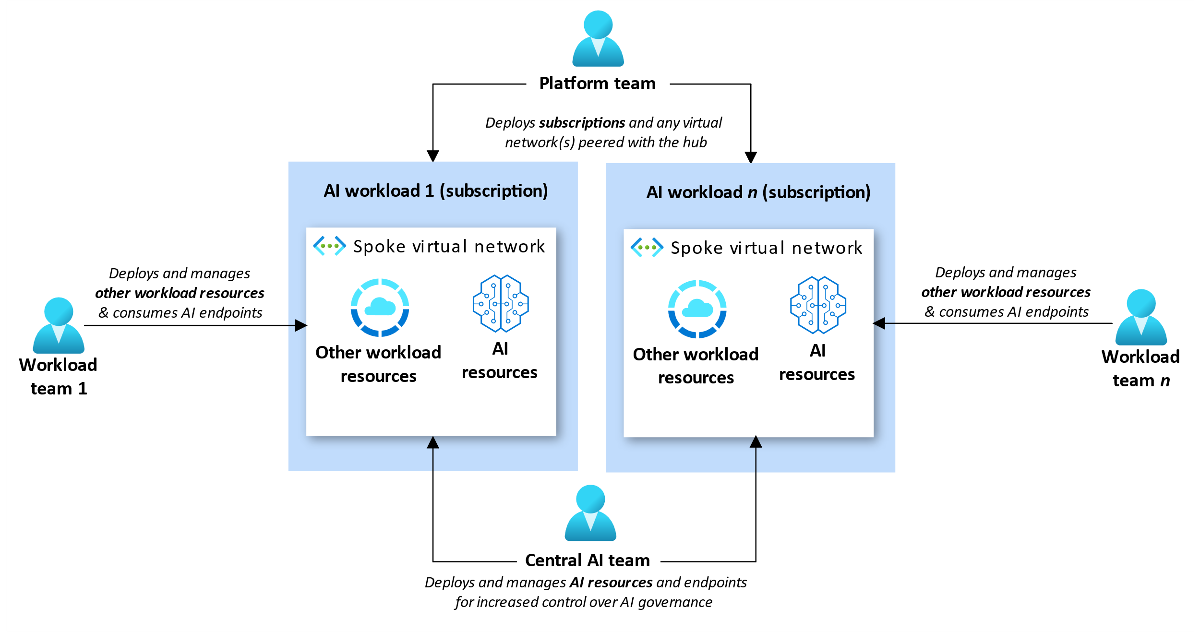
Manage AI deployment: Workload-team management of AI resources

Slide 45
1
Assess AI security risks
Secure AI
2
Implement AI security controls
3
Maintain AI security controls

Slide 46
1
Assess AI security risks
2
Implement AI security controls
Identify common AI security risks
Consider monitoring with Defender for Cloud
Identify data risks
Threat modeling and testing of (gen)AI models
Centralized AI asset inventory
Secure AI platforms
Ensure vector stores and data store consistency
Maintain AI security controls
3
Provide trainings to employees
Recurring/periodic risk assessments
Incident response plans

Slide 47
Q &A

