Slide 1
SBqM™
Prepared by:
Marina Radi
Mohamed El-Hosary
Hazem Morad

Slide 2
1. I/O Table :
Name | Type | Size (n of bit(s)) | Description
clk | In | 1 | Clock
reset | In | 1 | Reset
q_in | In | 1 | Photo Cell 1
q_out | In | 1 | Photo Cell 2
teller_1 | In | 1 | First Teller
teller_2 | In | 1 | Second Teller
teller_3 | In | 1 | Third Teller
empty_fg | Out | 1 | Empty Flag
full_fg | Out | 1 | Full Flag
seven_segment_1 | Out | 7 | Seven Seg. To display number of customers
seven_segment_2 | Out | 7 | Seven Seg. To display the first digit of W(time)
seven_segment_3 | Out | 7 | Seven Seg. To display the second digit of W(time)

Slide 3
2. SBqM™ icon:
clk
SBqM™ icon
reset
empty_flag
full_flag
q_in
q_out
seven_segment_1
teller_1
teller_2
seven_segment_2
teller_3
seven_segment_3

Slide 4
3. Full Architecture :
clk
reset
Edge-det
FSM
Counter
P_count
Sensor 1
state
F
Edge-det.
enable
E
Sensor 2
Empty Flag
Full Flag
BCDin
Sev_seg_1
ROM_out converter
ROM
BCDin
Wtime
Sev_seg_2
BCDin
Sev_seg_3
t1
t2
t3

Slide 5
4. Finite State Machine (FSM) :
empty_flag=0
full_flag=0
q_in=1
q_out=0
empty_flag=0
full_flag=0
q_in=0
q_out=1
Count_state=1
Count_enable=1
Count_state=0
Count_enable=1
Available
empty_flag=0
full_flag=0
q_in=1
q_out=0
empty_flag=0
full_flag=1
q_in=1
q_out=0
Count_state=1
Count_enable=1
Count_state=1
Count_enable=1
empty_flag=0
full_flag=1
q_in=0
q_out=1
empty_flag=1
full_flag=0
q_in=0
q_out=1
Count_state=0
Count_enable=1
Count_state=0
Count_enable=1
Empty
Full
state | Description
Empty | queue is empty
Available | queue neither full nor empty
Full | queue is full
empty_flag=1
full_flag=0
q_in=0
q_out=0
empty_flag=0
full_flag=1
q_in=1
q_out=0
Count_state=0
Count_enable=0
Count_state=1
Count_enable=0

Slide 6
5. Counter :
clk
Counter
reset
up_down
Pcount
enable
full_flag
empty_flag
The counter start at 0 and it will increment or decrement based on “up_down” and “enable” signals. Pcount represents the number
of customer(s) in the queue. Full_flag represents if the queue is full or not. Empty_flag represents if the queue is empty or not.
Note: - The size of inputs and outputs are 1-bit except Pcount is 3-bits
- The maximum number of customers in the queue is “7” and at this case the full_flag will be equal “1”
- Empty_flag will be equal 1 only when Pcount=000
- Counter’s Range is from “0” (000) to “7” (111)
- reset will set the counter to “0” (000)

Slide 7
6. ROM :
clk
ROM
Pcount
Wtime
teller_1
teller_2
teller_3
ROM converts the three signals of teller_1, teller_2 and teller_3 to a representation of 2 bits. Those 2 bits represent the number of tellers
in the system. Then it will concatenate between tellers_num (2 bits) and Pcount (3 bits) to get the address of the location in “rom.txt”
that has the Wtime.
Note: - Wtime represents the waiting time in binary and it a size of 8-bits

Slide 8
7. ROM_out Converter :
ROM_out converter
Wtime
output
- This converter used to convert the Wtime to a suitable representation that can be valid to be inputs for two BCDin.
- Wtime has size of 8-bits
- Output has size of 8-bits

Slide 9
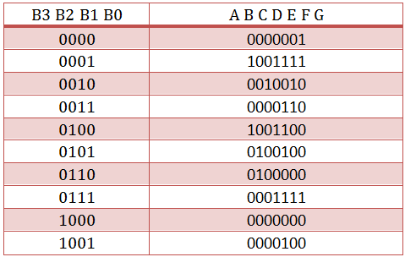
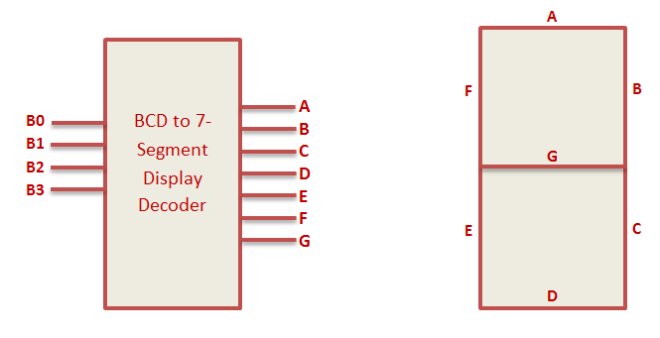
8. Seven Segment Decoder :
input
BCDin
output

Slide 10
9. SBqM™ test_bench:
clk
SBqM™ test_bench
reset
empty_flag
full_flag
q_in
q_out
seven_segment_1
teller_1
teller_2
seven_segment_2
teller_3
seven_segment_3
This architecture has been passed through several test cases which had been set by the
design team. The test shows that the two flags correctly reflect the status of the queue.
And that the counter does not wrap around. So, it does not display ‘0’ when it gets
an increment signal while the queue is full or ‘7’ when it gets a decrement signal
while the queue is empty.

Slide 11
Thank you

