Slide 1

Energy Usage: Anomaly Detection Dashboard
Presentation For
By Zane Motiwala
Feb 2024

Slide 2
I chose this project because it showcases a variety of skills including my ability to lead projects from end to end
Aligned with role
I worked closely with engineering and development team and helped ensure there data pipelines and models are accurate
This was a crucial time for the energy startup and was a direct request from the CEO and COO to ensure data quality
It required a broad array of skills: data engineering, analytics, statistics, modeling and visualizations
High Visibility Project
Showcases broad skillset

Slide 3
It was crucial for the company to ensure data accuracy to avoid government fines and to retain commercial clients
Situation
Conflict
Resolution
Company needed to ensure energy usage submitted to gov’t is accurate to avoid fines
Needed a clear way to visual data and
Also wanted to monitor their forecasting models
Current process was manual in MS Excel
Errors had gone unnoticed in the past
Clients were questioning data controls
Engineered new data pipeline and process to output a monitoring dashboard
Included anomaly detection with automated alerts
Accounted for seasonality and weather changes

Slide 4






The data and applications were quite new so I created a workflow for the DS&A team using AWS Suite
Input Data
Data Cleaning
Output Data
QuickSight dashboard and Jira tickets
Initial data validation and post script testing with logs written into python script
Data ingested into JupyterHub using SQL from S3

Slide 5
After exploring the data in depth I found strong correlation between energy usage with temperature + seasonality
Data Cleaning
Joined data, formatted dates, checked for null values, duplicates and numeric ranges
Feature Engineering
Added several features based on weather, seasonality, and comparisons with other metrics over time
Visualizations
Modeling
Created time series charts, scatter plots, and correlation heatmaps to views trends and relationships
Used linear regression and tree models to find that Temperature and Day of Week were important features

Slide 6



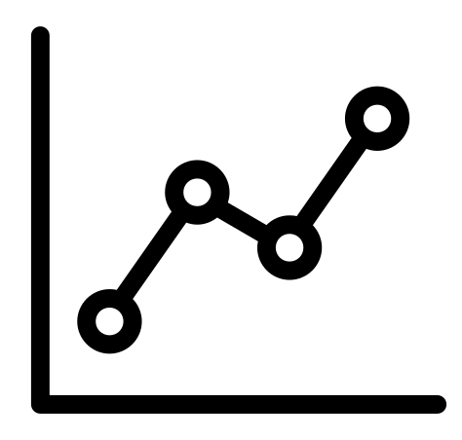


I used the findings from data exploration to iteratively build the anomaly detection process using statistical significance
Feature Selection
Validate and collect feedback
Energy KwH % Deltas
Temperature
Seasonality
Anomaly Detection Process Iteration
Calculate 1 Year of
Historical Stats
Save alert information and logs
Mean
Std Deviation
Generate Jira Tickets
Set Statistical
Significance Thresholds
Test Daily Process
Backtest
Simulate examples
Calculate p-value
Determine confidence interval
w/ upper and lower bounds

Slide 7
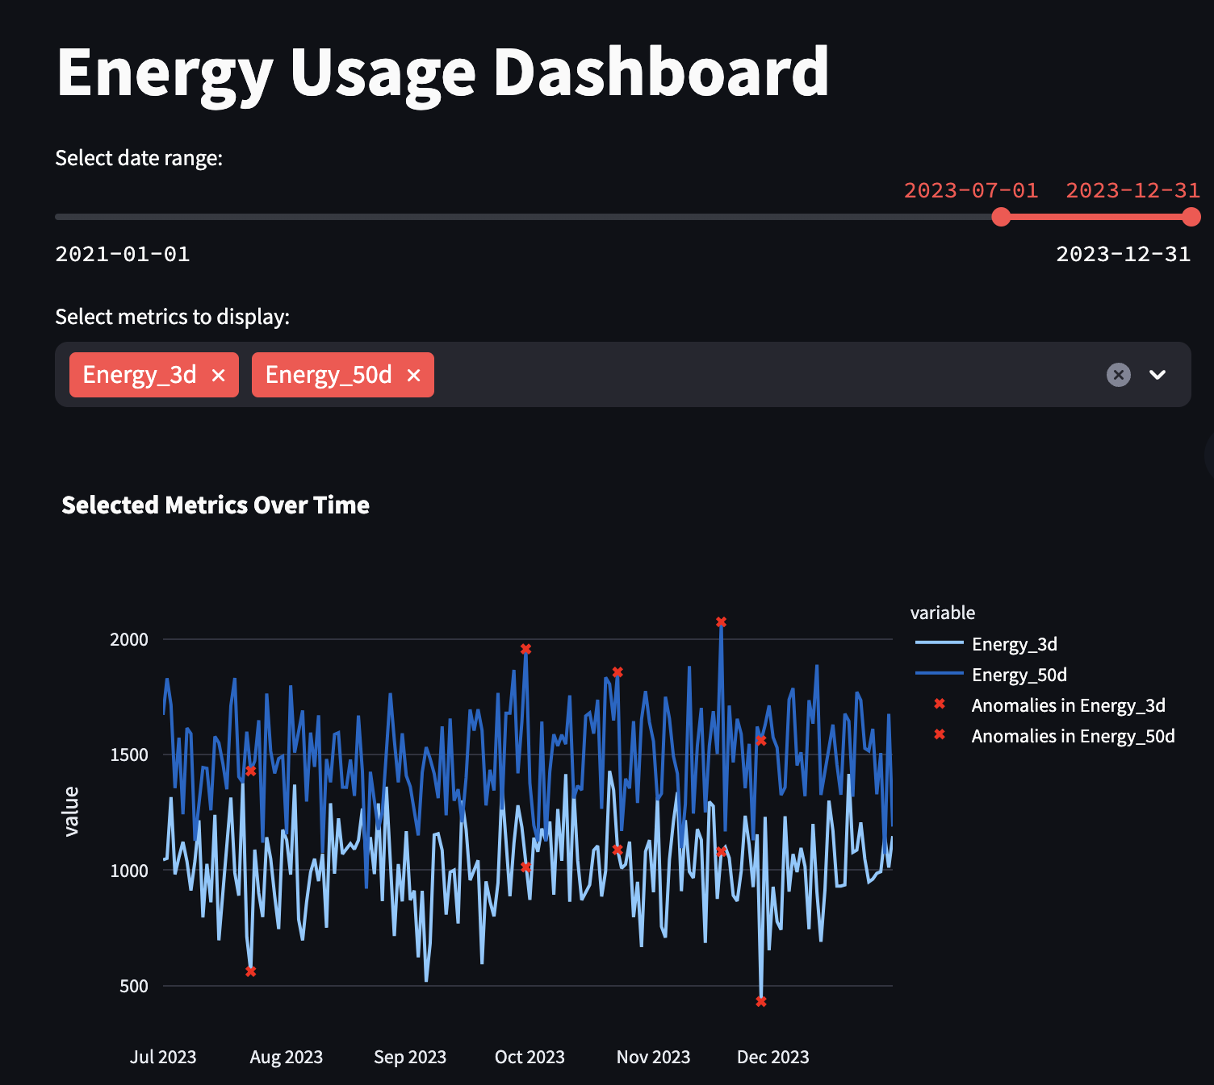
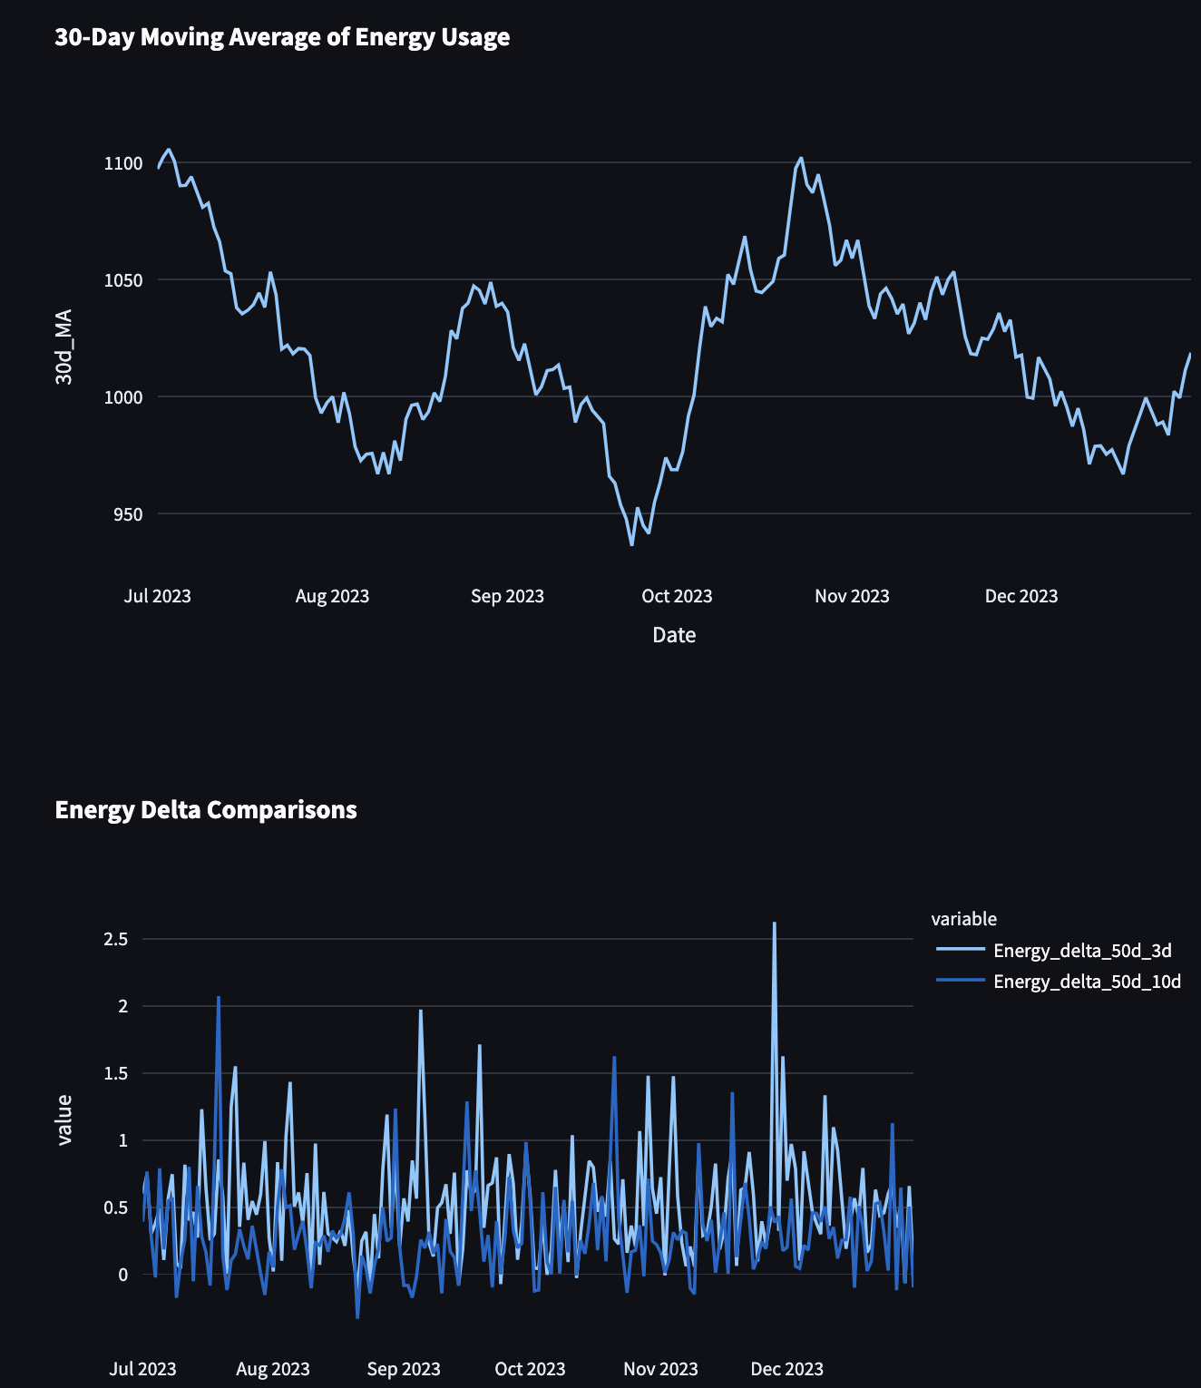
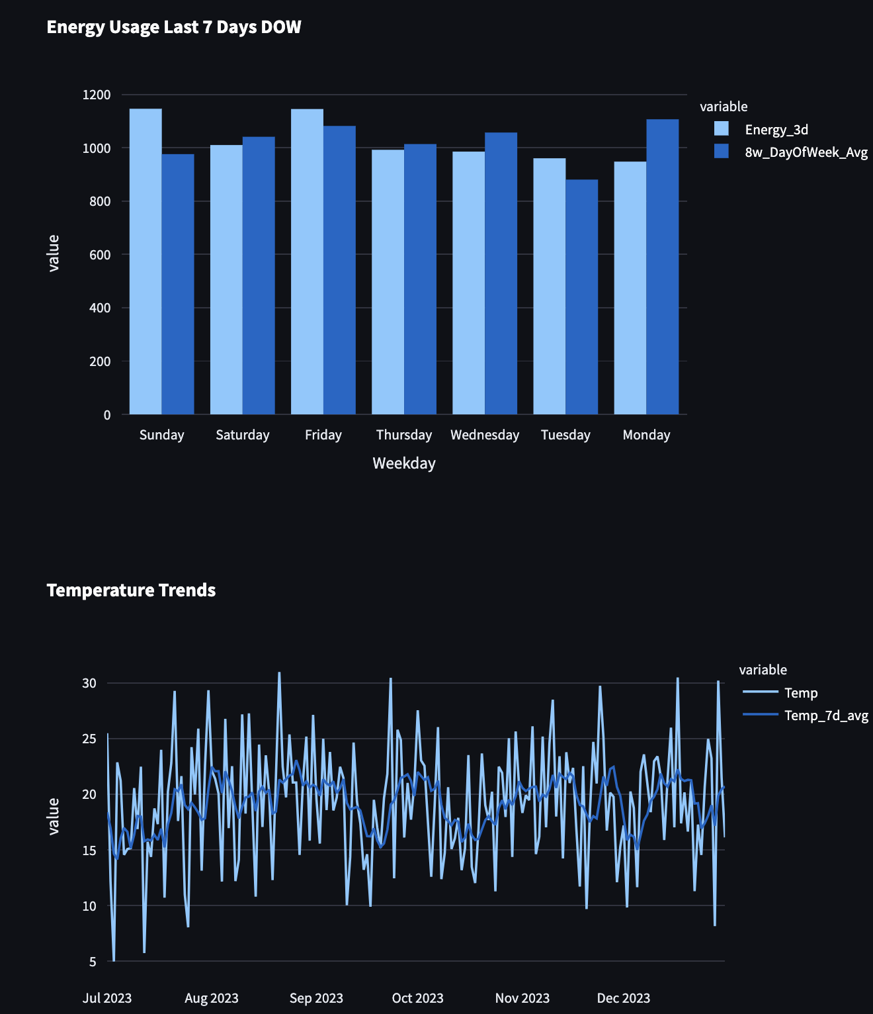
Below is a link to a Streamlit dashboard that shares a sample replica of the energy usage dashboard
Streamlit Energy Dashboard Link

Slide 8


The anomaly detection process and dashboard were a big success and led to several other initiatives
In total there were 14 anomaly checks each day. It was a day and night difference from the previous MS Excel process
This process helped identify multiple issues in the past 2 years
Found 5+ major errors in the first 6 months after implementation
The actual dashboard had many tabs to show in-depth analysis
A tab for each of the 3 energy forecasts
A weather tab to show temperature, humidity, wind, and precipitation
This was the first of many other dashboards
Account level (business/residential)
Geospatial graphs and trends
Marketing Campaigns

Slide 9
As a data scientist, I love challenging projects which require iterative problem-solving and debugging
Challenges
Learnings
New Tools, data source, energy business nuances
Very small amount of actual examples
Many of points of failures between all the applications used
AWS suite of applications and integrations with other applications like Jupyter and Jira
End to end data pipeline design with effective logs and backtracking
Advanced dashboard design and automation
Energy industry and seasonality

Slide 10



There is always room for improvement
Reduce False Positives
Add data distribution checks and SLA tracking
Further analyze and account better for rain, holidays, and weather events like fires and blackouts
Try advanced anomaly detection techniques
Try an ensemble of methods: statistical, machine learning, and time-series, perhaps even deep learning
Add in error handling and delays when data unavailable or weekend disruptions
Integrate with other dashboards to show if particular regions or accounts are causing issue
Explore Outlier Detection Techniques
Automate The Process Further

Slide 11

I appreciate this opportunity and would like to reiterate my interest in Snowflake and this role
A Decade of Dedication
From data analyst to data science leader with ML/AI experience, my decade-long journey has been fueled by a passion to harness data for optimal solutions
I see a profound connection between my passion for data science, my pursuit of innovation, and the transformative solutions that Snowflake delivers
Transformative Leader
Spearheaded initiatives leading to over $300M increase in discounts and a $100M revenue boost
Innovator at Heart
Whether it's developing anomaly detection tools, analyzing product experiments or building LLM backed product prototypes, innovation is at the core of my approach
Notes:
Ready for Snowflake: With a proven track record, a Master’s degree under my belt, and a zeal for data's power to innovate, I am ready to help Snowflake soar to new heights.

Slide 12
THANK YOU ☺
Checkout my github and sample Streamlit projects
https://github.com/hzmotiwala
LLM ChatGPT-like chatbot
https://llm-chatbot-zm.streamlit.app
LLM Youtube Summary (Try a 5-10 minute Ted Talk)
https://llm-youtube-summary-zm.streamlit.app
Energy Usage Anomaly Detection Dashboard Sample
https://energy-usage-anomaly-dashboard.streamlit.app
Stock market visualization with ML Forecasting and Feature Importance
https://stock-app-zm.streamlit.app

Slide 13




Appendix: Mockup of data sources input/output
3 day energy forecast
10 day energy forecast
input
50 day energy usage
Weather data
Zane DB of Historical calculations
output
Zane DB of Historical calculations

