Slide 1

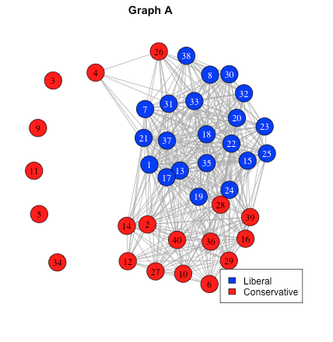
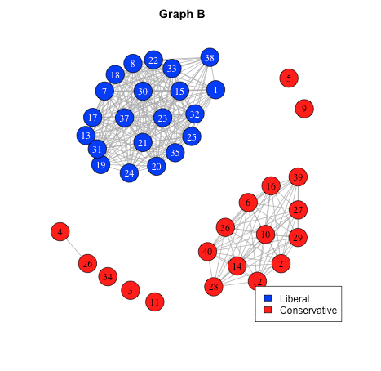
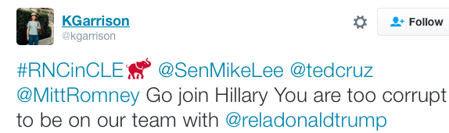
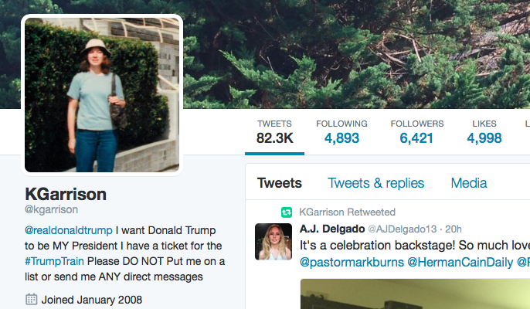
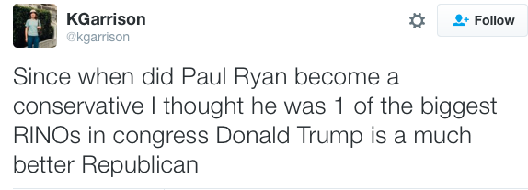
Propagating Opinions vs. Evolving Graphs For Simulating
Political Polarization
Hannah Zontine— Department of Computer Science, University of Mary Washington
Dr. Stephen Davies— Faculty Supervisor
Abstract
Political polarization represents the increasing divergence of opinions between Liberals and Conservatives on the political spectrum. As social media fosters an echo-chamber, people tend to form relationships with the like-minded, and break ones with the opposite. Over time, tight network clusters separated by ideology begin to prevent communication between the political parties. A happy medium between no conversation and total uniformity of opinion is key in cultivating a healthy society.
Our task was to simulate a network of Twitter users and model their changing political opinions on a graph. We coded a function to take several parameters, including the initial graph, and produce an animation file of the changing plot over some amount of time. Some methods other researchers choose to implement did not accurately represent the framework of Twitter. We found a significant difference in the length of time before complete consensus of opinion, when the order of interactions between neighbors varies as well as the number of users present in the interaction. Opinion dynamics literature cites one micro-behavior, a few stubborn users who never change their opinion, as a cause of a macro-behavior, polarization of political ideology. Another macro-behavior, uniformity of opinion, is cited to always occur for users with binary opinions where each user adopts another’s opinion. In future works, we plan to study real Twitter users who follow politicians and are politically active. Once we have constructed an accurate political text classifier, we can label users according to their tweets. Recording the dynamic relationships of these users will allow us to study the effect of observed micro-behaviors on the dataset.
Opinion Dynamics literature is rich in variations of models where opinions propagate. The Binary Voter Model, produced independently by [2] and [8], is a simple model where each agent has one binary opinion value. Periodically, each individual chooses a random neighbor and adopts the chosen neighbor’s opinion. The Binary Voter Model is cited by [1] to always reach uniformity of opinion for connected graphs. [12] redesigned this model by adding a binary stubbornness attribute to each person. If a user’s stubbornness was equal to 1, he/she would never change his/her political opinion. Yildiz discovered that the presence of only a few stubborn people always led to a graph which was polarized by opinion. [11] created a model where agents hold a continuous opinion value between 0 and 1 and randomly interacted in pairs when the difference of their opinions was below a fixed threshold value. [5] produced a model where agents have a continuous opinion value between 0 and 1 and a binary stubbornness value toward his/her initial opinion. Agents update their opinion each iteration based on their initial opinion, how strongly they feel about their initial opinion, and the opinions of their neighbors. [4] also published a model where an agent has one continuous opinion. However, this model conducted its pairwise interactions with random agents from the whole graph. The Hegselmann-Krause Model [7] involves agents with continuous opinions, but they “aggregate all other agent opinions within their confidence bound and considers the group average for shifting their opinion” [10].
While the Opinion Dynamics literature is full of models where agents update their opinions, there is no published work on an "evolving graph model": i.e., one in which individuals add or delete relationships with others. This is clearly a shortcoming, since it takes into account only one of the two key phenomena that produce polarization -- not only do people change
their opinions to match those of their friends, but they also deliberately seek out friends (consciously or unconsciously) who agree with their opinions. In terms of online social networks, users have the ability to friend/follow and unfriend/unfollow others on every social networking site. We implemented a simple model that incorporates this phenomenon which works as follows: cycle through all of the agents in the graph. For each of the agent's neighbors, if their opinions are the same, add an edge between the agent and another neighbor of that neighbor. If they disagree, on the other hand, remove the edge from the graph.
Analytical Solutions vs. Simulations
Many researchers in the field of Opinion Dynamics have chosen to simplify their model so that the solution could be worked out analytically. The Binary Voter Model is just one example. By coding a simulator function and many helper functions, not only can we reproduce and visualize published models, but we can explore other more complex variations that make the models more realistic and accurate. There are two reasons to simulate a model: 1) to determine whether certain micro-behaviors are sufficient to produce known macro-observations and 2) to determine the macro-consequences of certain micro-behaviors. We are interested in the modeling assumptions that will produce macro-behaviors, such as entrenched polarization, alignment on seemingly diverse issues, and uniformity of opinion.
Lastly, we simulated the "evolving graph model" described above. One key variant is the question of what happens when an edge is to be added between the agent and a friend-of-a-friend: should the edge only be added if their political opinions are already the same, or should it be unconditionally added? It is not clear what the effect of this choice would be, nor which choice best models real-world social networks. We discovered that the two alternatives lead to very different behaviors: conditionally adding the edge results in a completely polarized graph with a few unconnected nodes on the side, whereas this is not true for unconditional addition. See Figure 3.
Figure 3: These graphs represent the last iteration out of 40. Both were initialized by random sampling with the same parameters, except Graph A always added edges and Graph B only added an edge if the ideologies were the same.
Political Polarization
Polarization, in the world of politics, occurs when “public opinion goes to two extremes, and there is no real middle ground or moderates” [3]. With the creation of social networking, people have the ability to build a personal profile and choose who they wish to receive information from. Each person can choose how much or how little he/she wishes to share about his/her own personal beliefs online.
The Homophily principle is an observed tendency that individuals “like to associate with like” [9]. If two friends agree on one issue and follow each other, we theorize that one may directly or indirectly influence the other into adopting his/her opinion on another issue. Over time, politically active users have been observed to aggregate into communities of interest, which allows confirmation bias to be reinforced and selective news to go undisputed. When public opinion is polarized, it becomes increasingly difficult to compromise on solutions for pressing national issues.
Future Work
One way we could get real-live data on people’s opinions and degree of polarization is from a social network like Twitter. Twitter, a free social networking microblogging service, allows us to compile mass amounts of their data at a slow rate. We have gathered the tweets, friends, and followers of every twitter user who follows both Speaker of the House, Paul Ryan, and House Minority Leader, Nancy Pelosi. We plan to track the dynamic relationships between the users and classify their political ideologies over time.
On Twitter, each user has a unique twitter handle (i.e. username) and twitter identification number. Below is an example of a real Twitter user who follows Paul Ryan and a few of her tweets.
Opinion Dynamics
The study of how people formulate and change their own opinion based on the opinions of others is fundamental to the field of Opinion Dynamics. There are many different ways to model how users interact and change their opinion. The political ideology for each user can be modeled as a single discrete or continuous value. A discrete ideology value is categorical variable, meaning it takes on one of a fixed number of possible values; if there are only two values possible, ideology becomes a binary variable. Continuous ideology values are measured on a spectrum from 0 to 1, where 0 is strong Liberal, 0.5 is moderate, and 1 is strong Conservative (or vice versa). Alternatively, the political opinion of a person can be modeled as several values, where each one represents the person’s opinion on a disputed political topic. Each single value can be expressed as either discrete or continuous. It doesn’t matter which way opinions are modeled, but it is important to be consistent across all people in the set.
In order to model a population of users as a graph, each Twitter user must be represented as a vertex, also known as a node, on the graph. The relationship between two users on Twitter can be unidirectional (one follows the other) or bidirectional (they both follow each other), and is depicted as either an arrow or a line respectively. The arrow is always directed from the one who is followed toward the one who does the following in order to portray the direction of information flow.
Once every person has an initial political opinion, interactions are simulated between neighbors (people who are directly connected), friends of a friend (people who are indirectly connected through other people), and/or strangers (people who aren’t connected). We define an interaction as some transfer of information that may or may not have influence over the receiver’s political opinion. In the real world, you mostly interact with your family and friends, so they have the largest potential influence over your ideals. For this reason, most models have elected to analyze the random interactions between neighbors as opposed to all nodes in graph. Interactions can be modeled as either pairwise or group influence. Pairwise interactions always occur between two users, whereas group influence is where a user considers the group average of his/her neighbors.
Results
Most of the classic Opinion Dynamics work was produced in the age before computational simulation was feasible; therefore, researchers were restricted to solving (simplified) analytical models. The assumptions necessary to make these models tractable were in some cases not ideal, and can be revised in a simulation setting. For instance, the original Binary Voter Model [8] assumes a newly chosen agent at random for each interaction. It seems more reflective of the real-world phenomenon, though, to cycle through all the users once
before repeating. After all, people are receptive to information at all times; everyone should get a chance to update their opinion in tandem. We ran 50 simulations of this variation and discovered a significant difference in the time before uniformity of opinion. See Figure 1.
Another assumption of the Binary Voter Model is that the node randomly chosen for the interaction always adopts the opinion of a randomly chosen neighbor. We tested another variation where the node chosen for the interaction always influences the randomly chosen neighbor. After 50 simulations, we learn that this simple tweak caused the graph to converge to a consensus at a significantly faster rate. See Figure 2.
Literature cited
[1] Aldous and Fill, “Reversible Markov Chains and Random Walks on Graphs.” 1994.
[2] P. Clifford and A. Sudbury, “A Model for Spatial Conflict,” Biometrika, vol. 60, no. 3, pp. 581–588, 1973.
[3] Davemanual.com. ”The Definition of Polarization.”
[4] Deffuant, Guillaume, David Neau, Frederic Amblard, and Gérard Weisbuch. “Mixing Beliefs among Interacting Agents.” Advances in Complex Systems 3, (2000): 87–98.
[5] Ghaderi, Javad, and R. Srikant. “Opinion Dynamics in Social Networks: A Local Interaction Game with Stubborn Agents.” arXiv:1208.5076 [cs], August 24, 2012.
[6] Gollapudi, Das, and Munagala. “Modeling Opinion Dynamics in Social Networks.” In Proceedings of the 7th ACM International Conference on Web Search and Data Mining, 2014.
[7] Hegselmann, Rainer, Ulrich Krause, and others. “Opinion Dynamics and Bounded Confidence Models, Analysis, and Simulation.” Journal of Artificial Societies and Social Simulation 5, no. 3 (2002).
[8] Holley and Liggett, “ERGODIC THEOREMS FOR WEAKLY INTERACTING INFINITE SYSTEMS AND THE VOTER MODEL.” 1975.
[9] Kossinets, Gueorgi, and Duncan J. Watts. “Origins of Homophily in an Evolving Social network1.” American Journal of Sociology 115, no. 2 (2009): 405–50.
[10] Lorenz, Jan. “Continuous Opinion Dynamics under Bounded Confidence: A Survey.” International Journal of Modern Physics C 18, no. 12 (2007): 1819–38.
[11] Weisbuch, Gerard, Guillaume Deffuant, Frederic Amblard, and Jean Pierre Nadal. “Interacting Agents and Continuous Opinions Dynamics.” arXiv:cond-mat/0111494, November 26, 2001.
[12] Yildiz, Ercan, Asuman Ozdaglar, Daron Acemoglu, Amin Saberi, and Anna Scaglione. “Binary Opinion Dynamics with Stubborn Agents.” ACM Trans. Econ. Comput. 1, no. 4 (December 2013): 19:1–19:30. doi:10.1145/2538508.
Acknowledgments
Dave Marchette is super smart.
Figure 1
Figure 2

