Slide 1


QHL: A Fast Algorithm for Exact Constrained Shortest Path Search on Road Networks
Libin Wang, Department of CSE, HKUST
Raymond Chi-Wing Wong, Department of CSE, HKUST
Notes:
Good afternoon everyone. Today, I'd like to present a groundbreaking study titled "QHL: A Fast Algorithm for Exact Constrained Shortest Path Search on Road Networks."

Slide 2
Outline
Motivation
Preliminaries
Methodology
Experiments
Conclusion
Notes:
Lets start with some motivation

Slide 3
Outline
Motivation
Preliminaries
Methodology
Experiments
Conclusion

Slide 4



Motivation: route planning
Route planning plays a critical role in many spatial applications
Notes:
As we all know，Route planning plays a critical role in many applications, such as tourists’ trip planning, ride-hailing platforms, or food delivery services. Online mapping apps, such as Google Maps , it offers navigation guidance to meet users’ traveling demands.

Slide 5
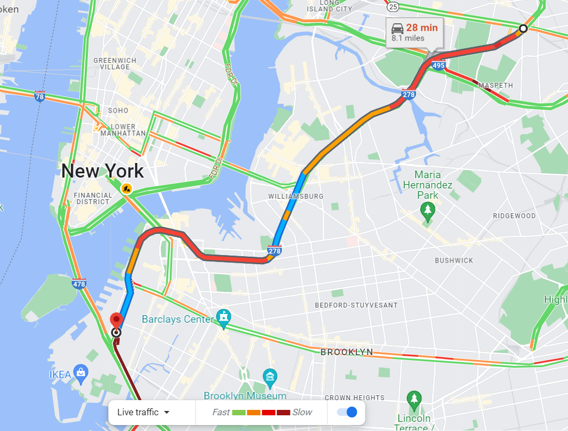
Motivation: one single objective
The recommended route only minimizes the travel time
Notes:
However, the recommended routes often optimize one single objective (e.g., the shortest travel time or distance) and ignore various users’ preferences in different scenarios.

Slide 6
Motivation: objective under a constraint
Traffic jam
One may accept slightly long detours to experience less crowded roads
Long-distance trip
One may not choose highways and bridges with high toll charges under limited budget
Constrained Shortest Path problem (CSP)
NP-hard!
Notes:
For example, during a traffic jam, drivers may accept some slightly long detours to experience less congested road segments. Under travelers’ limited budgets, the fastest route may be infeasible since it could utilize many highways and bridges with toll charges. The constrained shortest path (CSP) query matches this requirement, but the query efficiencies of previous solutions are often low due to CSP’s NP-hardness.

Slide 7





























Motivation: Constrained Shortest Path (CSP) problem
A road network -> a connected undirected graph G(V,E)
Each edge e has its weight-cost pair (w(e), c(e))
Traffic jam: congestion degree -> w(e); distance -> c(e)
Minimize congestion s.t. the detour distance ≤ a given value
Long-distance trip: travel time -> w(e); toll charge -> c(e)
Minimize the travel time s.t. the toll charges ≤ a given value
$$v_{1}$$
$$(8,9)$$
$$v_{13}$$
$$(7,6)$$
$$v_{12}$$
$$(3,2)$$
$$(2,5)$$
$$(1,1)$$
$$v_{6}$$
$$(2,3)$$
$$(1,2)$$
$$v_{8}$$
$$(2,4)$$
$$v_{3}$$
$$v_{11}$$
$$v_{4}$$
$$(2,1)$$
$$(6,2)$$
$$(6,3)$$
$$(2,2)$$
$$v_{7}$$
$$(4,2)$$
$$(1,6)$$
$$(1,1)$$
$$(3,4)$$
$$(5,2)$$
$$v_{2}$$
$$v_{9}$$
$$v_{10}$$
$$v_{5}$$
Notes:
In CSP problem，a road network is modeled by a connected undirected graph G like this figure with vertices and edges， each edge e has its weight-cost pair （w(e), c(e))。In traffic jam，the congestion degree is w(e), the distance is c(e), the minimize congestion subject to the constains as the detour distance is at most a given value。For Long-distace trip, the travel time is w(e), and a toll charge is c(e). the author minimize the travel time subject to the constrans as the toll charge at most the given value.

Slide 8
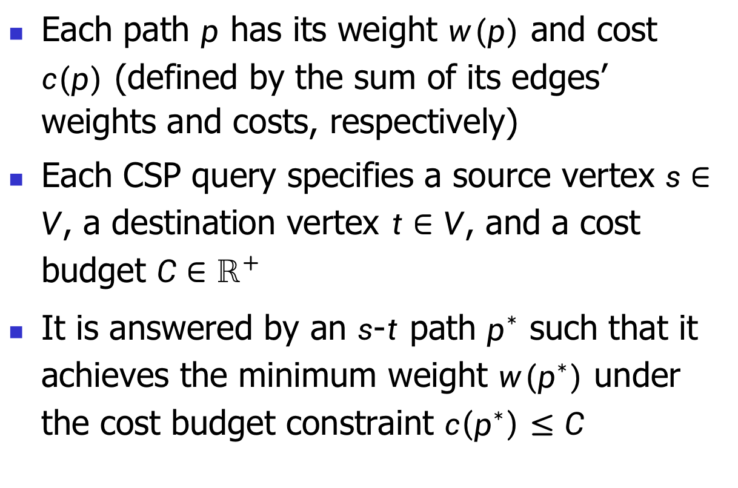
Motivation: Constrained Shortest Path (CSP) query
Each path $p$ has its weight $w(p)$ and cost $c(p)$ (defined by the sum of its edges’ weights and costs, respectively)
Each CSP query specifies a source vertex $s∈V$, a destination vertex $t∈V$, and a cost budget $C∈ℝ^{+}$
It is answered by an $s$-$t$ path $p^{∗}$ such that it achieves the minimum weight $w(p^{∗})$ under the cost budget constraint $c\left(p^{∗}\right)≤C$
Notes:
Each path p has its weight w(p) and cost c(p), each CSP query specifies a source vertex s, a destination vertex t, and a cost budget c.Is answered by an s-t path pstart such that it achieves the minimum weight w(pstart) under the cost budget constraint that the c(pstart) is at most C.

Slide 9
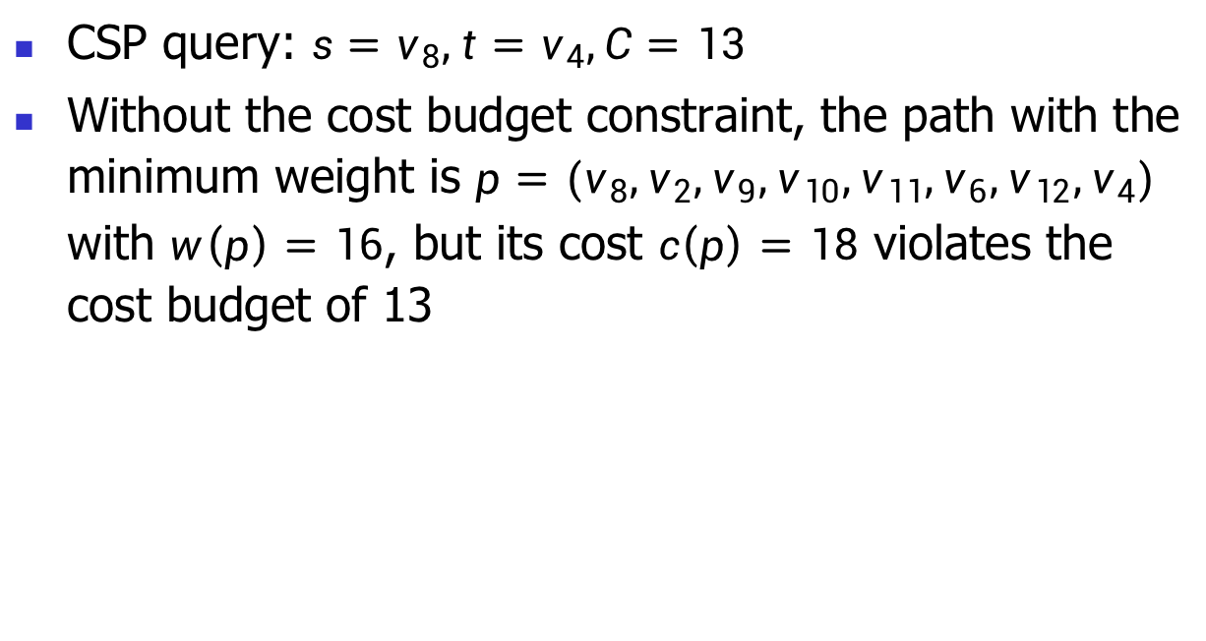
Definition: CSP query example
CSP query: $s=v_{8},t=v_{4},C=13$
Without the cost budget constraint, the path with the minimum weight is $p=(v_{8},v_{2},v_{9},v_{10},v_{11},v_{6},v_{12},v_{4})$ with $w\left(p\right)=16$, but its cost $c\left(p\right)=18$ violates the cost budget of 13
$$v_{1}$$
$$(8,9)$$
$$v_{13}$$
$$(7,6)$$
$$v_{12}$$
$$(3,2)$$
$$(2,5)$$
$$(1,1)$$
$$v_{6}$$
$$(2,3)$$
$$(1,2)$$
$$v_{8}$$
$$(2,4)$$
$$v_{3}$$
$$v_{11}$$
$$v_{4}$$
$$(2,1)$$
$$(6,2)$$
$$(6,3)$$
$$(2,2)$$
$$v_{7}$$
$$(4,2)$$
$$(1,6)$$
$$(1,1)$$
$$(3,4)$$
$$(5,2)$$
$$v_{2}$$
$$v_{9}$$
$$v_{10}$$
$$v_{5}$$
Notes:
Consider this examlple， s is Veight， t is Vfour, anc C is thirteen. Without the cost budget constraint, the path with the minimum weight is shown by the red lines, but its cost violates the cost budget .

Slide 10

Definition: CSP query example
CSP query: $s=v_{8},t=v_{4},C=13$
Under the cost budget constraint, the CSP answer $p^{∗}=(v_{8},v_{2},v_{9},v_{10},v_{5},v_{4})$ with its minimum weight $w\left(p^{∗}\right)=17$ and $c\left(p^{∗}\right)=13≤C=13$
$$v_{1}$$
$$(8,9)$$
$$v_{13}$$
$$(7,6)$$
$$v_{12}$$
$$(3,2)$$
$$(2,5)$$
$$(1,1)$$
$$v_{6}$$
$$(2,3)$$
$$(1,2)$$
$$v_{8}$$
$$(2,4)$$
$$v_{3}$$
$$v_{11}$$
$$v_{4}$$
$$(2,1)$$
$$(6,2)$$
$$(6,3)$$
$$(2,2)$$
$$v_{7}$$
$$(4,2)$$
$$(1,6)$$
$$(1,1)$$
$$(3,4)$$
$$(5,2)$$
$$v_{2}$$
$$v_{9}$$
$$v_{10}$$
$$v_{5}$$
Notes:
Unde r the cost budget constraint, the CSP answer pstart is shown by the red lines with its minimum weight of 17 and its cost satisfies the budget constraint。

Slide 11
Motivation: related work
Index-free solutions:
Build recursive formulae for dynamic programming by considering the answer to the subproblem from s to each intermediate vertex v: JMAA66, COR12
Remove the constraint by using the Lagrangian relaxation and solve the unconstrained CSP: Networks80, ESA00
DFS search with pruning rules: COR13
Iteratively find paths in the increasing order of weights (using the concept of K-shortest paths) until the cost budget constraint is satisfied: CIKM10, AMC15
Notes:
next lets review some related work about csp, for index-free solotions, they include dynamic programming, the lagrangian relaxation, the DFS search with pruning rules and Iteratively find paths in the increasing order of weights.

Slide 12
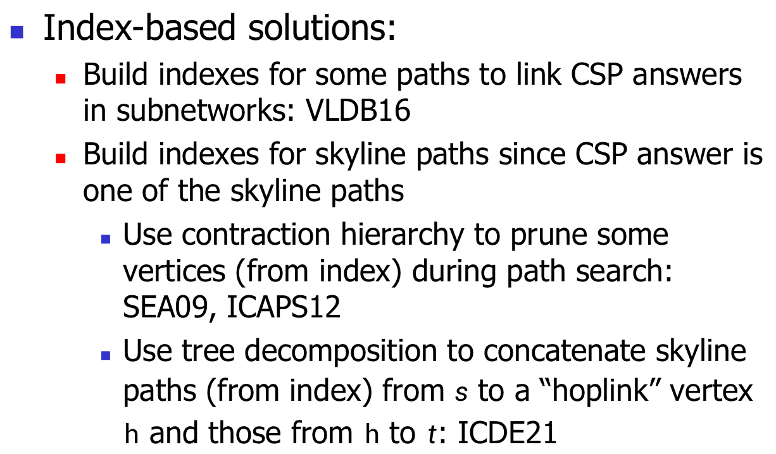
Motivation: related work
But, CSP-2Hop essentially finds skyline paths, which overlooks CSP query information that can be used to prune computations. For example, not all skyline paths satisfy the cost budget constraint
Index-based solutions:
Build indexes for some paths to link CSP answers in subnetworks: VLDB16
Build indexes for skyline paths since CSP answer is one of the skyline paths
Use contraction hierarchy to prune some vertices (from index) during path search: SEA09, ICAPS12
Use tree decomposition to concatenate skyline paths (from index) from $s$ to a “hoplink” vertex $h$ and those from $h$ to $t$: ICDE21
Proposed CSP-2Hop with its query time orders of magnitude faster than all the other solutions
Notes:
For index-based solutions, the build indexes for some paths to link CSP answers in subnetworks, or indexes for skyline paths since CSP answer is one of the skyline paths. we can use contraction hierarchy (点下一个ppt)or tree decoposition， this paper proposed a CSP with its query time orders of magnitude faster than all the other solutions, but csp-2hop essentially finds skyline paths, which overlooks CSP query information that can be used to prune computations. For example, not all skyline paths satisfy the cost budget constraint。

Slide 13
Motivation: related work
Index-based solutions:
Build indexes for some paths to link CSP answers in subnetworks: VLDB16
Build indexes for skyline paths since CSP answer is one of the skyline paths
Use contraction hierarchy to prune some vertices (from index) during path search: SEA09, ICAPS12
Use tree decomposition to concatenate skyline paths (from index) from $s$ to a “hoplink” vertex $h$ and those from $h$ to $t$: ICDE21
Notes:
For index-based solutions, the build indexes for some paths to link CSP answers in subnetworks, or indexes for skyline paths since CSP answer is one of the skyline paths. we can use contraction hierarchy (点下一个ppt)or tree decoposition， this paper proposed a CSP with its query time orders of magnitude faster than all the other solutions, but csp-2hop essentially finds skyline paths, which overlooks CSP query information that can be used to prune computations. For example, not all skyline paths satisfy the cost budget constraint。

Slide 14
Motivation: related work
But, CSP-2Hop essentially finds skyline paths, which overlooks CSP query information that can be used to prune computations. For example, not all skyline paths satisfy the cost budget constraint
Index-based solutions：
Build indexes for some paths to link CSP answers in subnetworks: VLDB16
Build indexes for skyline paths since CSP answer is one of the skyline paths
Use contraction hierarchy to prune some vertices (from index) during path search: SEA09, ICAPS12
Use tree decomposition to concatenate skyline paths (from index) from s to a “hoplink” vertex ℎ and those from ℎ to t: ICDE21
Proposed CSP-2Hop with its query time orders of magnitude faster than all the other solutions
Notes:
For index-based solutions, the build indexes for some paths to link CSP answers in subnetworks, or indexes for skyline paths since CSP answer is one of the skyline paths. we can use contraction hierarchy (点下一个ppt)or tree decoposition， this paper proposed a CSP with its query time orders of magnitude faster than all the other solutions, but csp-2hop essentially finds skyline paths, which overlooks CSP query information that can be used to prune computations. For example, not all skyline paths satisfy the cost budget constraint。

Slide 15
Contributions
We propose an index-based exact solution, called Query-aware Hop Labeling (QHL), which is specific to CSP queries
We design several useful pruning strategies by fully utilizing CSP query information
QHL runs faster than the state-of-the-art CSP-2Hop by up to two orders of magnitude, and its time complexity has one fewer multiplier than CSP-2Hop’s complexity
Notes:
next i will summarize authors contributions as follows, they propose an index-based exact solution, called Query-aware Hop Labeling, which is specific to CSP queries.They design several useful pruning strategies by fully utilizing CSP query information. and QHL runs faster than the state-of-the-art CSP-2Hop by up to two orders of magnitude, and its time complexity has one fewer multiplier than CSP-2Hop’s complexity.

Slide 16
Outline
Motivation
Preliminaries
Methodology
Experiments
Conclusion
Notes:
Lets give some Preliminaries.

Slide 17

Preliminaries: skyline paths
For two path p and p′, p dominates p′ (intuitively, p has a smaller weight and cost)
The skyline path p is an s-t path that is not dominated by any other s-t paths
The skyline path set is defined to be the set of all skyline paths
The CSP answer p∗∈
Notes:
For two path p and p prime, p dominates p prime when p has a smaller weight and cost. The skyline path p is an s-t path that is not dominated by any other s-t paths. The skyline path set Pst is defined to be the set of all skyline paths. The CSP anwser pstart belongs to Pst.

Slide 18





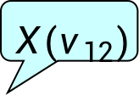




































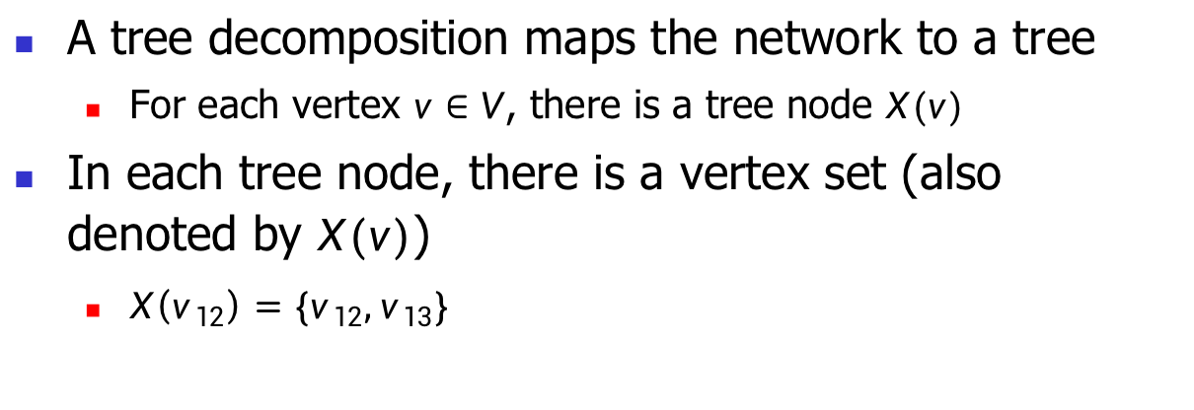
Preliminaries: tree decomposition
A tree decomposition maps the network to a tree
For each vertex $v∈V$, there is a tree node $X(v)$
In each tree node, there is a vertex set (also denoted by $X(v)$)
$X\left(v_{12}\right)=\{v_{12},v_{13}\}$
$$X(v_{12})$$
$${ v}_{13}$$
$$v_{1}$$
$$(8,9)$$
$$v_{13}$$
$$(7,6)$$
$$v_{12}$$
$${ v}_{12},v_{13}$$
$$(3,2)$$
$$(2,5)$$
$$(1,1)$$
$$v_{6}$$
$$(2,3)$$
$${ v}_{11},v_{12}, v_{13}$$
$$(1,2)$$
$$v_{8}$$
$$(2,4)$$
$$v_{3}$$
$$v_{11}$$
$$v_{4}$$
$${ v}_{10},v_{11}, v_{12}, v_{13}$$
$${ v}_{6},v_{11}, v_{12}$$
$$(2,1)$$
$$(6,2)$$
$$(6,3)$$
$$(2,2)$$
$$v_{7}$$
$$(4,2)$$
$${ v}_{9},v_{10}, v_{13}$$
$${ v}_{5},v_{10}, v_{12}$$
$${ v}_{7},v_{10}, v_{11}$$
$$(1,6)$$
$$(1,1)$$
$$(3,4)$$
$$(5,2)$$
$${ v}_{8},v_{9}, v_{13}$$
$${ v}_{4},v_{5}, v_{12}$$
$$v_{2}$$
$$v_{9}$$
$$v_{10}$$
$$v_{5}$$
$${ v}_{1},v_{8}, v_{13}$$
$${ v}_{2},v_{8}, v_{9}$$
$${ v}_{3},v_{8}, v_{9}$$
Notes:
Lets define tree decomposition.A tree decomposition maps the network to a tree, for each vertex v, there is a tree node X(v). In each tree node, there is a vertex set denoted by X(v).For example, as node X(v12) include vertex v12 and v13.

Slide 19
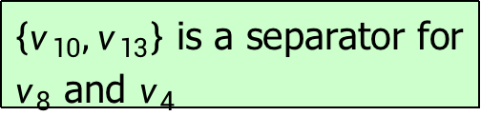

Preliminaries: separator
The separator for $s$ and $t$ is a vertex set such that any $s$-$t$ path must visit at least one vertex in it
$$v_{1}$$
$$(8,9)$$
$$v_{13}$$
$$(7,6)$$
$$v_{12}$$
$$(3,2)$$
$\left\{v_{10},v_{13}\right\}$ is a separator for $v_{8}$ and $v_{4}$
$$(2,5)$$
$$(1,1)$$
$$v_{6}$$
$$(2,3)$$
$$(1,2)$$
$$v_{8}$$
$$(2,4)$$
$$v_{3}$$
$$v_{11}$$
$$v_{4}$$
$$(2,1)$$
$$(6,2)$$
$$(6,3)$$
$$(2,2)$$
$$v_{7}$$
$$(4,2)$$
$$(1,6)$$
$$(1,1)$$
$$(3,4)$$
$$(5,2)$$
$$v_{2}$$
$$v_{9}$$
$$v_{10}$$
$$v_{5}$$
Notes:
then define separator, it's a vertex set such that any s-t path must visit at least one vertex in it. For example {v10 and v13} is a separator for v8 and v4.{v10, v11, v12, v13} is also a separator for v8 and v4.

Slide 20
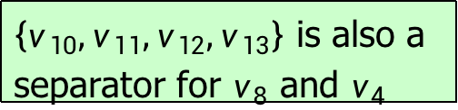
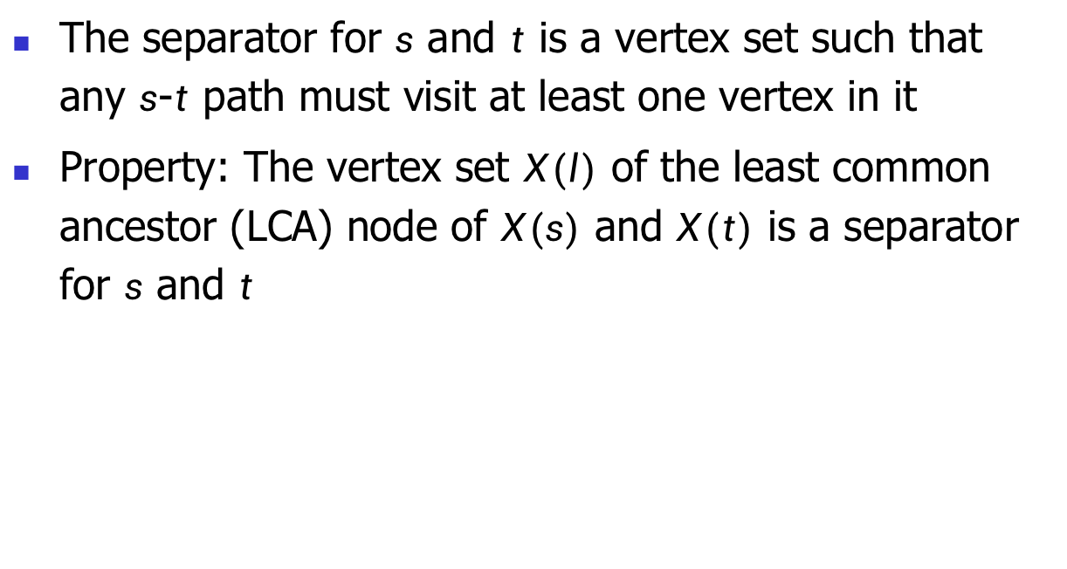
Preliminaries: separator in LCA
The separator for $s$ and $t$ is a vertex set such that any $s$-$t$ path must visit at least one vertex in it
Property: The vertex set $X(l)$ of the least common ancestor (LCA) node of $X(s)$ and $X(t)$ is a separator for $s$ and $t$
$$v_{1}$$
$$(8,9)$$
$$v_{13}$$
$$(7,6)$$
$$v_{12}$$
$$(3,2)$$
$\left\{v_{10},v_{13}\right\}$ is a separator for $v_{8}$ and $v_{4}$
$$(2,5)$$
$$(1,1)$$
$$v_{6}$$
$$(2,3)$$
$$(1,2)$$
$$v_{8}$$
$$(2,4)$$
$$v_{3}$$
$$v_{11}$$
$$v_{4}$$
$\left\{v_{10},v_{11},v_{12},v_{13}\right\}$ is also a separator for $v_{8}$ and $v_{4}$
$$(2,1)$$
$$(6,2)$$
$$(6,3)$$
$$(2,2)$$
$$v_{7}$$
$$(4,2)$$
$$(1,6)$$
$$(1,1)$$
$$(3,4)$$
$$(5,2)$$
$$v_{2}$$
$$v_{9}$$
$$v_{10}$$
$$v_{5}$$
Notes:
one useful property of tree decomposition is that the vertex set X(l) of the least common ancestor node of X(s) and X(t) is a separator for s and t.(

Slide 21






Preliminaries: separator in LCA
Property: The LCA $X(l)$ of $X(s)$ and $X(t)$ is a separator
For $s=v_{8}$ and $t=v_{4}$, its LCA $X\left(v_{10}\right)=\{v_{10},v_{11},v_{12},v_{13}\}$ is a separator for $v_{8}$ and $v_{4}$
$${ v}_{13}$$
$$v_{1}$$
$$(8,9)$$
$$v_{13}$$
$$(7,6)$$
$$v_{12}$$
$${ v}_{12},v_{13}$$
$$(3,2)$$
LCA node
$$(2,5)$$
$$(1,1)$$
$$v_{6}$$
$$(2,3)$$
$${ v}_{11},v_{12}, v_{13}$$
$$(1,2)$$
$$v_{8}$$
$$(2,4)$$
$$v_{3}$$
$$v_{11}$$
$$v_{4}$$
$${ v}_{10},v_{11}, v_{12}, v_{13}$$
$${ v}_{6},v_{11}, v_{12}$$
$$(2,1)$$
$$(6,2)$$
$$(6,3)$$
$$(2,2)$$
$$v_{7}$$
$$X(v_{8})$$
$${ v}_{9},v_{10}, v_{13}$$
$${ v}_{5},v_{10}, v_{12}$$
$${ v}_{7},v_{10}, v_{11}$$
$$(4,2)$$
$$(1,6)$$
$$(1,1)$$
$$(3,4)$$
$$(5,2)$$
$$v_{2}$$
$$v_{9}$$
$$v_{10}$$
$$v_{5}$$
$${ v}_{8},v_{9}, v_{13}$$
$${ v}_{4},v_{5}, v_{12}$$
$$X(v_{4})$$
$${ v}_{1},v_{8}, v_{13}$$
$${ v}_{2},v_{8}, v_{9}$$
$${ v}_{3},v_{8}, v_{9}$$
Notes:
(切ppt) For example, when s is v8 and t is v4, (切ppt)we can find X(v8) and X(v4), and its LCA node(切ppt) is X(v10) which is a separator。

Slide 22

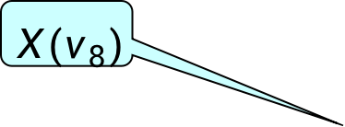



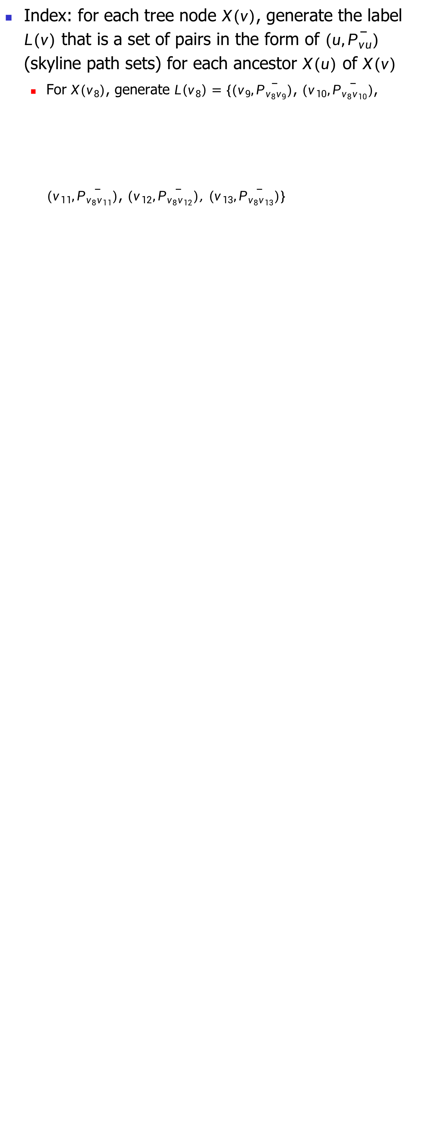
Preliminaries: CSP-2Hop Index
Index: for each tree node $X(v)$, generate the label $L(v)$ that is a set of pairs in the form of $(u,\overline{P_{vu}})$ (skyline path sets) for each ancestor $X(u)$ of $X(v)$
For $X(v_{8})$, generate $L\left(v_{8}\right)=\{(v_{9},\overline{P_{v_{8}v_{9}}})$, $(v_{10},\overline{P_{v_{8}v_{10}}})$, $(v_{11},\overline{P_{v_{8}v_{11}}})$, $(v_{12},\overline{P_{v_{8}v_{12}}})\text{, }(v_{13},\overline{P_{v_{8}v_{13}}})\}$
$${ v}_{13}$$
$${ v}_{12},v_{13}$$
$${ v}_{11},v_{12}, v_{13}$$
$$X(v_{8})$$
$${ v}_{10},v_{11}, v_{12}, v_{13}$$
$${ v}_{6},v_{11}, v_{12}$$
$${ v}_{9},v_{10}, v_{13}$$
$${ v}_{5},v_{10}, v_{12}$$
$${ v}_{7},v_{10}, v_{11}$$
$${ v}_{8},v_{9}, v_{13}$$
$${ v}_{4},v_{5}, v_{12}$$
$${ v}_{1},v_{8}, v_{13}$$
$${ v}_{2},v_{8}, v_{9}$$
$${ v}_{3},v_{8}, v_{9}$$
Notes:
For CSP-2Hop solution, it first builds an index for each tree node X(v), it generate the label L(v) that is a set of pair in the form of (u, pvu) for each ancest X(u) and X(v). For example, for X(v8), it generates label(v8) by consolidate all of its ancestors.(看看原文).

Slide 23

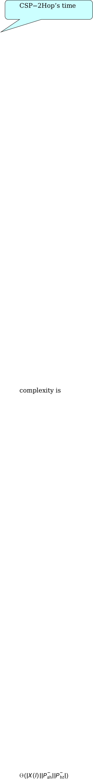


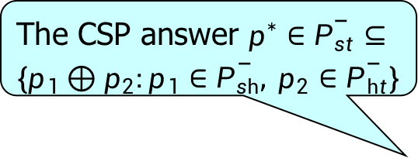
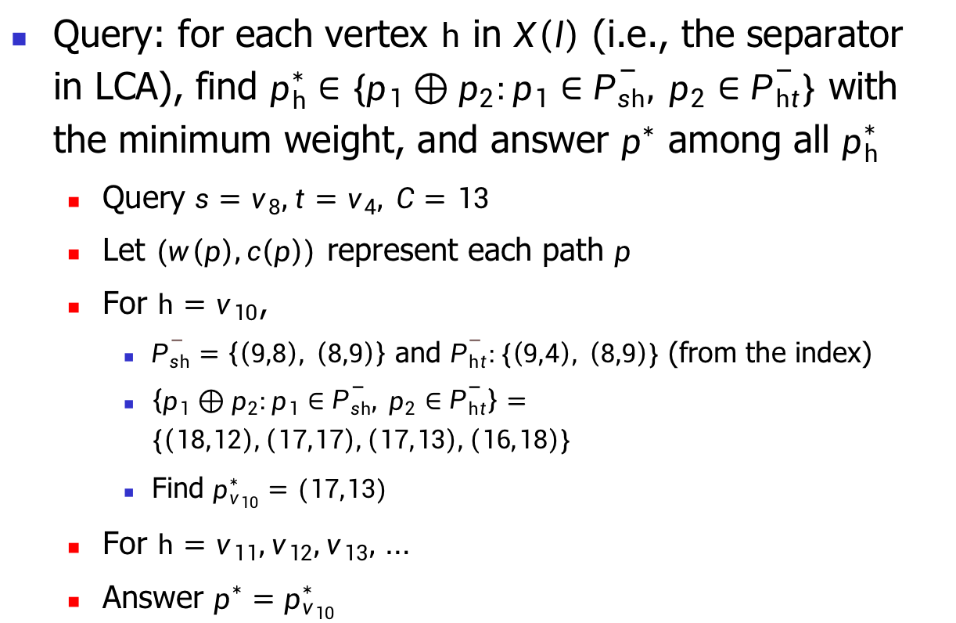
Preliminaries: CSP-2Hop query processing
The CSP answer $p^{∗}∈\overline{P_{st}}⊆\{p_{1}⊕p_{2}:p_{1}∈\overline{P_{sh}}, p_{2}∈\overline{P_{ht}}\}$
$$\text{CSP}\text{−}\text{2}\text{Hop}\text{’}\text{s} \text{time} \text{complexity} \text{is} 𝒪(\left|X\left(l\right)\right|\left|\overline{P_{sh}}\right|\left|\overline{P_{ht}}\right|)$$
Query: for each vertex $h$ in $X\left(l\right)$ (i.e., the separator in LCA), find $p_{h}^{∗}∈\{p_{1}⊕p_{2}:p_{1}∈\overline{P_{sh}}, p_{2}∈\overline{P_{ht}}\}$ with the minimum weight, and answer $p^{∗}$ among all $p_{h}^{∗}$
Query $s=v_{8},t=v_{4}, C=13$
Let $(w\left(p\right),c\left(p\right))$ represent each path $p$
For $h=v_{10}$,
$\overline{P_{sh}}=\left\{\left(9,8\right), \left(8,9\right)\right\}$ and $\overline{P_{ht}}:\{\left(9,4\right), \left(8,9\right)\}$ (from the index)
$\left\{p_{1}⊕p_{2}:p_{1}∈\overline{P_{sh}}, p_{2}∈\overline{P_{ht}}\right\}=\{\left(18,12\right),\left(17,17\right),\left(17,13\right),\left(16,18\right)\}$
Find $p_{v_{10}}^{∗}=(17,13)$
For $h=v_{11},v_{12},v_{13},$ …
Answer $p^{∗}=p_{v_{10}}^{∗}$
LCA node $X(v_{10})$
$$v_{10}$$
$$v_{11}$$
$$v_{12}$$
$$v_{13}$$
$${X(v}_{8})$$
$${X(v}_{4})$$
Notes:
In query processing, it first find the LCA node X(l). If X(l) is X(t), which meansX(l) is the ancestor of X(s), we can find the anwser in pst stored in the label(s), otherwise let Hoplinks be X(l). for each hoping edge, the author first concatenate path in psh with those in pht with them find pstarth with the some minimum weight.and finally return CSP answer pstart. This algorithm correct beacause CSP answer pstar is well for the skyline pah.and it's time complexity is O(x(l) times psh times pht), which is mainly from step 4.

Slide 24
Outline
Motivation
Preliminaries
Methodology
Experiments
Conclusion
Notes:
Next introduce author's methodology.

Slide 25



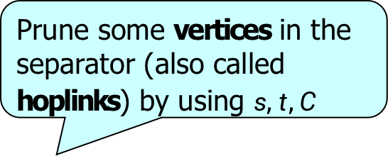



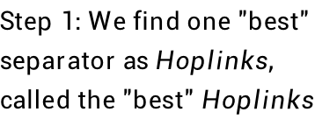
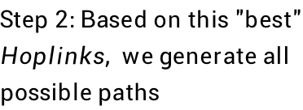













QHL: framework
Prune some vertices in the separator (also called hoplinks) by using $s,t,C$
$$v_{8}:$$
$$8$$
$$14$$
$$0$$
$$0$$
$$Separator H_{1}:$$
$$v_{6}:$$
$$1$$
$$∞$$
$$0$$
$$0$$
$$X(l)$$
$$⋯$$
$$H(s)$$
$$H(t)$$
$$v_{4}:$$
$$0$$
$$3$$
$$0$$
$$X(t)$$
$$Separator H_{2}:$$
$$v_{7}:$$
$$0$$
$$4$$
$$0$$
$$Index:$$
$$X(s)$$
$$Tree decomposition$$
$$⋯$$
$$⋯$$
$$\& Skyline path sets$$
$$Pruning Conditions$$
$$Query$$
$$Processing:$$
$$Step 1:We find one "\text{best}\text{"}$$
$$separator as Hoplinks,$$
$$called the "best" Hoplinks$$
$$Step 2:Based on this \text{"}\text{best}\text{"}$$
$$Hoplinks, we generate all$$
$$possible paths$$
Prune some possible paths by using $C$
Notes:
In authors query processing, they first find one "best separator as Hoplinks, called the best hoplinks, based on this best hoplinks, they generate all possible path. For the index section, they still use tree decomposition and skyline path sets.In addition, they build some pruning conditions to prune some vertices in the separator by using s, t, C. In step 2, they prune some possible paths by using C.

Slide 26
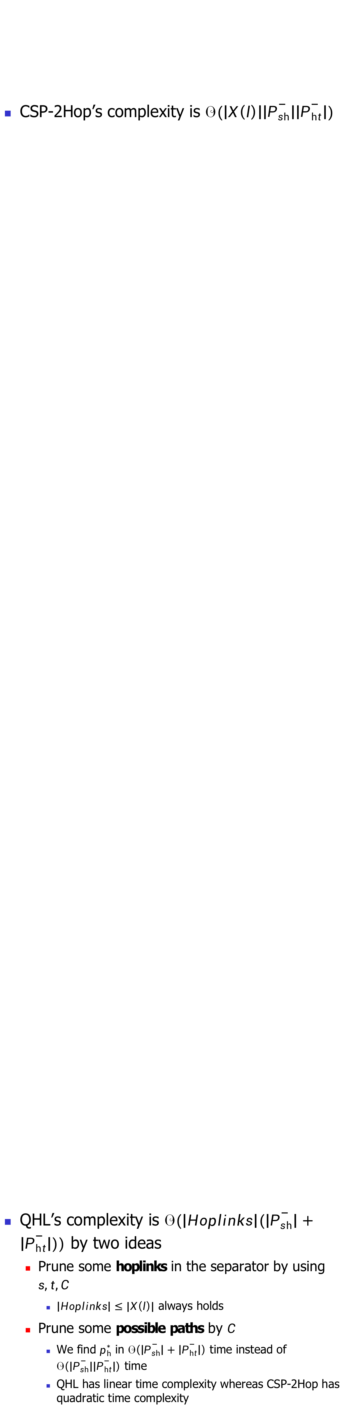
QHL: time complexity
CSP-2Hop’s complexity is $𝒪(\left|X\left(l\right)\right|\left|\overline{P_{sh}}\right|\left|\overline{P_{ht}}\right|)$
QHL’s complexity is $𝒪(\left|Hoplinks\right|(\left|\overline{P_{sh}}\right|+\left|\overline{P_{ht}}\right|))$ by two ideas
Prune some hoplinks in the separator by using $s,t,C$
$\left|Hoplinks\right|≤|X\left(l\right)|$ always holds
Prune some possible paths by $C$
We find $p_{h}^{∗}$ in $𝒪\left(\left|\overline{P_{sh}}\right|+\left|\overline{P_{ht}}\right|\right)$ time instead of $𝒪\left(\left|\overline{P_{sh}}\right|\left|\overline{P_{ht}}\right|\right)$ time
QHL has linear time complexity whereas CSP-2Hop has quadratic time complexity
Notes:
Their complexity is the O sizeof hoplinks times the sum of (the sizeof psh
and the sizeof pht). Their first idea about prunning some hoplinks is guarantees that the sizeof hoplinks is at most X(l). For second idea aboud pruning some possible paths we can find pstarh in linear time instead of quadratic time.

Slide 27
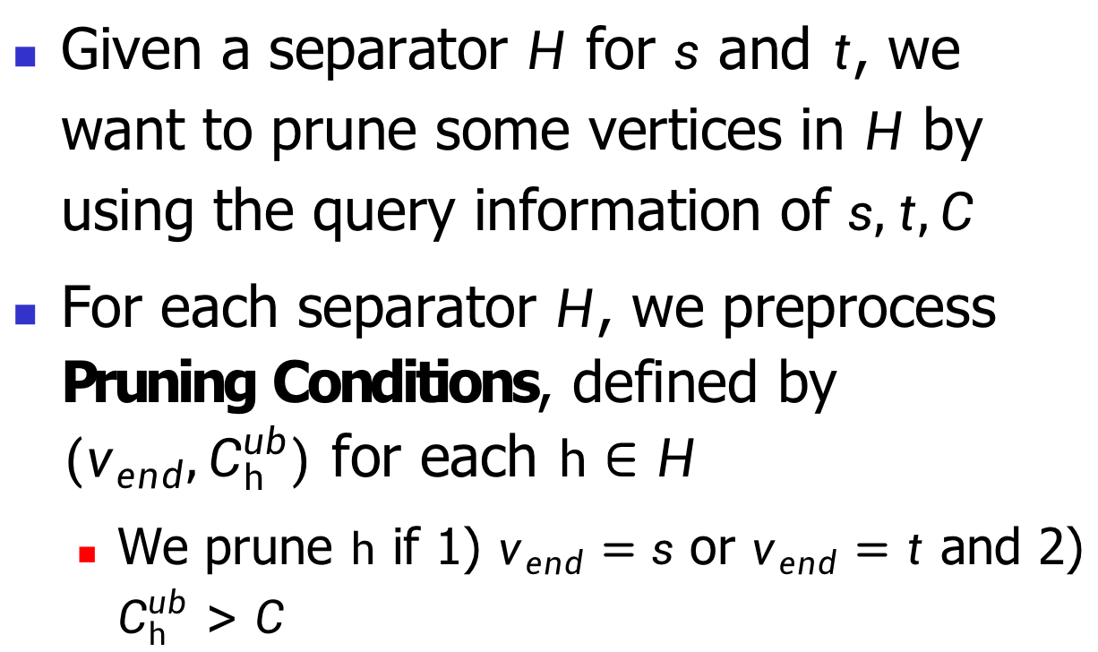
QHL: prune hoplinks
Given a separator $H$ for $s$ and $t$, we want to prune some vertices in $H$ by using the query information of $s,t,C$
For each separator $H$, we preprocess Pruning Conditions, defined by $(v_{end},C_{h}^{ub})$ for each $h∈H$
We prune $h$ if 1) $v_{end}=s$ or $v_{end}=t$ and 2) $C_{h}^{ub}>C$
Notes:
next i will introduce the two ideas. For the first one, given a separator H for s and t, they want to prune some vertices in H. For each separator H, the preprocess pruning conditions, defined by Vend Cubh for each hoplinks. They prune hoplink h if v is s or t and Cubh is greater than C.

Slide 28
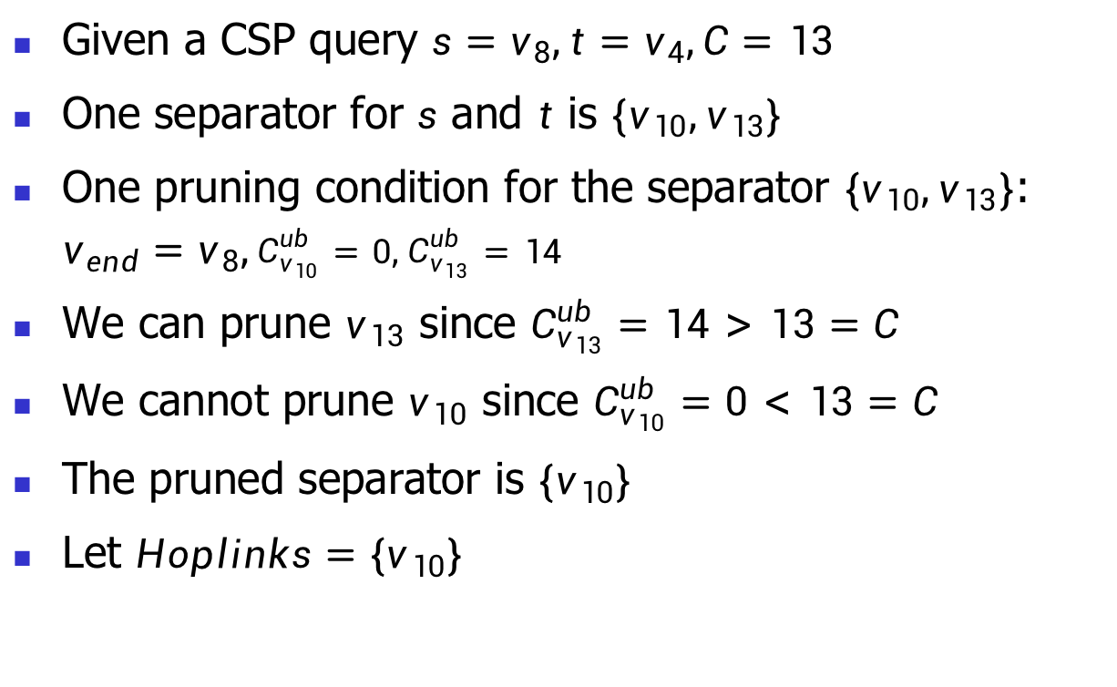
Prune hoplinks: example
Given a CSP query $s=v_{8},t=v_{4},C=13$
One separator for $s$ and $t$ is $\{v_{10},v_{13}\}$
One pruning condition for the separator $\{v_{10},v_{13}\}$: $v_{end}=v_{8},C_{v_{10}}^{ub}=0,C_{v_{13}}^{ub}=14$
We can prune $v_{13}$ since $C_{v_{13}}^{ub}=14>13=C$
We cannot prune $v_{10}$ since $C_{v_{10}}^{ub}=0<13=C$
The pruned separator is $\{v_{10}\}$
Let $Hoplinks=\{v_{10}\}$
Notes:
Consider this example, one separator for s and t is V10 and V13, one pruning condition specifies Vend as V8, CubV10 as 0, CubV13 as 14, we can prune V13 since CubV13 is larger than C. We cannot prune V10 since CubV10 is smaller than C. The prunded separator is V10, and Let Hoplinks being V10.

Slide 29
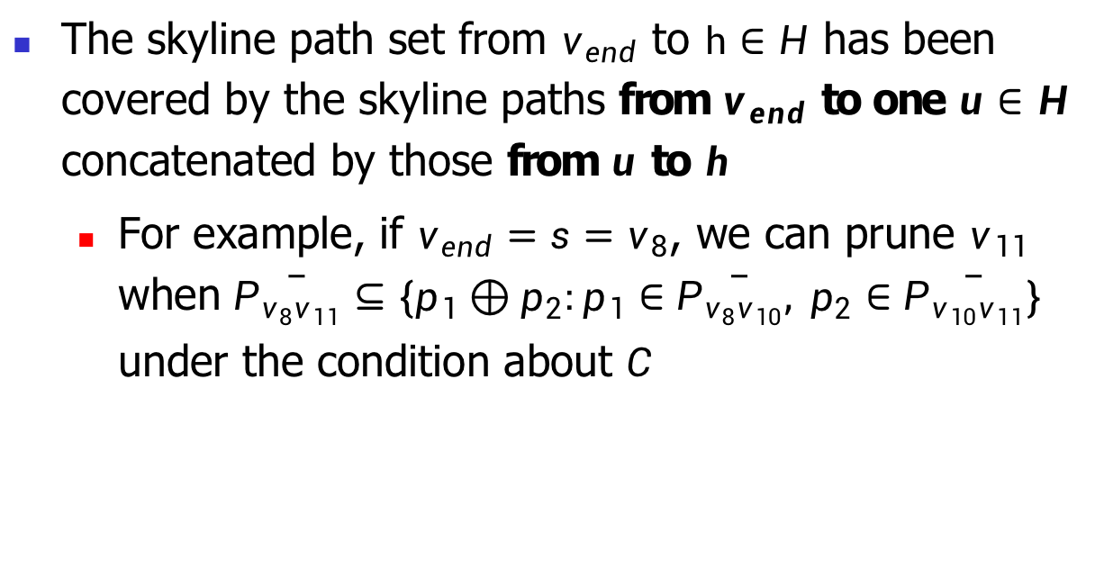
Prune hoplinks: intuition
The skyline path set from $v_{end}$ to $h∈H$ has been covered by the skyline paths from $v_{end}$ to one $u∈H$ concatenated by those from $u$ to $h$
For example, if $v_{end}=s=v_{8}$, we can prune $v_{11}$ when $\overline{P_{v_{8}v_{11}}}⊆\{p_{1}⊕p_{2}:p_{1}∈\overline{P_{v_{8}v_{10}}}, p_{2}∈\overline{P_{v_{10}v_{11}}}\}$ under the condition about $C$
$$v_{10}$$
$$v_{11}$$
$$v_{12}$$
$$v_{13}$$
$${X(v}_{8})$$
Notes:
The intuition behave pruning hoplinks is that the skyline path set from Vend to h has benn covered by the skyline paths from Vend to one u in H concatenated by those from u to h. For example, if Vend is V8, we can prune V11 when the skyline paths set pv8v11 has been covered under the condition about C.

Slide 30
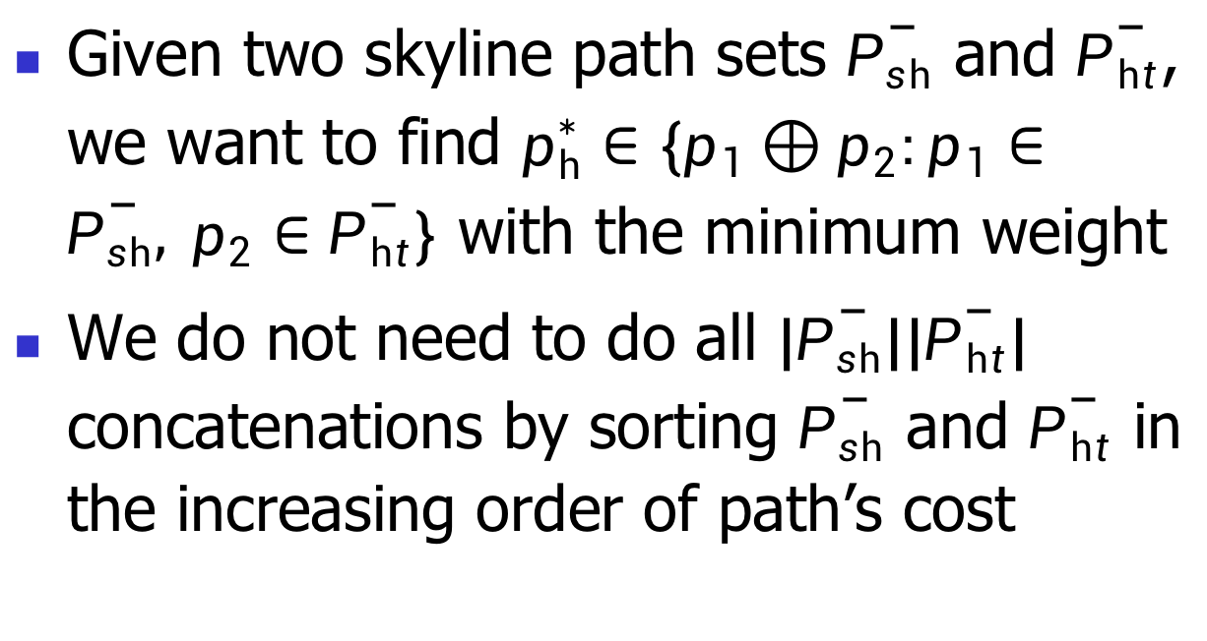
QHL: prune possible paths
Given two skyline path sets $\overline{P_{sh}}$ and $\overline{P_{ht}}$, we want to find $p_{h}^{∗}∈\{p_{1}⊕p_{2}:p_{1}∈\overline{P_{sh}}, p_{2}∈\overline{P_{ht}}\}$ with the minimum weight
We do not need to do all $|\overline{P_{sh}}\text{||}\overline{P_{ht}}|$ concatenations by sorting $\overline{P_{sh}}$ and $\overline{P_{ht}}$ in the increasing order of path’s cost
Notes:
For the second idea, given tow skyline path psh and pht, we want to find pstarh, we do not need to do all the path concatenations by sorting the two paths in the increasing order of path's cost.

Slide 31
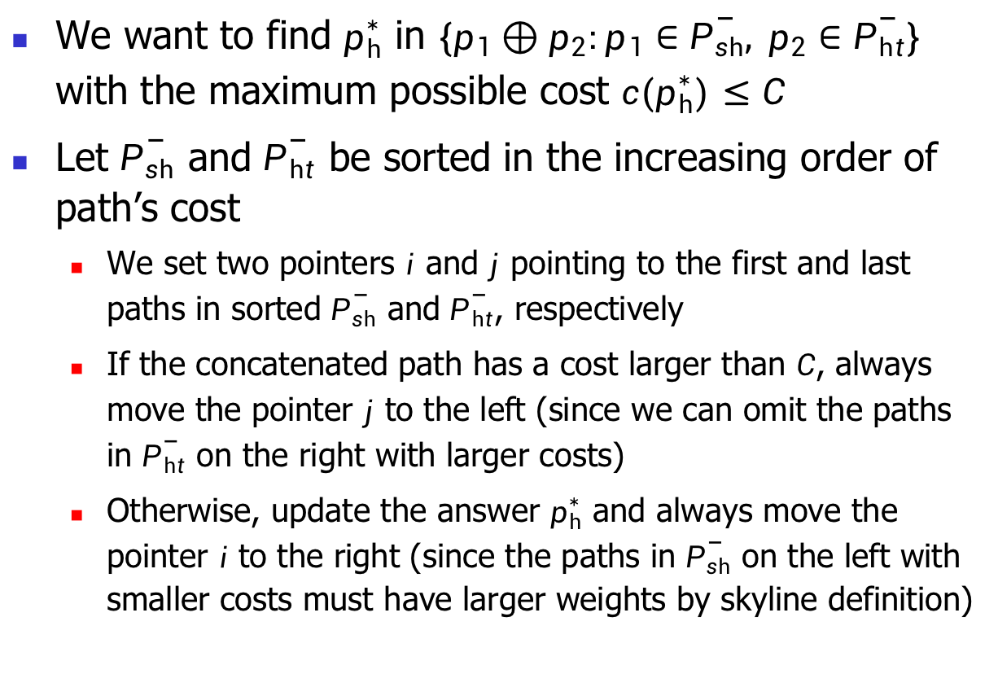
Prune possible paths: intuition
We want to find $p_{h}^{∗}$ in $\{p_{1}⊕p_{2}:p_{1}∈\overline{P_{sh}}, p_{2}∈\overline{P_{ht}}\}$ with the maximum possible cost $c(p_{h}^{∗})≤C$
Let $\overline{P_{sh}}$ and $\overline{P_{ht}}$ be sorted in the increasing order of path’s cost
We set two pointers $i$ and $j$ pointing to the first and last paths in sorted $\overline{P_{sh}}$ and $\overline{P_{ht}}$, respectively
If the concatenated path has a cost larger than $C$, always move the pointer $j$ to the left (since we can omit the paths in $\overline{P_{ht}}$ on the right with larger costs)
Otherwise, update the answer $p_{h}^{∗}$ and always move the pointer $i$ to the right (since the paths in $\overline{P_{sh}}$ on the left with smaller costs must have larger weights by skyline definition)
Notes:
The intuition is as follows. The authors set two pointers i and j pointing to the first and last path in sorted psh and pht. If the concatenated path has a cost larger than C, always move the pointer j to the left. Otherwise, update the answer pstarth and alwats move the pointer i to the right.

Slide 32
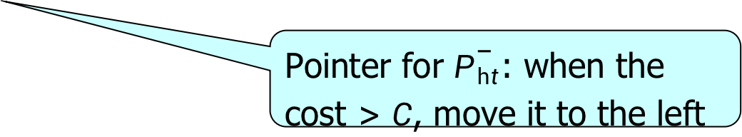





Prune possible paths: example
Given a CSP query $s=v_{8},t=v_{4},C=13$
The pruned separator is $\{v_{10}\}$ and $h=v_{10}$
$\left(9,8\right)⊕\left(8,9\right)$: Its cost of $17>C=13$. Move $\overline{P_{ht}}$’s pointer to the left
$$h_{3},h_{4}$$
$$\overline{P_{sh}}:\{\left(9,8\right), \left(8,9\right)\}$$
$$C=13$$
$$\overline{P_{ht}}:\{\left(9,4\right), \left(8,9\right)\}$$
Pointer for $\overline{P_{ht}}$: when the cost $>C$, move it to the left
Notes:
Consider this example, the prune speparator is V1o and h is equal to V10. The first concatenate (9,8) with (8,9). lts cost is larger than C. So move pht's pointer to the left(点击下一个)Next its cost is smaller than 13. We update pstarth and move psh's pointer to the right.(点击下一个） Similarly we can update pstarth and move psh's pointer to the right. Finally we return the CSP answer pstarth since the pointer for psh has reached the end.

Slide 33
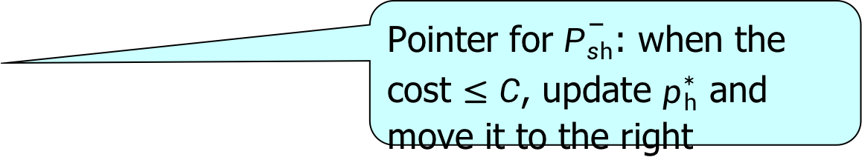

Prune possible paths: example
$\left(9,8\right)⊕\left(9,4\right)$: Its cost of $12≤C=13$. Update $p_{h}^{∗}=(18,12)$. Move $\overline{P_{sh}}$’s pointer to the right
Pointer for $\overline{P_{sh}}$: when the cost $≤C$, update $p_{h}^{∗}$ and move it to the right
$$h_{3},h_{4}$$
$$\overline{P_{sh}}:\{\left(9,8\right), \left(8,9\right)\}$$
$$C=13$$
$$\overline{P_{ht}}:\{\left(9,4\right), \left(8,9\right)\}$$

Slide 34
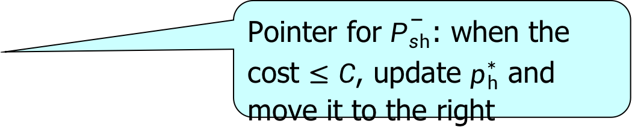

Prune possible paths: example
$\left(8,9\right)⊕\left(9,4\right)$: Its cost of $13≤C=13$. Update $p_{h}^{∗}=\left(17,13\right)$ since its weight is smaller than $(18,12)$. Move $\overline{P_{sh}}$’s pointer to the right
Pointer for $\overline{P_{sh}}$: when the cost $≤C$, update $p_{h}^{∗}$ and move it to the right
$$h_{3},h_{4}$$
$$\overline{P_{sh}}:\{\left(9,8\right), \left(8,9\right)\}$$
$$C=13$$
$$\overline{P_{ht}}:\{\left(9,4\right), \left(8,9\right)\}$$

Slide 35
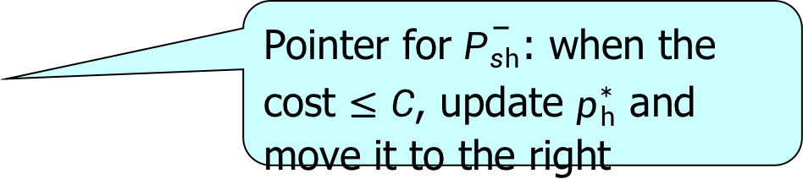

Prune possible paths: example
Return the answer $p_{h}^{∗}=\left(17,13\right)$ since the pointer for $\overline{P_{sh}}$ has reached the end
Pointer for $\overline{P_{sh}}$: when the cost $≤C$, update $p_{h}^{∗}$ and move it to the right
$$h_{3},h_{4}$$
$$\overline{P_{sh}}:\{\left(9,8\right), \left(8,9\right)\}$$
$$C=13$$
$$\overline{P_{ht}}:\{\left(9,4\right), \left(8,9\right)\}$$

Slide 36
Outline
Motivation
Preliminaries
Methodology
Experiments
Conclusion
Notes:
Next i will introduce experiments.

Slide 37
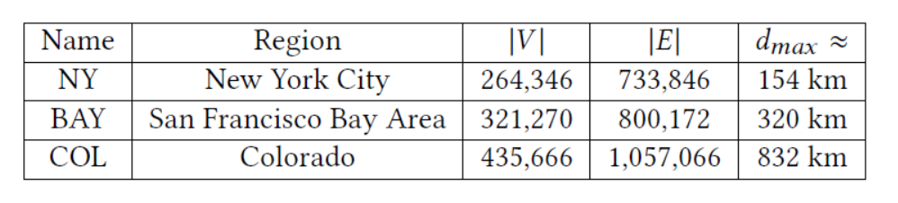
Experimental setting
Real road networks: NY, BAY, COL
Algorithms:
Index-based solutions: QHL, CSP-2Hop [ICDE21], COLA [VLDB16]
Notes:
The author use three real road networks, NY, BAY,COL with details shown in the table. The compulsory algorithm QHL, CSP-2Hop and COLA.

Slide 38
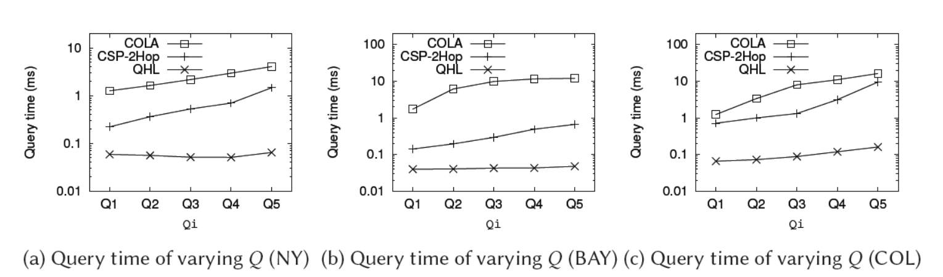
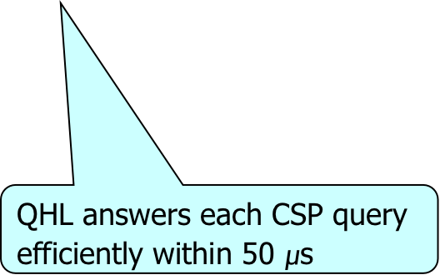
Experimental results
Query processing time on different road networks
QHL answers each CSP query efficiently within 50 $μ$s
QHL outperforms the other two by up to two orders of magnitude
Notes:
For query processing we can find that QHL anwsers each CSP query efficiently within 50 microseconds and QHL outperforms the other two by up to two orders of magnitude.

Slide 39
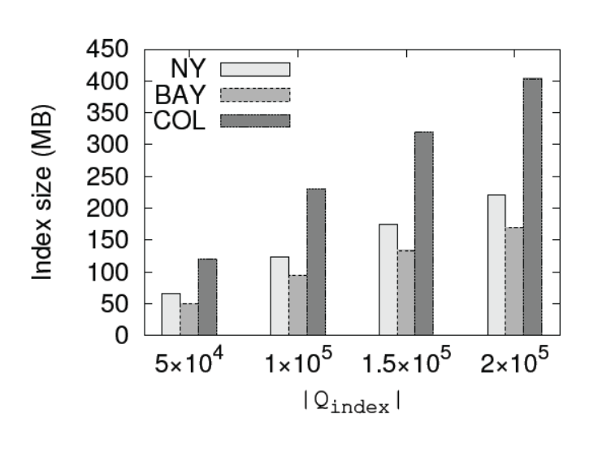
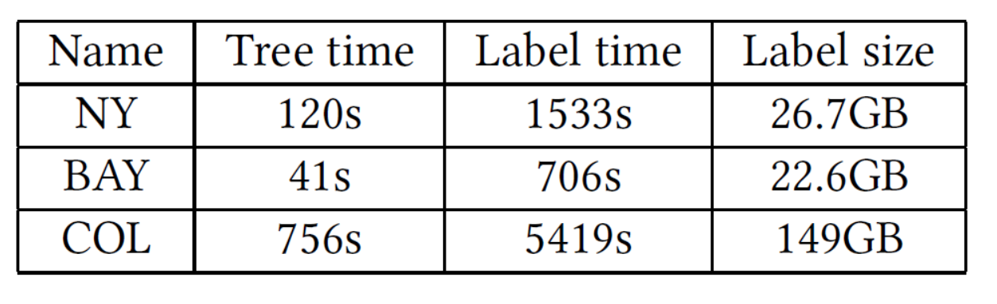
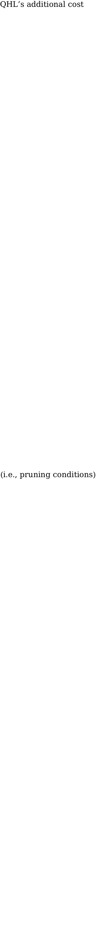
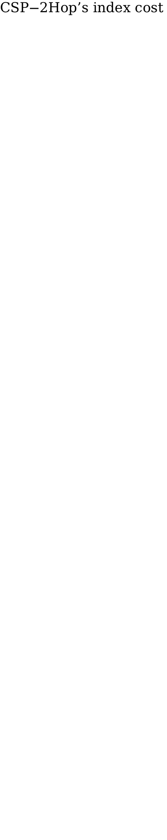
Index cost
$$\text{QHL}\text{’}\text{s} \text{additional} \text{cost}$$
$$\text{(}\text{i}\text{.}\text{e}\text{., }\text{pruning} \text{conditions}\text{)}$$
$$\text{CSP}\text{−}\text{2}\text{Hop}\text{’}\text{s} \text{index} \text{cost}$$
QHL consumes around 1% additional space cost compared with CSP-2Hop
Notes:
For index cost, QHL consumes around 1% additional space cost compared with CSP-2Hop.

Slide 40
Outline
Motivation
Preliminaries
Methodology
Experiments
Conclusion
Notes:
Finally, i will conclude the authors work.

Slide 41
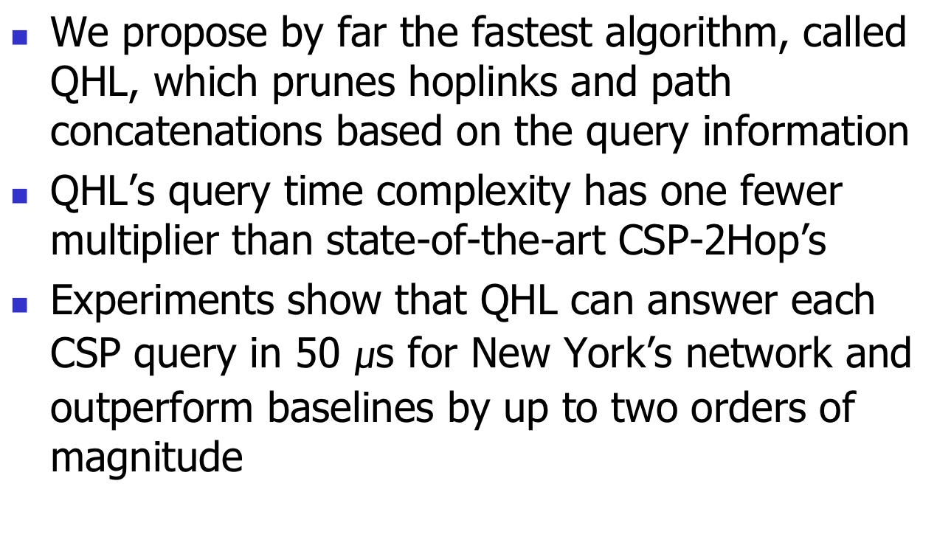
Conclusion
We propose by far the fastest algorithm, called QHL, which prunes hoplinks and path concatenations based on the query information
QHL’s query time complexity has one fewer multiplier than state-of-the-art CSP-2Hop’s
Experiments show that QHL can answer each CSP query in 50 $μ$s for New York’s network and outperform baselines by up to two orders of magnitude
Notes:
They propose by far the fastest algorithm, called QHL, which prunes hoplinks and concatenations based on the query information. QHL's query time complexity has one fewer multiplier than state of the art CSP-2Hop's. Experiments show that QHL can answer each CSP query in 50 microsecond for New York's network and outperform baselines by up to two orders of magnitude.

Slide 42
Q & A
Thank you for listening!

