Slide 1





SDC HACKATHON 2026 DOMAIN 1
SHIFTATLAS
3D
A source-traceable career atlas
for Malaysia
Primary: SDG 4
Supporting: SDGs 8 and 10
SELADEVS UTHM
Universiti Tun Hussein Onn Malaysia
Notes:
We are SELADEVS UTHM. SHIFTATLAS helps Malaysian graduates choose a credible next learning step as AI changes work. Our prototype connects reviewed skills with evidence, explainable role coverage and affordable learning.
Sources
Domain 1 brief PDF pages 2 and 4
https://github.com/hzqfarhan/SDC2026-SELADEVSUTHM
Visual sources
Prototype screenshots: SHIFTATLAS 3D, 25 October 2026. Low-poly concept illustrations and background: OpenAI built-in image generation. SELADEVS logo: https://www.seladevs.my/branding/seladevs-logo.png; copyright SELADEVS and contributing student designers. UN SDG icons: https://sdgs.un.org/goals; unchanged artwork. Targets4.4,8.5and10.2 describe intended contributions. Full asset provenance and hashes: ASSET_PROVENANCE.json and DESIGN_SOURCES.md.

Slide 2

The next learning decision
Which skill should
Aina learn next?
A fictional Malaysian graduate
SQL or Python next?
Limited weekly time. Limited budget.
An ordered plan with reasoning
she can inspect.
Concept illustration · fictional learner
02
Notes:
Aina is our fictional graduate. She can use spreadsheets, but cannot tell whether SQL, Python or another skill should come next. A useful result explains the trade-off and gives her an ordered plan that fits her time.
Sources
Synthetic Aina profile in src/lib/catalogue.ts
Domain 1 brief PDF pages 4 and 5
Visual sources
Prototype screenshots: SHIFTATLAS 3D, 25 October 2026. Low-poly concept illustrations and background: OpenAI built-in image generation. SELADEVS logo: https://www.seladevs.my/branding/seladevs-logo.png; copyright SELADEVS and contributing student designers. UN SDG icons: https://sdgs.un.org/goals; unchanged artwork. Targets4.4,8.5and10.2 describe intended contributions. Full asset provenance and hashes: ASSET_PROVENANCE.json and DESIGN_SOURCES.md.

Slide 3
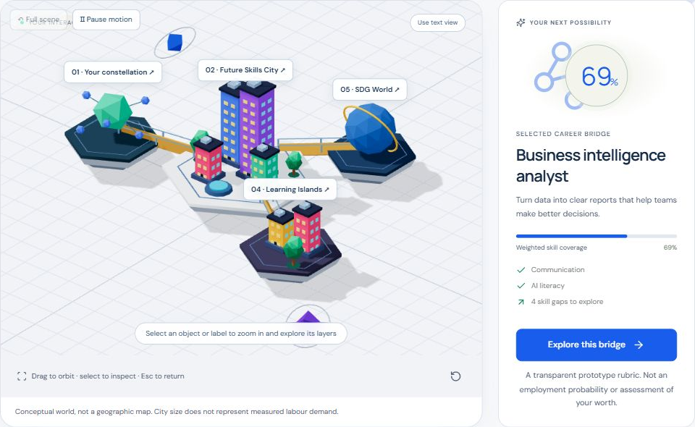
One profile across six connected modules
Reviewed skills Dated signals Role coverage Learning SDGs Scenarios
03
Notes:
The same profile connects all six modules. Dated signals inform role coverage. Visible gaps become learning steps. SDG pathways add purpose, while scenarios expose uncertainty. The interface offers both 3D exploration and equivalent text controls.
Sources
src/components/Atlas.tsx
Domain 1 must-have features PDF page 5
Visual sources
Prototype screenshots: SHIFTATLAS 3D, 25 October 2026. Low-poly concept illustrations and background: OpenAI built-in image generation. SELADEVS logo: https://www.seladevs.my/branding/seladevs-logo.png; copyright SELADEVS and contributing student designers. UN SDG icons: https://sdgs.un.org/goals; unchanged artwork. Targets4.4,8.5and10.2 describe intended contributions. Full asset provenance and hashes: ASSET_PROVENANCE.json and DESIGN_SOURCES.md.

Slide 4
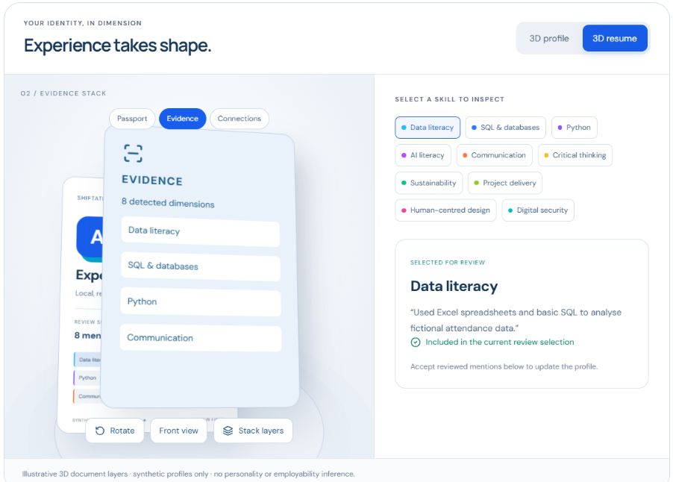
Reviewed intake and a 3D profile
Local parsing
Synthetic PDF, DOCX or TXT
Original evidence
Excerpts remain visible
for human review
The user chooses skill levels.
A mention cannot prove proficiency.
04
Notes:
Resume parsing stays on the device. Users can load a synthetic PDF, DOCX or text file and inspect the original excerpt behind each detected mention. They review the evidence and choose their level. The avatar reflects those self-assessments, without inferring personality or employability.
Sources
src/components/ResumeIntake.tsx
src/lib/resume.ts
docs/PROFILE_STUDIO.md
Visual sources
Prototype screenshots: SHIFTATLAS 3D, 25 October 2026. Low-poly concept illustrations and background: OpenAI built-in image generation. SELADEVS logo: https://www.seladevs.my/branding/seladevs-logo.png; copyright SELADEVS and contributing student designers. UN SDG icons: https://sdgs.un.org/goals; unchanged artwork. Targets4.4,8.5and10.2 describe intended contributions. Full asset provenance and hashes: ASSET_PROVENANCE.json and DESIGN_SOURCES.md.

Slide 5
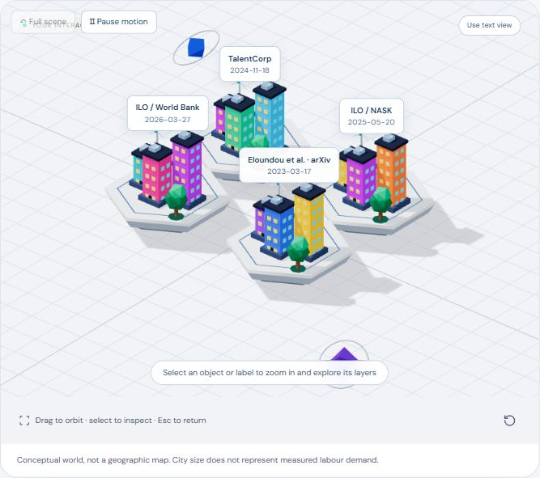
Dated signals feed the rubric
69% → 70%
Analyst coverage
in this synthetic example
Six dated research titles
Explicit opt-in weighting
25% maximum weight uplift
Research attention is experimental. Validated demand forecasting remains future work.
05
Notes:
An updatable arXiv feed supplies dated research titles. An explicit experiment counts skill-topic mentions and adjusts existing weights by at most twenty-five percent. In the current synthetic example, analyst coverage changes from sixty-nine to seventy percent. This demonstrates a working data-to-score loop. Research attention does not establish Malaysian hiring demand.
Sources
public/data/research.json, retrieved 19 October 2026
src/lib/signals.ts
https://export.arxiv.org/api/query
Visual sources
Prototype screenshots: SHIFTATLAS 3D, 25 October 2026. Low-poly concept illustrations and background: OpenAI built-in image generation. SELADEVS logo: https://www.seladevs.my/branding/seladevs-logo.png; copyright SELADEVS and contributing student designers. UN SDG icons: https://sdgs.un.org/goals; unchanged artwork. Targets4.4,8.5and10.2 describe intended contributions. Full asset provenance and hashes: ASSET_PROVENANCE.json and DESIGN_SOURCES.md.

Slide 6
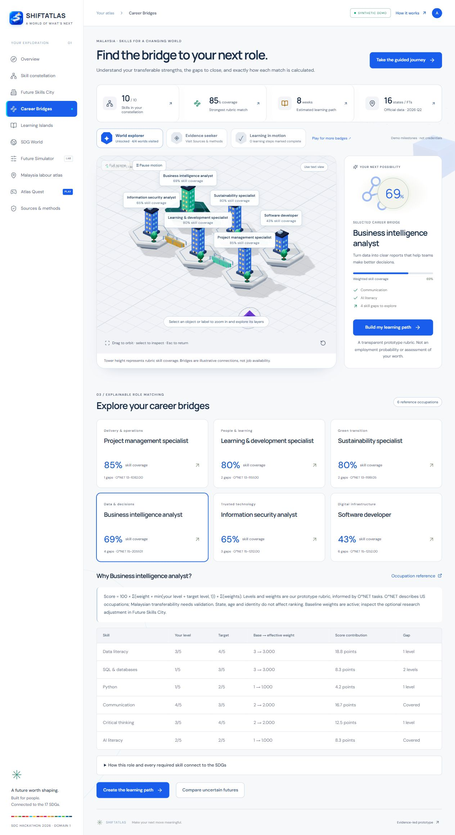
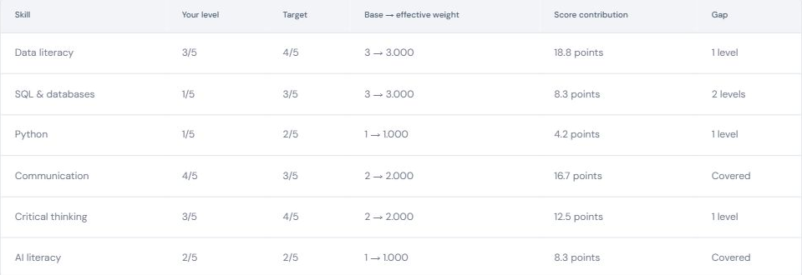
Explainable coverage and visible gaps
6 reference roles
10 skill dimensions
Current level · target · weight
Every score contribution stays visible.
O*NET references; project-authored rubric. Malaysian calibration remains open.
06
Notes:
Each role score exposes current level, target and weight. O*NET supplies the six occupation references, while the project authors the numerical rubric. Users can inspect every contribution and gap. The percentage describes rubric coverage, with Malaysian transferability still requiring validation.
Sources
src/lib/engine.ts
src/lib/catalogue.ts
https://www.onetonline.org/link/summary/15-2051.01
Visual sources
Prototype screenshots: SHIFTATLAS 3D, 25 October 2026. Low-poly concept illustrations and background: OpenAI built-in image generation. SELADEVS logo: https://www.seladevs.my/branding/seladevs-logo.png; copyright SELADEVS and contributing student designers. UN SDG icons: https://sdgs.un.org/goals; unchanged artwork. Targets4.4,8.5and10.2 describe intended contributions. Full asset provenance and hashes: ASSET_PROVENANCE.json and DESIGN_SOURCES.md.

Slide 7
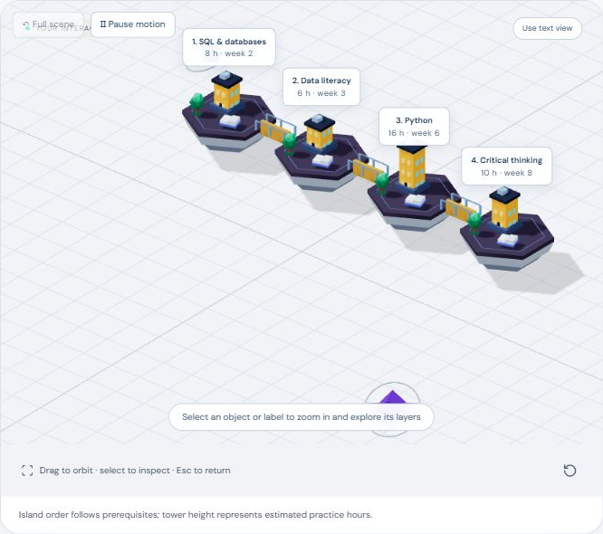
Learning in prerequisite order
An affordable
next step
Foundations first
Estimated practice hours
Real provider resources
Exportable plan
Activity completion does not certify proficiency. Practice hours are authored estimates.
07
Notes:
Learning Islands places foundations before dependent activities and estimates a sequence using skill gaps and weekly time. Real provider resources support each activity. Learners can track steps and export the plan. Completion records activity and does not automatically certify a skill.
Sources
src/lib/engine.ts, learningPlan
https://sqlbolt.com/
https://learn.microsoft.com/en-us/training/modules/introduction-power-bi/
Visual sources
Prototype screenshots: SHIFTATLAS 3D, 25 October 2026. Low-poly concept illustrations and background: OpenAI built-in image generation. SELADEVS logo: https://www.seladevs.my/branding/seladevs-logo.png; copyright SELADEVS and contributing student designers. UN SDG icons: https://sdgs.un.org/goals; unchanged artwork. Targets4.4,8.5and10.2 describe intended contributions. Full asset provenance and hashes: ASSET_PROVENANCE.json and DESIGN_SOURCES.md.

Slide 8
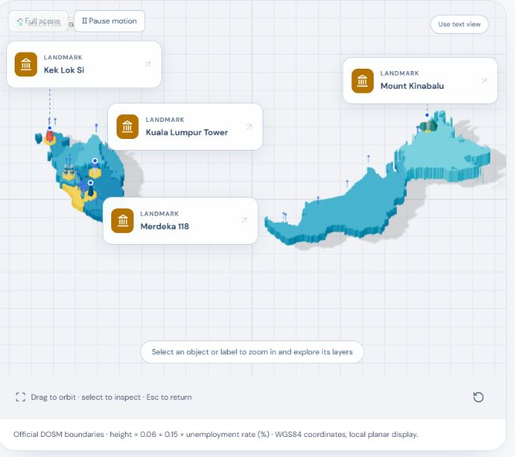
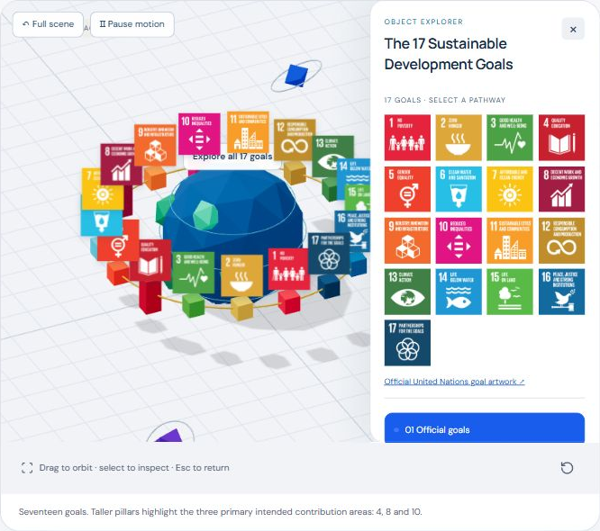
Malaysia and the 17 SDGs
16 states and federal territories
17 target-level pathways
Targets 4.4 · 8.5 · 10.2
DOSM observations: 2026 Q2
Intended contributions; outcomes unmeasured
08
Notes:
The Malaysia atlas uses actual DOSM state boundaries and quarterly state observations. We preserve that resolution and avoid city or individual inferences. Every role and required skill also connects to a specific SDG target. The app explains intended contributions across all seventeen goals, without claiming measured outcomes.
Sources
https://open.dosm.gov.my/data-catalogue/lfs_qtr_state
public/data/labour.json, 2026 Q2
https://sdgs.un.org/goals
Visual sources
Prototype screenshots: SHIFTATLAS 3D, 25 October 2026. Low-poly concept illustrations and background: OpenAI built-in image generation. SELADEVS logo: https://www.seladevs.my/branding/seladevs-logo.png; copyright SELADEVS and contributing student designers. UN SDG icons: https://sdgs.un.org/goals; unchanged artwork. Targets4.4,8.5and10.2 describe intended contributions. Full asset provenance and hashes: ASSET_PROVENANCE.json and DESIGN_SOURCES.md.

Slide 9
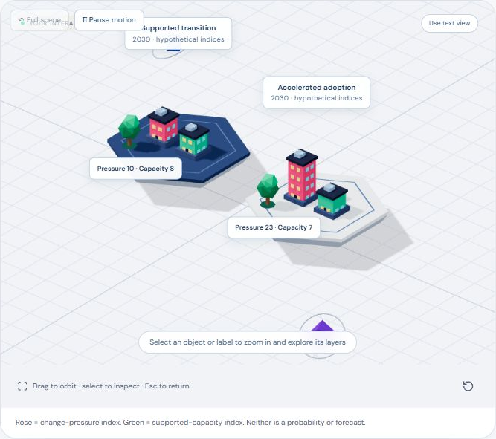
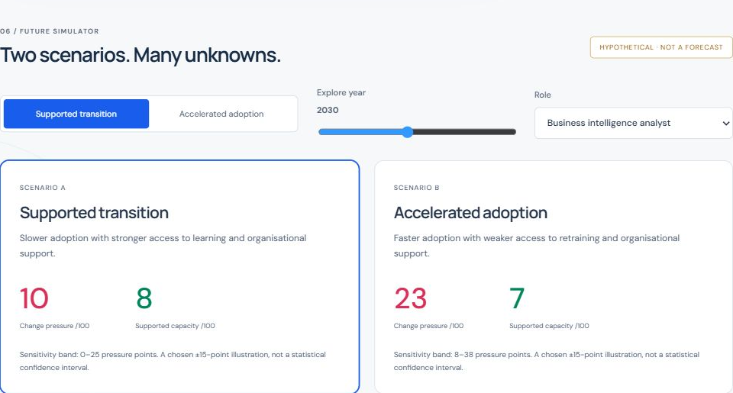
Two uncertain adoption scenarios
Supported transition and accelerated adoption
2026–2035 · hypothetical indices · disclosed assumptions · no assigned probabilities
09
Notes:
The simulator compares a supported transition with accelerated adoption. Users change the year and inspect every chosen coefficient. These hypothetical indices illustrate how adoption and learning support could interact. We assign no scenario probability and make no forecast of jobs lost or an individual’s employment.
Sources
src/lib/engine.ts, simulate
https://www.ilo.org/publications/generative-ai-and-jobs-refined-global-index-occupational-exposure
Visual sources
Prototype screenshots: SHIFTATLAS 3D, 25 October 2026. Low-poly concept illustrations and background: OpenAI built-in image generation. SELADEVS logo: https://www.seladevs.my/branding/seladevs-logo.png; copyright SELADEVS and contributing student designers. UN SDG icons: https://sdgs.un.org/goals; unchanged artwork. Targets4.4,8.5and10.2 describe intended contributions. Full asset provenance and hashes: ASSET_PROVENANCE.json and DESIGN_SOURCES.md.

Slide 10
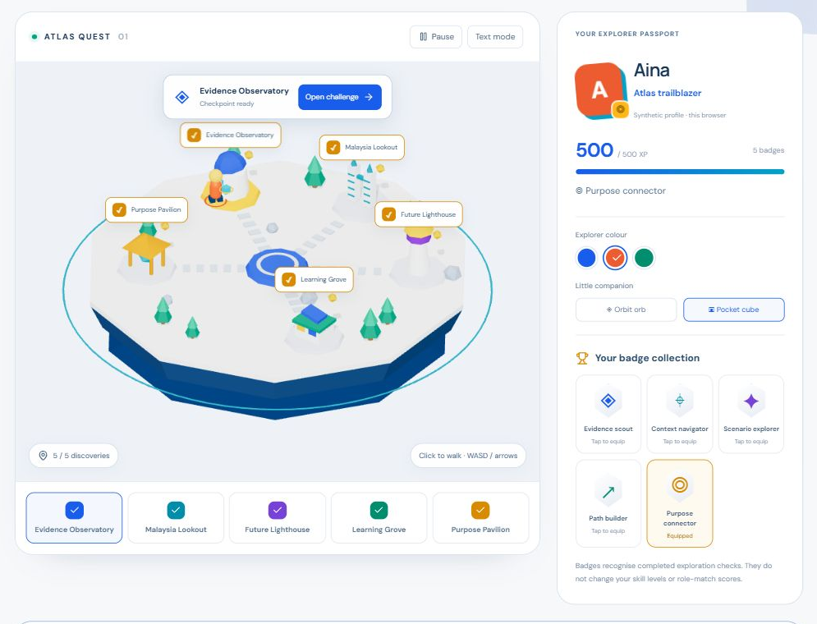
Atlas Quest makes exploration playable
5 discoveries
Unique badges
Saved passport
Outfits and companions
Activity badges.
Scores unchanged.
10
Notes:
Atlas Quest adds a playable low-poly island. Five checkpoints reinforce evidence review, geographical resolution and uncertainty. Unique badges, outfits and companions personalise the saved explorer passport. The rewards track exploration only. A learner study is still needed to establish an engagement benefit.
Sources
src/lib/quest.ts
src/components/AtlasQuest.tsx
docs/ATLAS_QUEST.md
Visual sources
Prototype screenshots: SHIFTATLAS 3D, 25 October 2026. Low-poly concept illustrations and background: OpenAI built-in image generation. SELADEVS logo: https://www.seladevs.my/branding/seladevs-logo.png; copyright SELADEVS and contributing student designers. UN SDG icons: https://sdgs.un.org/goals; unchanged artwork. Targets4.4,8.5and10.2 describe intended contributions. Full asset provenance and hashes: ASSET_PROVENANCE.json and DESIGN_SOURCES.md.

Slide 11

Career Council: one AI, four perspectives
One model. Four perspectives.
01 Profile reviewer
02 Role explorer
03 Learning planner
04 Grounding critic
Replit coordinates four sequential RunPod jobs.
The original skill rubric stays unchanged.
Architecture concept illustration
Reference-linked reviews · original skill rubric retained
11
Notes:
Our Career Council gives one AI model four specialist roles: profile reviewer, career explorer, learning planner and critic. Each stage builds on the previous suggestions. The critic challenges the reasoning and highlights trade-offs. Our gateway brings the stages together around the same trusted catalogue, helping learners compare choices while keeping their original skill scores intact.
Sources
src/components/CareerCouncil.tsx
scripts/council-gateway.mjs
Four viewpoints from one model, not four independent models
https://replit.com/@haziqfarhan174/SDC2026-SELADEVSUTHM
Council execution requires separate deployment acceptance
Visual sources
Prototype screenshots: SHIFTATLAS 3D, 25 October 2026. Low-poly concept illustrations and background: OpenAI built-in image generation. SELADEVS logo: https://www.seladevs.my/branding/seladevs-logo.png; copyright SELADEVS and contributing student designers. UN SDG icons: https://sdgs.un.org/goals; unchanged artwork. Targets4.4,8.5and10.2 describe intended contributions. Full asset provenance and hashes: ASSET_PROVENANCE.json and DESIGN_SOURCES.md.

Slide 12

Grounding checks before the answer
01 Fictional text
02 Replit gateway
03 RunPod inference
04 Validated report or visible failure
Schema, known IDs and exact quotes checked.
Secrets stay on the server.
Qwen3-4B-Instruct-2507 · Apache 2.0
Explicit cloud consent · server-held credentials · source-linked review
12
Notes:
We designed the Council around source-linked choices. Our gateway checks the response structure, recognised roles and courses, and exact quotations from the fictional profile. It restores learning prerequisites and keeps API keys on the server. Qwen3-4B-Instruct-2507 supplies the four review roles; E5 separately provides semantic retrieval. Learners retain control over the final choice.
Sources
https://huggingface.co/Qwen/Qwen3-4B-Instruct-2507
https://huggingface.co/Qwen/Qwen3-4B-Instruct-2507/commit/cdbee75f17c01a7cc42f958dc650907174af0554
scripts/council-gateway.mjs, validateReview and validateReceipt
Qwen revision cdbee75f17c01a7cc42f958dc650907174af0554
This architecture slide does not present a completed Council result
Visual sources
Prototype screenshots: SHIFTATLAS 3D, 25 October 2026. Low-poly concept illustrations and background: OpenAI built-in image generation. SELADEVS logo: https://www.seladevs.my/branding/seladevs-logo.png; copyright SELADEVS and contributing student designers. UN SDG icons: https://sdgs.un.org/goals; unchanged artwork. Targets4.4,8.5and10.2 describe intended contributions. Full asset provenance and hashes: ASSET_PROVENANCE.json and DESIGN_SOURCES.md.

Slide 13
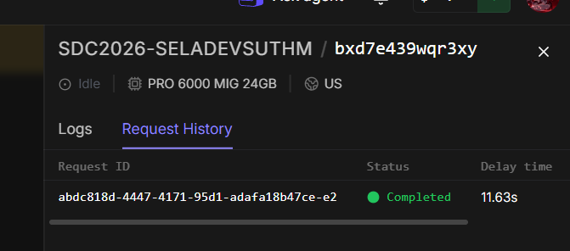

Verified E5 GPU execution
3.452 s
Model execution time
PRO 6000 MIG 24GB
CUDA · Runpod Serverless
multilingual-e5-base
1 fictional query · 2 authored passages
Queue delay: 11.626 s
25 October 2026
03:11 MYT
55 application tests · 18 offline worker checks
Production build passed
Pinned E5 revision · actual CUDA response · dated provider receipt retained
13
Notes:
We built and ran our E5 worker on RunPod using a PRO six thousand M I G, twenty-four gigabyte GPU. Our recorded fictional query compared two role descriptions and returned CUDA results in three point four five two seconds, after eleven point six two six seconds in the queue. We also passed fifty-five application tests, eighteen offline worker checks and the production build. Our submission includes the actual request history and completion receipt.
Sources
outputs/submission/evidence/runpod/e5-completion.json, Runpod job abdc818d-4447-4171-95d1-adafa18b47ce-e2, COMPLETED
outputs/submission/evidence/runpod/e5-completed-request-history.png, worker PRO 6000 MIG 24GB
Generated 2026-10-24T19:11:44.011980Z = 25 October 2026, 03:11 MYT
intfloat/multilingual-e5-base revision d128750597153bb5987e10b1c3493a34e5a4502a
One fictional query and two authored passages; executionTime 3452 ms; delayTime 11626 ms
55 application tests, 18 offline worker contract checks, production build and TypeScript passed
docs/VERIFICATION.md
https://github.com/hzqfarhan/SDC2026-SELADEVSUTHM
Visual sources
Prototype screenshots: SHIFTATLAS 3D, 25 October 2026. Low-poly concept illustrations and background: OpenAI built-in image generation. SELADEVS logo: https://www.seladevs.my/branding/seladevs-logo.png; copyright SELADEVS and contributing student designers. UN SDG icons: https://sdgs.un.org/goals; unchanged artwork. Targets4.4,8.5and10.2 describe intended contributions. Full asset provenance and hashes: ASSET_PROVENANCE.json and DESIGN_SOURCES.md.

Slide 14

Next: a learner pilot
Proposed pilot with 10 learners
20%
Less median planning time
versus a static resource list
80%
Correctly explain a score
and its uncertainty
Pilot targets: planning speed and explanation quality
Development: OpenAI Codex / GPT-5.1 Sol · Qoder · Cortex Code (CoCo)
14
Notes:
Our next phase brings SHIFTATLAS to ten learners. We aim for twenty percent less median planning time and eighty percent correctly explaining their score and uncertainty. We built the project with OpenAI Codex and GPT-five-point-one Sol, alongside coding assistance from Qoder and Cortex Code, CoCo. Our goal is clear: help learners choose a next step they can understand, afford and act on.
Sources
Planned ten-learner pilot accepted for proposal preparation on 25 October 2026
docs/TECHNICAL_DECLARATION.md
Domain 1 brief PDF pages 7 and 8
Visual sources
Prototype screenshots: SHIFTATLAS 3D, 25 October 2026. Low-poly concept illustrations and background: OpenAI built-in image generation. SELADEVS logo: https://www.seladevs.my/branding/seladevs-logo.png; copyright SELADEVS and contributing student designers. UN SDG icons: https://sdgs.un.org/goals; unchanged artwork. Targets4.4,8.5and10.2 describe intended contributions. Full asset provenance and hashes: ASSET_PROVENANCE.json and DESIGN_SOURCES.md.

