Slide 1
Drivers of cost of care analysis
Hui Zhen Tam

Slide 2
Population characteristics
3400 records of admission
Data collected from year 2011 to 2015
Gender distribution is 50:50

Slide 3
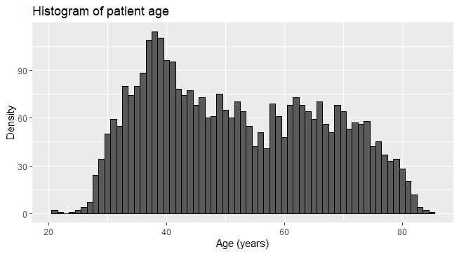
Population characteristics
Mean (median) age 52 (50) years old
Minimum age 21 years old
Maximum age 85 years old

Slide 4
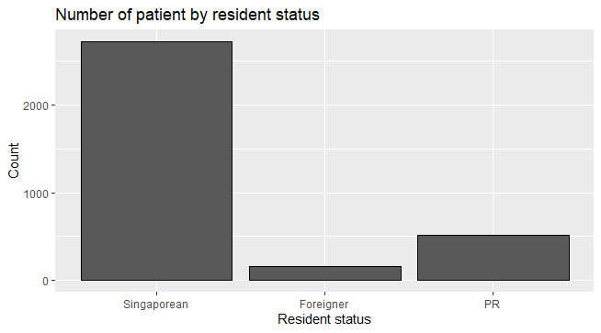
Population characteristics
80% are Singaporean
15% are PR
5% are foreigner

Slide 5
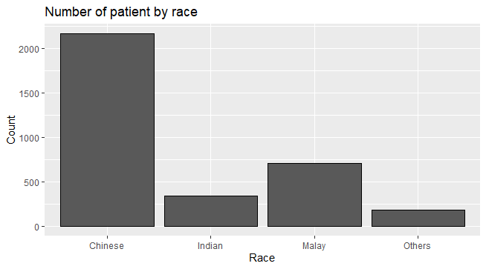
Population characteristics
64% Chinese
21% Malay
10% Indian
5% Other races

Slide 6
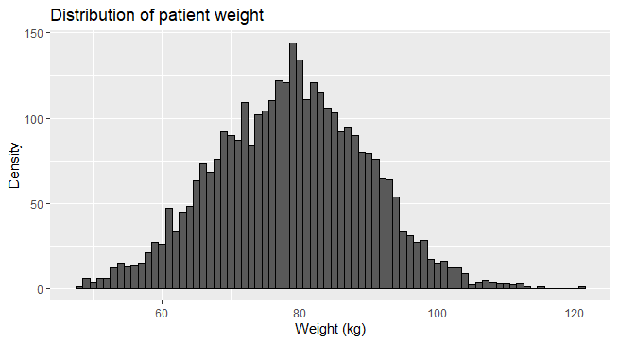
Population characteristics
Mean weight 78.75kg
Median weight 78.90kg
Minimum weight 48kg
Maximum weight 121kg

Slide 7
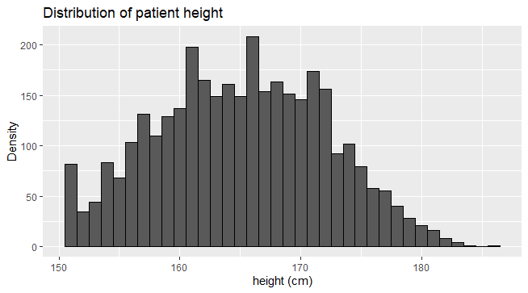
Population characteristics
Mean height 165.1cm
Median height 165.0cm
Minimum height 151cm
Maximum height 186cm

Slide 8
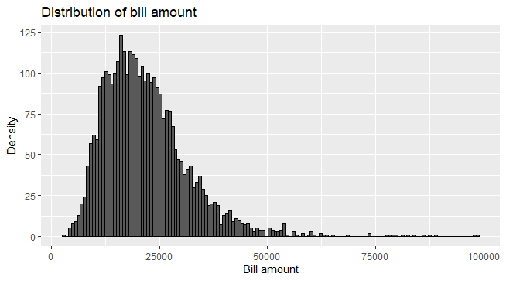
Population characteristics
Mean amount $21859
Minimum amount $2946
Maximum amount $98724
Median amount $20180
IQR [14793-26680]
Right skew

Slide 9
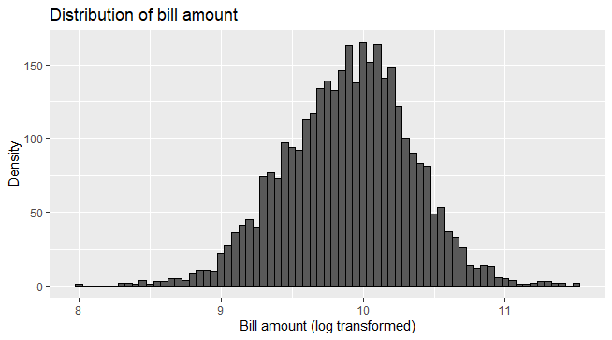
Statistical method
Log transformation of bill amount variable – the normality assumption of linear regression
Since bill amount is a continuous variable, linear regression is used to model the relationship between bill amount and other explanatory variables

Slide 10
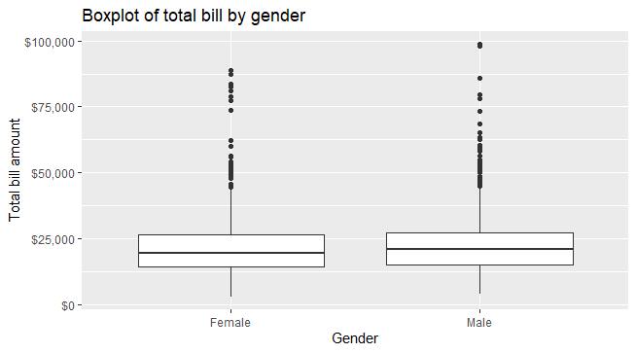
Linear regression model – Gender
Wald test p-value=0.0001
There is evidence of difference in bill amount between female and male group
The bill amount increases by about 6% in male group compared to female group.

Slide 11
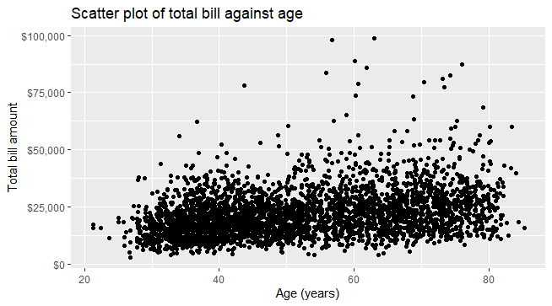
Linear regression model – Age
Appear to have positive correlation, i.e., increase in age is associated with increase of bill amount
For a year increase in age, the bill amount is increased by 1%, p<0.0001

Slide 12
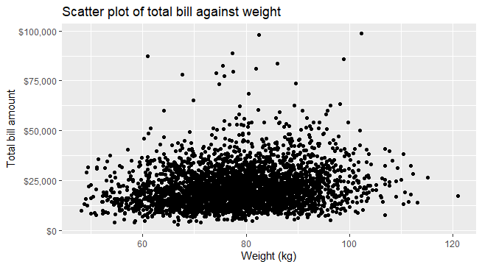
Linear regression model – Weight
Appear to have some positive correlation
For a unit increase in weight, the bill amount is increased by 0.7%, p<0.0001

Slide 13
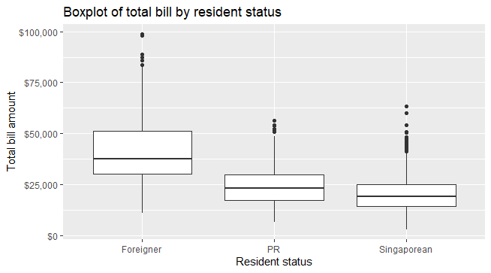
Linear regression model – Resident status
Distribution of bill amount right skew in foreigner group
Singaporean and PR similar distribution
Using Singaporean group as reference:
Bill amount of foreigner is 2.1 times the bill mount of Singaporean, p<0.0001
Bill amount of PR is increased by 21% compared to Singaporean, p<0.0001

Slide 14
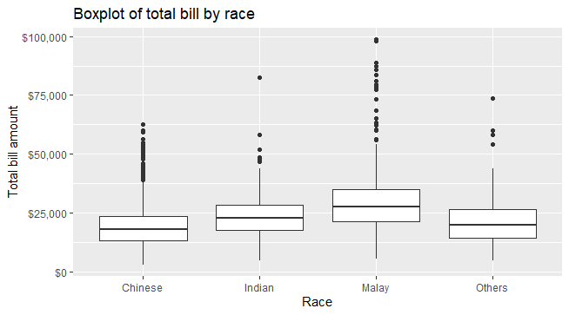
Linear regression model – Race
Malay has highest median of bill amount, following Indian, other races and Chinese
Using Chinese group as reference:
Bill amount increases by 26% in Indian group, p<0.0001
Bill amount increases by 55% in Malay group, p<0.0001
Bill amount increases by 10% in other races group, p<0.003

Slide 15
Linear regression model – Medical history
Compared to patient without the preoperative medication
Patient with medical history 1 has 32% increase in bill amount, p<0.0001
Patient with medical history 2 has 3% increase in bill amount, p=0.0784
Patient with medical history 3 has 3% increase in bill amount, p=0.134
Patient with medical history 4 has 3% decrease in bill amount, p=0.463
Patient with medical history 5 has 6% increase in bill amount, p=0.0604
Patient with medical history 6 has 18% increase in bill amount, p<0.0001
Patient with medical history 7 has 4% increase in bill amount, p=0.0411

Slide 16
Linear regression model – Preoperative medication
Compared to patient without the preoperative medication
Patient with preoperative medication 1 has 2% increase in bill amount, p=0.314
Patient with preoperative medication 2 has 4% increase in bill amount, p=0.0149
Patient with preoperative medication 3 has 2% increase in bill amount, p=0.321
Patient with preoperative medication 4 has 2% increase in bill amount, p=0.287
Patient with preoperative medication 5 has 0.7% increase in bill amount, p=0.739
Patient with preoperative medication 6 has 4% increase in bill amount, p=0.029

Slide 17
Linear regression model – Symptom
Compared to patient without the symptom
Patient with Symptom 1 has 15% increase in bill amount, p<0.0001
Patient with Symptom 2 has 19% increase in bill amount, p<0.0001
Patient with Symptom 3 has 22% increase in bill amount, p<0.0001
Patient with Symptom 4 has 18% increase in bill amount, p<0.0001
Patient with Symptom 5 has 68% increase in bill amount, p<0.0001

Slide 18
Conclusion
Average bill amount of male patient is higher than female patient
Increase in age and weight is associated with increase in the cost of care
Foreigner has highest bill amount in average, which is 2 times the bill amount of Singaporean
Malay has the highest bill amount among 4 race groups
Medical history 1, 6 and 7, and preoperative medication 2 and 6 significantly increase the cost
Symptom 5 largely increased the bill amount by almost 70%
There is no statistically significant effect of lab results on the hospitalization bill amount

