Slide 1
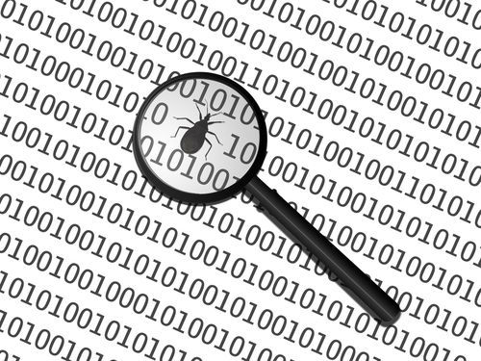
Integration of Static Security Code Analysis in Continuous Integration Lifecycles
Brian Pfretzschner
Sebastian Funke
Hamza Zulfiqar
Source: http://povilasb.com/_images/code_analysis.jpeg

Slide 2
Agenda
Introduction
Input Validation
Static Security Code Analysis
Limitations and Conclusion
Notes:
- gjg

Slide 3
Agenda
Introduction 1.1 Motivation 1.2 Security Code Analysis
Input Validation
Static Code Analysis Tools
Limitations and Conclusion
Notes:
- gjg

Slide 4
1.1 Motivation
Static Code Analysis is
your personal
(security) code auditor!

Slide 5
1.1 Motivation
Vulnerabilities:
Example 1:
<?php $post_id = $_GET['post_id']; $post = mysql_query('SELECT * FROM posts WHERE id='.$post_id); echo '<h1>'.$post['title'].'</h1>'; echo '<p>'.$post['body'].'</p>'; echo '<a href="'.permanentUrl($post_id).'">Permanent link</a>'; function permanentUrl($id) { return '?post_id='.$id; } ?>

Slide 6
1.1 Motivation
Vulnerabilities:
Example 2:
#include <stdio.h> #include <string.h> int main(int argc, char **argv) { char buf[4]; unsigned short num = 12345; // Read user input printf("Enter a num (max 4 characters): "); gets(buf); // Print the value of num printf("%d\n", num); return 0; }

Slide 7
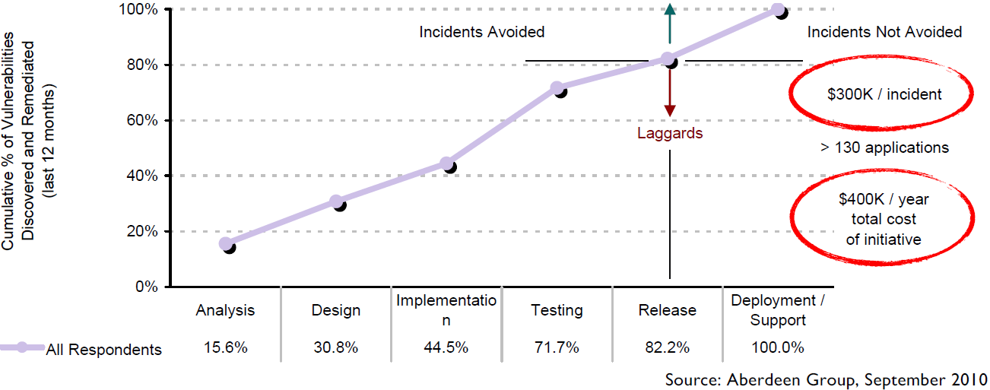
1.1 Motivation
Market statistics:
Source Eric Bodden, ACA Lecture slides

Slide 8
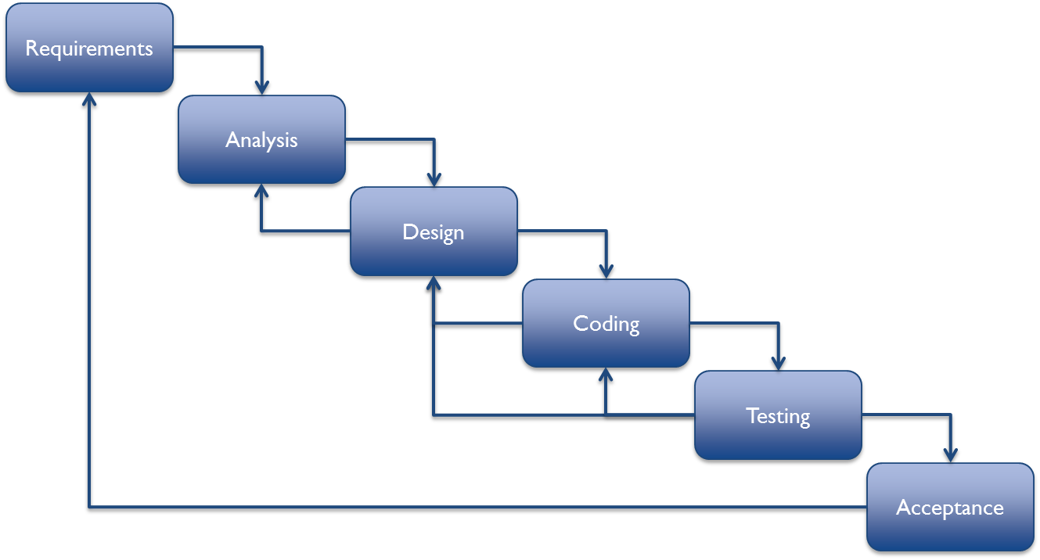
1.2 Security Code Analysis
Source: http://www.covalentmarketing.com/wp-content/uploads/2013/02/Agile-Approach.png

Slide 9
1.2 Security Code Analysis
Security code analysis
Memory Leaks Type checking
Style checking
Program understanding
Program/Property verification
Bug finding
Dynamic analysis
Static analysis
Input validation
Notes:
Close related to compilers
Type checking eliminates entire categories of programming mistakes
Pure style checkers enforce rules related to whitespaces, naming, commenting and program structures etc. Concerns with readability and maintainability
Program understanding tools help programmer make sense of a large code base. E.g. find use of this method or find declaration of global variable
Program verification toll accepts a specification and code and tries to prove that code is faith full implementation of specification
Point out that places where program will behave in a way that the programmer did not intend. Come prestocked with a set of bug finding idioms/rules
Programs need to accept input and computing a good result based on having good input.

Slide 10
Agenda
Introduction
Input Validation 2.1 What to validate? 2.2 How to validate?
Static Code Analysis Tools
Limitations and Conclusion
Notes:
- gjg

Slide 11

2. Input Validation
Every program takes input
Validation of every input is a defensive measure
Never expect that you can trust input just because it comes from somewhere that seems reliable
Source: http://web.securityinnovation.com/Portals/49125/images/MP900401804[1].JPG

Slide 12

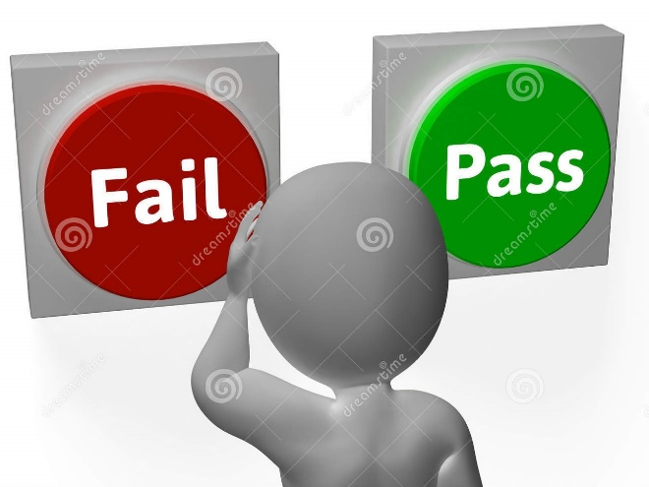
2. Input Validation
2.1 What to validate?
2.2 How to validate?
Source:
http://thumbs.dreamstime.com/z/fail-pass-buttons-show-rejection-validation-showing-34210524.jpg
http://www.geinstruments.com/files/images/headers%20270/industry%20application/pharma/pharma_testimonials_270.jpg

Slide 13

2.1.1 Validate all input
Don’t make optimistic assumptions
Every single input must be validated
Input validation sub groups
Syntax Check
Semantic Check
Make it impossible for programmer to say “I forgot to do input validation”
Source: http://www.quantumsoftware.com.au/Images/Products/WindowsFormsComponents/NumberBox.gif
Notes:
Validate input even if it comes from secure connection and arrives from trusted source or protected by strict file permission.
Syntax check can perform at the point where data enters the program and semantic check goes along the application logic

Slide 14

2.1.2 Validate input from all source
Command line parameters
Configuration files
Data received from a database
Environment variables
Network services
Registry values
System properties
Temporary files
Source: http://www.tnsi.com/site/imagerotators/4/20.jpg

Slide 15
2.1.3 Establish trust boundaries
Define clear boundaries to distinguish trusted and untrusted data
Data can bypass to other side only after validation
Boundary line can be deceived
status = request.getParameters(“status”); if (status != null && status.length() > 0) { session.setAttribute(“USER_STATUS”, status); }

Slide 16
Agenda
Introduction
Input Validation 2.1 What to validate? 2.2 How to validate?
Static Code Analysis Tools
Limitations and Conclusion
Notes:
- gjg

Slide 17

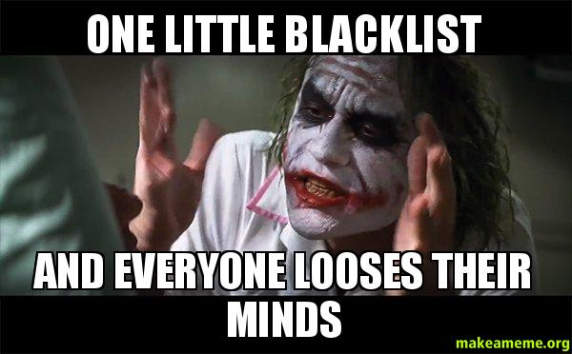
2.2.1 Avoid blacklisting
Rejects potentially dangerous input values and sequences
for (int i = 0; i < content.length; i++) { switch (content[i]) { case ‘<‘: result.append("&lt;"); break; case ‘>‘: result.append("&gt;"); break; default : result.append(content[i]); } }
http://makeameme.org/media/created/One-Little-Blacklist.jpg
http://www.alphasandesh.com/blog/wp-content/uploads/2013/06/email-blacklist.png

Slide 18
2.2.2 Use strong input validation
Indirect selection
Whitelisting
public static void main (string[] args) throws IOException { String regex = “^[0-9\\-\\. ]+$”; Pattern p = Pattern.compile(regex); for (int i = 0; I < args.length; i++) { String num = args[i].trim(); matcher m = p.matcher(num); if (m.matches()) { dialNumber(num); } else { system.out.println(“Not a valid phone number”); } }

Slide 19
2.2.3 Reject bad data
Don’t repair data that fails input validation check
String sensor(String input) { String[] badWords = new String[] {“bastich”, “sharries”, “prunt”}; for(int i = 0; i < badWords.length; i++) { do { index = input.indexOf(badWords[i]); if (index != -1) { String early = input.substring(0, index); String late = input.substring(index + badWords[i].length(), input.length()); input = early + late; } while (index != -1); return input; } }}

Slide 20
2.2.4 Make good input validation default
<?php $post = new Post(); $post->title = $_POST["title"]; // “First blog post!!” $post->author_id = $_POST["author_id"]; // “5” $post->save($validate=true); ?>
System Libraries
Security-Enhanced API
Program Logic
INSERT INTO `posts` (title,author_id) VALUES('First blog post!!', 5)
Notes:
Place input validation in your program
Layer of abstraction on top of system libraries
PHP ActiveRecord example:
Developer should not access system libraries directly

Slide 21
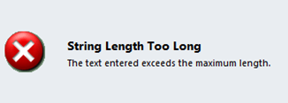
2.2.5 Check input length
Validate input against maximum and minimum expected length
Input length validation should be separated from business logic
if (path != null && path.length() > 0 && path.length() <= MAX) { fileOperation(path); }
Source: https://community.dynamics.com/resized-image.ashx/__size/550x0/__key/CommunityServer-Components-UserFiles/00-00-03-61-89-Attached+Files/0447.String-too-long-error.png

Slide 22
2.2.5 Check input length & content
The following example uses regular expression to check against a whitelist and verify input length at same time.
final String PATH_REGEX = "[a-zA-Z0-9/]{1, "+MAXPATH+"}"; final Pattern PATH_PATTERN = Pattern.compile(PATH_REGEX); …. …. if (path != null && PATH_PATTERN.matcher(path.matches())) { fileOperation(path); }

Slide 23
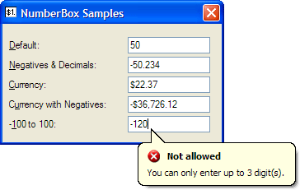
2.2.6 Bound numeric input
Check numeric input against upper bound and lower bound
String numStr = request.getParameter("numPurchased"); int numPurchased = Integer.parseInt(numStr); if (numPurchased > 0) { total = numPurchased * 100; // each item costs $100 }
Entering 42969671 will result in -196
Source: http://www.quantumsoftware.com.au/Images/Products/WindowsFormsComponents/NumberBox.gif
Notes:
Input values exceed the magnitude

Slide 24
2.2.7 Preventing Meta-character Vuln.
Allowing user to control commands leads to big trouble
Attacker enters string “name’ OR ‘a’=‘a”,
then query becomes
SELECT * FROM items
WHERE owner = ‘Alex’ AND itemname = ‘name’ OR ‘a’ = ‘a’;
String username = ctx.getAuthenticatedUserName(); String itemName = request.getParameter("itemName"); String query = "SELECT * FROM items WHERE owner = '" + userName + "' AND itemname = '„ + itemName + "'"; Statement stmt = conn.createStatement(); ResultSet rs = stmt.executeQuery(query);
SELECT * FROM items WHERE owner = <userName> AND itemname = <itemName>;

Slide 25

2.2.7 Preventing Meta-character Vuln.
Parameterized Queries:
Keep data and control information separated
Use Bind Parameters as placeholders for users’ input
String username = ctx.getAuthenticatedUserName(); String itemName = request.getParameter("itemName"); String query = "SELECT * FROM items WHERE owner =?" + " AND itemname =?"; PreparedStatement stmt = conn.PrepareStatement(query); Stmt.setString(1, userName); Stmt.setString(2, itemName); ResultSet rs = stmt.executeQuery(query);
Source: http://2.bp.blogspot.com/-FEai-TN7IyU/VFPdSuIq7jI/AAAAAAAADAY/vWsyyOfU_qA/s1600/SQL%2BInjection%2BAttacks%2B-%2BHow%2Bto%2BPrevent%2BVB.Net%2BDatabase%2BApplications.gif

Slide 26
2.2.7 Path manipulation
Input is allowed to include file system metacharacters (.,/,\)
Unauthorized file system access
String rName= request.getParameters("reportName"); File rFile = new File ("/usr/local/apfr/reports/" + rName); rFile.delete();
It can cause the application to delete
some configuration file.

Slide 27
2.2.7 Path manipulation (cont..)
final static int MAXNAME = 50; final static int MAXSUFFIX = 5; final static String FILE_REGEX = "[a-zA-Z0-9]{1, "+MAXSUFFICE+"}" + "\\.?" + "[a-zA-Z0-9]{1, "+MAXSUFFICE+"}"; final static Pattern FILE_PATTERN = Pattern.compile(FILE_REGEX); public void validateFilename(String filename) { if (!FILE_PATTERN.matcher(filename).matches()) { throw new validateException("illegal filename"); } }

Slide 28
Agenda
Introduction
Input Validation
Static Code Analysis Tools 3.1 Weakness Classes and Definitions 3.2 Simple Approach 3.3 Lexical Analysis 3.4 Data Flow Analysis 3.4.1 Intra-Procedural Analysis 3.4.2 Inter-Procedural Analysis 3.5 Use Cases
Limitations and Conclusion
Notes:
- gjg

Slide 29
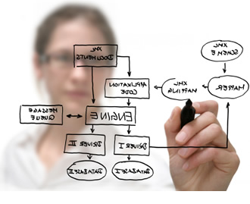

3. Static Code Analysis Tools
Source:
http://www.saiamerica.com/images/inner_page/system_analysis.jpg https://www.nerdsonsite.com/blog/wp-content/uploads/2012/07/iStock_000017107306XSmall.jpg

Slide 30
3.1 Weakness Classes
Authentication and Access Control
Buffer Handling
Code Quality
Control Flow Management
Encryption and Randomness
Error Handling
File Handling
Information Leaks
Initialization and Shutdown
Injection
Miscellaneous
Number Handling
Pointer and Reference Handling
Source: National Security Agency Center for Assured Software: On Analyzing Static Analysis Tools
Notes:
Lets first introduce a few categories of weaknesses classified by the NSA

Slide 31
3.1 Definitions
Performance Definitions:
False positives: Wrong reportings of found vulnerabilities
False negatives: Not found vulnerabilities
Precision: How many false positives did the analysis produce
Recall: How many false negatives had the analysis
Notes:
Lets introduce a few important terms to share a common language about the performance of a static analysis.

Slide 32

3.2 Simple Approach
How do we start ?
Source: http://cdn.makeuseof.com/wp-content/uploads/2012/07/Question.png?2780e3
Notes:
Lots of different things we wanne find, so how do we start?

Slide 33
3.2 Simple Approach
How to find the Buffer Overflow?
Simple approach: grep -nr gets source.c
#include <stdio.h> #include <string.h> int main(int argc, char **argv) { char buf[4]; unsigned short num = 12345; // Read user input printf("Enter a num (max 4 characters): "); gets(buf); // Print the value of num printf("%d\n", num); return 0; }
Notes:
Strcpy is a dangerous function, it doesnt check if the buffer ist gonna copy in, is actually big enough…better use strncpy
But, we would need to write lots of rules and have many false positives….how to automate this and find more vulnerabilties?

Slide 34
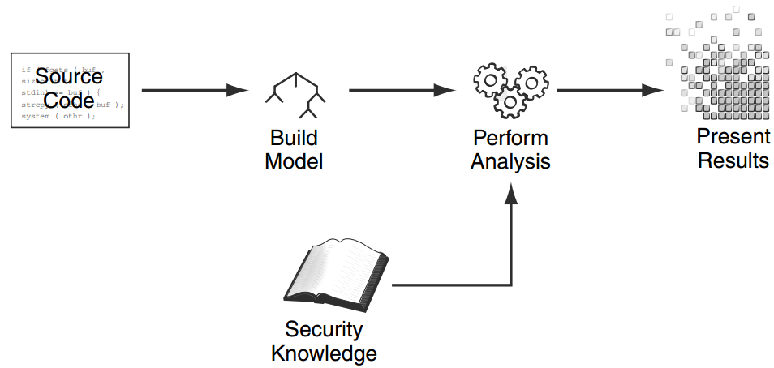
3.2 Simple Approach
Source Brian Chess & Jacob West: Secure Programming with Static Analysis, p. 71
Notes:
Lets take a look how does a static code analysis works in general?
Security Knowledge as Analysis input in form of Rules
→ we need Rules out of our security knowledge

Slide 35
3.2 Simple Approach
Source Code vs. Compiled Binaries
Language Abstraction (e.g. Java → Jimple/AST)
How? → Parsing and Lexing (Compiler)
How? Building a context free grammar and tokenize the code
Harder to analyse (nested statements, syntactic sugar)
Easy reporting
Hard reporting
Not the actuall program
Easier to analyse
Notes:
Source Code:
More complicated (nested statements and language constructs like classes)
Easy reporting
Binaries:
Compiler effects included, not the actuall program!
Hard reporting
No type information
Less complicated
We can still use it on compiled code to verify the trust of our libraries!
Lets meet somewhere in between to have the best out of both worlds!
How to abstract the source code? Use compiler tools like Parser/Lexer and Tokenizer
E.g. Lex Yacc in C, JavaCC for Java

Slide 36
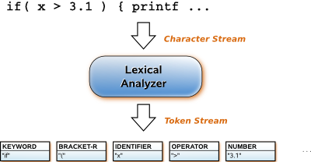
3.3 Lexical Analysis
Source: http://quex.sourceforge.net/images/lexical-analysis-concept.png
Notes:
A Lexical Analysis converts source code syntax into ‘tokens’ of information in an attempt to abstract the source code and make it easier to manipulate

Slide 37
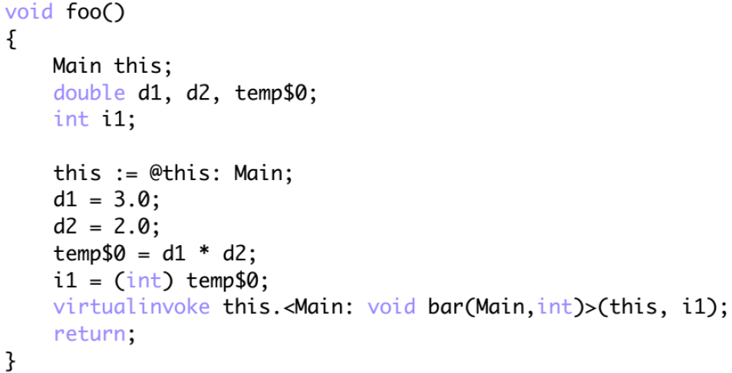
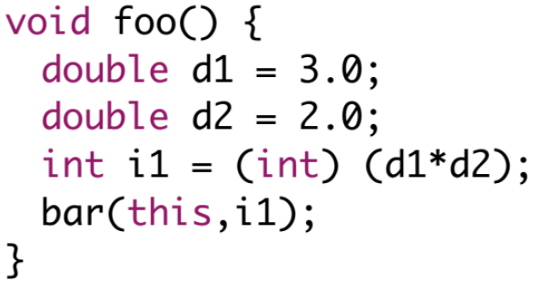
3.3 Lexical Analysis
Jimple in SOOT: Java code, but simple ;-)
Java
Jimple
Source: Eric Bodden - ACA lLecture slides

Slide 38
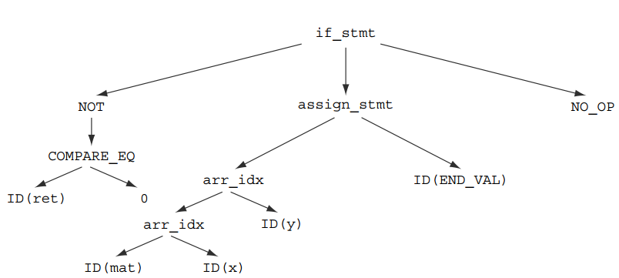
3.3 Lexical Analysis
Abstract Syntax Tree (AST):
Additionally:
Collect semantics of nodes with Symbol Tables
Source Brian Chess & Jacob West: Secure Programming with Static Analysis, p. 75
Notes:
Out of this easier syntax we can build a tree structure for easier analysis
To understand the semantics of those nodes we have to build simultanously a symbol table with all variable and statement names and values

Slide 39
3.3 Lexical Analysis
More Advanced: RATS
Lexical approach with predefinied patterns for finding:
Memory leaks (Buffer Overflows)
Race Conditions, etc…
Usable reporting
Scalable
Extensible
RATS-XML-Rule to find the gets Buffer Overflow
Tools to find memory leaks: ccpcheck
<Vulnerability> <Name>strcpy</Name> <BOProblem> <SrcBufArg>2</SrcBufArg> <Severity>High</Severity> </BOProblem> </Vulnerability>
Notes:
Rough Auditing Tool for Security
rats is a significant improvement becaue it uses a lexical approch with a set of predefined patterns to identify potentially dangourous areas of the code
But we need to write lots of rules for those kind of lexical analyzers, still finds lots of false positives and false negatives (cause it finds just very common vulnerabilities)
→ we want usually something more automatical and precise, something that can also consider the context → Data Flow Analysis

Slide 40
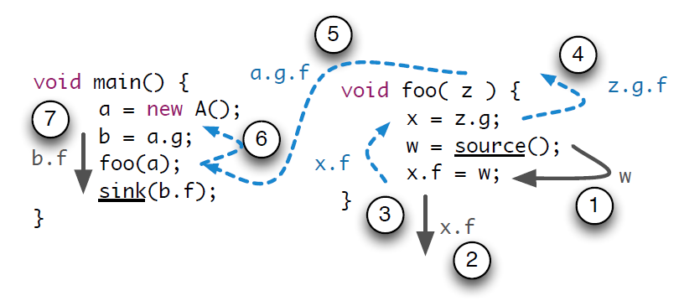
3.4 Data Flow Analysis
Source: http://sseblog.ec-spride.de/wp-content/uploads/2013/05/aliasFlow.png
Notes:
Data flow analysis is used to collect run-time (dynamic) information about data in software while it is in a static state

Slide 41
3.4.1 Intra-Procedural Analysis
Intra-procedural (local)
Limited to one function
Less complicated
Tracking of Control and Data Flow!
Find potential vulnerabilities by tracking inputs (Source) through the code to potential leaks (Sink)
How? Control- and Data-Flow Graphs
Inter-procedural (global)
More complicated
Analyzes the whole program
Notes:
Lets start with a basic approach of an intra-procedural analysis, because ist easier to abstract from function calls in the beginning
We come back to Inter-procedural Analysis later…
We can find vulnerabilities by tracking the flow of data from a sensible user input/source (e.g. a password), to a leak/sink (e.g. a messaging routine)

Slide 42
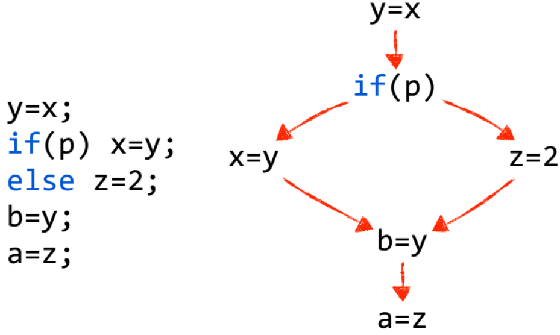
3.4.1 Intra-Procedural Analysis
Control Flow Graph (CFG):
Source Eric Bodden, ACA Lecture slides
Notes:
Paint if its <16:20
on top of the AST, we build a CFG,
Nodes: simplified statement, or basic blocks of statements that can be summarized
Edges: Control flow
But how can we track Data from Source to Sink with this structure??
We could handle an additional structure of a Data Flow Graph, or more usual:
With traversing the CFG we can simultanously track the data flow from a Source to a Sink
Question: Is this CFG flow sensitive or flow insensitive?

Slide 43
3.4.1 Intra-Procedural Analysis
Control Flow Graph (CFG):
x = “Password”; // Source
…
Basic Block
…
leak(x); // Sink
Source Eric Bodden, ACA Lecture slides
Notes:
on top of the AST, we build a CFG,
Nodes: simplified statement, or basic blocks of statements that can be summarized
Edges: Control flow
But how can we track Data from Source to Sink with this structure??
We could handle an additional structure of a Data Flow Graph, or more usual:
With traversing the CFG we can simultanously track the data flow from a Source to a Sink
Question: Is this the CFG for a backward or forward analysis? (look at the arrows)

Slide 44
3.4.1 Intra-Procedural Analysis
Flow-sensitive vs. Flow-insensitive Analysis:
Forward/Top-Down-Analysis:
Information from the control-flow past needed?
Flow-sensitive → less false positives → more precision
Backward/Bottom-Up-Analysis:
Information from the control-flow future needed?
Flow-insensitive → more false positives → less precision
Notes:
we can choose the direction of how we analyze our program
How do we model the program flow?

Slide 45

3.4.1 Intra-Procedural Analysis
Example: RIPS:
uses a CFG to find Web- vulnerabilties
PHP only!
No object oriented programs possible!
Source http://2.bp.blogspot.com/_xJ5LrusWfss/TGaJvKUhvRI/AAAAAAAAAjE/CLByMYZ5YR4/s1600/rips-logo.png

Slide 46
3.4.1 Intra-Procedural Analysis
Aliasing and Pointers:
Aliases need to get tracked with the data flow
p1 = p2; *p1 = getUserInput(); processUserInput(*p2);
Notes:
Which pointers could possibly refer to the same memory location?

Slide 47
3.4.1 Intra-Procedural Analysis
Live vs. Tainted Variable Analysis:
Constant Propagation:
Propagate if variables become constants
Live Variable Analysis:
Propagate if a variable got used before redefinied
Backward Analysis (flow-insensitive)
Dead/Taint Variable Analysis:
Propagate if variables become tainted
Forward Analysis (flow-sensitive)
Best choice for modeling security issues
Notes:
On every traversing step through the Control Flow Graph, we have to update our data flow information about Aliases but more important, if a variable gets constant or tainted
Life: a variable is live for a statement if she got used at least once before definied again
Tainted: a variable becomes tainted if she gets used by a malicious function or she gets assigned a value from a malicious source

Slide 48

3.4.1 Intra-Procedural Analysis
Example: Perl Taint Mode:
Tainted Variable Analysis
Perl Compiler Mode (-T)
Enforces Input Validation
$filename =~ /^([a-zA-Z0-9]+)$/ or die "Bad data in first argument"; $filename = $1; my $file = "/tmp/$filename"; # Assign untainted data open FOO, ">$file" or die $!;
Source http://i1.wp.com/www.ivankristianto.com/uploads/2010/11/Perl.gif?resize=643%2C326

Slide 49

3.4.1 Intra-Procedural Analysis
Example: OWASP LAPSE:
Tainted Variable Analysis
IDE integration (Eclipse plugin)
Uses a CFG to detect Source and Sink
Can find new vulnerabilities
Example: XSS Vulnerability
Source https://www.owasp.org/images/thumb/3/30/LapseLogo.png/800px-LapseLogo.png

Slide 50
3.4 Data Flow Analysis
Recap, what do we have so far?
Lexical Analysis (RATS) → weak Precision
Data Flow Analysis (RIPS) → increased Precision
Intra-procedural
Context-insensitive
Language Abstraction with AST
Control Flow Graph with Data Flow information
Flow-sensitive (Top-Down/forward analysis)
Taint Analysis
Source Eric Bodden, ACA Lecture slides
Notes:
external variables and functions are untrusted so far → tainted → overapproximation

Slide 51
Agenda
Introduction
Input Validation
Static Code Analysis Tools 3.1 Weakness Classes and Definitions 3.2 Simple Approach 3.3 Lexical Analysis 3.4 Data Flow Analysis 3.4.1 Intra-Procedural Analysis 3.4.2 Inter-Procedural Analysis 3.5 Use Cases
Limitations and Conclusion
Notes:
- gjg

Slide 52

3.4.2 Inter-Procedural Analysis
Goal:
Lets get ouf of the box/main function
Interprocedural Analysis
Context-sensitive analysis for the whole program
Analyze Caller and Callee side
Source: http://facilitativeleadership.files.wordpress.com/2011/12/get_out_of-the_box.png
Notes:
Now our Goal: To get out of this box, to reduce the false positives, increase the precision and enable analyzing a whole program!
Extends the scope of data flow analysis across procedure boundaries incorporates the effects of
- procedure calls in the caller procedures, and
- calling contexts in the callee procedures

Slide 53
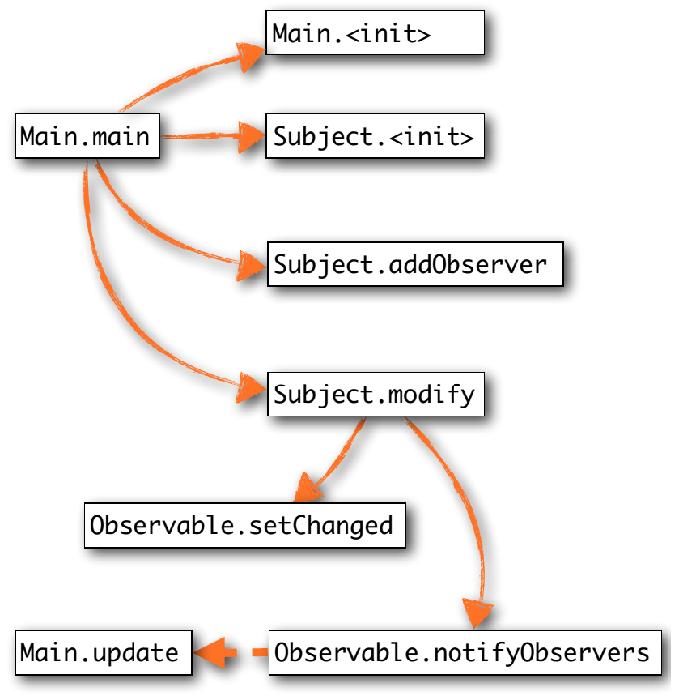
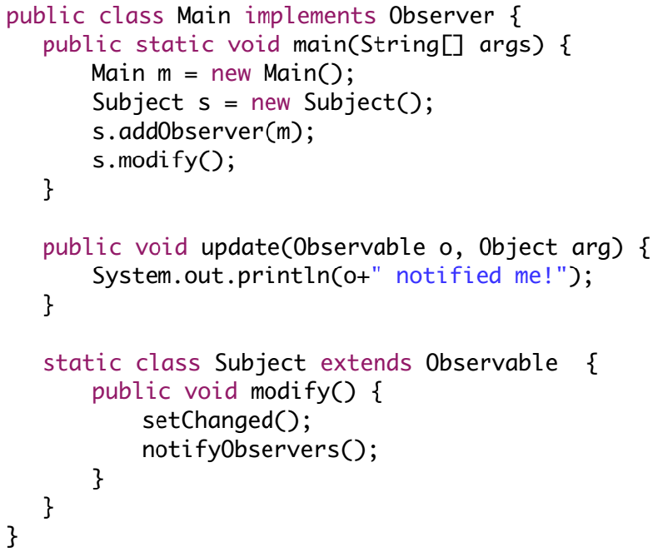
3.4.2 Inter-Procedural Analysis
Call Graph:
Source Eric Bodden, ACA Lecture slides
Notes:
To incorporate a function calls and control flow between functions, objects and classes, we need the additional structure of an call graph
How could a call graph for the left codesnipet look like?
Call Graph:
Nodes: Methods
Edges: Calls
Flow-insensitive
Different Types of Call Graphs:
Class Hierarchy Analysis (Overapproximation…too many edges)
Rapid Type Analysis (like CHA, but considers just instanciated objects, but still Overapproximated)
Points-To Set (very accurate, but might be complicated to calculate)
Pointer Assignment Graph (PAG)
Variable Type Analysis

Slide 54
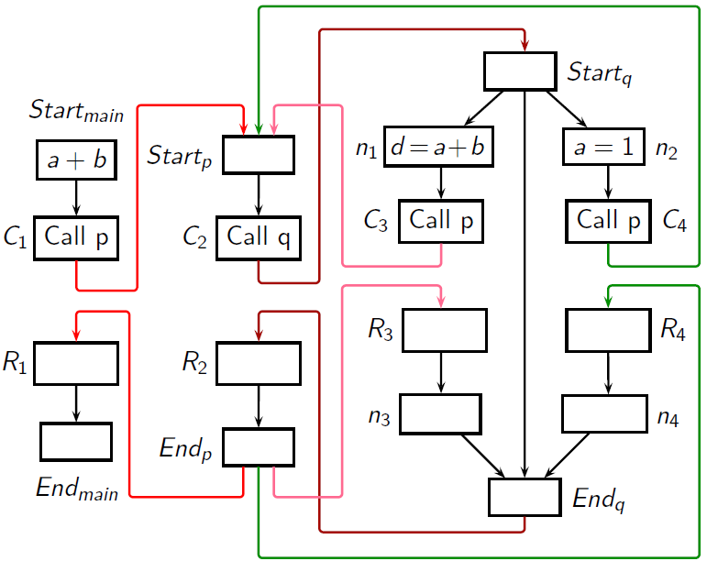
3.4.2 Inter-Procedural Analysis
Inter-procedural Control Flow Graph (ICFG):
Call Graph extended with Control Flow Graph
Source: ACA Slide 4-11
Notes:
Call Graph is an approach to context-sensitivity, but we need a ICFG to connect caller and callee context
ICFG introduces RETURN SITES , to trace variable values through functional returns

Slide 55



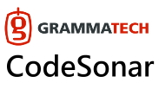
3.4.2 Inter-Procedural Analysis
Example: HEROS:
Inter-Procedural Data Flow Solver
From Prof. Eric Bodden (TU Darmstadt)
Definition of Data Flow Problems with Template-Language
Programming Language independent
Multi-Threaded
Other commercial Tools:
Source
http://sable.github.io/heros/logo/heros-logo.png
http://www.nbel.com.tw/images/grammatech/codesonar.jpg
http://upload.wikimedia.org/wikipedia/en/9/91/Fortify_logo.jpg
http://upload.wikimedia.org/wikipedia/de/thumb/3/3b/Coverity_Prevent_logo.svg/799px-Coverity_Prevent_logo.svg.png

Slide 56
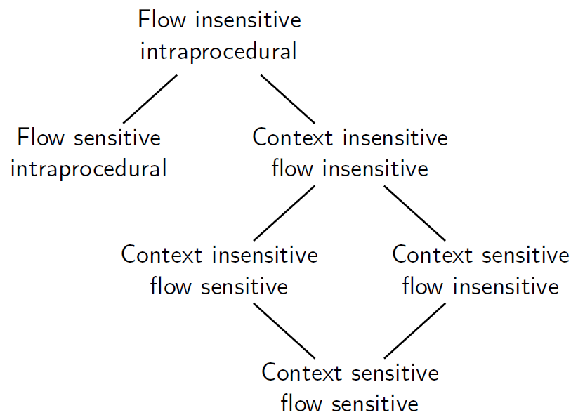
3.3 Data Flow Analysis
Tradeoffs:
Increasing Precision and Decreasing Performance
Source: ACA Slide 4-31
Notes:
We see different tradeoffs between performance, precision (false positives/false negatives) and in between the feasability to analyze special language features

Slide 57
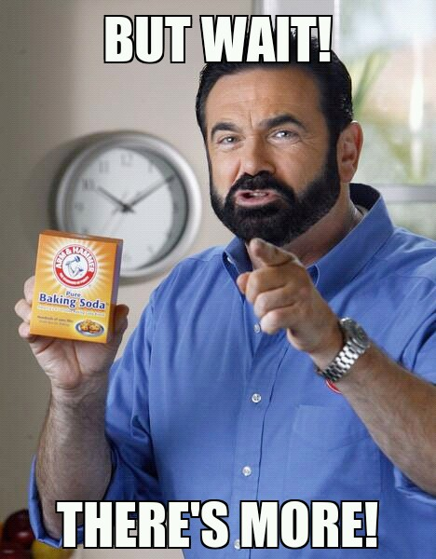

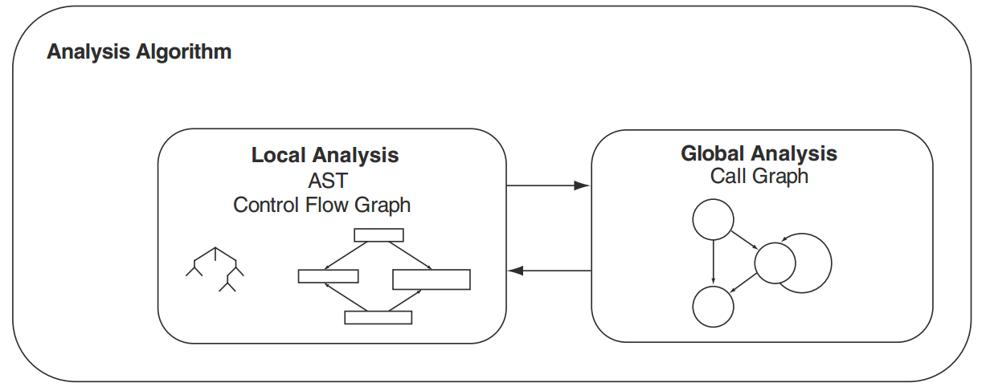
3.4 Data Flow Analysis
Source Brian Chess & Jacob West: Secure Programming with Static Analysis, p. 83 , http://s.quickmeme.com/img/cd/cd81e042784002dc888375c1fddab72c2e322a6eebd9abe9a132cb35d26dcf75.jpg http://www.graphics99.com/wp-content/uploads/2012/07/when-you-think-youre-done-pooping.jpg
Notes:
• now we combine our structures from the intra-procedural (local) analysis with the structures we need for a global analysis and we are done!
But….are we really done?
Can you think about any problems we still have?

Slide 58

3.4 Data Flow Analysis
Many problems:
How to deal with Recursion?
How to deal with Reflection?
How to handle Library functions?
How to handle Virtual Dispatch?
How to handle Multi-Threading?
How to deal with Global/Static variables?
How to deal with Overloaded Functions?
How to deal with Objects and Inheritance?
How to reduce function analysis Redundancy?
Source: http://www.listeningpays.com/wp-content/uploads/2013/01/QUESTION.jpg
Notes:
Maaaaany problems result from noval language features…also we can‘t analyse dynamic class loading → dynamic analysis necessary
I can‘t go in detail with answering those question, especially since some of them are still open research
So before I conclude our presentation, I want to show you 2 specialized security use cases for using static analysis

Slide 59
Agenda
Introduction
Input Validation
Static Code Analysis Tools 3.1 Weakness Classes and Definitions 3.2 Simple Approach 3.3 Lexical Analysis 3.4 Data Flow Analysis 3.4.1 Intra-Procedural Analysis 3.4.2 Inter-Procedural Analysis 3.5 Use Cases
Limitations and Conclusion
Notes:
- gjg

Slide 60

3.5 Use Cases
Android Vulnerabilties → FlowDroid
Goal: Find private data leaking apps
Solution:
Context-, flow-, field-,object-sensitive and lifecycle-aware static taint analysis
Generate Dummy-Main method
Construct an incomplete ICFG
Make ICFG complete by adding registered event‘s callback code (found in XML configs) to the app lifecycle until fixpoint reached and all app code is in the Dummy-Main method
Source: http://sseblog.ec-spride.de/wp-content/uploads/2014/06/FlowDroid.jpg
Notes:
To show, that all that theory is actually used, I present FlowDroid, a tool from this department to analyse android applications

Slide 61

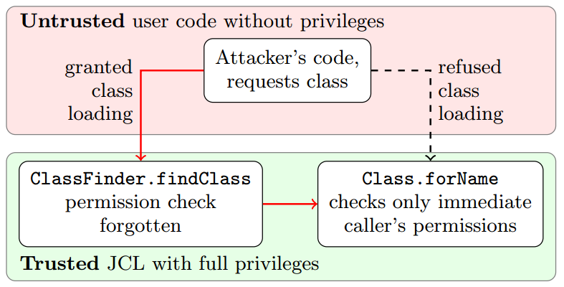
3.5 Use Cases
Java CVE_2012_4681 →
Source: https://repository.st.informatik.tu-darmstadt.de/sse/aca/2013/public/reading/lecture-13/lhb+14flowtwist.pdf, p.3 https://github.com/johanneslerch/FlowTwist/raw/master/FlowTwist_Logo_rgb.png
Notes:
Vulnerability: Untrusted Attacker Code can escape out of his permission system in Java7<Update7 (Privilege Escalation), by using a deputy class (ClassFinder) from the Trusted System space, to call a protected System-Function from the System Space

Slide 62
3.5 Use Cases
CVE_2012_4681: FlowTwist
Solution:
Operates bottom-up
Searching feasible paths from potentially vulnerable call sites deep down in the JDK all the way up to the public API
During this process it has to correlate two taint-analysis problems, one for integrity and one for confidentiality
Source: https://github.com/johanneslerch/FlowTwist/raw/master/FlowTwist_Logo_rgb.png
Notes:
To show, that all that theory is actually used, I present FlowDroid, a tool from this department to analyse android applications

Slide 63
Agenda
Introduction
Input Validation
Static Code Analysis Tools
Limitations and Conclusion
Notes:
- I hope we could teach you all a little bit about Static Analysis, What it is, Why every Software Engineer needs it, How it works and What tools exist…

Slide 64
4. Limitations and Conclusion
Important Selection Criteria
Is your language supported?
Can it detect the types of vulnerabilities you’re searching?
Does it require a fully buildable set of source?
Can it run against binaries instead of source?
Can it be integrated into the developer's IDE?
Can you afford the license cost for the tool?
Does it support Object-oriented programming (OOP)?
…
Notes:
You have to be very carefull in selecting the right tool for your needs…
Every tool has tradeoffs and there is no allrounder who can analyse everything

Slide 65
Thank you very much for your Attention!
Questions ?
Autors:
Sebastian Funke
Brian Pfretzschner
Hamza Zulfiqar
Static Code Analysis is
your personal
(security) code auditor!

Slide 66
Sources
Brian Chess & Jacob West: Secure Programming with Static Analysis (2011)
V. Benjamin Livshits and Monica S. Lam: Finding Security Vulnerabilities in Java Applications with Static Analysis, Stanford University (2005)
Gary McGraw: Static Analysis for Security (2004)
Eric Bodden: Automated Code Analysis Lecture Slides, TU Darmstadt (2013)
OWASP: LAPSE Project, https://www.owasp.org/index.php/OWASP_LAPSE_Project
Perl Taint Mode: http://perldoc.perl.org/perlsec.html
Johannes Dahse: RIPS: http://rips-scanner.sourceforge.net/
National Security Agency Center for Assured Software: On Analyzing Static Analysis Tools, http://media.blackhat.com/bh-us-11/Willis/BH_US_11_WillisBritton_Analyzing_Static_Analysis_Tools_WP.pdf (2011)
Johannes Lerch, Ben Hermann, Eric Bodden and Mira Mezini: FlowTwist: http://www.bodden.de/pubs/lhbm14flowtwist.pdf (2014)
Eric Bodden, HEROS: http://sable.github.io/heros/
Steven Arzt, Siegfried Rasthofer, Christian Fritz, Eric Bodden, Alexandre Bartel, Jacques Klein, Yves le Traon, Damien Octeau and Patrick McDaniel: FlowDroid: Precise Context, Flow, Field, Object-sensitive and Lifecycle-aware Taint Analysis for Android Apps, http://www.bodden.de/pubs/far+14flowdroid.pdf (2014)
http://istqbexamcertification.com/what-is-dynamic-analysis-tools-in-software-testing/

