Slide 1


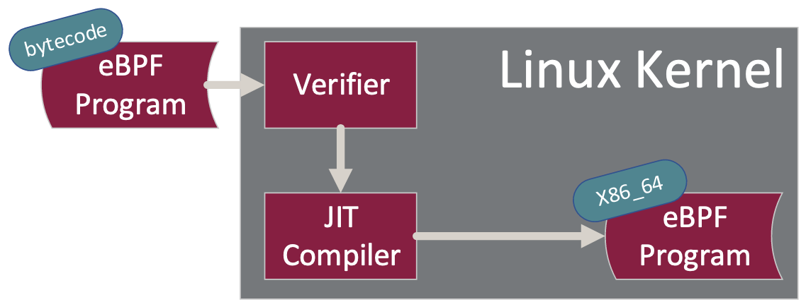
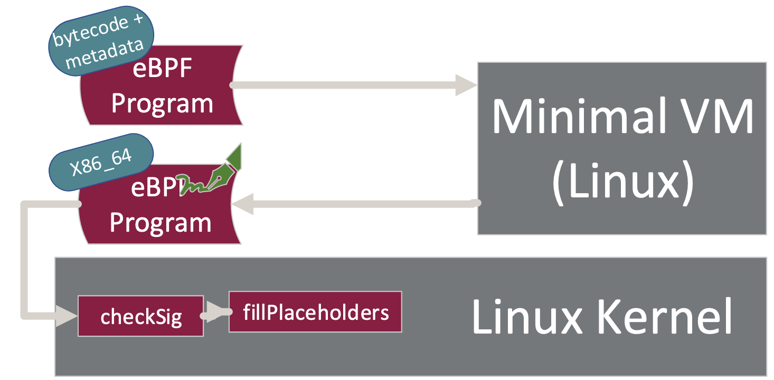
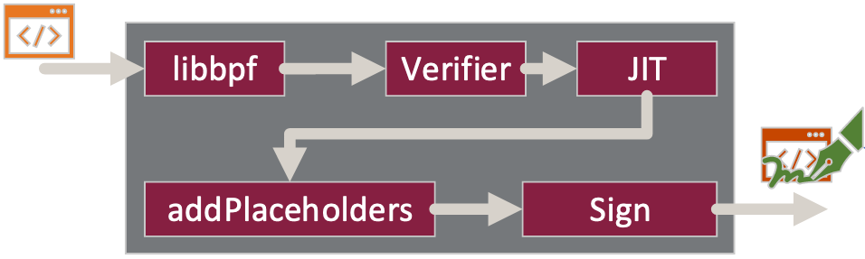
Moving eBPF Verification Out of the Kernel
Adam Oswald, Raj Sahu, Jinghao Jia, Dan Williams, Michael V. Le, Tianyin Xu
Background
Design
Design allows for offloading verification to a separate machine
Embedded devices
eBPF aims to allow loading verified and safe programs into the kernel
Verification and JIT is done in kernel space
eBPF vulnerabilities often target the verifier and the JIT
Lack of a rigid testing framework for the verifier
Verification is slow on embedded devices
Provide a VM with a minimal kernel that performs verification and JIT
Pointer leaks only affect guest kernel
eBPF doesn’t run inside VM
VM restarts from fresh state for every eBPF load
Output: Signed native machine code (e.g., x86_64)
Placeholders are made for relocs
Host checks and runs output from VM in kernel
Safety is provided through signing
Only need to verify program once
The verifier doesn’t only verify
Verifier fills in address to file descriptor
Verifier and BTF are tightly coupled
Type-checking
Verifier rewrites structs members to kernel structs
Two versions of structs are maintained
Proposal
The verifier and JIT should be moved outside of the host kernel
Use signing to confirm authenticity

