Slide 1


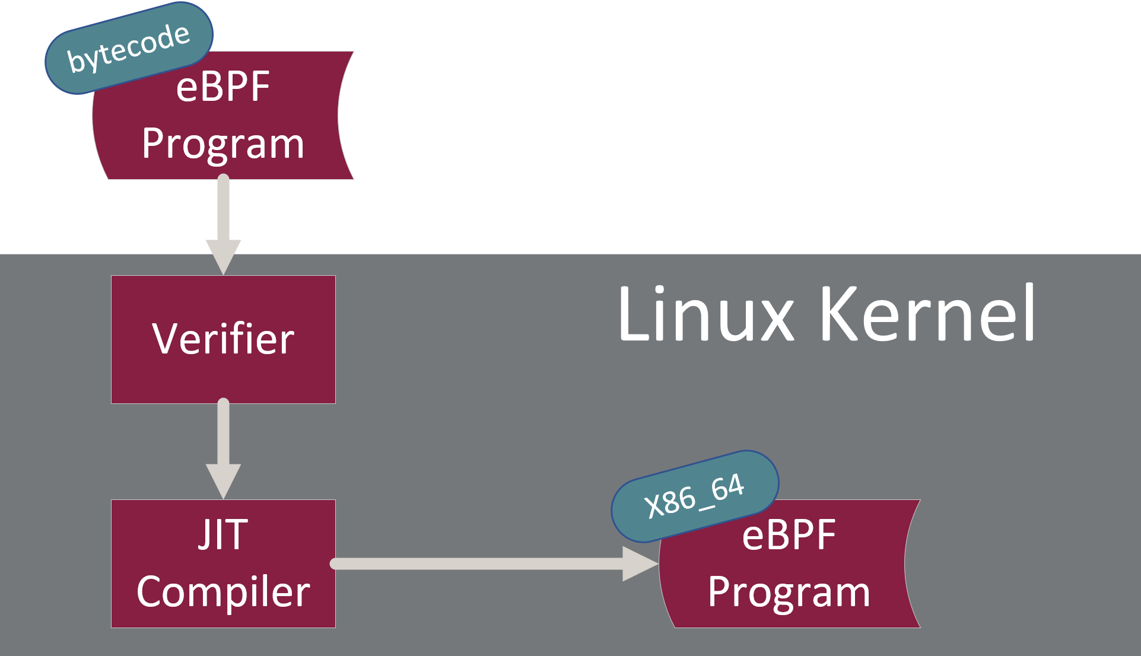
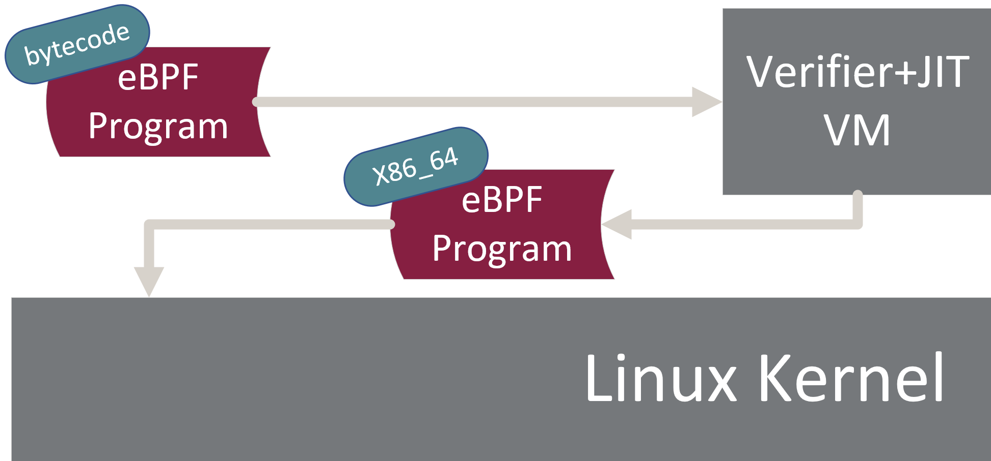
Moving eBPF Verification Out of the Kernel
Adam Oswald, Raj Sahu, Jinghao Jia, Dan Williams, Michael V. Le, Tianyin Xu
Background
Design
The verifier doesn’t only verify
eBPF aims to allow loading verified and safe programs into the kernel
Verification and JIT is done in kernel space
eBPF vulnerabilities often target the verifier and the JIT
Lack of a rigid testing framework for the verifier
Provide a VM with a minimal kernel that performs verification and JIT
Pointer leaks only affect guest kernel
eBPF doesn’t run inside VM
VM restarts from fresh state for every eBPF load
Output: Signed native machine code (e.g., x86_64)
Placeholders are made for relocs
Host checks and runs output from VM in kernel
Safety is provided through signing
Only need to verify program once
Verifier fills in address to file descriptor
Verifier and BTF are tightly coupled
Type-checking
Verifier rewrites structs members to kernel structs
Two versions of structs are maintained
Challenges
Verifier does more than verification
Code rewrites for maps and kernel structs
How to transition maps from guest to host?
Supporting multiple programs?
Host and guest Kconfig differences?
Kernel version differences?
Proposal
The verifier and JIT should be moved outside of the host kernel
Use signing to confirm authenticity

