Slide 1
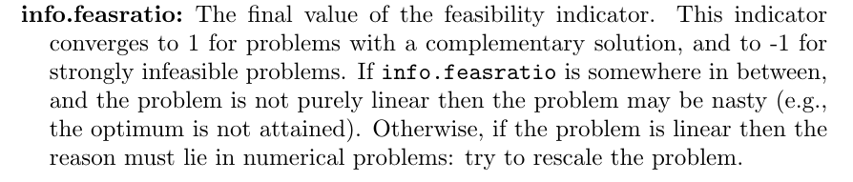
Condition of the SDP problem: indicator: info.feasratio in sedumi

Slide 2
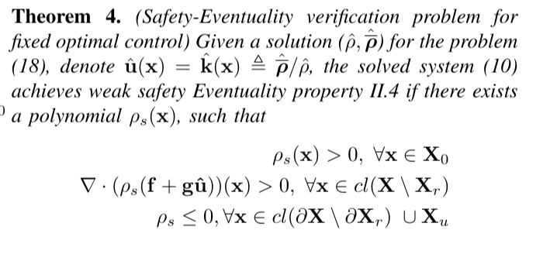
Safety eventuality verification

Slide 3
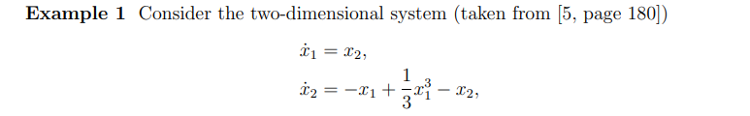
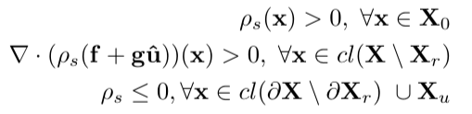
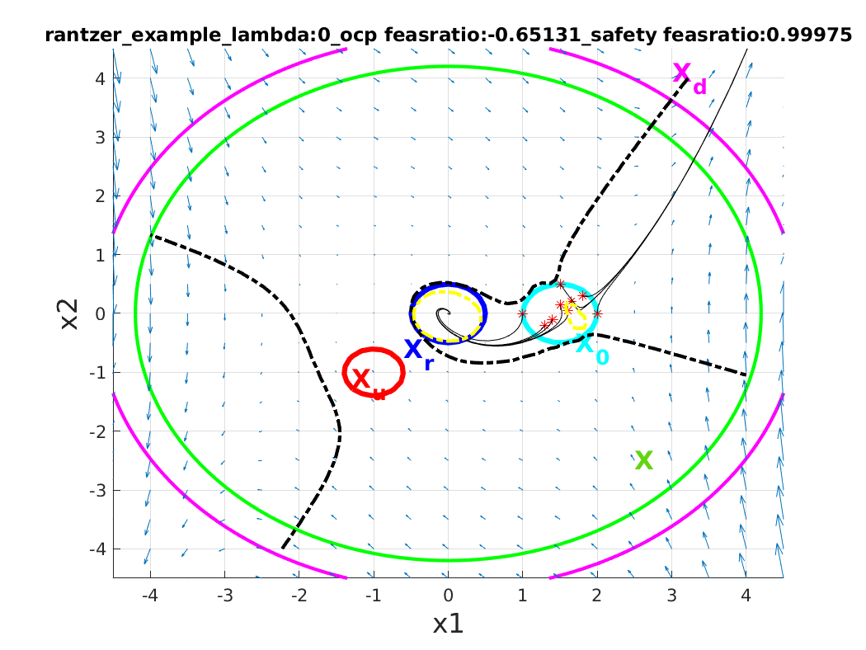
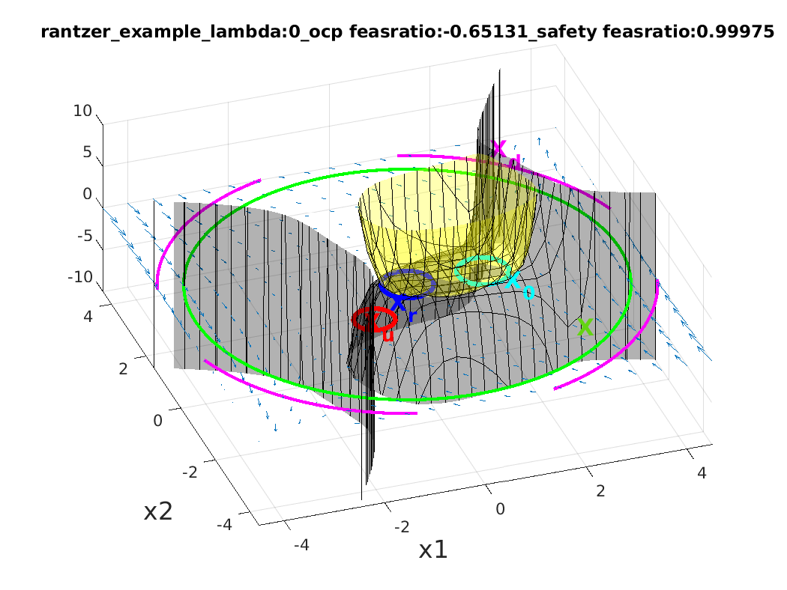

Slide 4
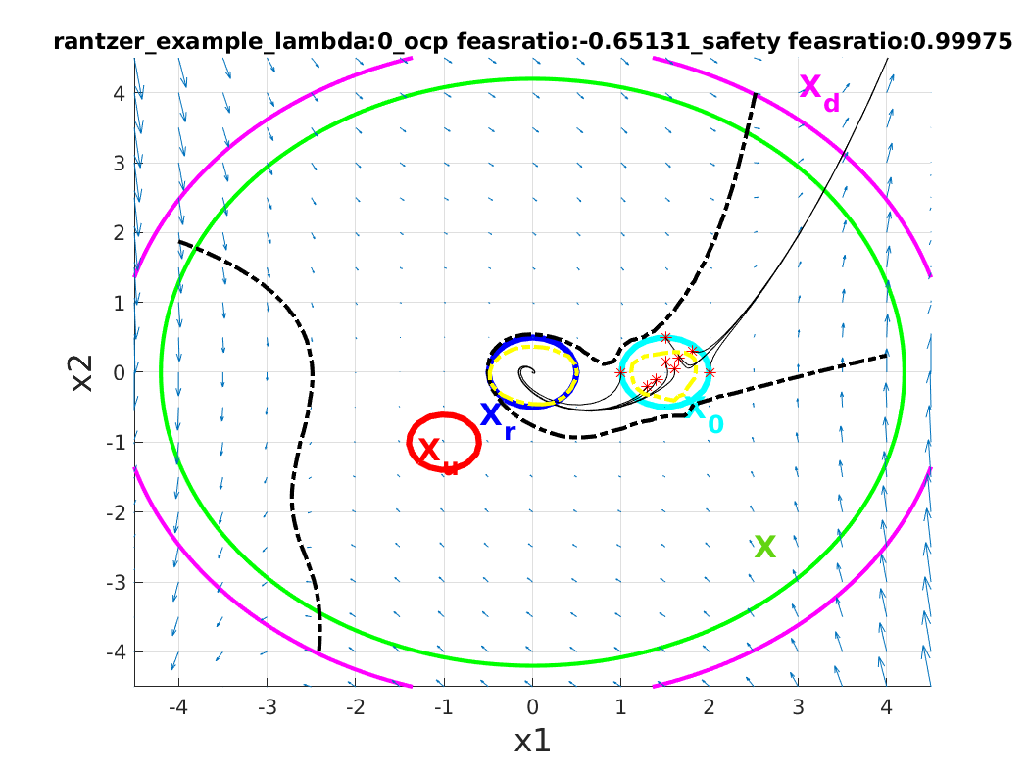
Compare
In the paper

Slide 5
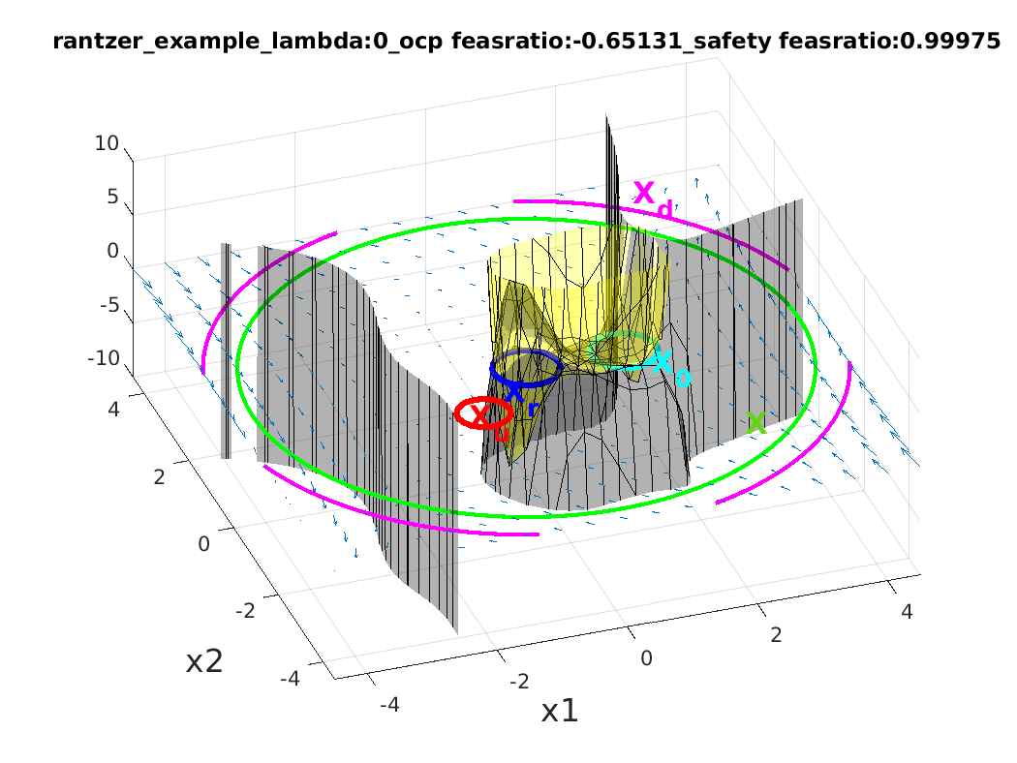
Compare

Slide 6
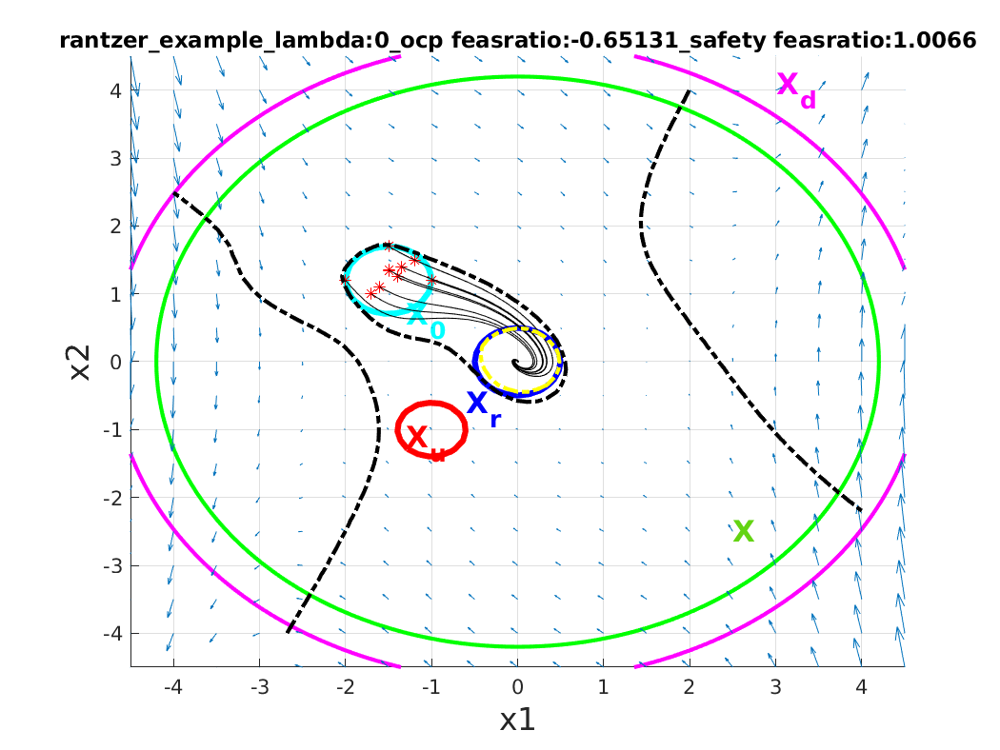
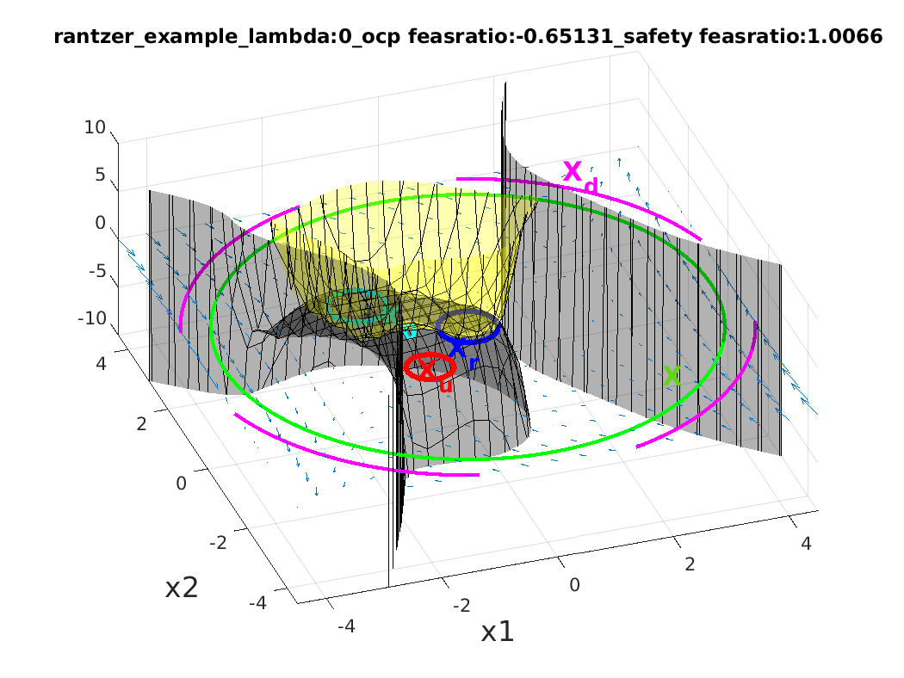
Another setting

Slide 7
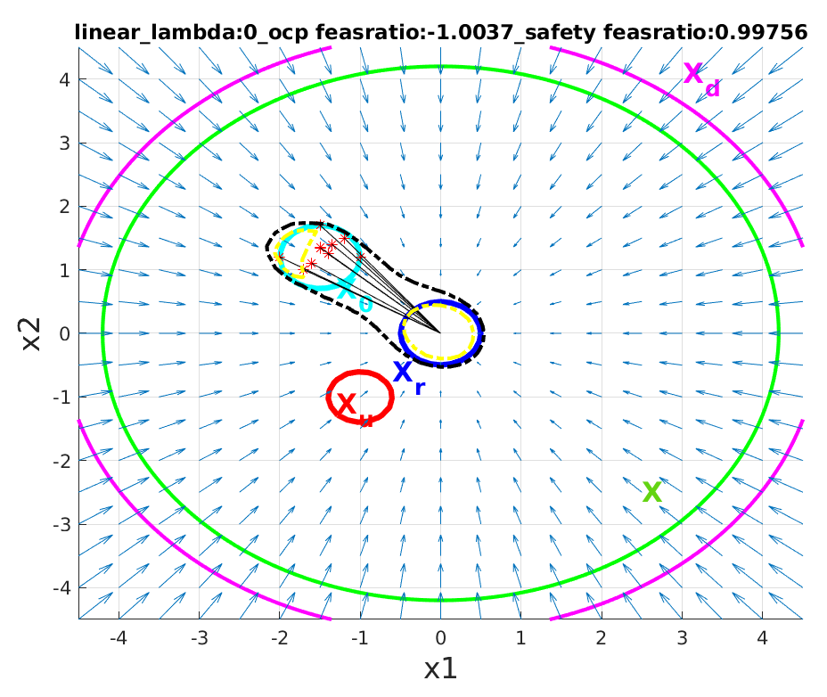
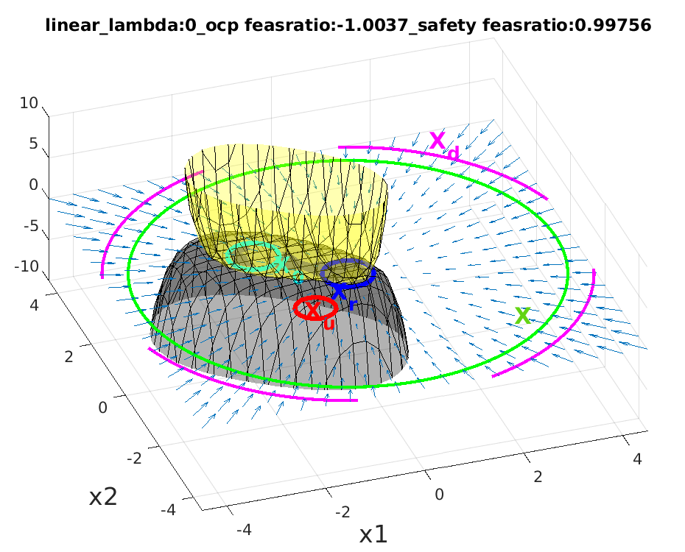
2.Linear dynamics f = [-x1;-x2] g=0

Slide 8
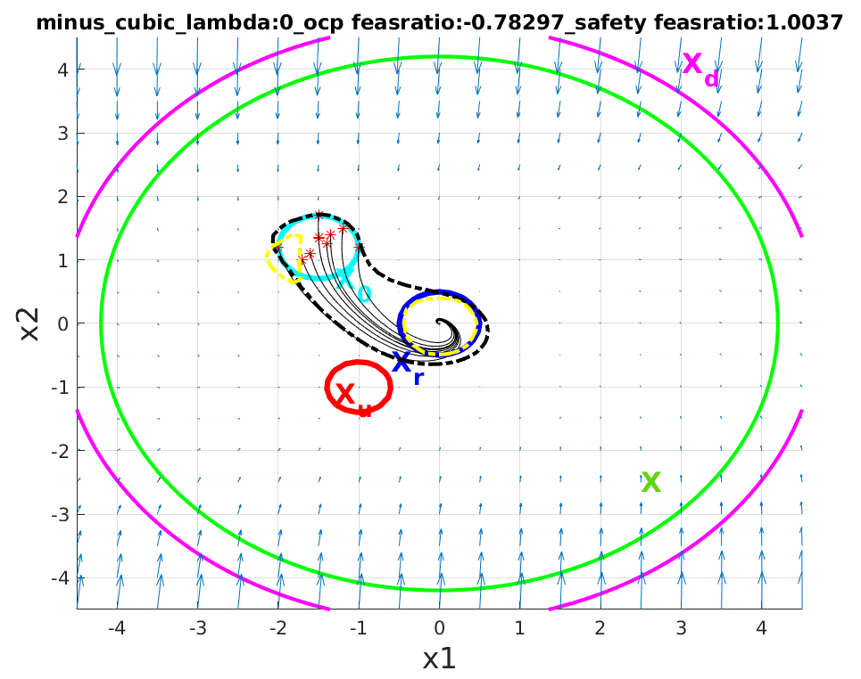
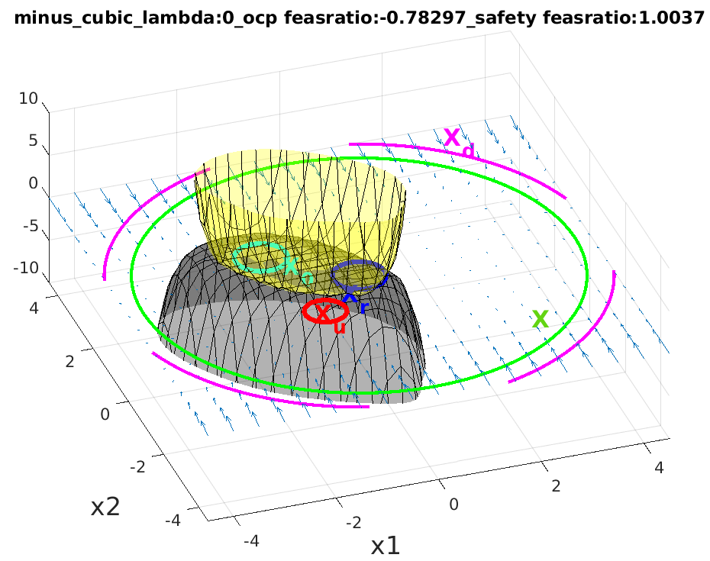
3. f = [-x1-x2; x1-x2^3], g = 0

Slide 9
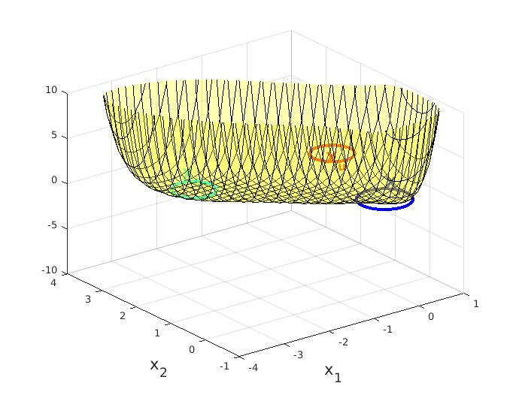
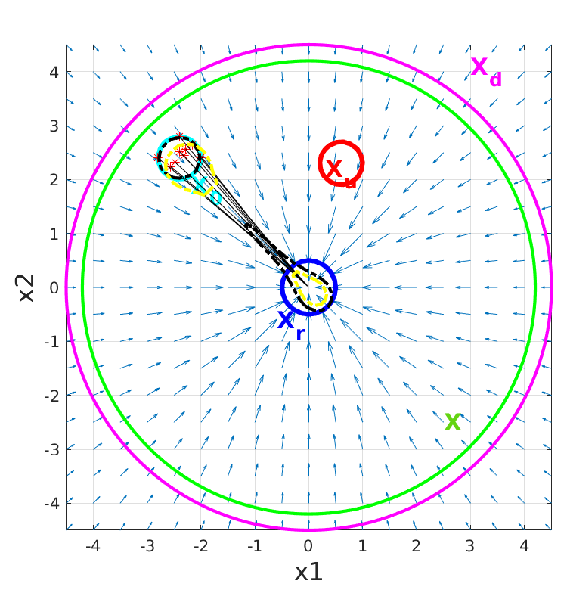
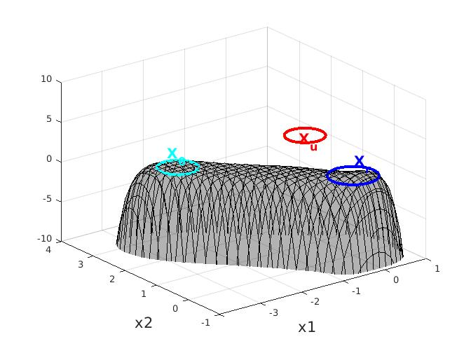
F=0,G=I;

Slide 10
For optimal control problem: u(x) = c(x)/a(x) will negatively impact the safety verification problem solution. The problem itself is often ‘dual infeasible’ given by the solver.
https://groups.google.com/g/yalmip/c/mU_WJ9y4eSk/m/Pkoyerx1FgAJ
Sensitive to numerical conditions
  Obj. function:
    623.72*c_a_4 + 346.77*c_a_6 + 6162.2*c_a_11 + 1172.9*c_a_13 + 2905.2*c_a_15 - 4.076e34*c_w_1 - 5.2292e17*c_w_2 - 6.587e16*c_w_3 - 2.4014*c_w_4 - 1.5856*c_w_6 + 72.686*c_w_11 + 17.942*c_w_13 + 36.788*c_w_15 + 554.51*c_w_22 + 89.85*c_w_24 + 69.207*c_w_26 + 256.92*c_w_28 + 5813.4*c_w_37 + 707.84*c_w_39 + 348.83*c_w_41 + 465.06*c_w_43 + 2556.4*c_w_45 + 109.47
  Numerically nasty problem
  Things tried: 1. increase ax, 2. decrease alpha in bx^alpha(denumerator), 3. re-scale the problem by dividing the objective by the smallest coefficient to make it 1(this is a solution suggested in sedumi), 4. different dynamics, 5. move around the sets and tried with different geometry parameters, 6. different lambdas 7. add a l1 norm in the objective function 8. different sedumi parameters
  Not working well..

Slide 11
Sedumi parameter
For safety verification problem:
option_safety.params.tol = 1e-12;
% option_safety.params.free = 0;
option_safety.params.stepdif = 1;
option_safety.params.vplot = 1;
option_safety.params.alg = 2;
option_safety.params.theta = 1;
option_safety.params.beta = 0.9;

