Slide 1
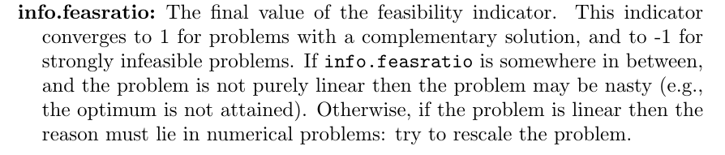
Condition of the SDP problem: indicator: info.feasratio in sedumi

Slide 2
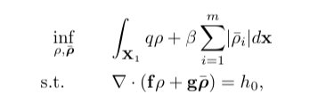
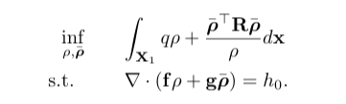
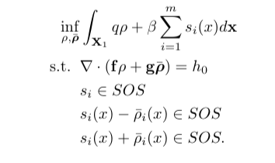
L1 penalty
L2 penalty
L1 penalty equivalent

Slide 3
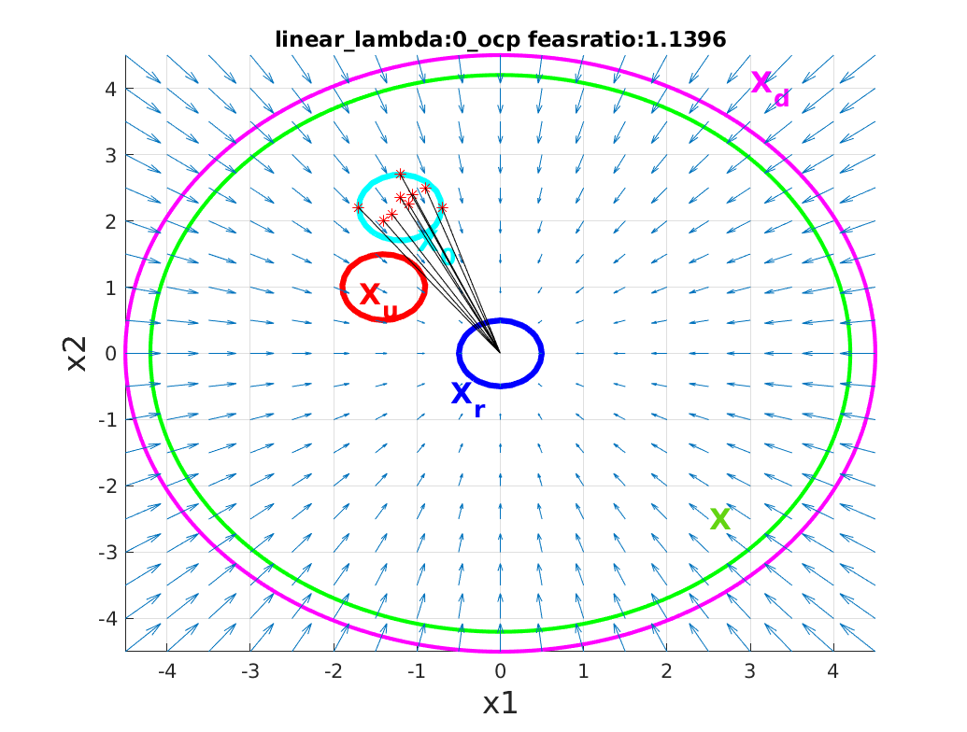
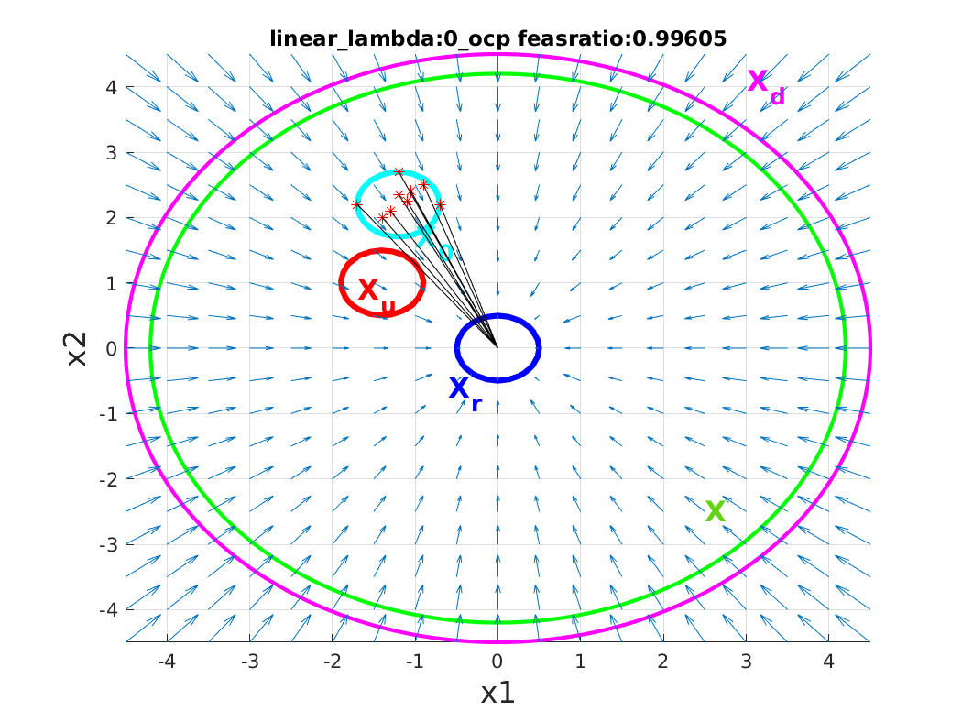
Comparison L2 with L1 penalty on the input u(x)
1. Linear system
L1, beta = 1000
L2

Slide 4
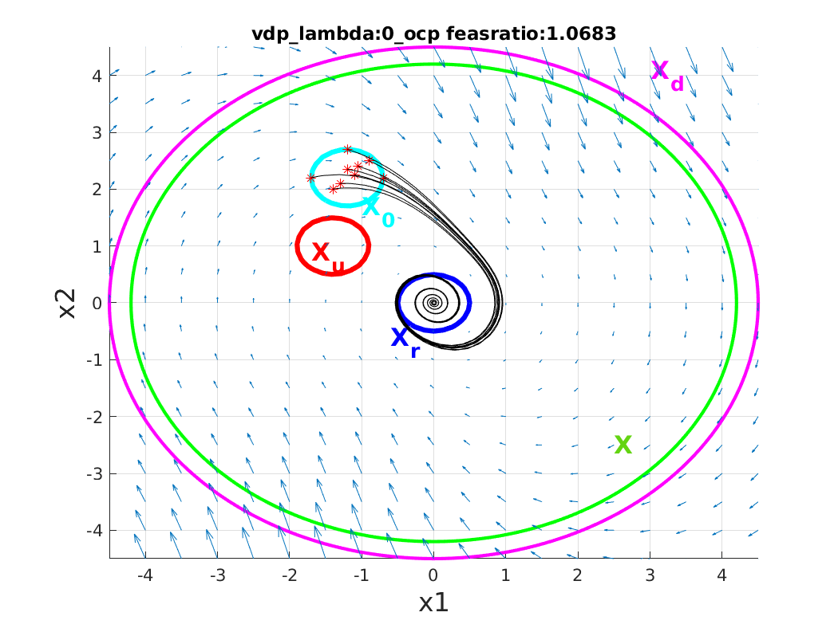
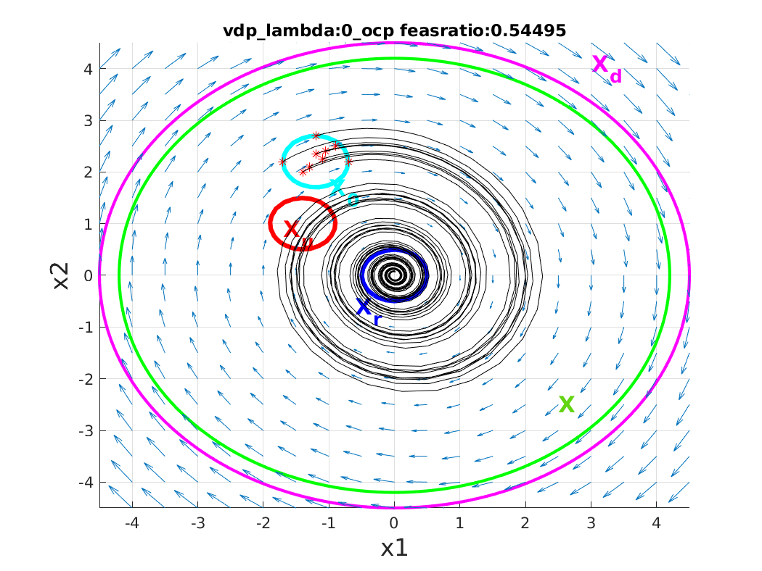
Comparison L2 with L1 penalty on the input u(x)
2. van der pol
L1, beta = 0.0005, a(0)=1
L2, R=I, a(0)=1

Slide 5
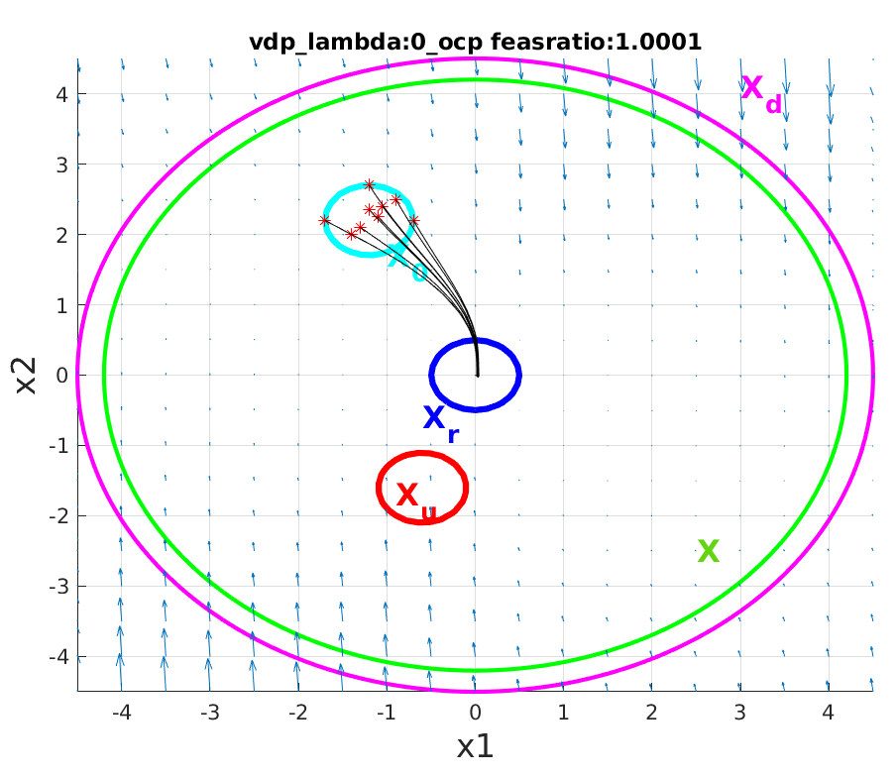

2. van der pol
L2 Coefficient constraints
L2, R=I, a(0)=1
L2, R=I, a(0) no constraint,
exact integration
L2, R=I, a(0) no constraint, cube integration

Slide 6
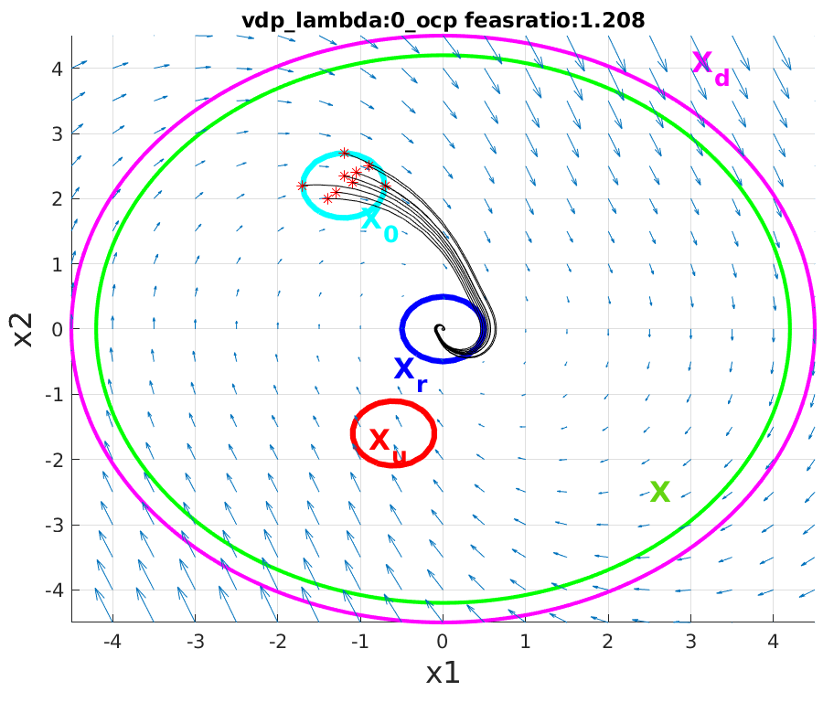
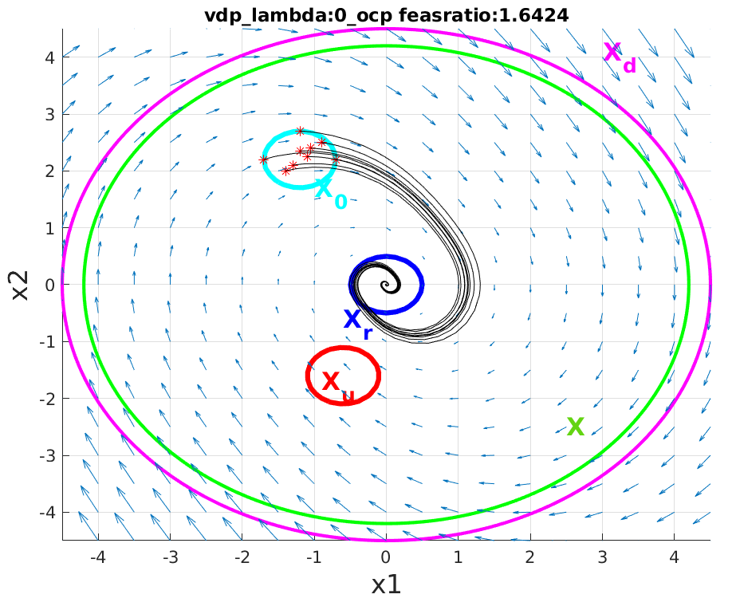
2. van der pol
L1 Coefficient constraints
L1, beta = 0.0005, a(0) = 1
L1, beta = 0.0005,
a(0) no constraint
L1, beta = 1000,
a(0) no constraint

Slide 7
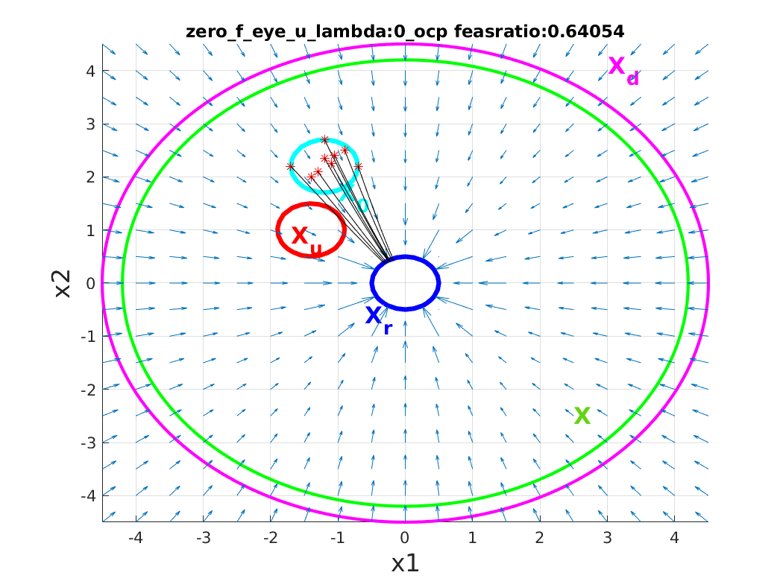
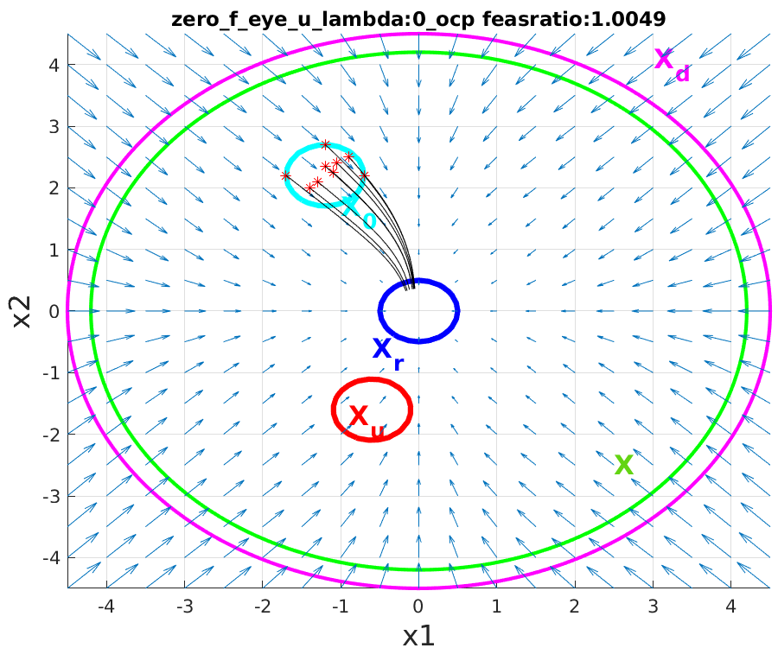
3. F=0,G=I: L1 need local controller;
L1, beta = 0.0005, no local controller
L2,no local controller

Slide 8


F=0,G=I;
L1, local lqr controller
L2, local lqr controller

Slide 9
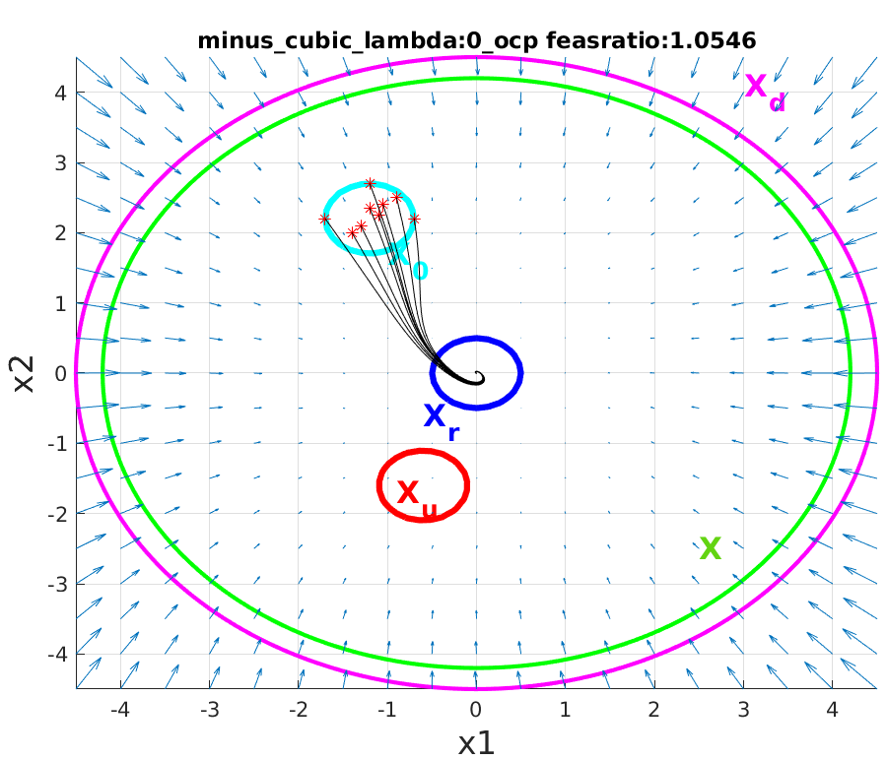
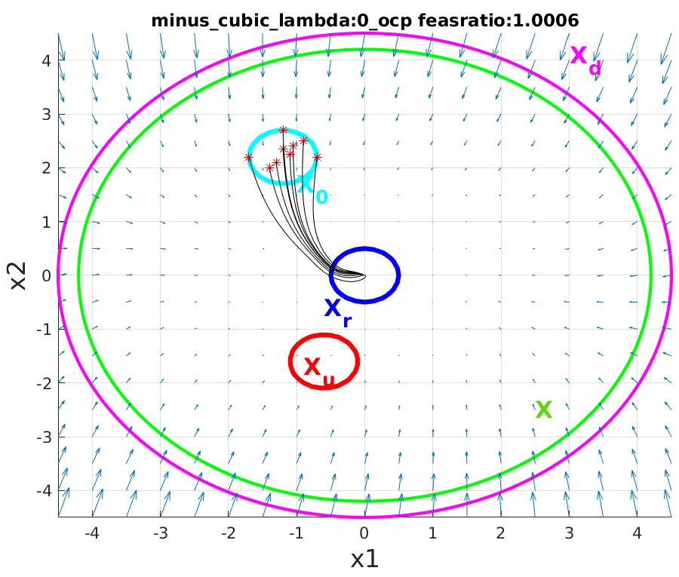
F = [-x1 - x2; x1 - x2^3];
G = [1, 0; 0, 1];
L1, beta = 0.0005
L2

