Slide 1
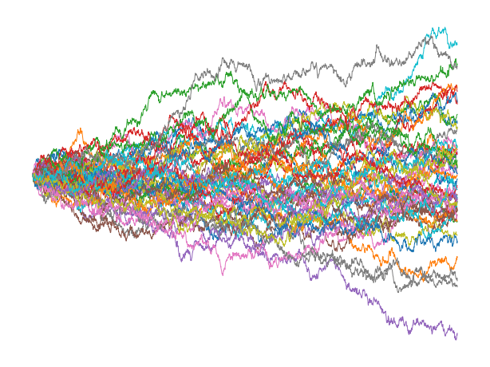
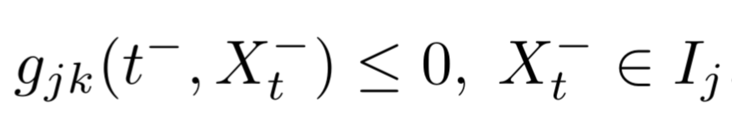
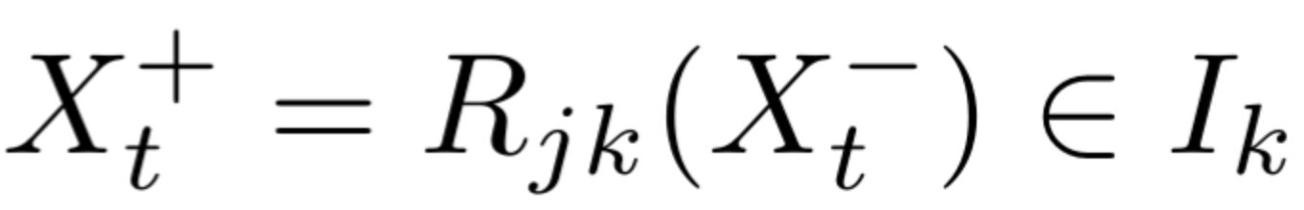
Stochastic Smooth Flows
Start State
Goal State
Trajectory Samples
Hybrid Transitions

