Slide 1

Unit 3

Slide 2

Unit 3 Travel Journal

Slide 3


Slide 4

When you travel, what kind of transport do you prefer to use?
Now list as many forms of transport as you can in 10 seconds.

Slide 5
Think about the advantages and disadvantages of each form of transport and fill in the chart.
Transport | Advantages | disadvantages
car
convenient
tired,
Traffic jams

Slide 6
1. cheaper than the airplane
2. journey ends in the center of the town/city
3.enjoy the view along the route
train
bike
1. take longer than the airplane
2. no meals
Tired, inefficient
Challenging,
Energy-consuming
Green,
Environmentally-friendly,
Free,
No traffic jams

Slide 7
1. expensive
2. journey ends far from the city
3. delay
airplane
Fast
/time-saving
2. efficient

Slide 8
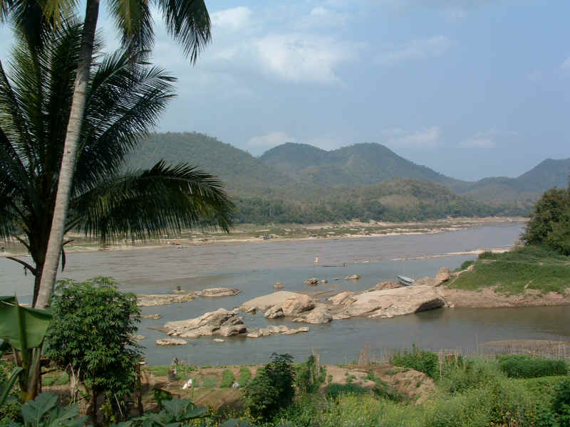
Do you know the Mekong River?

Slide 9
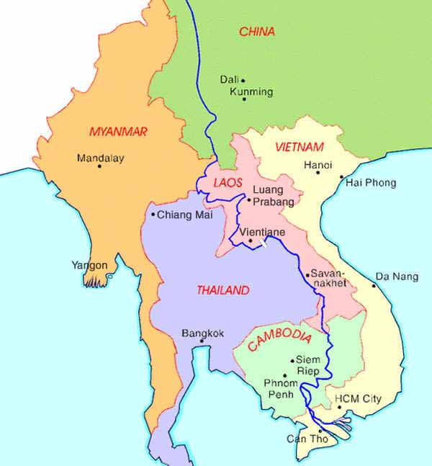
The Mekong River
China
Myanmar
Laos
Thailand
Vietnam
Cambodia
South China Sea

Slide 10


Journey down the Mekong

Slide 11




Skim the text and match.
Preparations for their trip.
Wang Kun and Wang Wei’s dream.
Wang Wei is stubborn.

Slide 12

Scan the passage and answer the questions.
1.What is Wang Kun and Wang Wei’s dream?
To take a great bike trip.
2.When did they get the chance to realize their dreams?
After graduating from college, they finally got the chance.

Slide 13
3.What difficulties did Wang Kun and Wang Wei find about their journey?
The journey will begin at an altitude of more than 5,000 meters, where it is hard to breathe and cold.

Slide 14
4.What do you think about Wang kun and Wang Wei?
The following words may help you:
enthusiastic, imaginative, helpful, careful, caring ,independent, creative, responsible, humourous, stubborn, critical, eager, risk-taking, sensible…

Slide 15
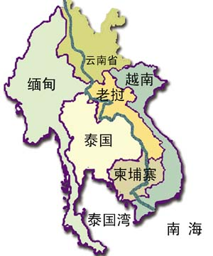
Fill in the blanks with the help of
illustrations (图示).
The Mekong River is called _____________ in China. It goes through _________ _____, _________, _________, _________ and pours into the ________________.
Lancang River
Myanmar
Laos
Thailand
Cambodia
Vietnam
South China Sea

Slide 16
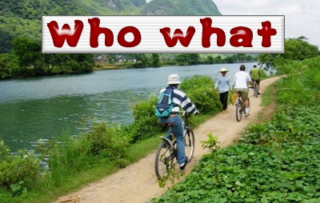
Wang Kun and ___ _____ Wang Wei are dreaming about ____________________.
his sister
taking a great bike trip

Slide 17

They have the idea to _____ ______ the Mekong River from ______ it ______ to ______ it _____.
cycle along
where
begins
where
ends

Slide 18
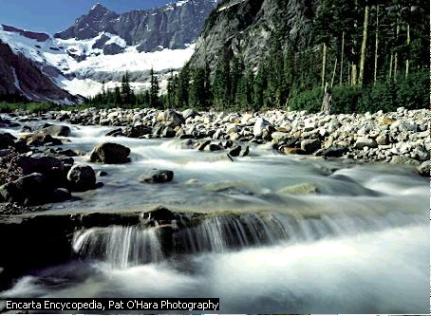
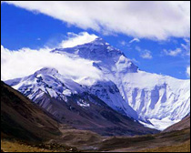
What can they see during the journey?
glacier
It begins in a _______ on a mountain in Qinghai.

Slide 19
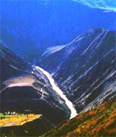
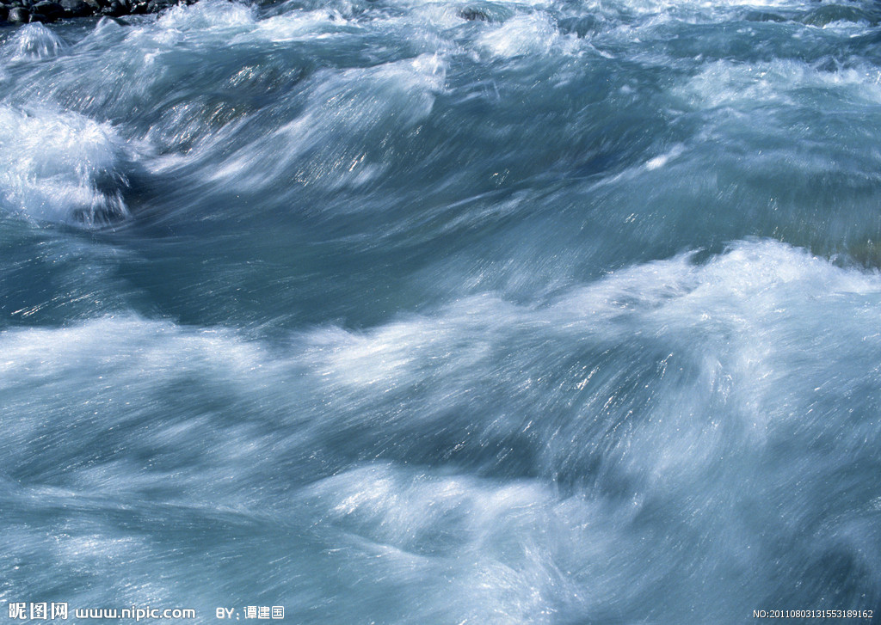
moves
Then, it ______ quickly. It becomes
______ as it passes through deep ______.
rapids
valleys

Slide 20
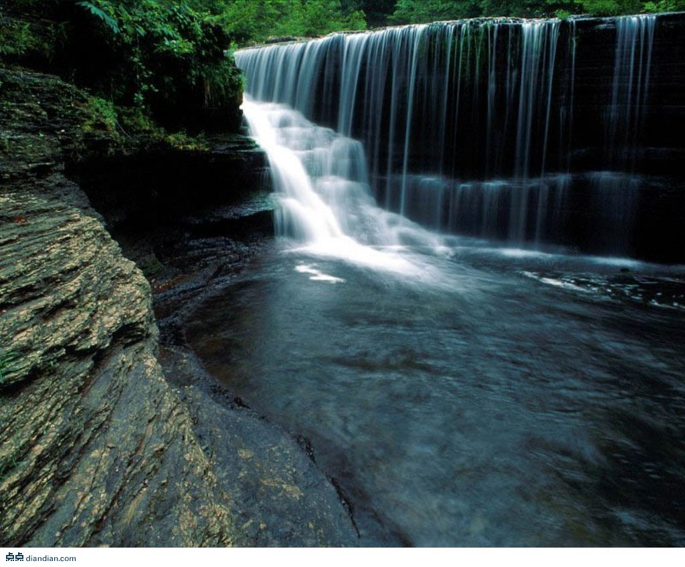
Sometimes, the river becomes a ________ and enters ____ ________.
waterfall
wide valleys

Slide 21
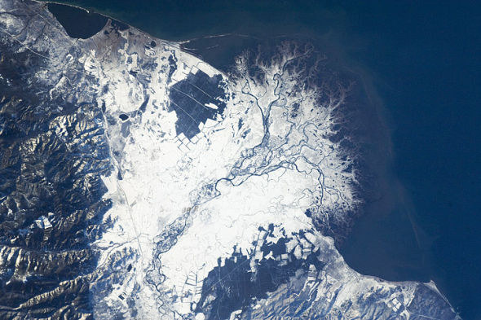
delta
At last, the river _____ enters
the South China Sea.

Slide 22


Imagine that you are Wang Kun and Wang Wei. Choose a paragraph from the passage and use the information to help you make up a dialogue.

Slide 23
WANG WEI: You know, we’ve always wanted to do a long bike trip. Why don’t we go on one after we graduate from college?
WANG KUN: That’s a good idea. …

Slide 24


