Slide 1
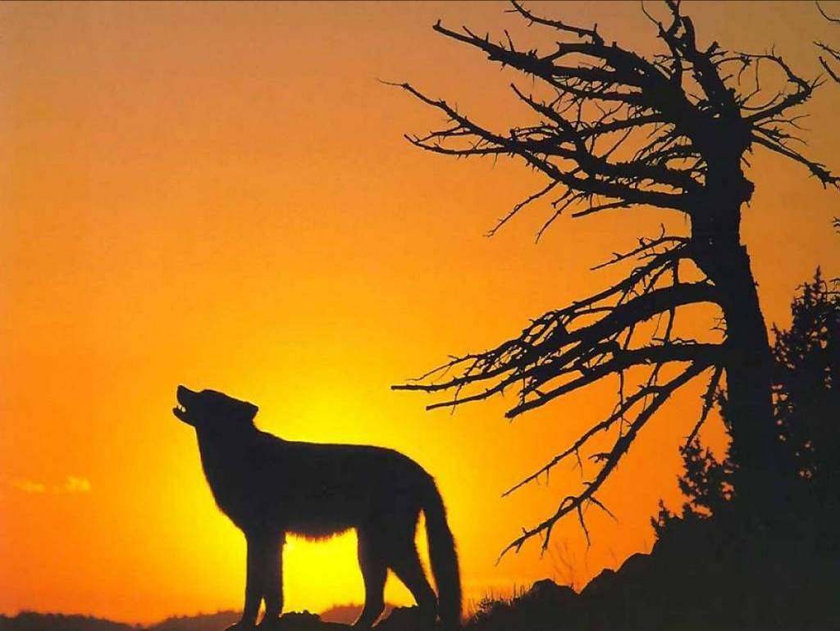
Unit 4 Wildlife Protection

Slide 2

Background
wildlife protection
Wild plants and animals have to look after themselves. They need food, a good environment and safety. If their habitat is threatened or they cannot find enough food, their numbers may decrease. As a result, these endangered animals may even die out. They need help. This is what wildlife protection is all about.

Slide 3
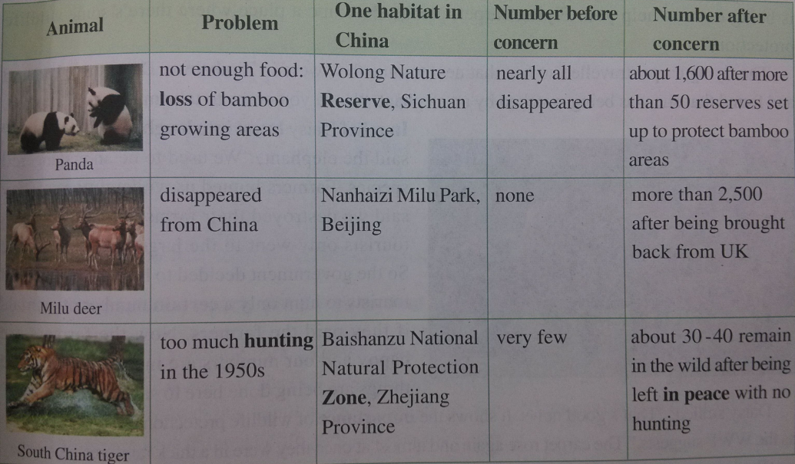
A report on some endangered wildlife in China
What other endangered animals do you know of? Make a list.

Slide 4
Let’s enjoy some pictures of some other endangered animals. Think about why they are endangered.

Slide 5
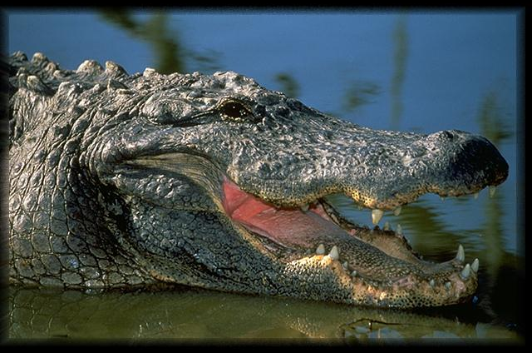
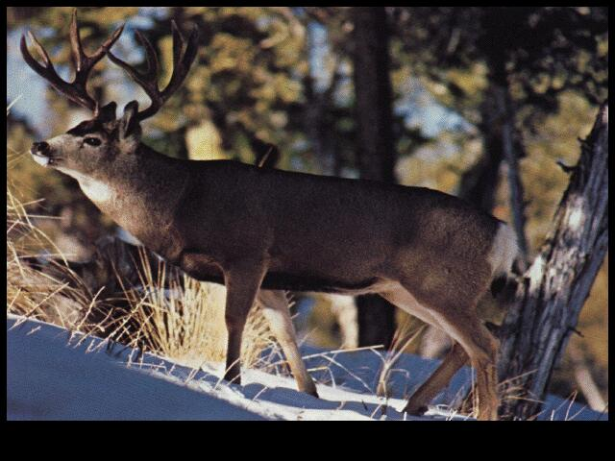
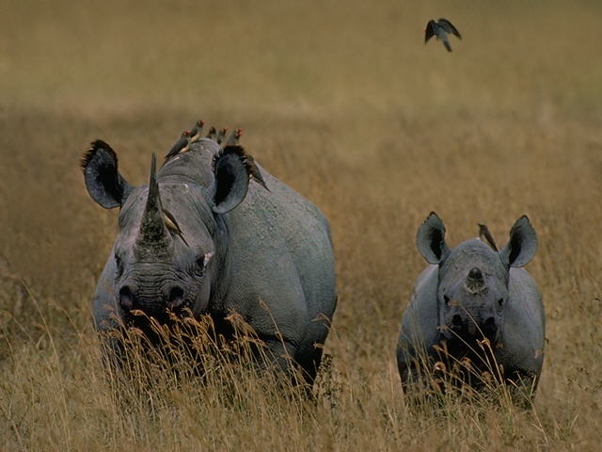
Chinese alligator
(扬子鳄)
rhino
milu deer

Slide 6
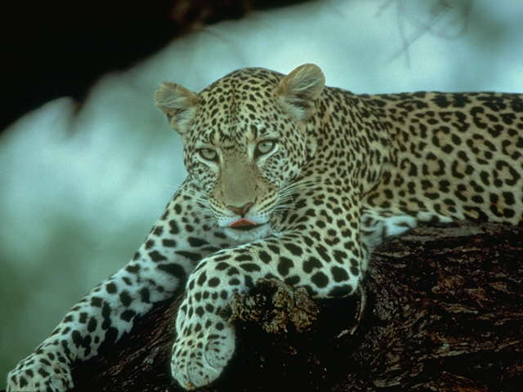
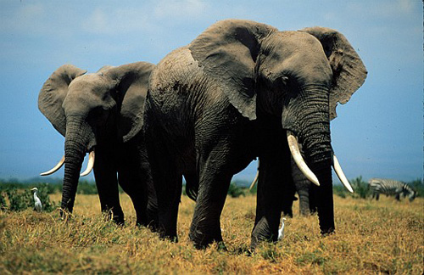
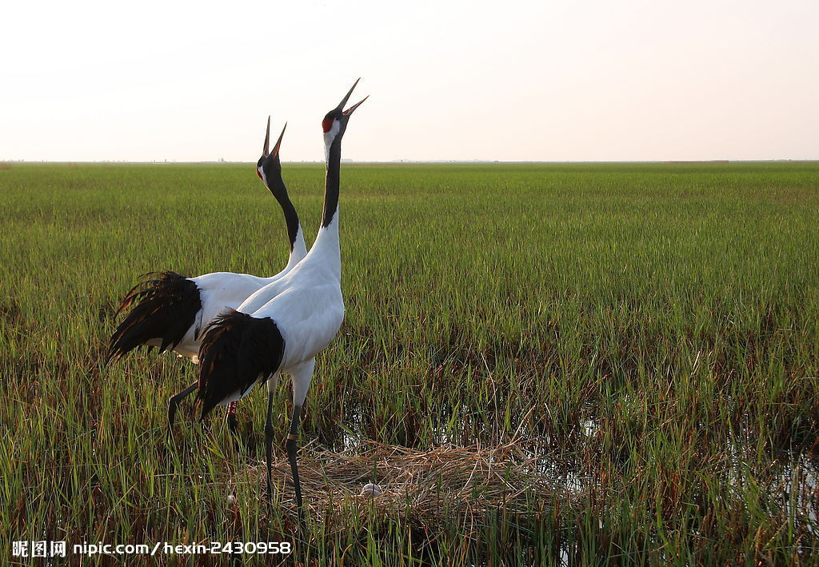
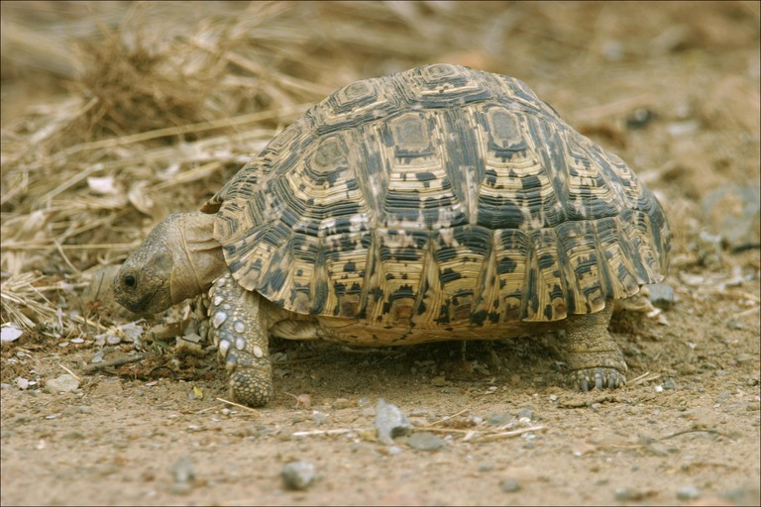
leopard
elephant
red-crowned crane
丹顶鹤 (仙鹤)
leopard tortoise

Slide 7


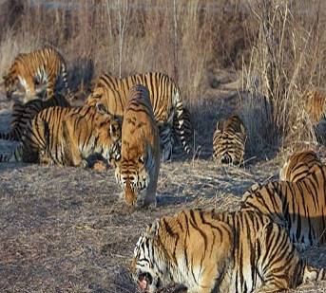
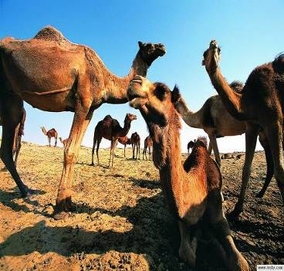
Why are these animals dying out?

Slide 8


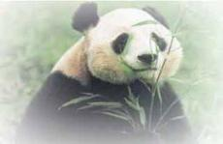
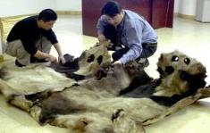
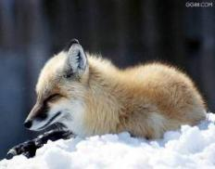

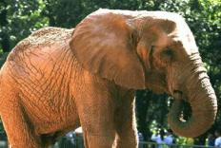
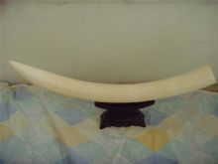
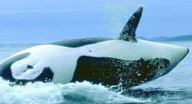
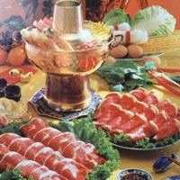
They may be hunted and killed for __________.
Problems wild animals may face:
body parts or food
fur
&
skin
ivory
meat

Slide 9
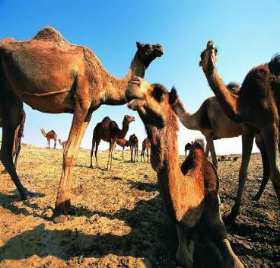
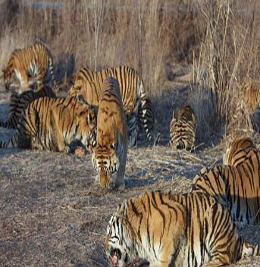
They cannot find ____________.
enough food

Slide 10
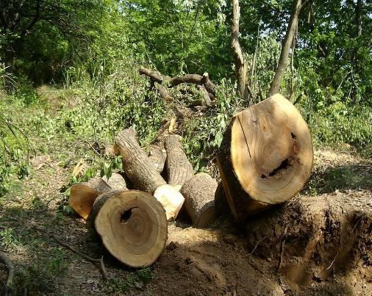
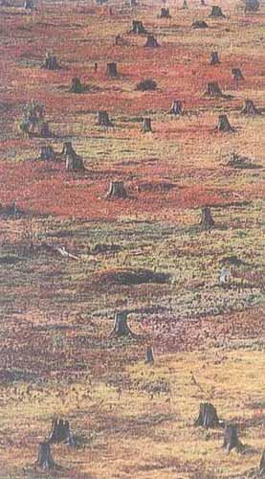
They may lose their_____________ because the forest is destroyed and people move into it.
natural habitat

Slide 11
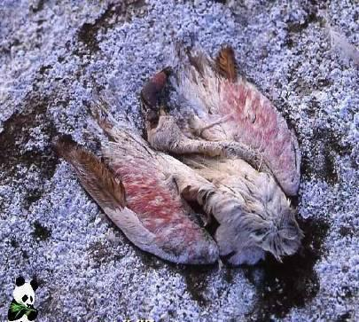
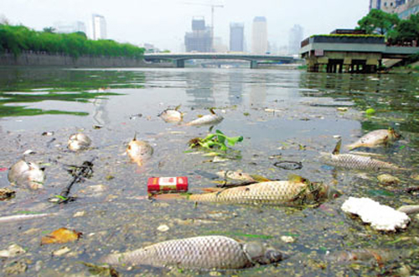
They may be killed by ___________.
pollution

Slide 12
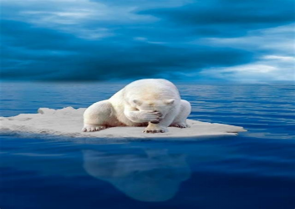
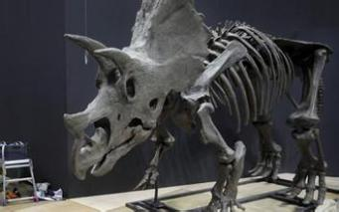
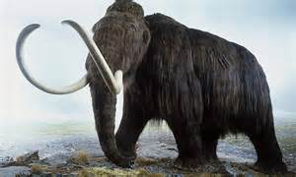
dinosaur
恐龙
polar bear
北极熊
They may be killed by
______________ .
climate change
mammoth
猛犸象

Slide 13
Every year thousands of wild animals and plants become extinct. According to the Red List of the International Union for the Conservation of Nature, more than 12,000 animal species are now in danger.

Slide 14


Slide 15


Background Information
What is WWF?
World Wildlife Fund 世界野生生物基金会
world’s largest privately financed conservation organization
protect endangered species and their habitats
works in more than 100 countries with nearly 5 million members

Slide 16

How Daisy learned to help wildlife?
What’s this passage about?

Slide 17
Skim the text quickly and fill in the blanks.
The text is mainly about Daisy’s ___________ in three areas which she goes to on a(n) ____________.
experience
flying carpet

Slide 18
Scan the text and find out the details of three stops.
The first stop
Purpose: to see some __________________
Place: ______
Animal: ________________
Situation: being hunted for the wool beneath its stomach and numbers are __________ rapidly
endangered wildlife
Tibet
Tibetan antelope
decreasing

Slide 19
The second stop
Purpose: to go to a place with wildlife _________
Place: Zimbabwe
Animal: ________
Situation: used to be hunted while now being protected by farmers making money from _______________
protection
elephant
tourism / tourists

Slide 20
The third stop
Purpose: to go to a place where the WWF is involved
Place: _________
Animal: _______
Situation: produces a drug naturally which can protect us from __________.
rainforest
monkey
mosquitoes

Slide 21
Read again and answer the following questions.
1. Why has the antelope in Tibet become
an endangered species?
2. Why are elephant numbers increasing in Zimbabwe?
3. How does the government of Zimbabwe help protect wild animals?
4. Why is it important to protect the rainforest?
5. What must be done if wildlife protection is to succeed?

Slide 22
Answer these questions below.
Why has the antelope in Tibet become an endangered species?
2. Why are elephant numbers increasing
in Zimbabwe?
Its fur is being used to make sweaters. As the sweaters become popular, more and more animals are killed. So very few antelopes are left.
The farmers stopped killing the elephants, so the numbers increased.

Slide 23
3. How does the government of
Zimbabwe help protect wild animals?
The government helps the farmers. It makes sure that the tour companies pay the farmers when tourists come
to visit and hunt a few animals.

Slide 24
4. Why is it important to protect the
rainforest?
Looking after the rainforest helps protect plants and animals we know nothing about. They may make it possible for us to produce medicines and drugs that we don’t yet know about.

Slide 25
5. What must be done if wildlife protection is to succeed?
1) Protect the environment.
Help animals return to nature.
2) Reduce hunting, and treat them as our friends
3) Never buy endangered animals’ products and tell your friends no to do so too!
4) Laws should be passed to prevent people from killing or hunting them.
5) The governments should educate people to love nature and protect it

Slide 26

One day, when Daisy woke up, she found a flying carpet by her bed. The carpet asked her where she wanted to go. Daisy responded that she'd like to see some 1. ____________ (endanger) wildlife. The carpet then took her to Tibet, a 2. __________ (distance) land where Daisy saw an antelope 3. __________ (look) sad.
endangered
distant
looking

Slide 27
The antelope said they were being killed for the wool. Daisy said she hadn’t known about this and she wondered what to do to help them.
Then they went to Zimbabwe, 4. ________ Daisy found an elephant which told Daisy that they were once an endangered species.
where

Slide 28
They were hunted 5. __________ mercy by farmers, who said the elephants destroyed their farms. Thanks to the government's help, the problem was 6. __________ (final) solved. Daisy said this showed the 7. __________ (important) of wildlife protection.
without
finally
importance

Slide 29
After a while they went into a forest. A monkey 8. _______________ (protect) itself from mosquitoes. The monkey asked Daisy to pay more attention 9. __________ the rainforest and said he would appreciate 10.
__________ if animals lived together.
was protecting
to
it

Slide 30
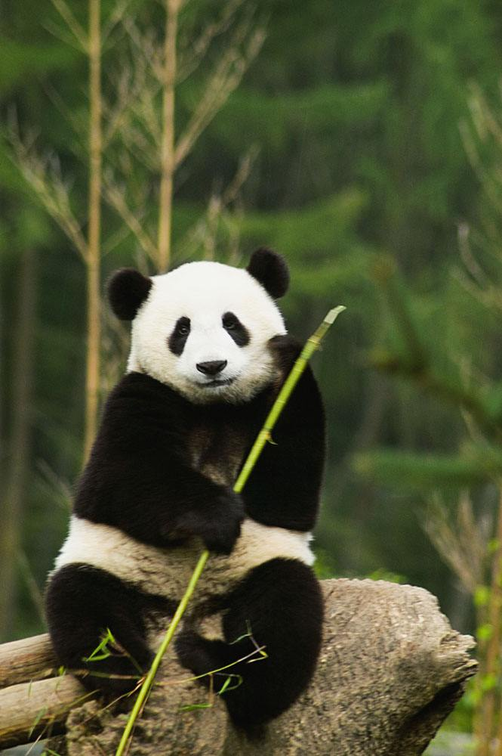
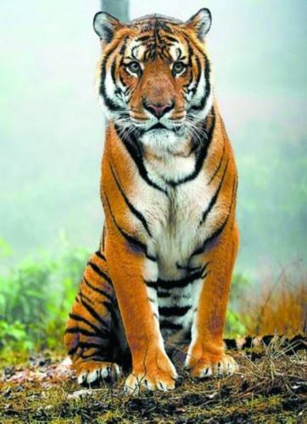
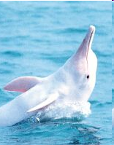
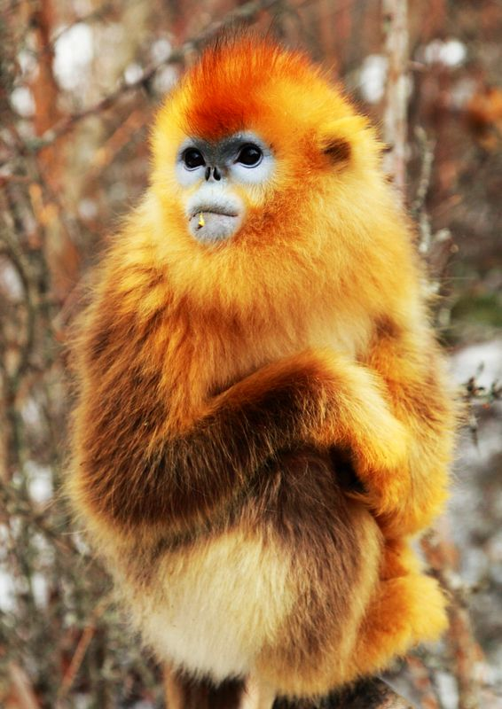
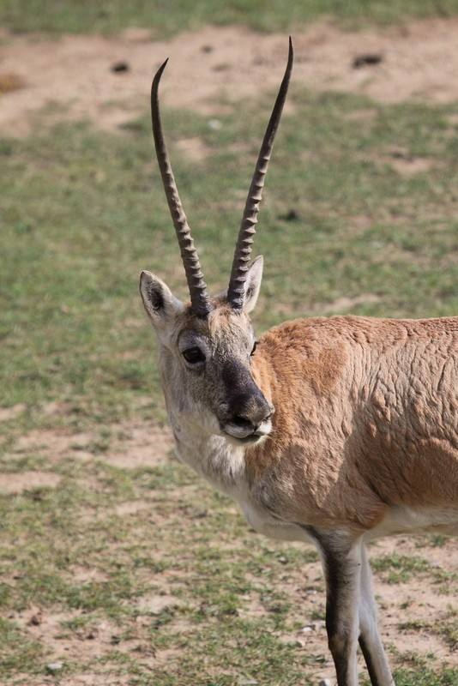
Protecting wildlife is protecting ourselves!
Animals are our friends.
No animals, no human beings!

Slide 31


