Slide 1

WFS-2
Group 1
CODEFURY 2020
AUTOMATED MEETING ROOM
BOOKING SYSTEM
TEAM MEMBERS
Ashutosh Danwe (Team Lead)
Kunal Rasam
Mrunal Ahire
Ravi Kachhadiya
Aishwarya Sonawane
Sophia Tiwari
Haritha Jayan
Drishika Dey
Akspreet Kaur
Sakshi Karanjekar
Mentored by:
Rajesh Upadhyay

Slide 2

AGENDA
Introduction
Existing System
Project Objectives
Proposed Solution
Project Scope
Project Objective
Application Features
Tasks Distribution
Tools and Technologies
Screenshots of application

Slide 3
INTRODUCTION
It is a web based application concerned with the scheduling of meetings in meeting rooms.
It is also concerned with the details of amenities and rooms available in the organization.
Employee and manager can check the meeting details and can give feedback about the system.
Admin can add users and manage rooms and room amenities.

Slide 4
EXISTED SYSTEM
Reservation of rooms for meeting held at different institutes manually.
Total scheduling of meeting is done by paper work.
It takes time and can produce conflicts.
It is hard to save and manage meetings data across a specific meeting.
If any person want to know about the room status, he/she definitely contact to admin and then will be able to reserve a room for meeting.
There is no system to display status of meeting room outside the rooms.

Slide 5
PROPOSED SOLUTION
A computer system is used to store employee data.
Simple and elegant GUI for managing amenities and room details.
Proper interface for feedbacks of system is designed.
Hide meeting rooms which are already booked while selecting room for the meeting.
Security
Transaction logging
Advantages:
Saves time
Reduce Human Effort

Slide 6

PROJECT SCOPE
Admin
Manager
Member
Create Room
Edit Room
Delete Room
Get Room Data
Import User
Organize Meeting
Give Feedback
View meeting
Give Feedback

Slide 7
PROJECT OBJECTIVES
Automated Meeting Room Booking system automates the procedure of booking a meeting room in an organisation.
Employees can schedule meetings based on their requirements.
Employees can search and
book a meeting.

Slide 8
APPLICATION FEATURES
Login page (Users-Manager, Admin, Member)
Import Users (Admin)
Home Page for Users
Create, Edit Room (Admin)
View scheduled meetings (Member)
Organize Meeting (Manager)

Slide 9
TOOLS AND TECHNOLOGIES
Tomcat Server (9.0.x)
Derby Database (10.13.1.1)
JDK (1.8)
Spring Tool Suite 4
Google Chrome
Logger - Log4j
HTML/CSS
JSP
Java Servlets
Bootstrap 4
Ajax
JavaScript

Slide 10
TASK DISTRIBUTION
MRUNAL
Manager Page (Organize Meeting Page)
Feedback Page
Logging
Refactoring
ASHUTOSH
Login Page
Home Page
Admin Page
Session Integration
AISHWARYA
Admin Home Page
Testing
Exception Handling
SOPHIA
Admin Page
Session Time Out
Readme File
Testing
AKSPREET
Manager Home Page
Session Time Out
User Info Login
Dataflow Diagrams
RAVI
Manager Page (Organize Meeting Page)
Git Master
Feedback Page
KUNAL
Import User Page
UID Generation
Password Storing with Hashing
HARITHA
Member Page
About Us Page
SRS
Demonstration Video
DRISHIKA
Member Page
About Us Page
SAKSHI
Class Diagram
ER Diagram
Use Case Diagram
Manager Home Page

Slide 11
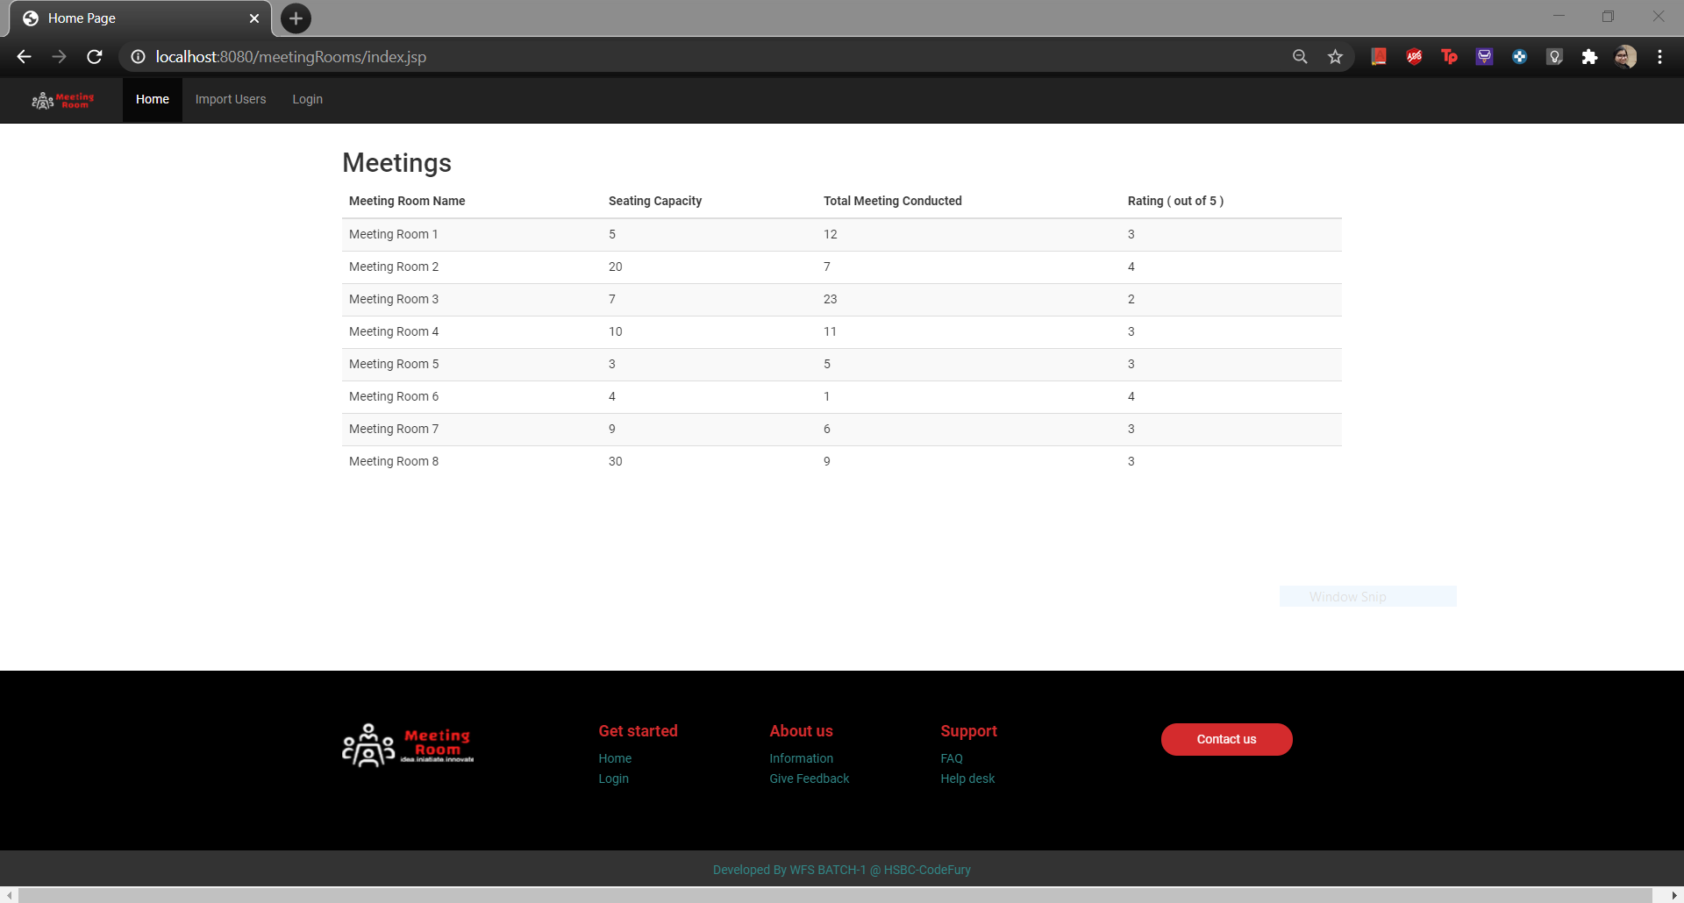
HOME PAGE

Slide 12
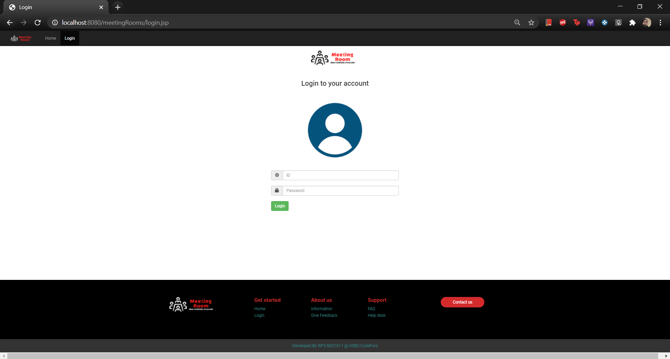
LOGIN PAGE

Slide 13
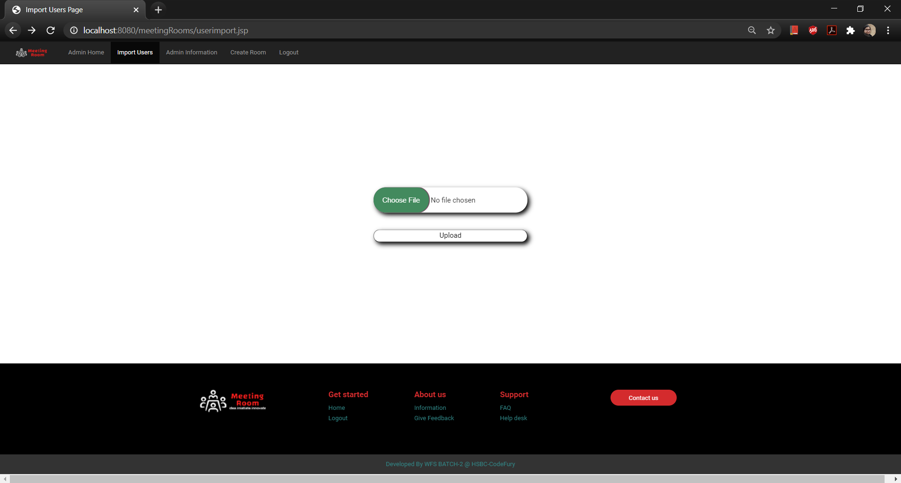
IMPORT USERS

Slide 14
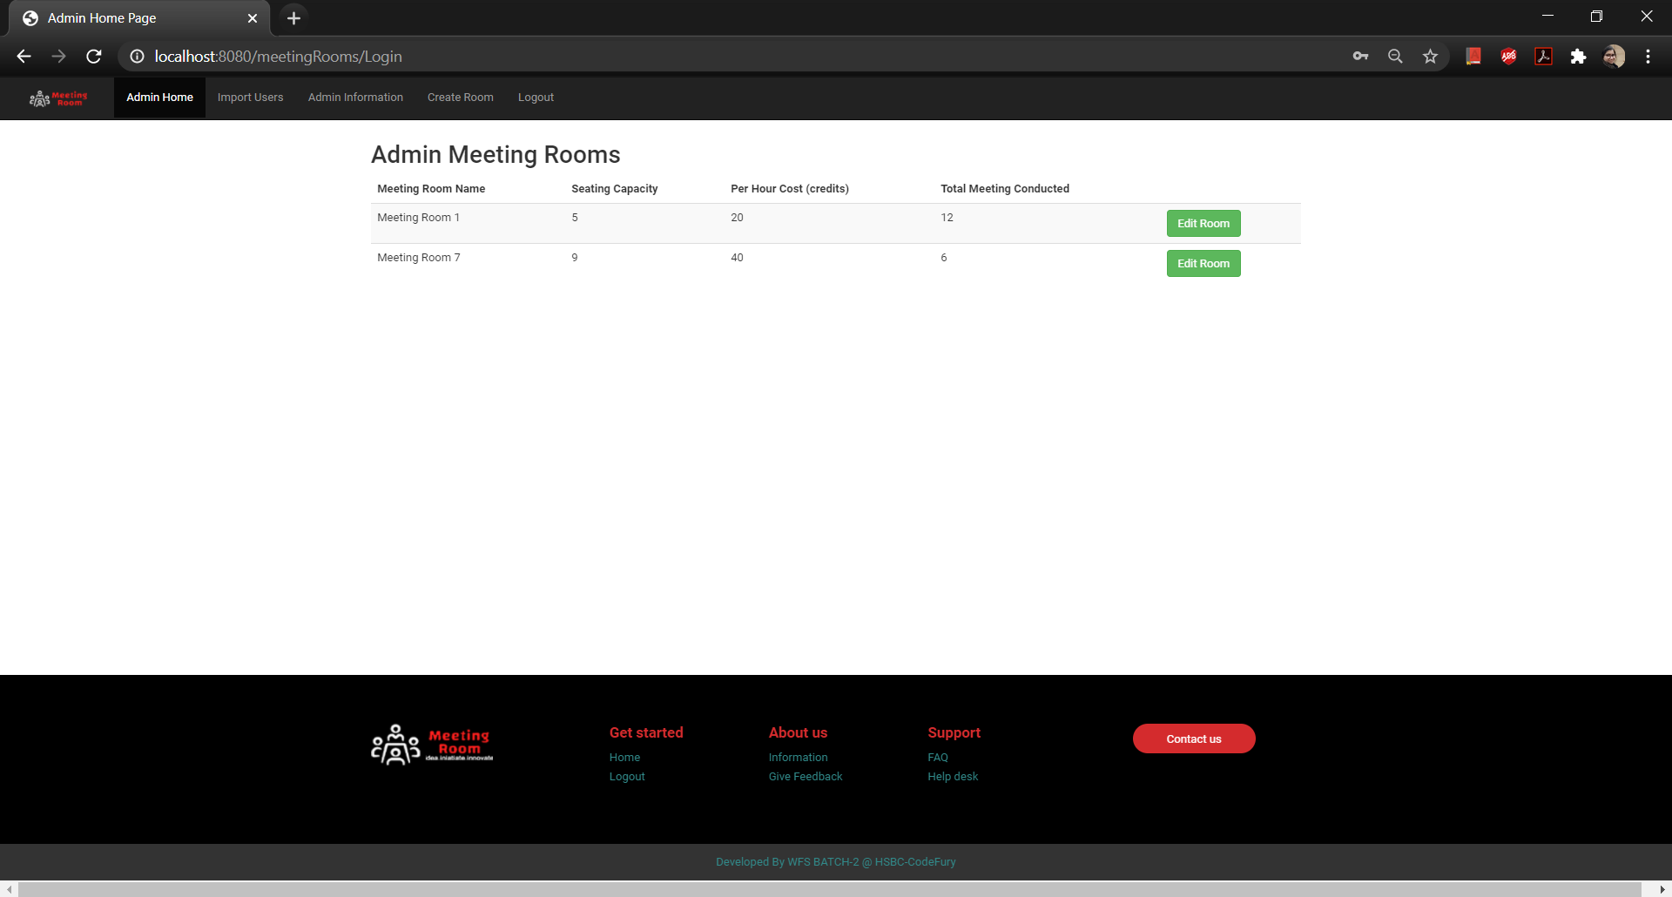
ADMIN – HOME PAGE

Slide 15
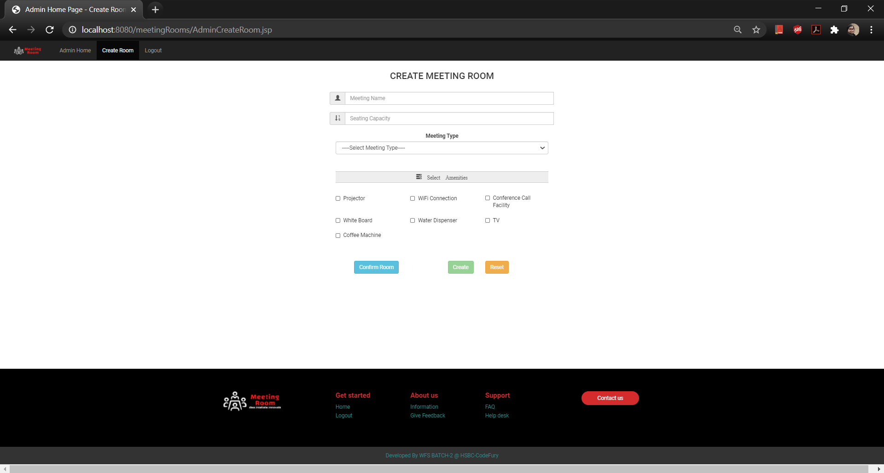
ADMIN – CREATE MEETING

Slide 16
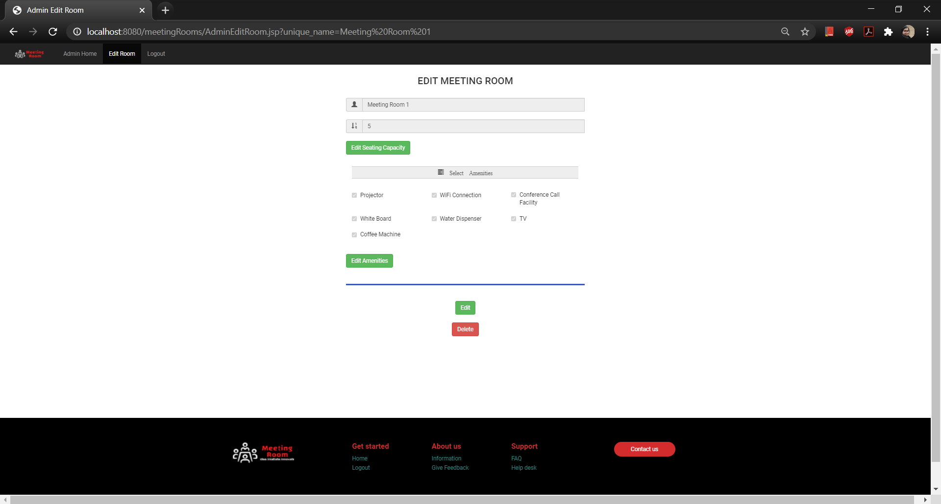
ADMIN – EDIT MEETING

Slide 17
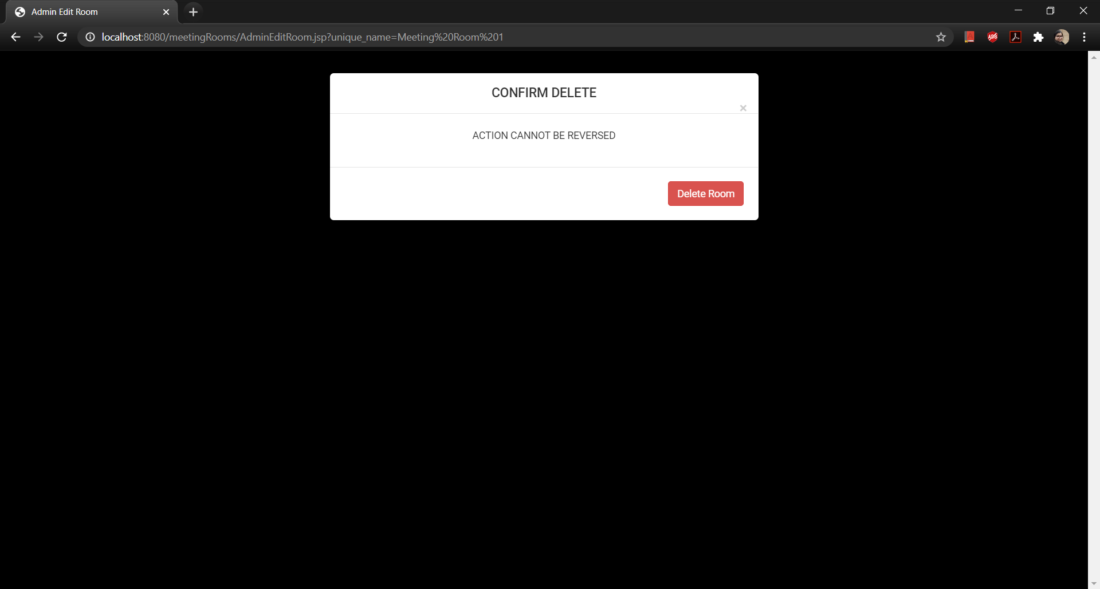
ADMIN – DELETE ROOM

Slide 18
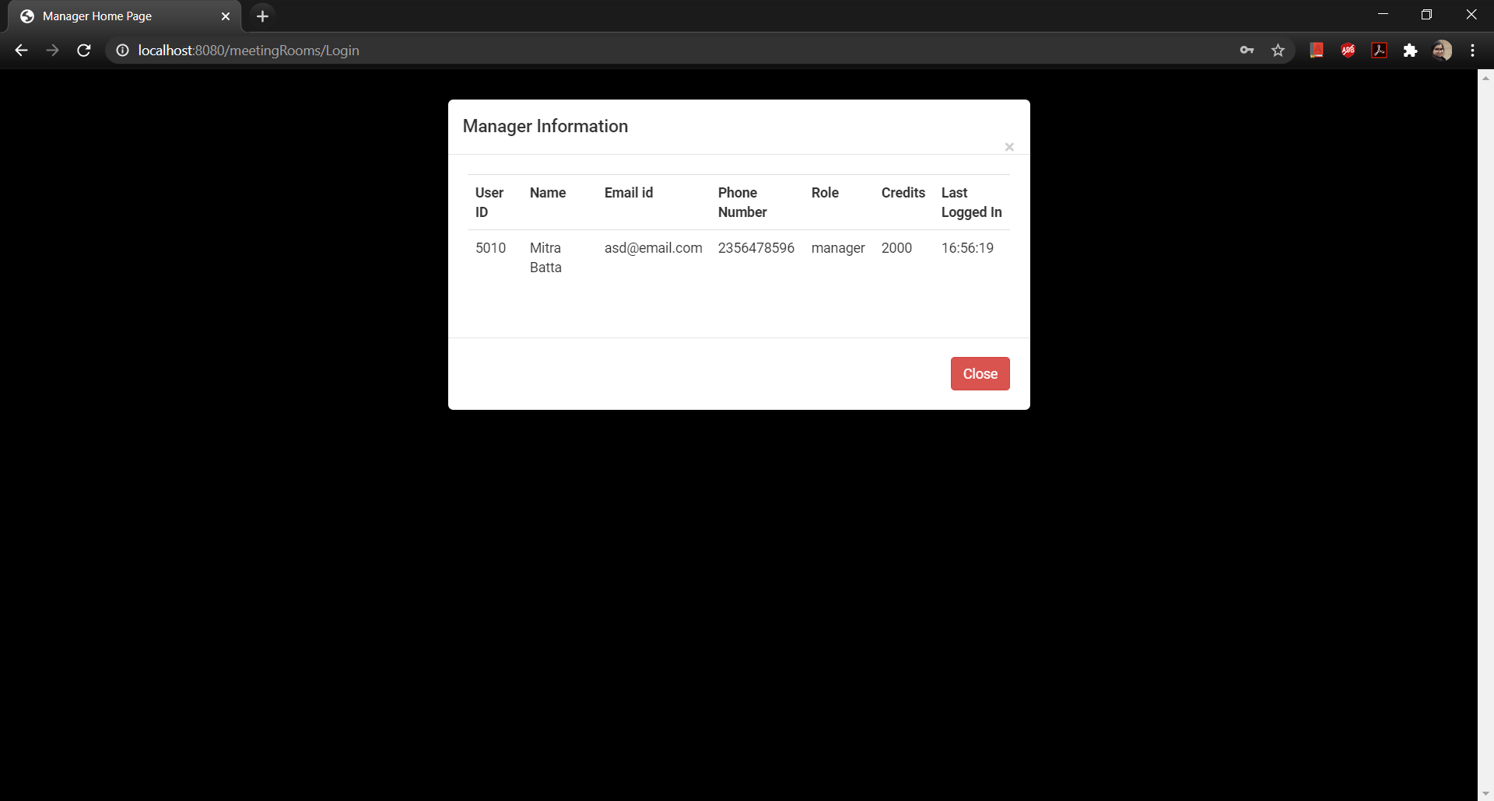
MANAGER - MANAGER INFORMATION

Slide 19
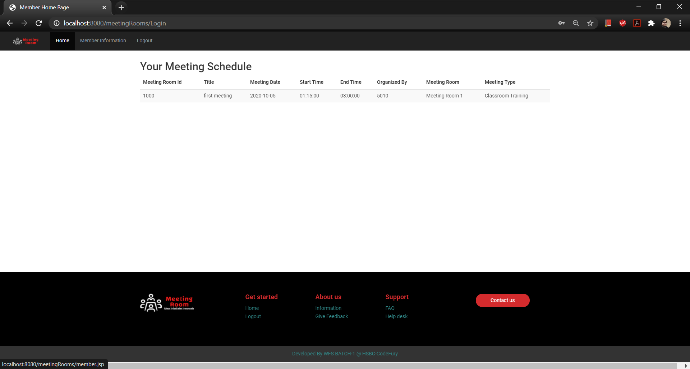
MEMBER – HOME PAGE

Slide 20
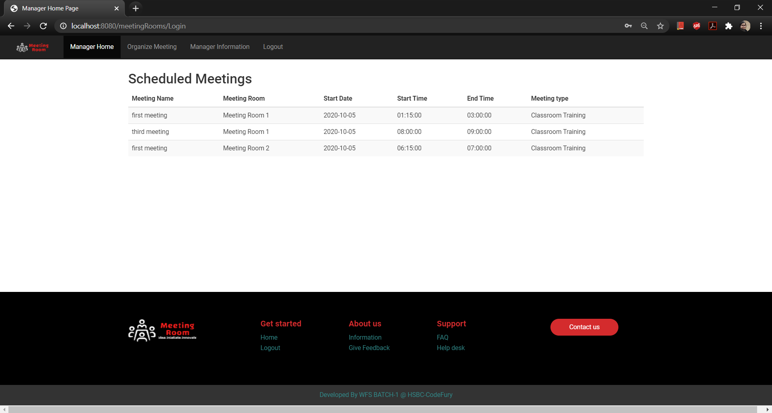
MANAGER - HOME PAGE

Slide 21
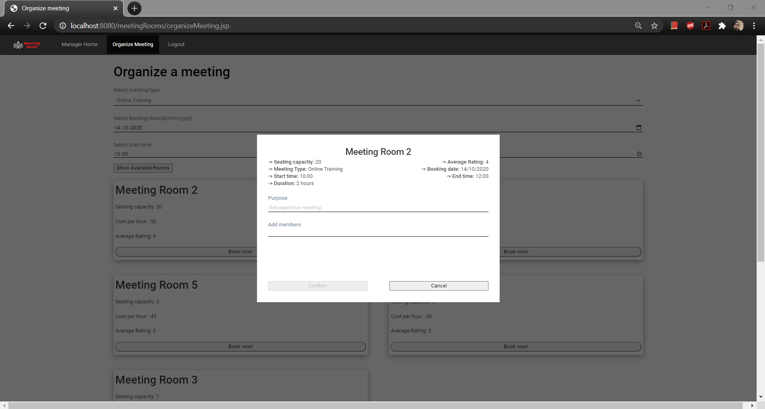
MANAGER – ORGANIZE MEETING

Slide 22
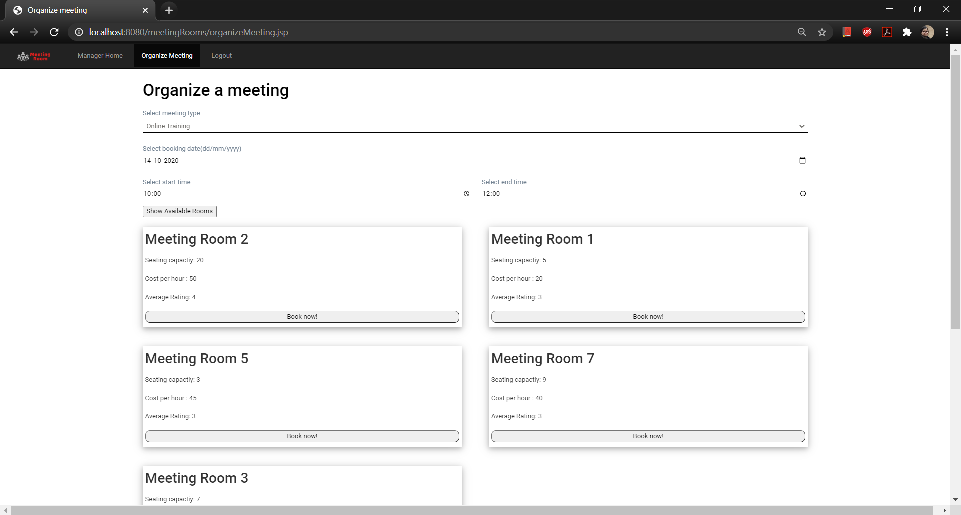
MANAGER – ORGANIZE MEETING

Slide 23
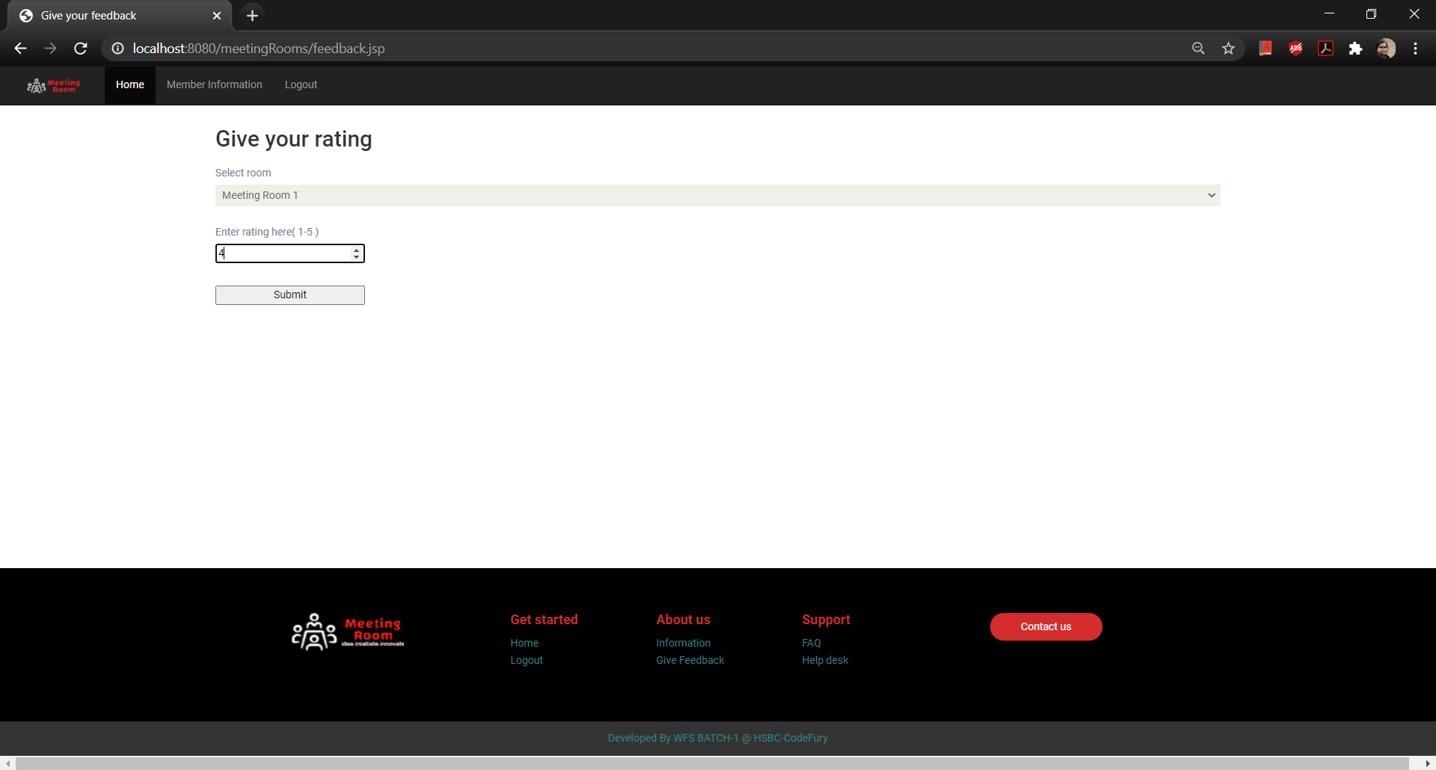
FEEDBACK PAGE

Slide 24
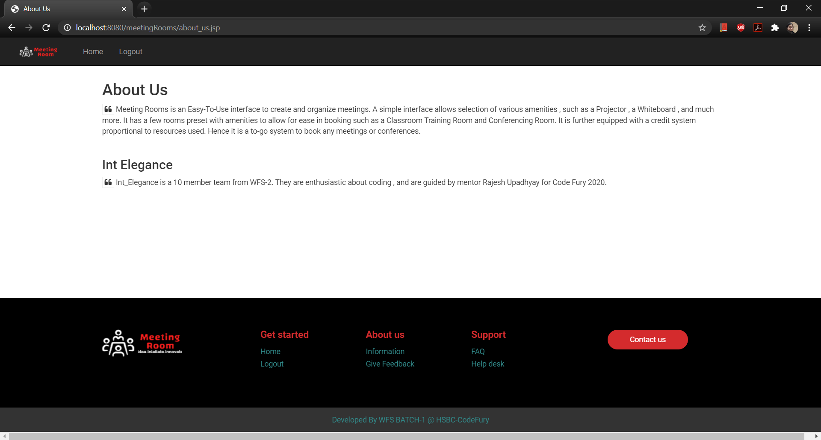
ABOUT US PAGE

Slide 25
THANK YOU

