Slide 1
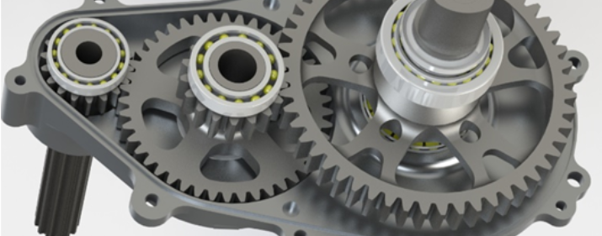
Gear Webbing Optimization
CWRU Motorsports 2021-2022 Season

Slide 2
Scope
Involving:
Topological Optimization
  Utilization of Rotational Symmetry to simplify analysis
Deeper exploration of FEA simulations
  Higher resolution, while also simplifying/working around unwieldy geometry
Iterative design based upon FEA results
Existing Gearbox Design utilized gear webbing with minimal documentation of calculations
Decrease weight and improve efficiency of the gears by targeting the webbing material
Investigate a ‘uni-directional’ optimization design

Slide 3
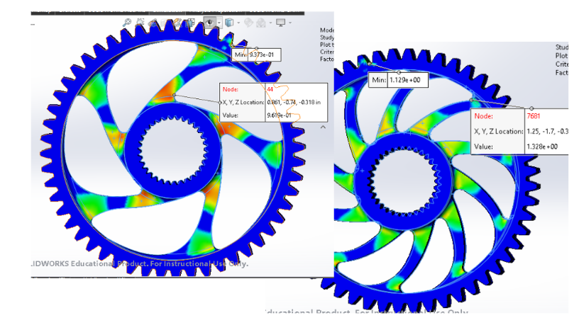
‘Unidirectional’ Design
Found to be inferior to straight-spoked designs, later confirmed by Topological Optimization

Slide 4
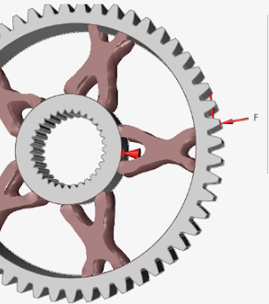
Topological Optimization
Subsequent analysis in Altair Inspire indicated that a symmetric webbing geometry provides the best strength.
Due to balancing the tensile and compressive loading.
Interpreted into a manufacturable solid model
Further iterations to hone-in the factor of safety.

Slide 5
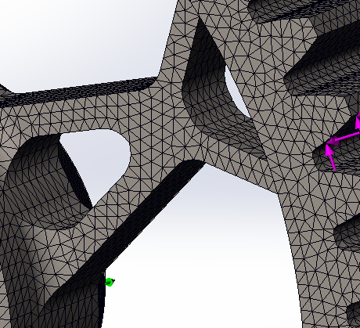
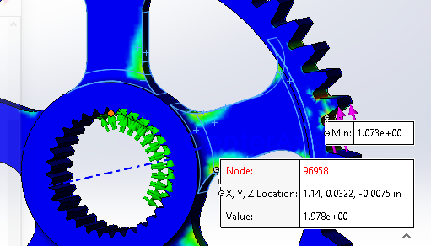
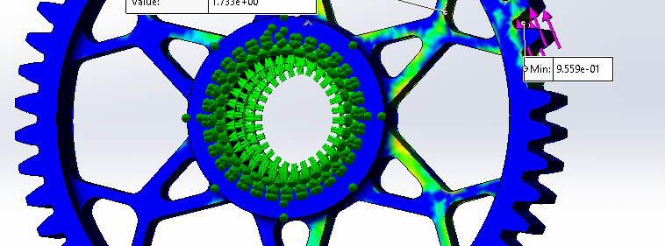

Slide 6
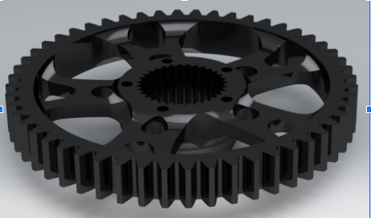

Slide 7
Takeaways
Stronger Foundation in FEA simulation
Mesh control and result analysis
Comfortability with Topological Optimization
A sweet new gear webbing design!
+20% Strength
-10% Mass

Slide 8
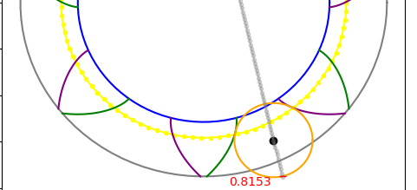
Gear Profile Calculations & Modeling
Summer 2024 (in-development)

Slide 9
Scope
Involving:
Utilizing existing publications on various aspects of gear/cam profiles.
  Involutimetry
  Trochoidal arcs
Familiarization with Python coding
  ‘Pythonic’ syntax & shorthands
  Scientific computing packages
    Numpy, Scipy, Pandas
  3D Modeling and Animation
While working for aerospace gear producer, realized there is a lack of clear public information on the underlying math & calculations for TRUE gear profiles.
Establish a set of scripts and code notebooks that lay out the thought process and understanding of how realistic gear forms are designed and implemented.

Slide 10
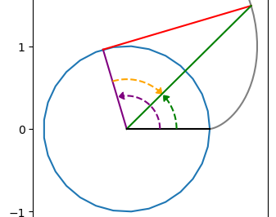
Expanding on existing material with a focus on coded examples (Jupyter Notebooks)
Establishing thorough descriptions of commonly ‘handwaved’ information

Slide 11
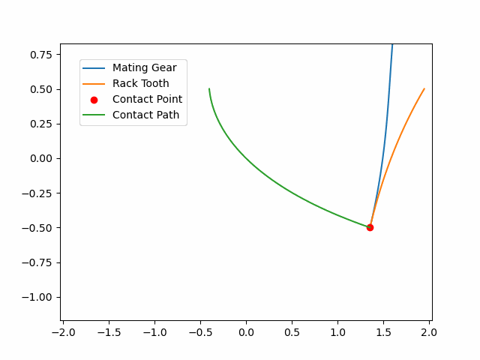
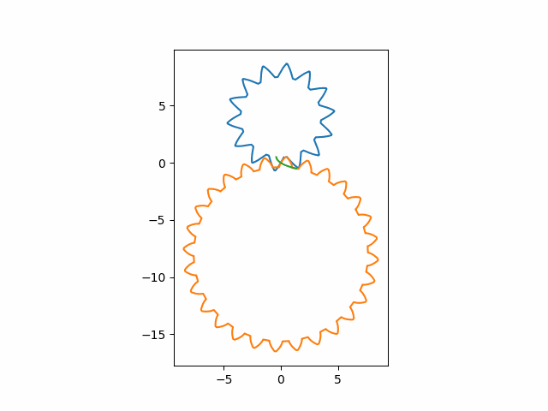
3D Animations of Generation Process available on github

Slide 12
Takeaways (so far)
Python Literacy + Git Familiarity
Complex Vectors for Animation
Intuitions for Mechanical Part Generation

