Slide 1
Global Happiness Report 2016 Dashboard
Analysis and Insights

Slide 2
Project Purpose
The purpose of this analysis was to identify and understand key factors contributing to happiness worldwide, using data from the 2016 World Happiness Report. The goal is to offer insights into how economic, health, and social indicators impact national well-being.

Slide 3
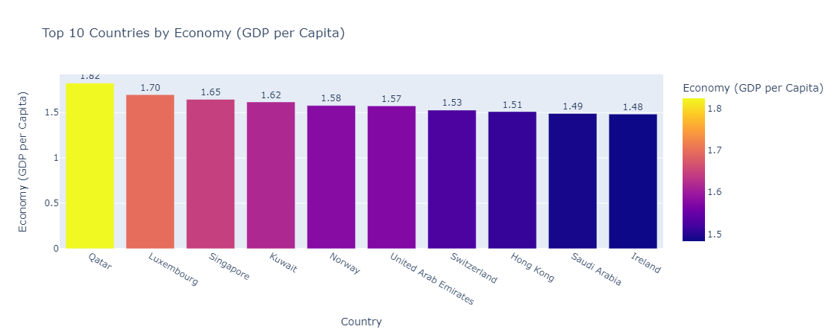
Top 10 Countries by Economy (GDP per Capita) and Life Expectancy
The bar charts display the top 10 happiest countries based on GDP per capita and healthy life expectancy, revealing the role these indicators play in happiness.

Slide 4
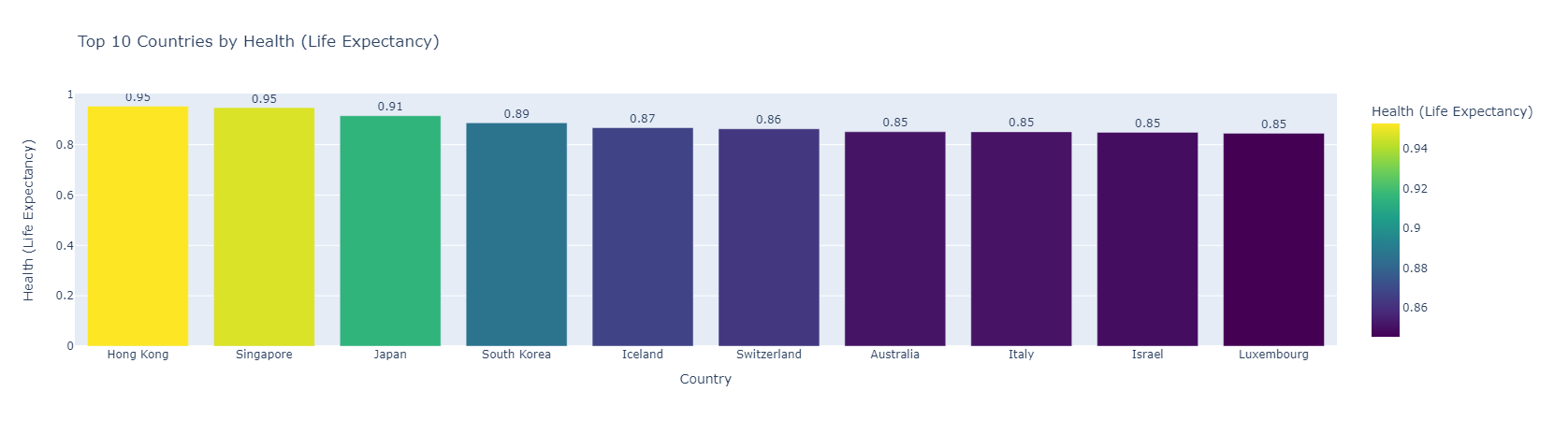
Top 10 Countries by Health (life Expectancy)
The bar charts display the top 10 happiest countries based on GDP per capita and healthy life expectancy, revealing the role these indicators play in happiness.

Slide 5
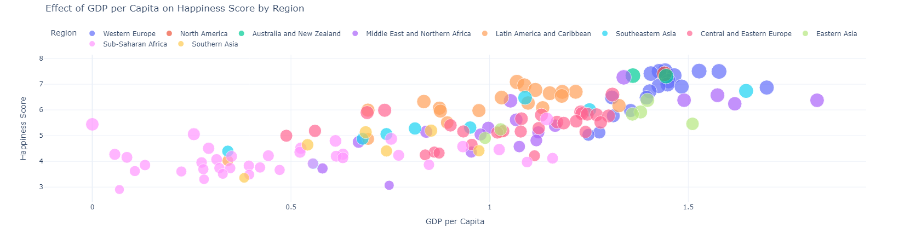
Happiness and GDP per Capita by Region
This scatter plot highlights the relationship between GDP per capita and Happiness Score across regions, showing how economic resources contribute to happiness in different parts of the world.

Slide 6
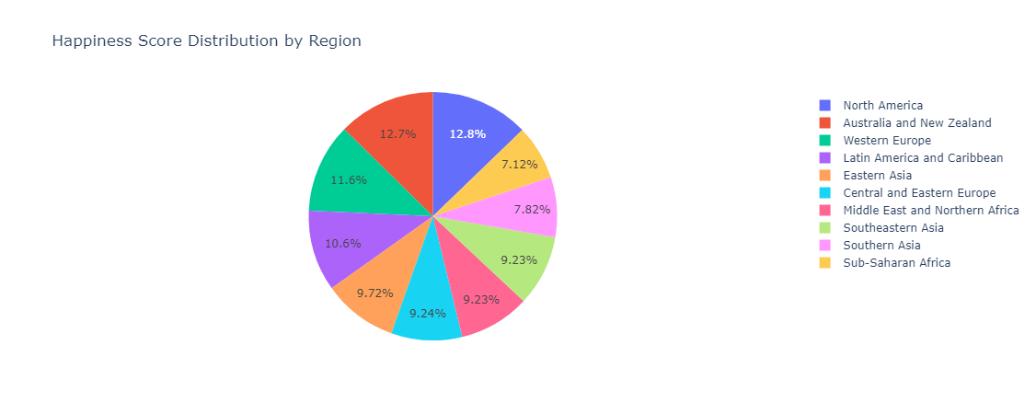
Happiness Score Distribution by Region
The pie chart shows the percentage contribution of each region to the Happiness Score, providing a visual assessment of global happiness distribution.

Slide 7
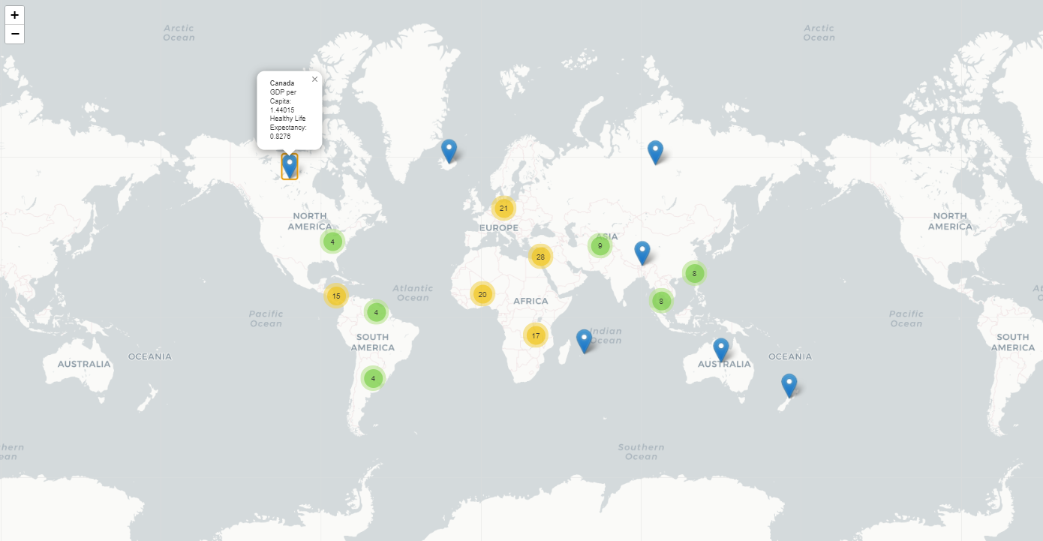
Global Map: GDP per Capita and Life Expectancy by Country
The map provides an interactive view of GDP per capita with Healthy Life Expectancy as a tooltip, highlighting countries with higher economic and health standards.

Slide 8
Key Takeaways
1. Economic and Health Indicators: High GDP and life expectancy correlate with higher happiness scores. 2. Regional Disparities: Wealthier regions show higher happiness, while regions with limited resources report lower levels. 3. Governance and Trust: Trust in government plays a role in national happiness.

Slide 9
Conclusion
This dashboard provides insights into global happiness, emphasizing the importance of economic stability, health, and governance. The analysis offers valuable information for policymakers aiming to address disparities and improve global well-being.

