Slide 1

ZOMATO RESTAURANTS INSIGHTS
Vikash kumar
12-march-2024

Slide 2
Why Location Matters
The right location is the secret sauce to a restaurant's success. It's like picking the freshest ingredients - it sets the stage for a delicious experience. We're looking for a place with the perfect blend of factors to attract hungry customers and keep them coming back for more.
Introduction and Objectives
Zomato, formerly known as Foodiebay, underwent a rebranding in 2010 to become the globally recognized platform it is today
Craving the Perfect Spot
We're on a mission to find the ideal location for our brand new restaurant! Just like Zomato connects you with amazing food experiences, we're searching for the perfect spot to bring our culinary vision to life.

Slide 3
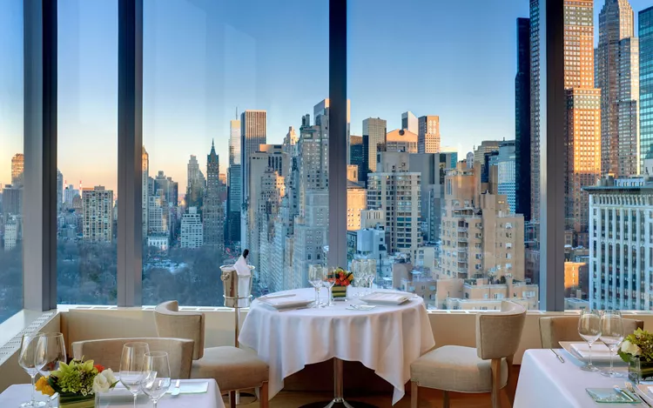
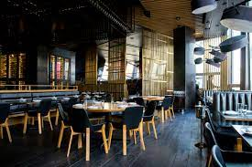
Exploring Restaurant Trends with Source Data
Total number of restaurant is 9,654
Restaurant ID: Unique identifier for each restaurant.
Cuisines: The type of cuisine offered by the restaurant.
Has_Table_booking: Indicates whether the restaurant has a table booking option (Yes/No)
Has_Online_delivery: Indicates whether the restaurant offers online delivery (Yes/No).
Price_range: A numeric value indicating the price range category of the restaurant.
Votes: The number of votes or ratings/(feedback) received by the restaurant.
Average_Cost_for_two: The average cost for two people dining at the restaurant.
Rating: The overall rating of the restaurant is based on user reviews.
Datekey_opening: The date when the restaurant was opened.

Slide 4
Analytical Approach and Tools
Collect the relevant data
Data Cleaning : Utilized functions like FIND,REPLACE and Remove Duplicate to ensure data accuracy.
Data Enrichment: Enhaticed the dataset with additional variables using VLOOKUP to cross- reference exterial data sources.
Descriptive Analysis: Employed Pivot Tables for suntnarizing key metrics and identifying sales patteriis across different regions and product categories
Customer Segmentation: Applied SORT and FILTER functions to classify
customer based on purchasing behavior and demographics.
Visualization: Created dynamic charts and dashboards for
data representation, enabling interactive data exploration
Clean the data
Apply the relevant analysis
Visualize and interpret the result

Slide 5
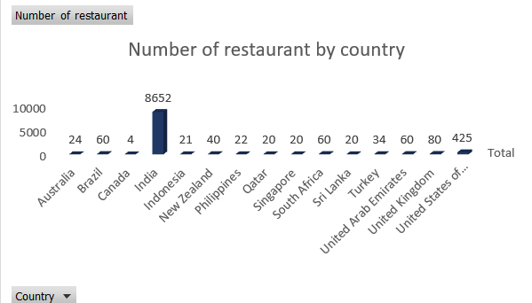
Breakdown of Restaurants by Country
The India has the most restaurants, with 8652.
Canada,Qatar,Singapore and Sri Lanka have the fewest restaurants.

Slide 6
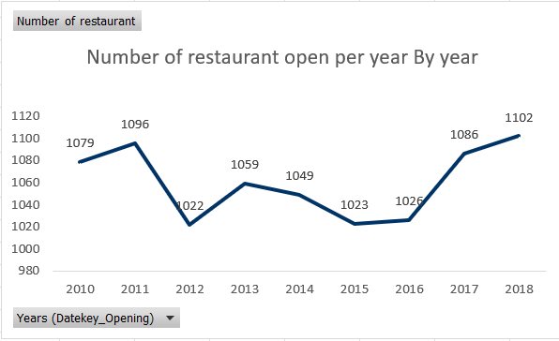
Number of Restaurants Opened Annually
The line graph shows an upward trend in the number of restaurants open per year. While there are fluctuations throughout the years, the overall trend suggests a growth.
It appears that the year 2010 has the lowest number of restaurants open at around 1000.
The data seems to indicate a steady increase in the number of restaurants opening year after year, possibly reaching a peak around 2018. It's difficult to say for sure though, given the limited data points for the latter years.

Slide 7
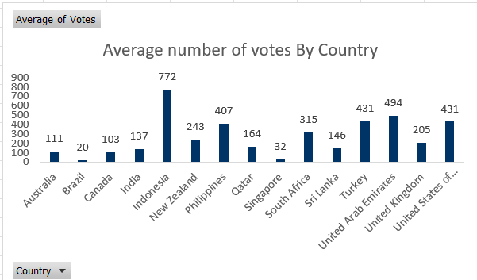
Average Votes Per Country
Indonesia has the highest average number of votes at 772, followed by United Arab Emirates at 494
Brazil,Singapore has the lowest average votes.

Slide 8
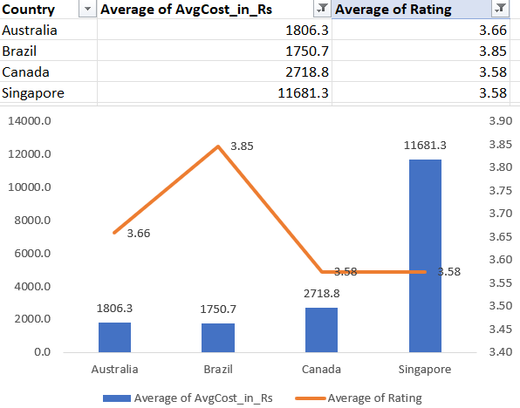
Lesser Competition
This table shows that India has the most restaurants, while Canada has the least. However, this doesn't necessarily mean there's more competition in India.
To understand competition better, I looked at the rating and average price of two.
I figured that places with rating less than 4 and average price of two is greater than 1500.
Canada , Australia , Brazil and Singapore where less competition area.

Slide 9
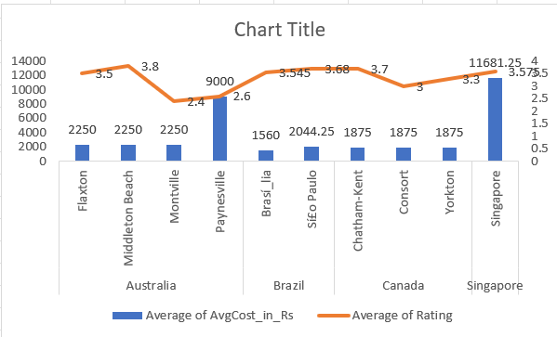
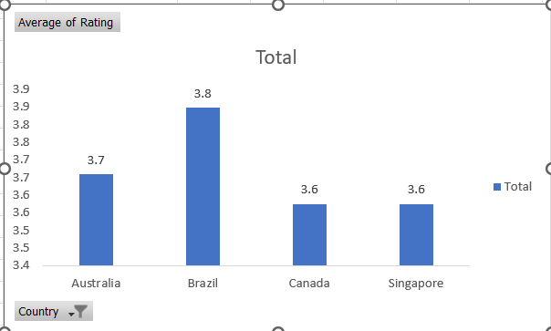
City in the suggested country for newer restaurant
Following the same approach as before, I analyzed a chart to find cities with less competition.
In this chart, I looked for cities where the with rating less than 4 and average price of two is greater than 1500.
Flaxton , Middleton Beach, Montville, Brasi_lia , siEo Paulo, chatham-kent , Consort, Yorkton, Singapore are the city where we can open new restaurant
Average rating of these country are 3.7,3.8,3.6 and 3.6.

Slide 10
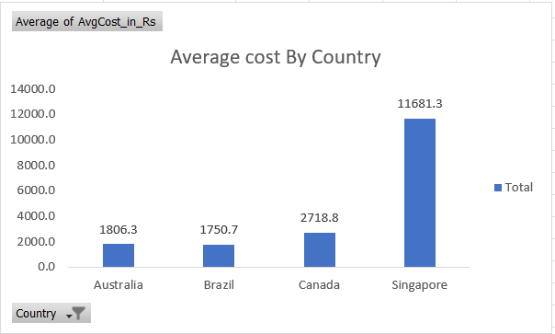
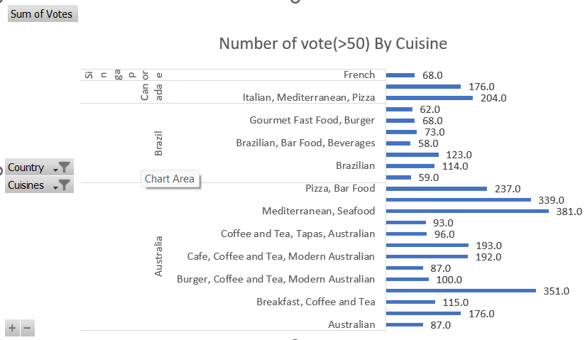
Average Cost for Two: This is Factor estimating overall food expenditure
Average of avg cost of two in suggested country
Matching Customer Demanded Cuisine with Pricing: Analyzing cuisine popularity can help me determine if a particular cuisine aligns with our pricing strategy. Popular cuisines might allow you to set competitive prices and attract a larger customer base.

Slide 11
Strategic Recommendations
Target Less Number Restaurant Areas with High User Demand:
Analyze areas with a low density of existing restaurants but high overall ratings. This suggests a market with
met costumer needs.
Target Price Range of the Restaurants :
Analyze the price range most frequented by audience. Align your restaurant's concept and
pricing strategy with their budget preferences to maximize appeal
Price Range Correlation with Cuisine:
Identify any correlations between price range and cuisine
Exploring Existing High-Rated Restaurants :
Identifying the high rated restaurant for knowing which cuisine make audience attract.
Prioritize Budget-Friendly Options in Cost-Conscious Areas:
Analyze data to identify areas with a lower average cost for two

Slide 12
Exploring Rating Correlation with Cuisine:
Identifying the rating of cuisine that has great rated in different restaurant of country
Delivery Penetration Rate:
Calculate the percentage of restaurants offering online delivery in country. A high penetration rate
suggests a strong customer preference for delivery options.
Correlation with Cuisine: Analyze if specific cuisines are more likely to offer online delivery. This might indicate higher customer demand for delivery for those cuisine types.
Delivery Popularity by Area: Identify areas with a high concentration of restaurants offering delivery. This suggests a strong customer base for delivery services, potentially driven by factors like busy lifestyles or limited dine-in options.

Slide 13
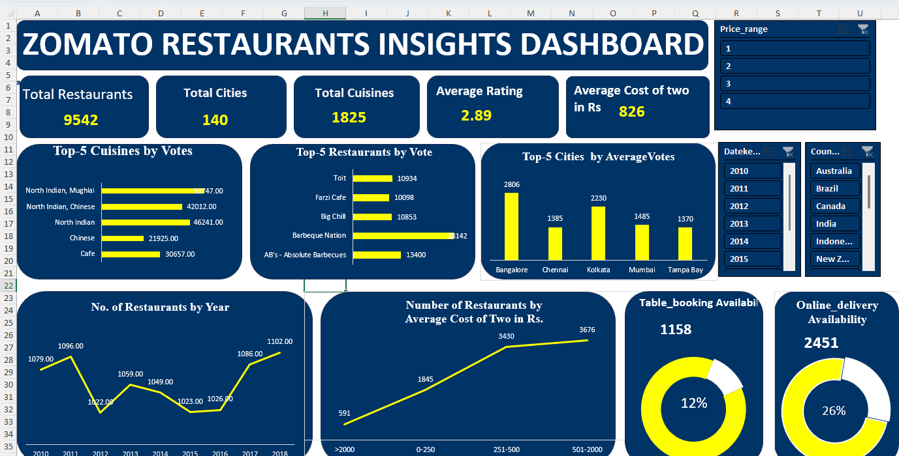
Dashboard and Visualizations

Slide 14
Conclusions
Our data-driven analysis has revealed valuable insights to guide Zomato's strategic selection of a new restaurant location
By leveraging Zomato data and market research, we can make informed decisions to maximize the success of Zomato's new restaurant venture
This data analysis equips Zomato with a comprehensive understanding of trends and customer preferences, paving the way for a strategic restaurant launch
By prioritizing less saturated locations, Zomato's new restaurant can establish a strong presence and attract a loyal customer base
Aligning the restaurant concept with popular cuisine preferences will ensure strong customer appeal for Zomato's new venture

Slide 15

References
ARTICLE: Targeting the Right Market
WEBSITE: www.google.com

