Slide 1
CAR RENTAL SYSTEM

Slide 2
DECLARATION :
I am hereby declare that this project of “Car Rental System” has not been copied from anywhere but designed & developed by us through the help of our college faculties for which we are very thankful of them.
Student Name: Adarsh Kumar
Enrollment No: 0103EC181006

Slide 3

INDEX :
Introduction of the Project
History
In Present system
My system
Requirement
Application Preview
Limitations
Future Enhancement
Conclusion

Slide 4
Optimizing technical requirements leads to Innovation .
Let’s start …

Slide 5
INTRODUCTION OF THE PROJECT
CAR RENTAL SYSTEM
Car Rental System , is a management application that is used to manage the records of the customer and the number of cars available. We all know that nowadays managing records or the data on notebooks become very old and tedious work. And, nobody likes to do the calculations so this application will help all those people who are facing the same issue.

Slide 6

HISTORY
In our past when there was no Desktop Applications, so the people use to handle the task using Manual work and to exchange data between different areas uses postal services. Which was so time consuming and the cost of managing the account was very high. Although there was no reliability. Data Handling with computers is also not avail.

Slide 7
IN PRESENT
In present we are trying to reduce the drawbacks of current system. The drawback of time consumption could be rectified in our present system , which will make our system more time efficient. Secondly being computerized our system will have much speed and accuracy as compared to manual system.
Our all data and information will be stored in secondary storage devices, which are non – perishable as compared to manual system.

Slide 8
MY SYSTEM
In the existing system the user has the facility of the insertion and updating of the Records. So that proper maintenance of the Records can be maintained and Costumers uses it most Information at different Computer Parts. And for the better Choice our systems it provides Current Details for Presents Rents, Booking Information, Available Car Details .

Slide 9
Requirements

Slide 10
REQUIREMENT
HARDWARE
Computer/processor : Pentium personal computer with minimum 90 MHz
or higher processor.
Memory : 256 MB RAM (128 recommended)
Operating system : Windows , macOS, Linux .
Peripheral/Miscellaneous: Mouse (not compulsory), keyboard
SOFTWARE REQUIREMENT
Programming : C Compiler and Code Blocks
Storing Data : File Handling

Slide 11
Code Blocks :
The open source, cross platform, free C, C++ and Fortran IDE.
Code::Blocks is a free C, C++ and Fortran IDE built to meet the most demanding needs of its users. It is designed to be very extensible and fully configurable.
Finally, an IDE with all the features you need, having a consistent look, feel and operation across platforms.
Built around a plugin framework, Code::Blocks can be extended with plugins. Any kind of functionality can be added by installing/coding a plugin. For instance, compiling and debugging functionality is already provided by plugins!
Special credits go to darmar for his great work on the FortranProject plugin, bundled since release 13.12.
We hope you enjoy using Code::Blocks!
The Code::Blocks Team

Slide 12
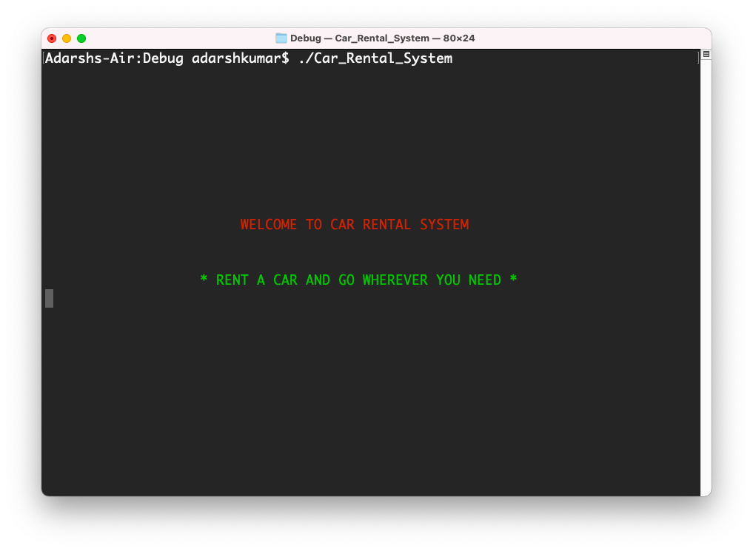
Welcome Screen :

Slide 13
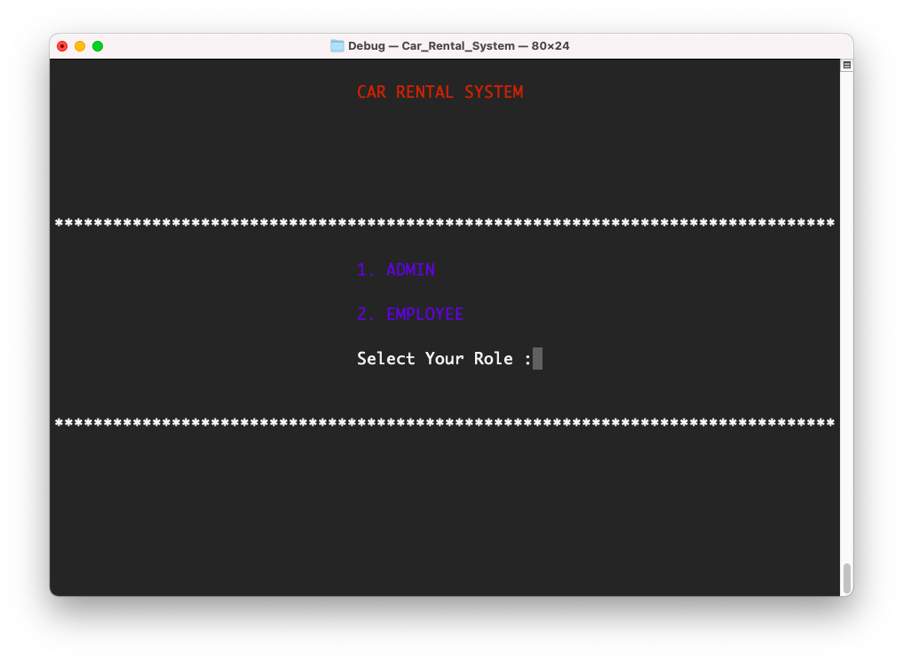
Login Menu :

Slide 14
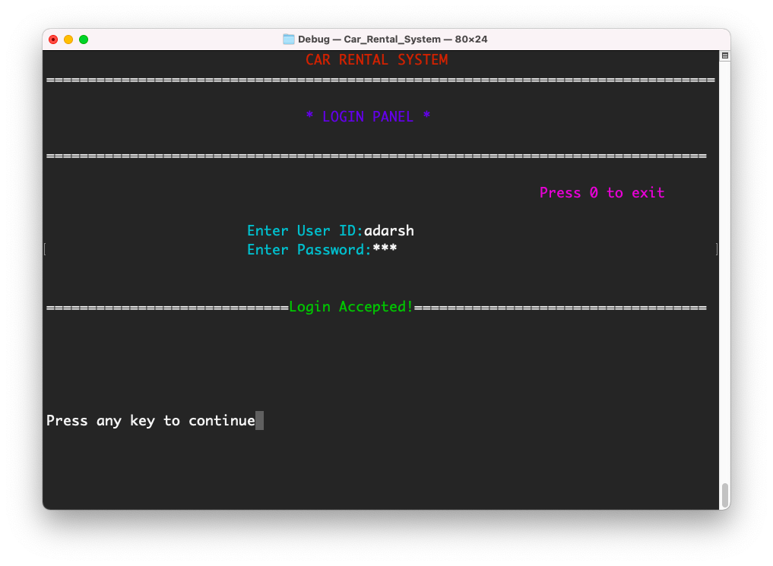
Admin Login :

Slide 15
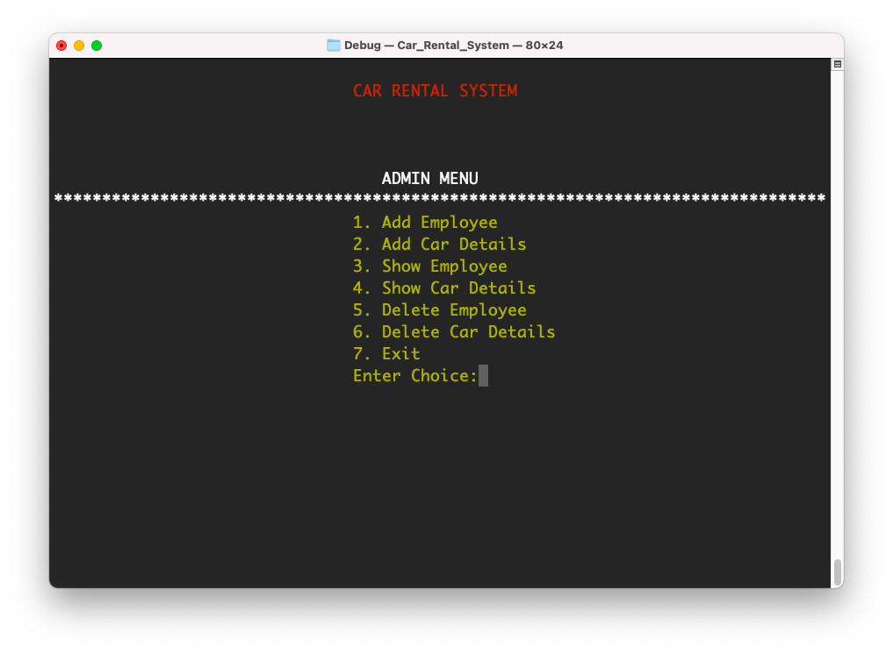
Admin Menu :

Slide 16
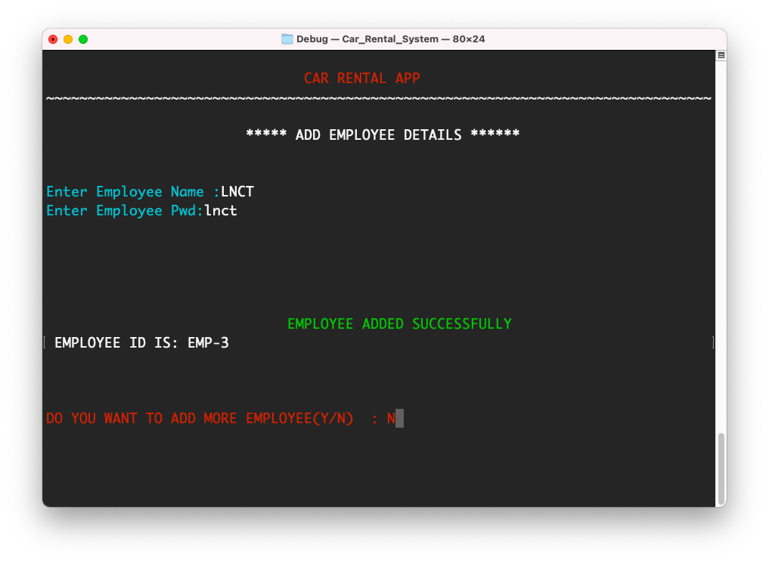
Add New Employee Menu :

Slide 17
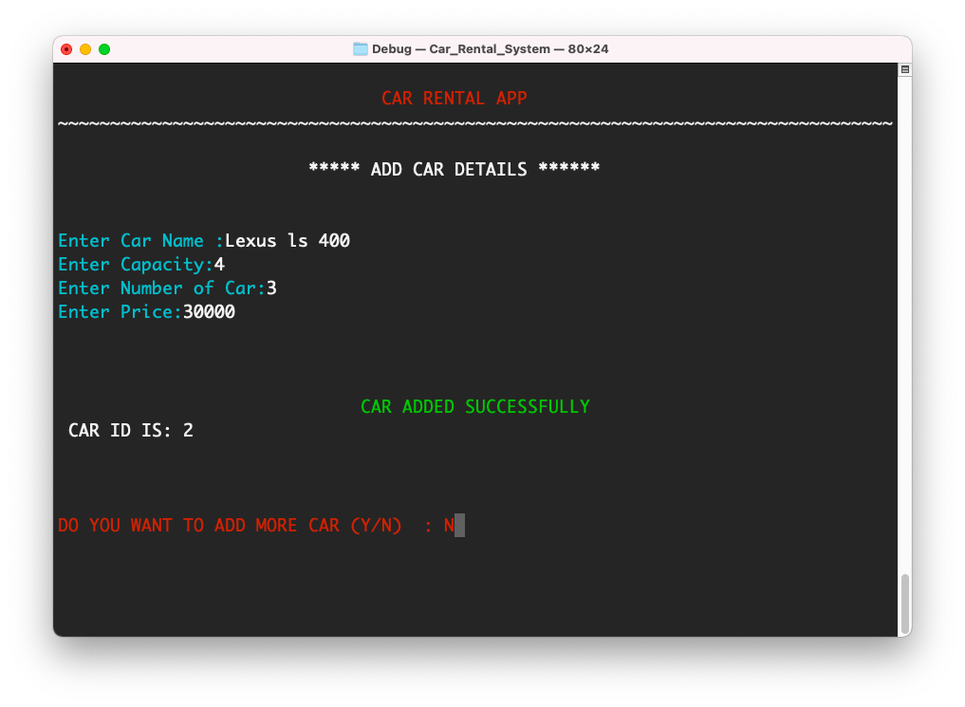
Add New Car Menu :

Slide 18
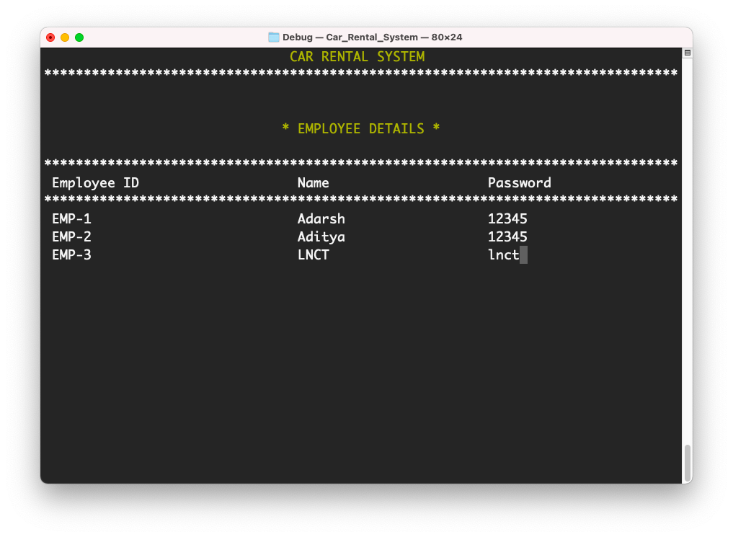
Show Employee Details Menu:

Slide 19
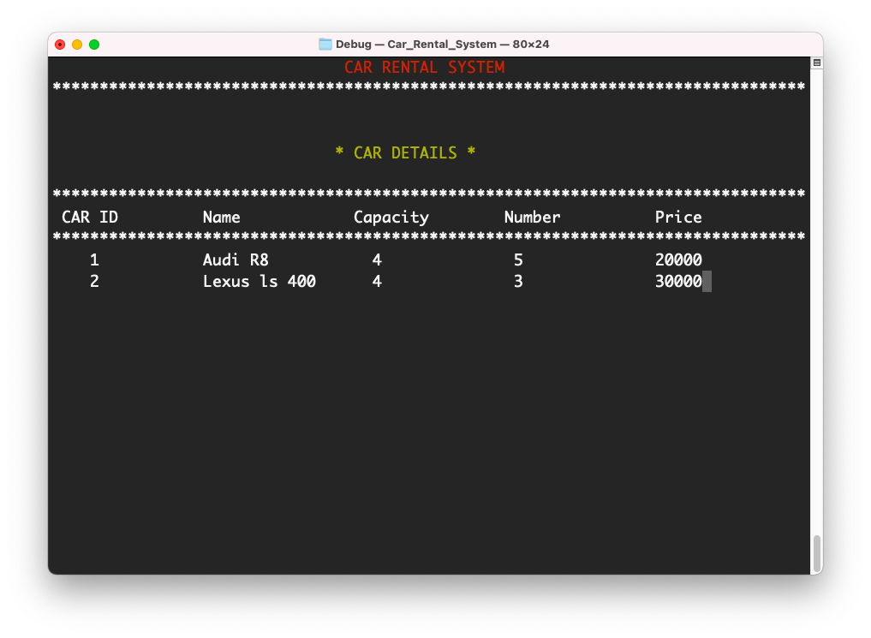
Show Car Details Menu :

Slide 20
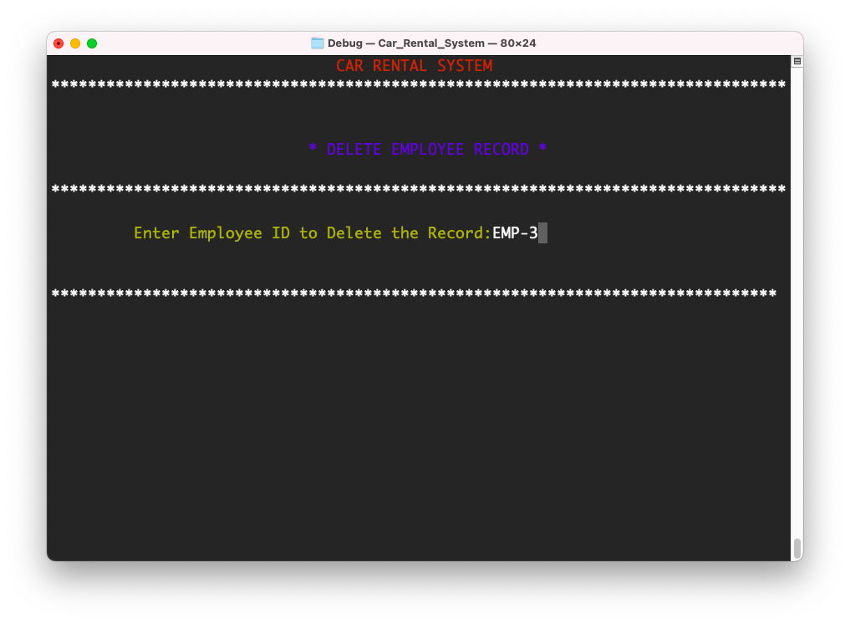
Delete Employee Menu :

Slide 21
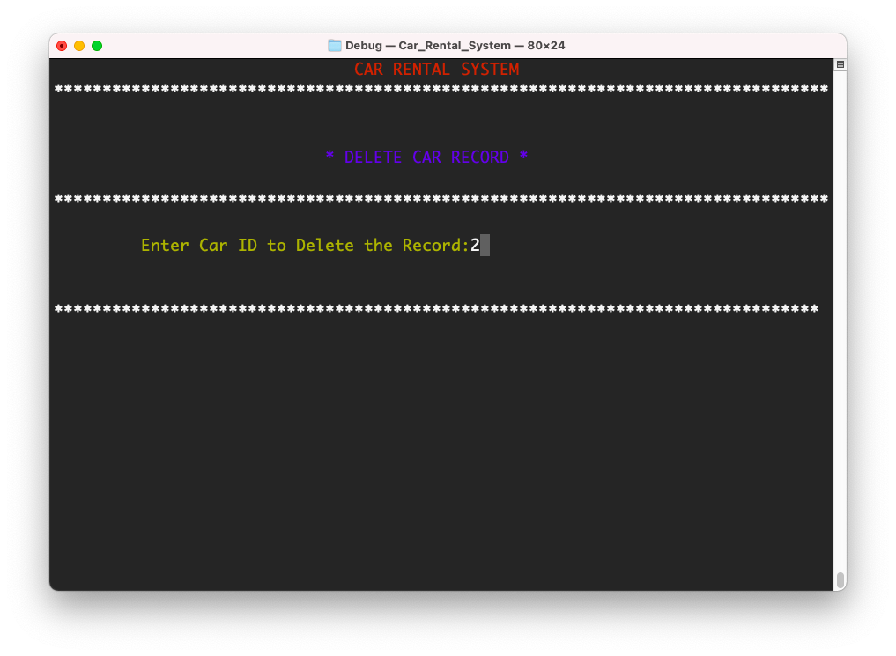
Delete Car Menu :

Slide 22

Employee Login :

Slide 23
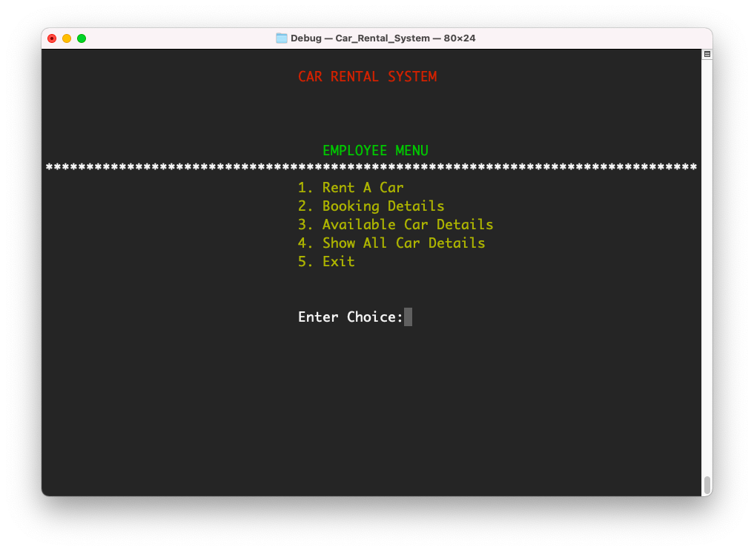
Employee Menu :

Slide 24
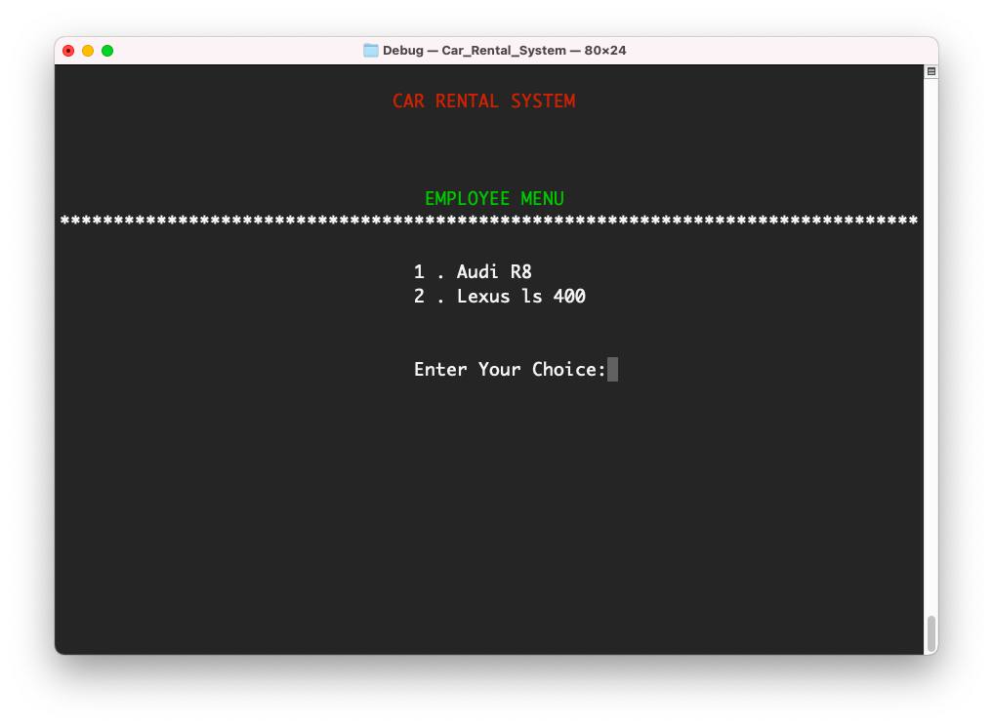
Employee Menu :

Slide 25
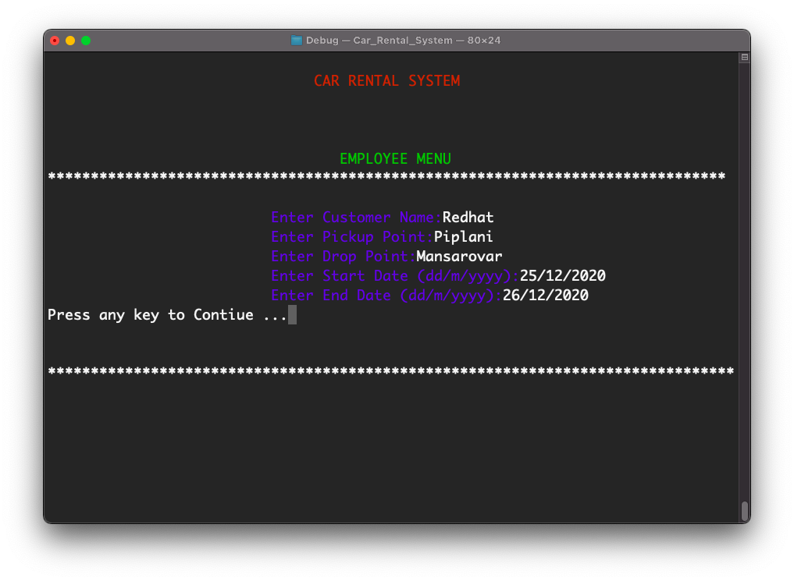
Car Booking Menu :

Slide 26
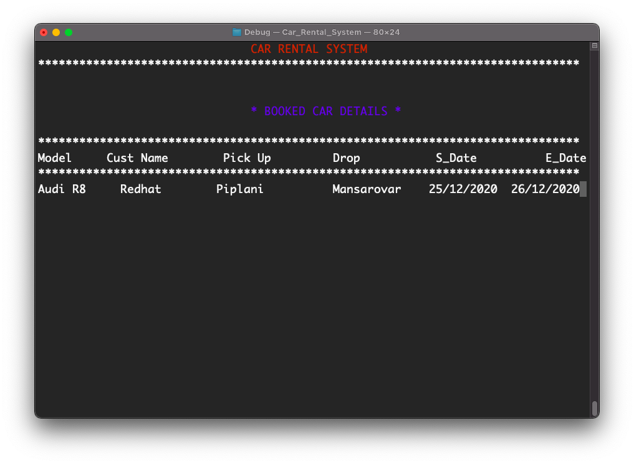
Booked Car Details :

Slide 27
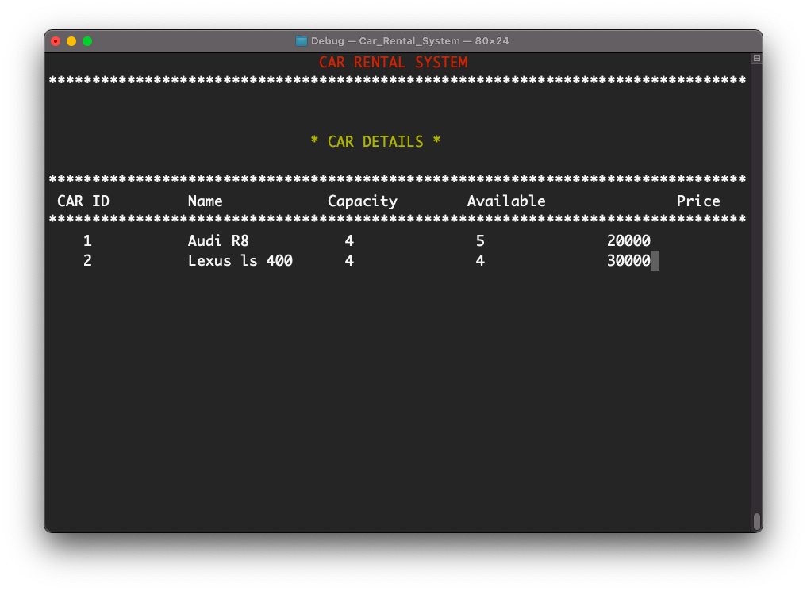
Available Car Details :

Slide 28
Live Demonstration

Slide 29
Limitations

Slide 30
Limitations :
Time Management
Dues of the customer.

Slide 31
FUTURE ENHANCEMENT
Optimizing technical requirements leads to Innovation .

Slide 32
FUTURE ENHANCEMENT :
We provide the facility of Calculating the dues of the customers.
Convert this console application to an Android Application .

Slide 33
Conclusion :
Every Work at the present time all the work perform by computerize and by this application our work is converted to totally computerized.
So that by this application we save our time & paper works.
Due to the advent of computer it has become very easy for Add Records, know the current available cars for rent, Adding New Employees, Deleting Employee and Maintain the record.

Slide 34
Submitted By :
Adarsh Kumar
0103EC181006
Department Of Electronics and Communication

Slide 35


Credits
Special thanks to
Ram Babu Lovewanshi Sir who made this project successful with there guidance and support.

Slide 36
THANK YOU!

