Slide 1


Slide 2
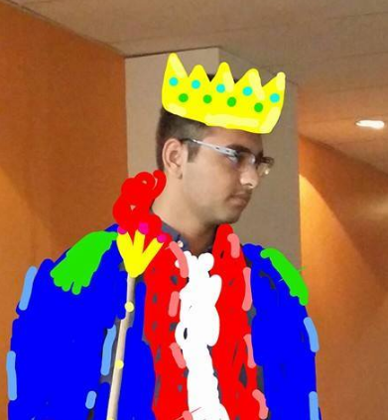
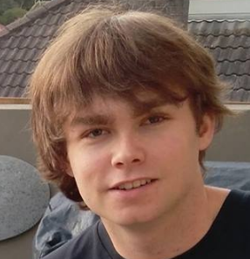
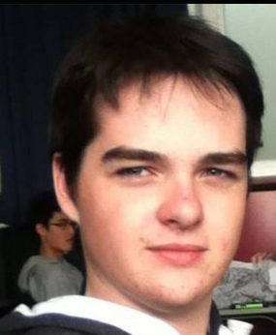
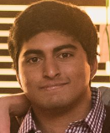
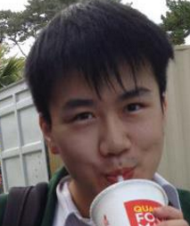
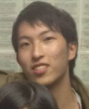
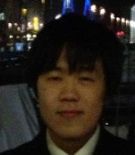

THE TEAM.
AMMAR
THE LEADER LINE
JACK
CAMPBELL
ADI
JUN
NATHAN
JUNO
KEVIN

Slide 3
THE STORY.
TWO SIBLINGS
ONE TORCH
ONE CAVE
ONE EXIT
TREASURE
TOTAL DARKNESS
PUZZLES
TRAPS
MONSTERS
A MOLE MAN.

Slide 4
THE GAME.
SERIOUS GAME CONCEPT:
Collaboration
Empathy
GENRE:
Puzzle
Adventure
RPG
GAME MODE:
Dual (Co-op)
Story mode
Infinite dungeons
TARGET AUDIENCE:
Intermediate students
High school students
Anyone with siblings

Slide 5



THE TOOLS.
UNITY
C#
Many assets
Lots of Tutorials
GITHUB
Source control
Wiki Pages
Issue Tracker

Slide 6


THE DESIGN.
FEATURES:
High Score
Sounds
Random level generation
Monetisation
2.5D!
ADVANCED:
Daily run system
Make your own Puzzles

Slide 7
