Slide 1


Slide 2
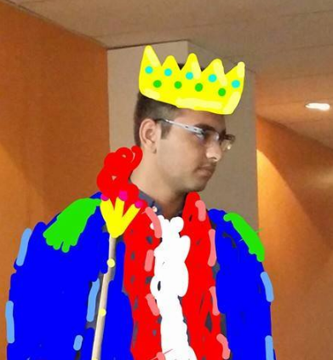
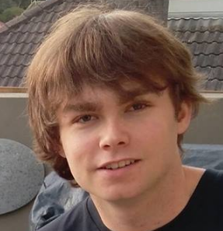
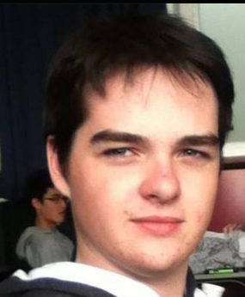
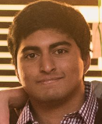
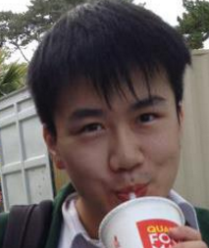

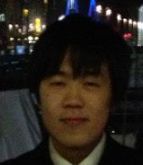
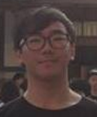
THE TEAM.
AMMAR
THE LEADER LINE
JACK
CAMPBELL
ADI
JUN
NATHAN
JUNO
KEVIN

Slide 3
Fading light - CHECK LIST.
Adventure/puzzle game
Serious Concept: Collaboration
Design features :
High score
Adding sound
2.5D
Fixed level generation =D
Advance feature (rip)

Slide 4
Collaboration elements
Highly collaborative puzzles
Stronger monsters per level requiring teamwork
More challenging traps as game progresses
Careful usage of fuel and items

Slide 5
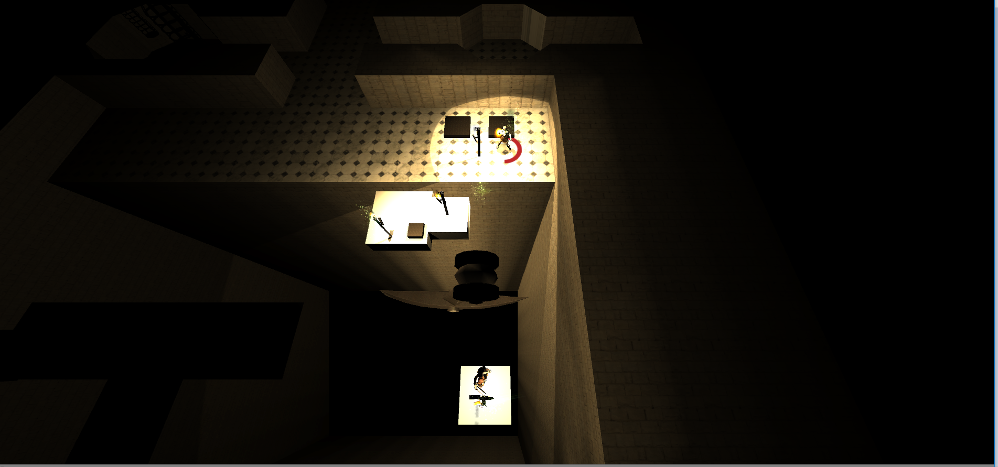

Slide 6
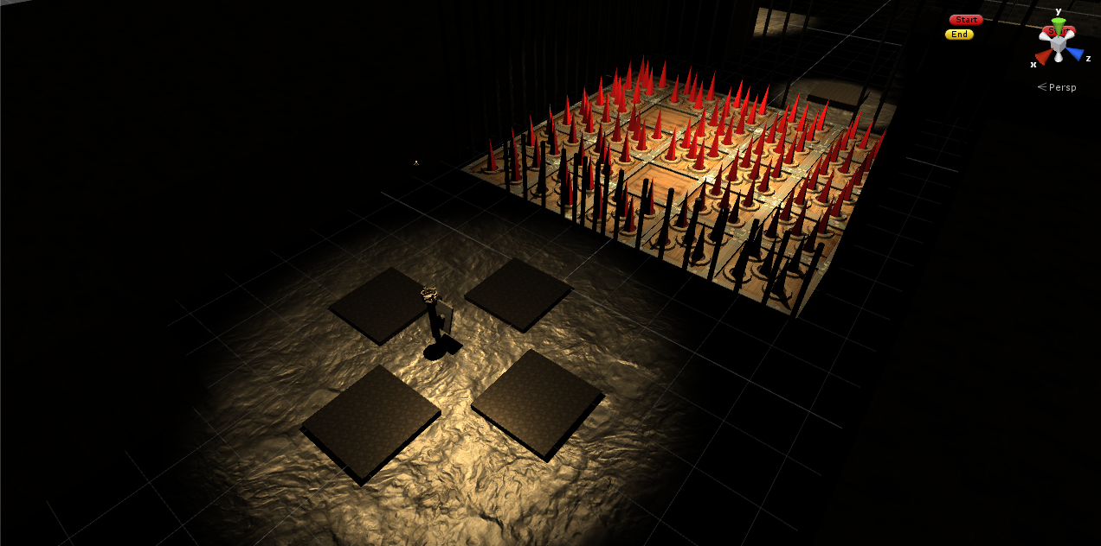

Slide 7
LETS PLAY

Slide 8
THANKS

