Slide 1


Slide 2
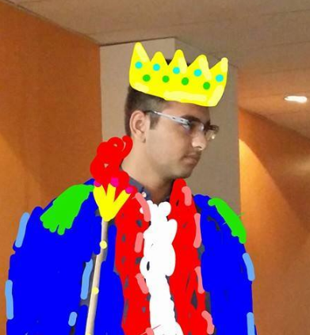
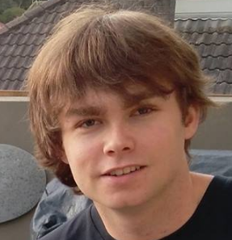
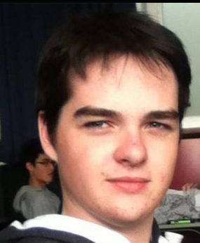
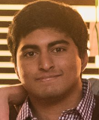
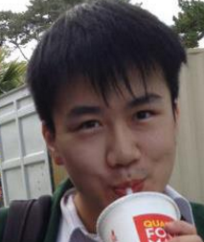
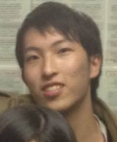
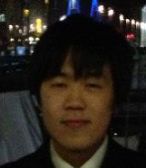
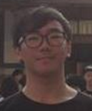
THE TEAM.
AMMAR
THE LEADER LINE
JACK
CAMPBELL
ADI
JUN
NATHAN
JUNO
KEVIN

Slide 3
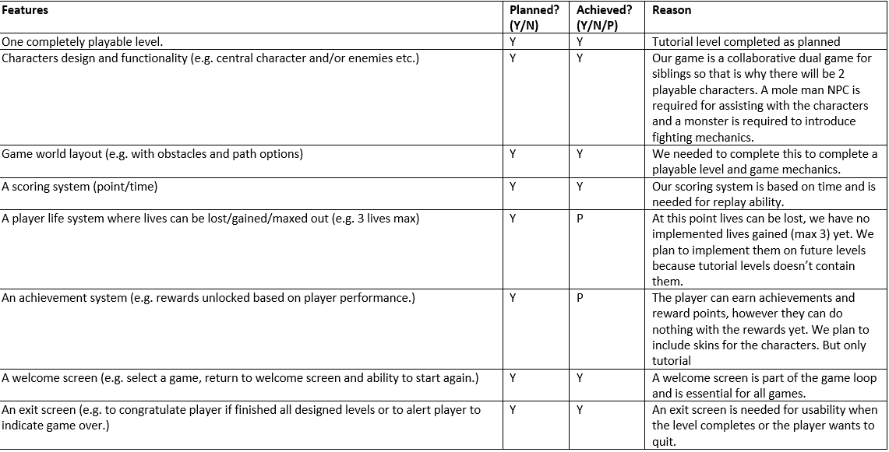

CHECK LIST.

Slide 4
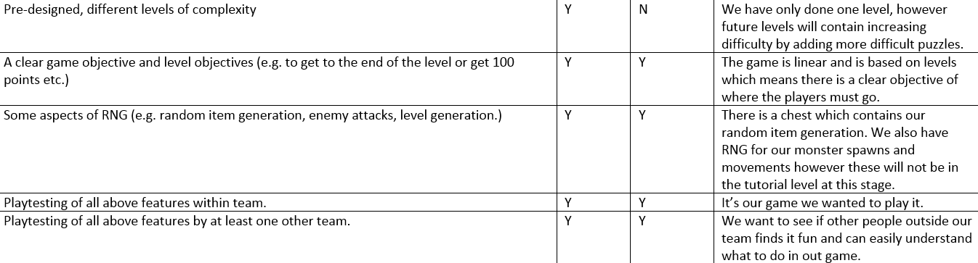
CHECK LIST.

Slide 5
Next Week
To Do:
Other Levels
More Puzzles
Refine mechanics
JUN
NATHAN

Slide 6
