Slide 1


Slide 2
Web Technologies and Programming
Lecture 11

Slide 3
HTML 5 Form elments

Slide 4
Summary of the previous lecture
Creating forms in HTML
Common Form Attributes
When to Use GET AND POST?
Form elements
Textbox
Password Field
Hidden Field
Checkbox
Radio Button
Text Area
Select List
Submit Button
Reset Button
Adding form elements

Slide 5
Outline
HTML5 enhancements in form
XHTML

Slide 6
1. HTML-5 form enhancement
HTML5 enhances the forms in two ways
Adding new attributes to exiting elements
New elements

Slide 7
1.1 The required attribute
Required attribute:
tells the browser to only submit the form if the field in question is filled out
ensures that all necessary information is provided by the user
<input type=“text” name=“name” required>

Slide 8
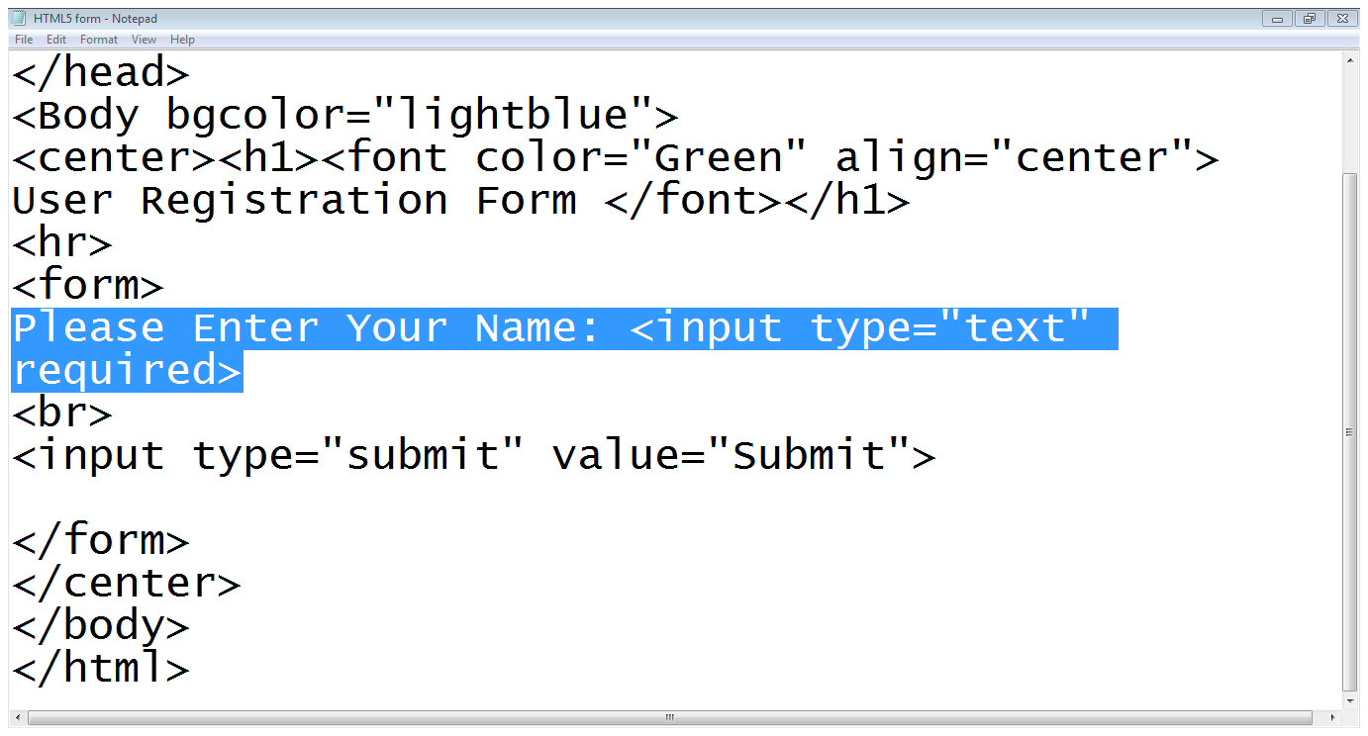
1.1 The required attribute…
Input type
Required attribute

Slide 9
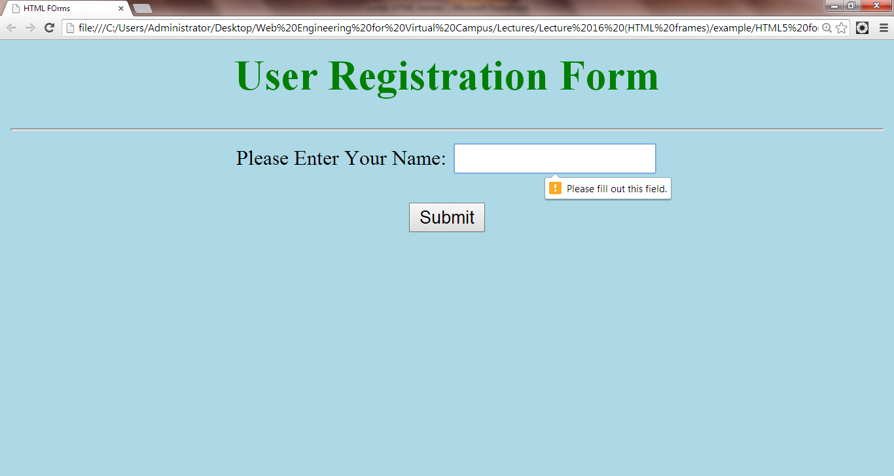
1.1 The required attribute…
Error message

Slide 10
1.2 The placeholder attribute
Placeholder attribute:
Allows a short hint to be displayed inside the form element
tell the user what data should be entered in that field
<input type=“text” name=“name”
placeholder=“Only upper case letters” >

Slide 11
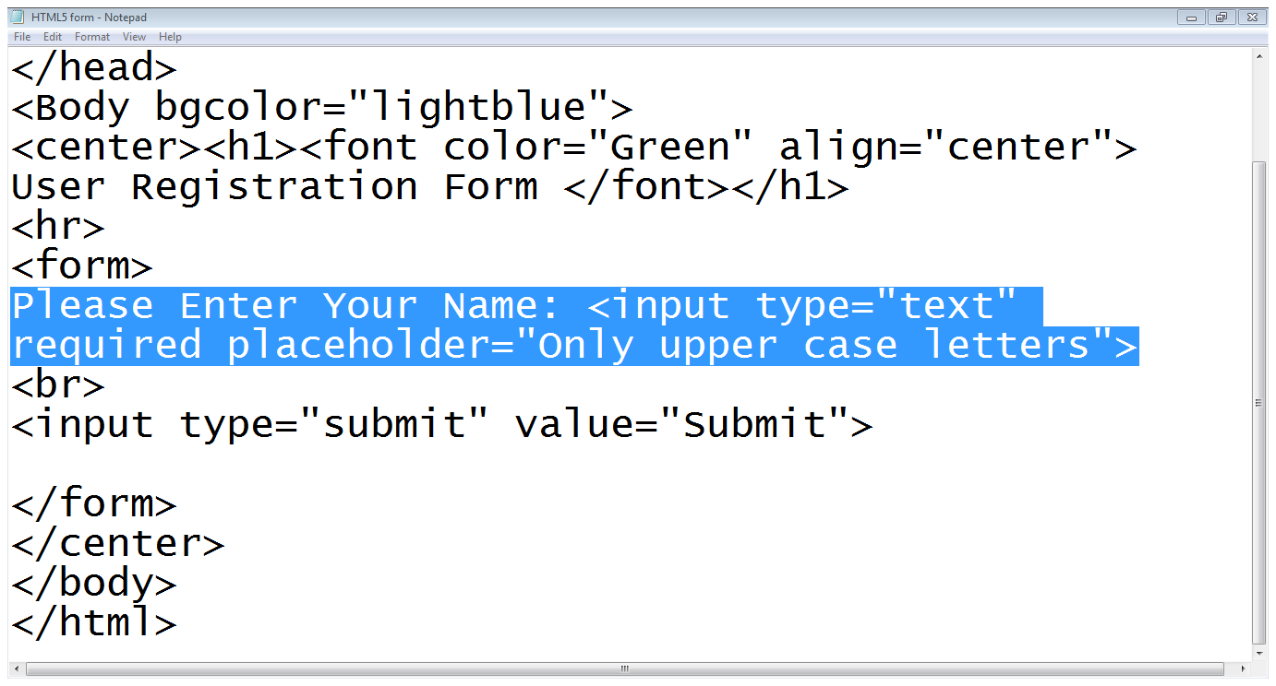
1.2 The placeholder attribute…
placeholder

Slide 12
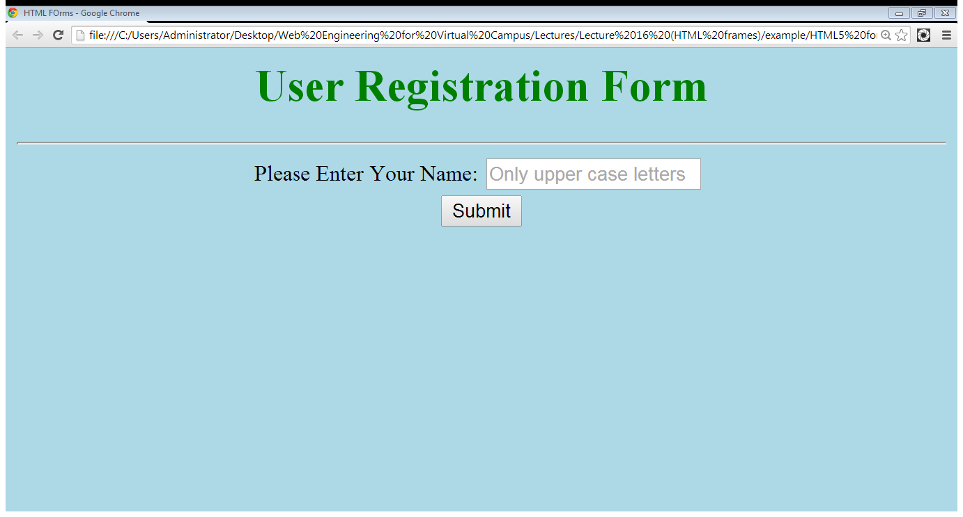
1.2 The placeholder attribute…
Hint about data

Slide 13
1.3 The pattern attribute
pattern attribute:
enables you to provide a regular expression that the user’s input must match in order to be considered valid
<input type=“text” pattern=“Regular Expression”>
<input type=“text” pattern=“[a-z]{1,20}”>

Slide 14
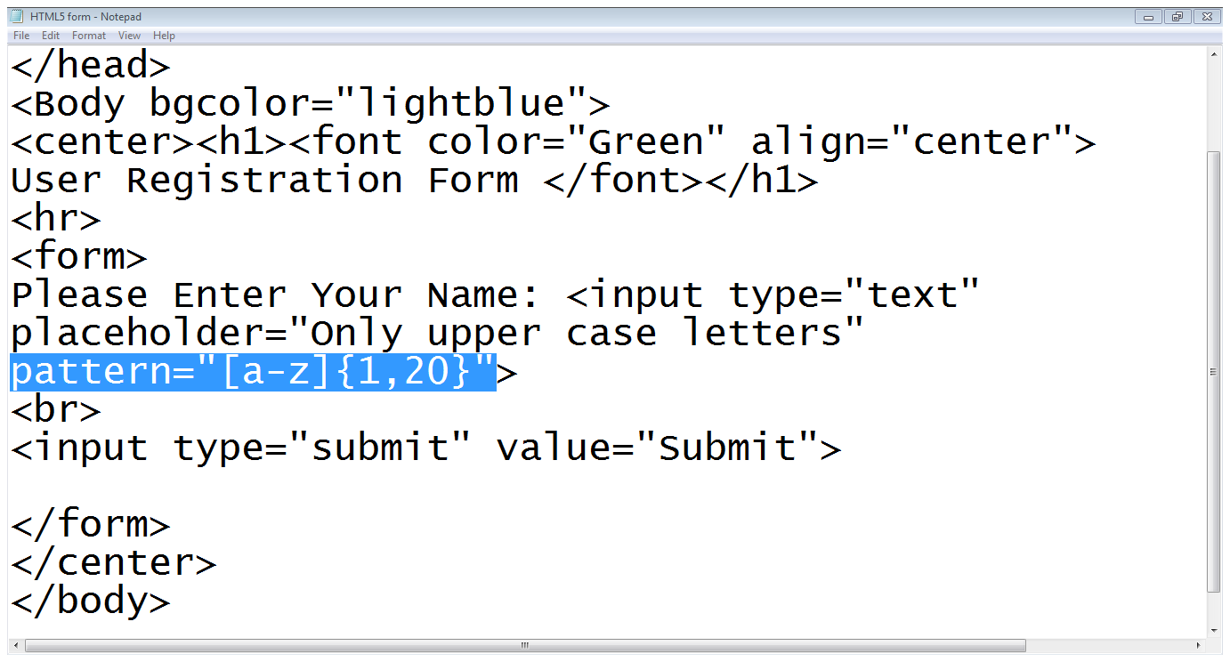
1.3 The pattern attribute
Allowed characters
Valid length
Pattern attribute

Slide 15
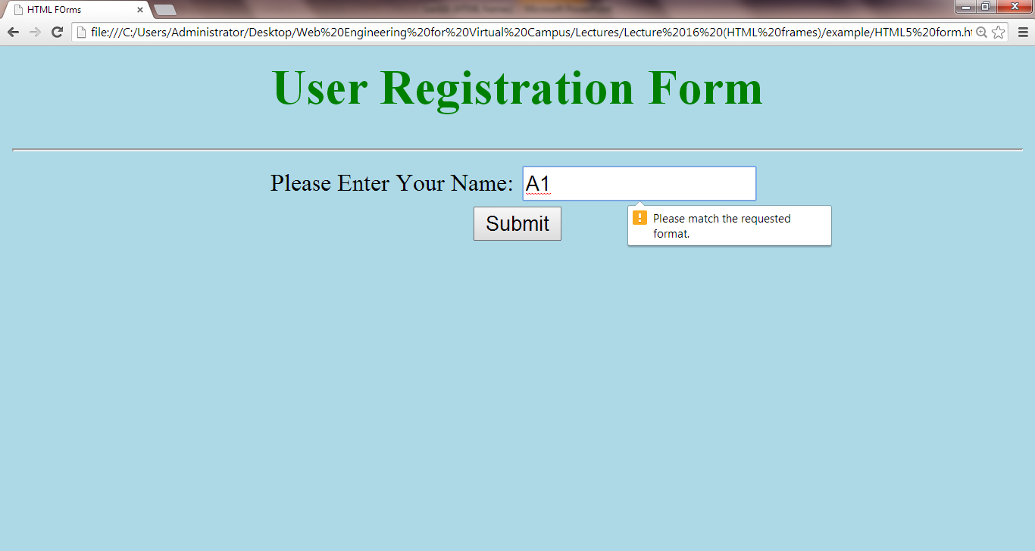
1.3 The pattern attribute…
Invalid input
Error message

Slide 16
1.3 The pattern attribute…
Writing Regular Expression:
[ ]: makes a class of characters
-: means a range of characters
[a-z],[0-9]
[^ ]: negates the class of character
[^0-9]
{n}: matches a character, class or sub-pattern for n times
{ n, m}: matches a character, class or sub-pattern for minimum n times and maximum m times

Slide 17
1.3 The pattern attribute…
Only alphabets
Allowed length
Example patterns:
<input type=“text” pattern=“[a-zA-Z]{1,20} ”>
<input type=“text” pattern=“[a-zA-Z]{1,20} [ ]
[a-zA-Z]{1,20}”>
Allowed length
Space is allowed
Only alphabets
Last name
Allowed length

Slide 18
1.3 The pattern attribute…
Example patterns:
<input type=“text” pattern=“[0-9]{2}[-][0-9]{2}[-][0-9]{4} ”>
<input type=“text” pattern=“[0-9]{5} [-][ 0-9]{7} [-][0-9]{1}”>
Allowed length
Only digits
- symbol
Only digits
Allowed length
- symbol

Slide 19
1.4 The disabled attribute
disabled attribute:
have the content grayed out in the browser
prohibit the user from focusing on a form control that has the disabled
<input type=“text” disabled>

Slide 20
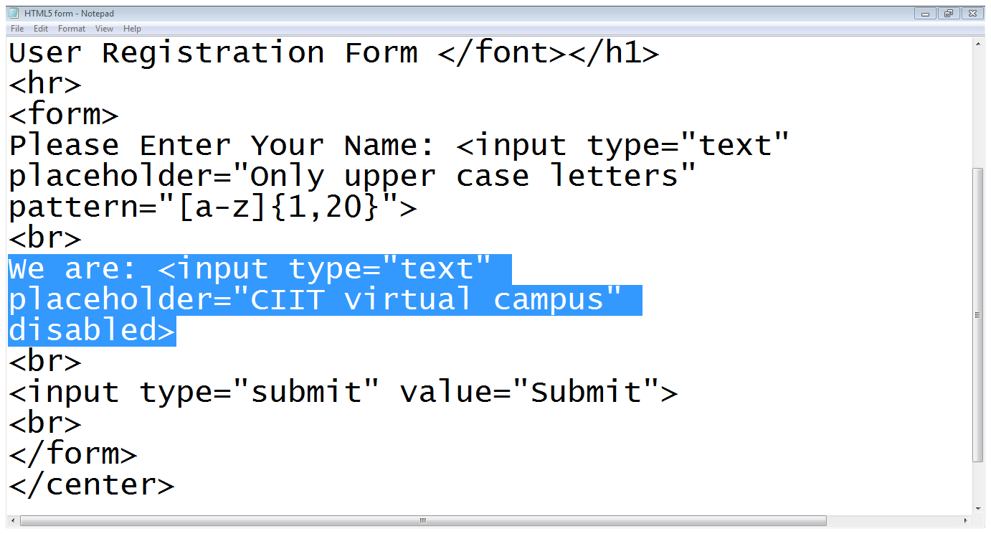
1.4 The disabled attribute…
Input field is disabled

Slide 21
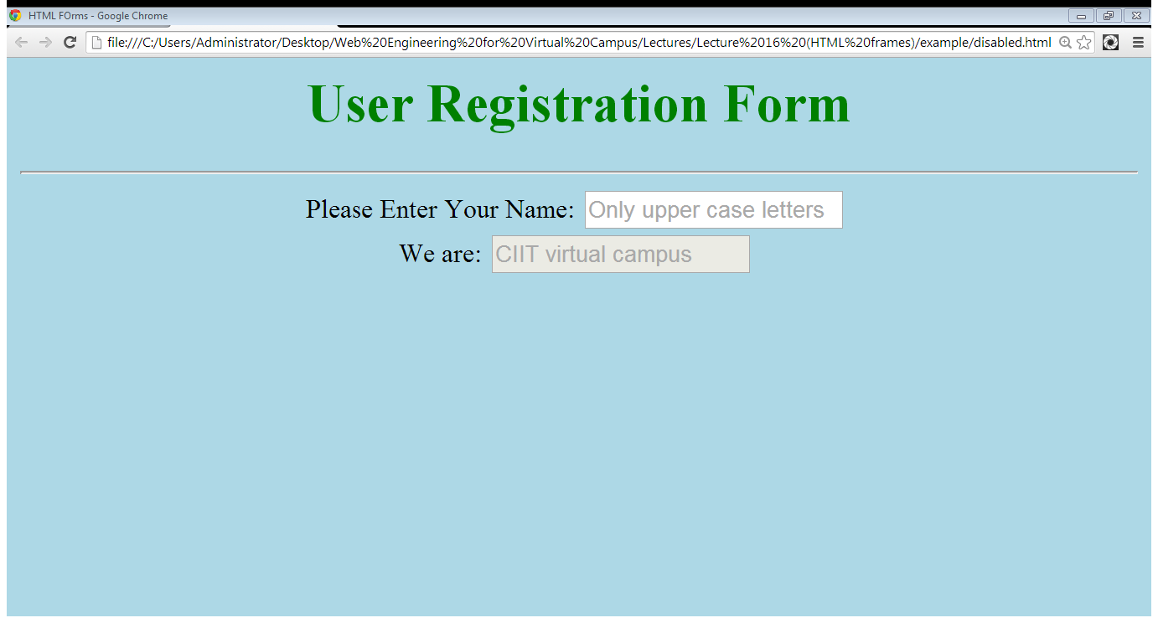
1.4 The disabled attribute…
Disabled field
Input field is disabled

Slide 22
1.5 The read only attribute
read only attribute:
it makes it impossible for the user to edit the form field
the field can receive focus
<input type=“text” readonly>

Slide 23
1.6 The autocomplete attribute
The autocomplete attribute:
this will be a drop-down list that appears when the user begins typing
<input type=“text” autocomplete>

Slide 24
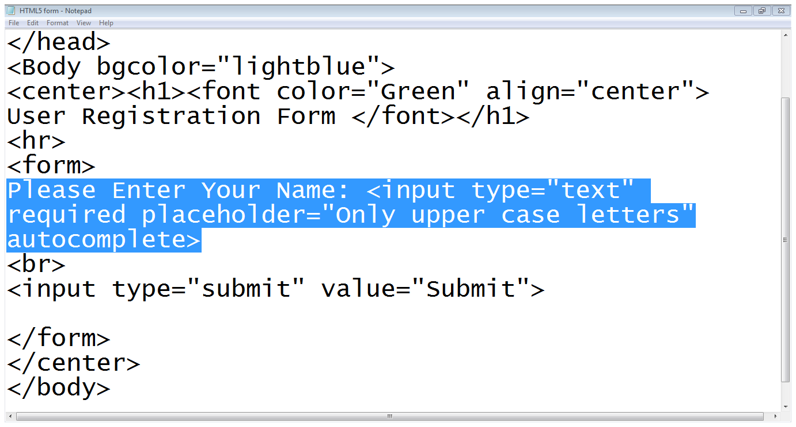
1.6 The autocomplete attribute…
autocomplete

Slide 25
1.7 The datalist element
The datalist element:
a text field with a set of predefined autocomplete options
First we define an input field with list attribute
Then we define the datalist
<input type=“text” list=“colors”>
<datalist id=“colors”>
<option>Red</option>
<option>Red</option>
</datalist>

Slide 26
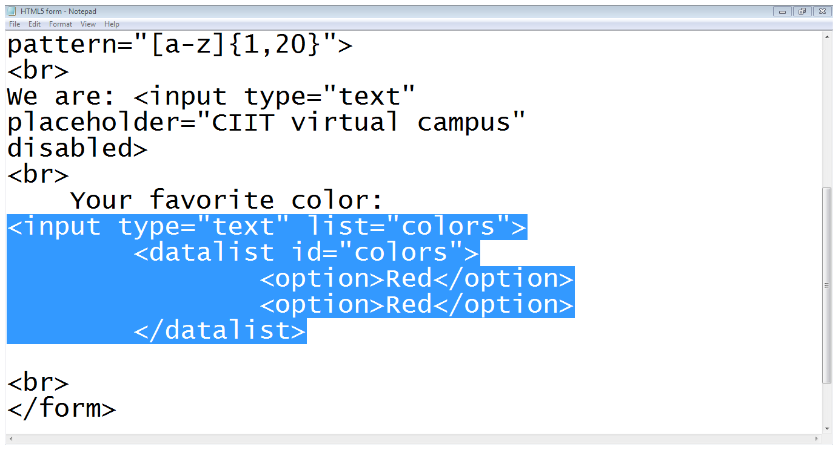
1.7 The datalist element…
List attribute
Datalist starts
Datalist ends
options

Slide 27
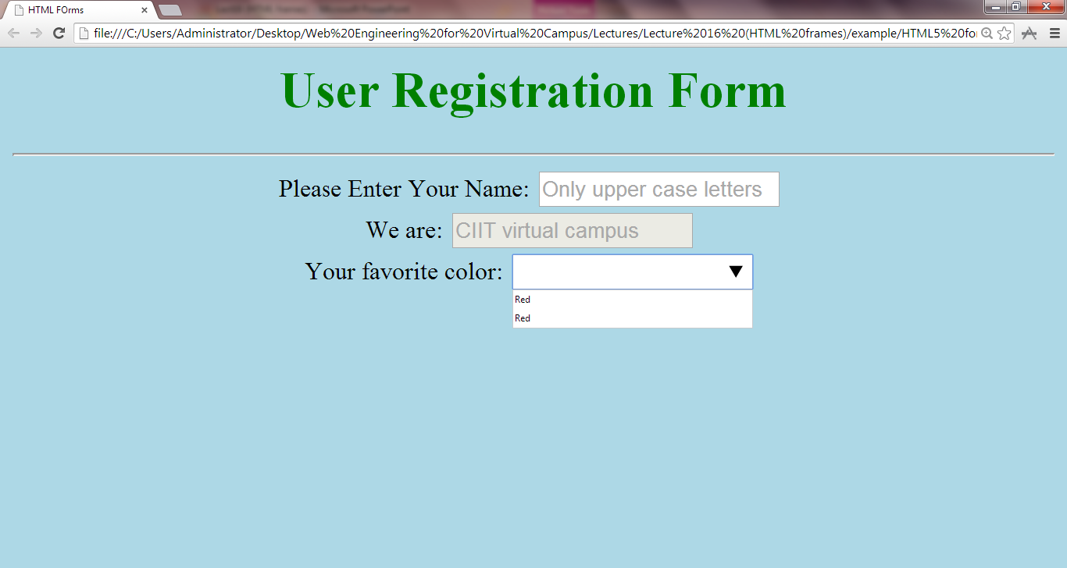
1.7 The datalist element…

Slide 28
2. HTML 5 new elements
Email element
Date element
Number element
Color element

Slide 29
2.1 Email element
The email element:
It ensures that user enters a valid email address
<input type=“email” name=“email”>

Slide 30
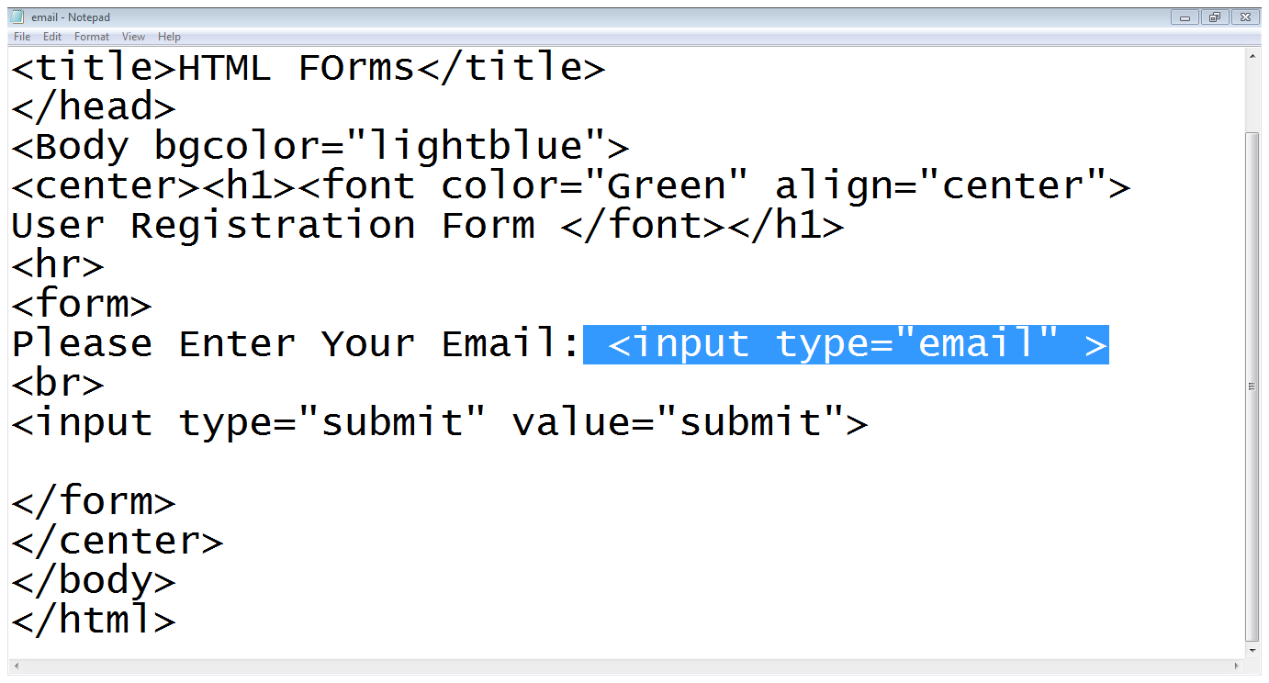
2.1 Email element
Input type

Slide 31
2.2 Date element
The date element:
It shows a calendar to user to select a date
<input type=“date” name=“DoB”>

Slide 32
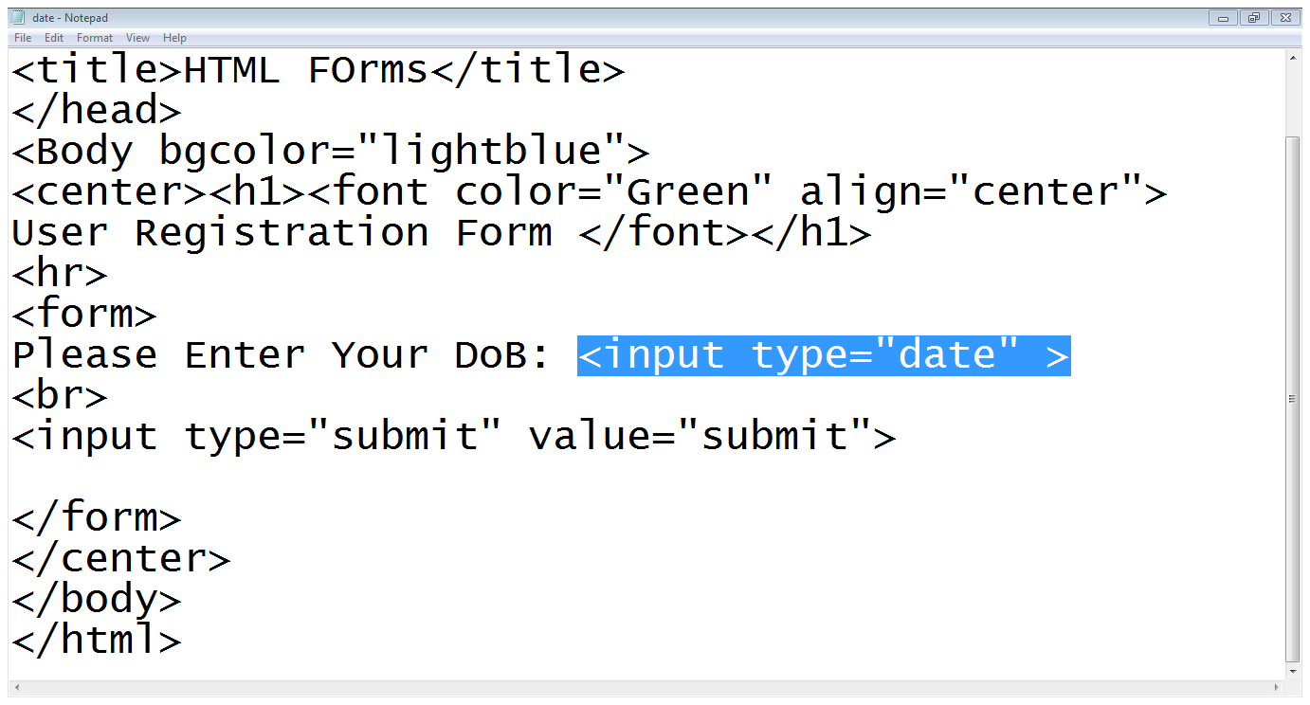
2.2 Date element…

Slide 33
2.3 Color element
The color element:
It facilitate the user to choose a color
<input type=“color” name=“color”>

Slide 34
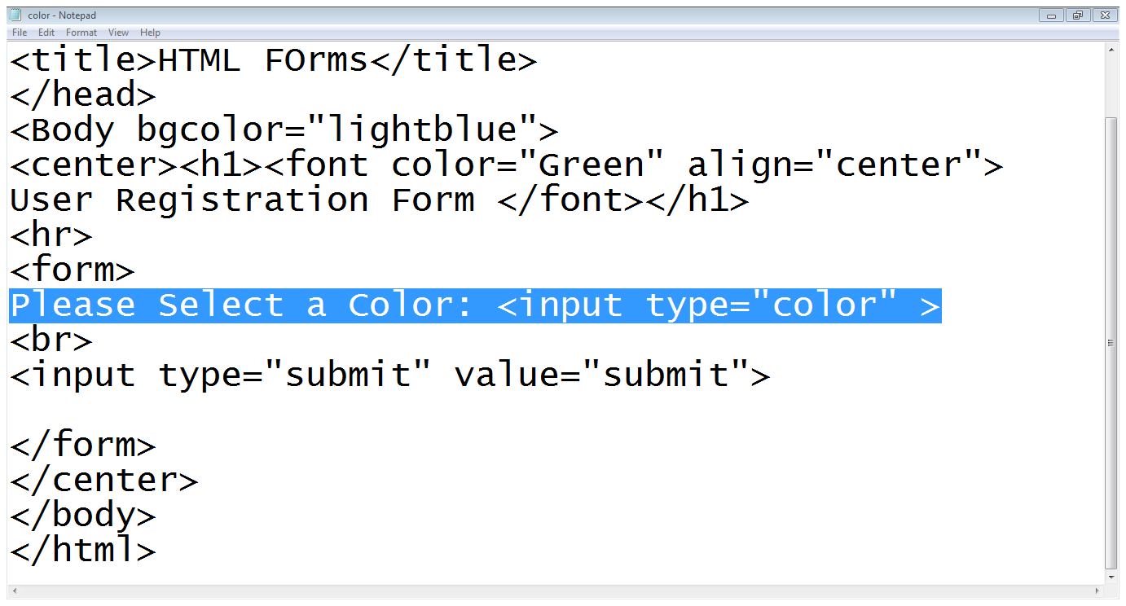
2.3 Color element….

Slide 35
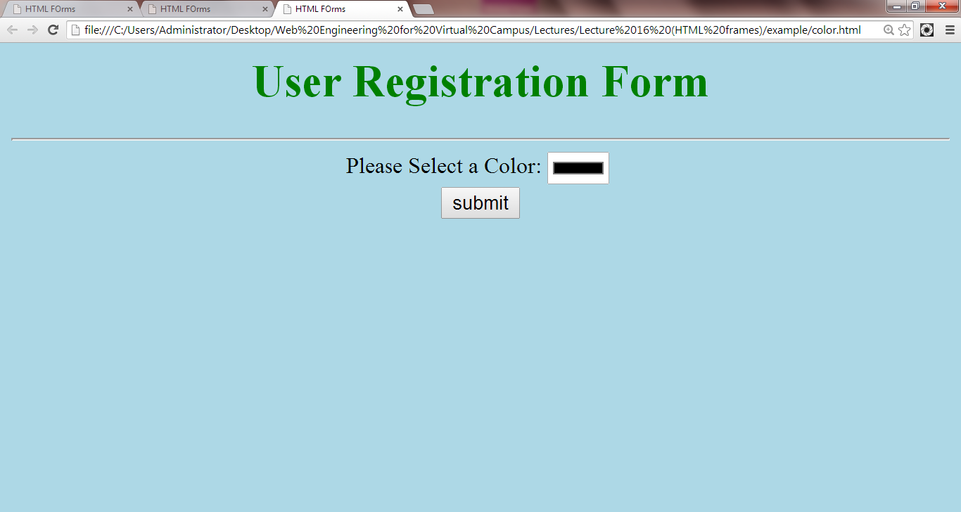
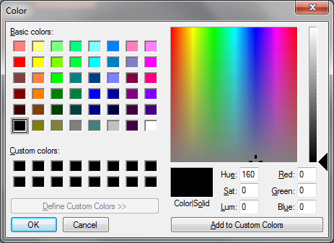
2.3 Color element….

Slide 36
2.4 Number element
The number element:
It ensures that user enters only a numeric value
<input type=“number” name=“number”>

Slide 37
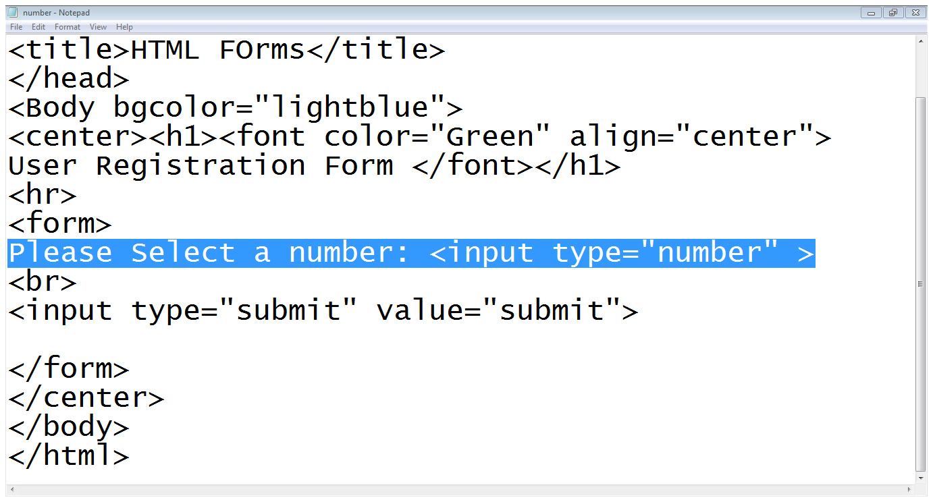
2.4 Number element…

Slide 38
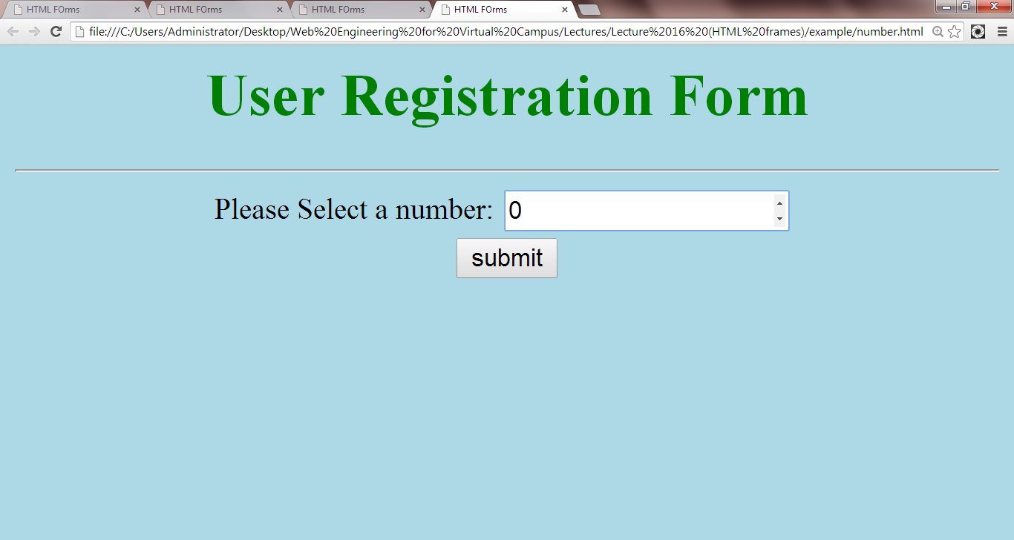
2.4 Number element…

Slide 39
3. XHTML
XHTML
EXtensible HyperText Markup Language
XHTML is almost identical to HTML
Stricter version than HTML
XHTML is HTML defined as an XML application
XHTML is supported by all major browsers

Slide 40
3. XHTML
<body> <h1>Bad HTML <p>This is a paragraph </body>
Above will work in browsers.
Above can work if used as HTML but it will not work as XHTML.

Slide 41
3. XHTML
In XHTML
XHTML DOCTYPE is mandatory
The xmlns attribute in <html> is mandatory
<html>, <head>, <title>, and <body> are mandatory

Slide 42
3. XHTML
In XHTML, elements must be
XHTML elements must be properly nested
XHTML elements must always be closed
XHTML elements must be in lowercase
XHTML documents must have one root element

Slide 43
3. XHTML
In XHTML, attributes must be
Attribute names must be in lower case
Attribute values must be quoted
Attribute minimization is forbidden

Slide 44
3. XHTML
Example
This is wrong:
<p>This is a paragraph <p>This is another paragraph
This is correct:
<p>This is a paragraph</p> <p>This is another paragraph</p>

Slide 45
3. XHTML
Example
This is wrong:
A break: <br> A horizontal rule: <hr>
This is correct:
A break: <br /> A horizontal rule: <hr />

Slide 46
4. How to Convert from HTML to XHTML
Add an XHTML <!DOCTYPE> to the first line of every page
Add an xmlns attribute to the html element of every page
Change all element names to lowercase
Close all empty elements
Change all attribute names to lowercase
Quote all attribute values

Slide 47
4. XHTML: Important Differences from HTML
Document Structure
XHTML DOCTYPE is mandatory
The xmlns attribute in <html> is mandatory
<html>, <head>, <title>, and <body> are mandatory

Slide 48
5. XML
By combining the strengths of HTML and XML, XHTML was developed.
XHTML is HTML redesigned as XML.
XML is a markup language where documents must be marked up correctly (be "well-formed").

Slide 49
Summary
New attributes to existing form elements
New form elements in HTML5
XHTML is the strict form of HTML

Slide 50
THANK YOU

