Slide 1


Slide 2
Web Technologies and Programming
Lecture 12

Slide 3
Introduction to Cascading Style-sheets (CSS)

Slide 4
Summary of previous lecture
New attributes to existing form elements
The required attribute
The placeholder attribute
The pattern attribute (Writing Regular Expression)
The disabled attribute
The read only attribute
The autocomplete attribute
New form elements in HTML5

Slide 5
Summary of previous lecture
New form elements in HTML5
The datalist element
Email element
Date element
Number element
Color element
XHTML is the strict form of HTML

Slide 6
Outline
Understand the basics of CSS (Cascading Style Sheets)
Understand the differences among inline, internal and external style sheets
Understand the difference between ids and classes.
Understand how to declare a style.

Slide 7
1. Cascading style sheets
CSS is a stylesheet language that describes the presentation of an HTML (or XML) document.
CSS describes how elements must be rendered on screen, on paper, or in other media.

Slide 8
1. Cascading style sheets
Created by Hakon Lie of MIT in 1994
Has become the W3C standard for controlling visual presentation of web pages
Cascading style-sheets are powerful mechanism to add style to web document
Enforce standards and uniformity
Create dynamic effects
Works by allowing you to specify rules

Slide 9
1. Cascading Style Sheet
All web pages can be broken down into bucketed content areas
We can change the presentation styles of these areas.
We can update these areas by changing the code on every page
- or -
We can use cascading style sheets!

Slide 10
1. Cascading Style Sheet
CSS ( Cascading Style Sheets ) is a style sheet language that describes the presentation style of an HTML Page.
It describes how HTML elements must be rendered/displayed on screen.

Slide 11
1.1 Versions of CSS
CSS 1 - Released in 1996
Spotty Netscape 4.x support
Netscape pushed their own style sheet language
IE 4.x was fully CSS1 compliant
Result: if you have users using Netscape 4.x then use CSSes with care!
Always test with both browsers!
Limitations of CSS1
Has almost no support for tables
Makes no provision for downloadable fonts
Lack of media types

Slide 12
1.1 Versions of CSS
CSS 2
Released in 1998
Extends CSS1
IE 5.x+ supports most, but not all CSS2 features
Netscape 6.x claims “unsurpassed support” for CSS1 and CSS2
Mozilla 1.x is generally considered to have the best CSS support

Slide 13
1.1 Versions of CSS
CSS 3
Draft Published in 1999, Released in 2012.
Backward Compatible with CSS2 and CSS1.
CSS3 has been split into different modules.
It also contains Old CSS Specification. But some old CSS tags has been removed in this version.
Fully Supported in only modern browsers like Google Chrome, Internet Explorer 11 etc.

Slide 14
1.2 Why use CSS ?
Separation of document from presentation.
Saves time.
Consistency
Easy to change.
Keep consistency.
Rich Design and Layout
Give you more control over layout.
Accessibility.
Use styles with JavaScript.
Make it easy to create a common format for all the Web pages.
Notes:
Separation of the document from the presentation
Easier coding and maintenance
Site control
Consistency (Uniformity)
All pages in the site look the same
Rich design and layout
Gives finer and increased control on document formatting than can be placed within HTML documents
Accessibility
PC browsers, mobiles, PDAs, printers, TVs, users with disabilities, etc…
No browser specific requirements, such as plug-ins
It can be used for both HTML and XML pages

Slide 15
1.2 Disadvantages of CSS ?
The only disadvantage that can be assigned to CSS is non-compatibility with all internet browsers
Surveys says that today 85% of users are able to see pages that use CSS, while the others are not
Notes:
Separation of the document from the presentation
Easier coding and maintenance
Site control
Consistency (Uniformity)
All pages in the site look the same
Rich design and layout
Gives finer and increased control on document formatting than can be placed within HTML documents
Accessibility
PC browsers, mobiles, PDAs, printers, TVs, users with disabilities, etc…
No browser specific requirements, such as plug-ins
It can be used for both HTML and XML pages

Slide 16
2. CSS Syntax
The general syntax is:
selector {property: value}
or
selector, ..., selector { property: value; . . . property: value }
where
selector is the tag to be affected (the selector is case-sensitive if and only if the document language is case-sensitive)
property and value describe the appearance of that tag
spaces after colons and semicolons are optional
a semicolon must be used between property:value pairs, but a semicolon after the last pair is optional
if the value is multiple words, put quotes around the value

Slide 17
2. CSS Syntax
CSS syntax is very simple -- it’s just a file containing a list of selectors (to choose tags) and descriptors (to tell what to do with them):
Example: h1 {color: green; font-family: Verdana} says that everything included in h1 (HTML heading level 1) tags should be in the Verdana font and colored green
A CSS file is just a list of these selector/descriptor pairs
Selectors may be simple HTML tags or XML tags, but CSS also defines some ways to combine tags
Descriptors are defined in CSS itself, and there is quite a long list of them

Slide 18
2. CSS Syntax (Examples)
/* This is a comment */
h1,h2,h3 {font-family: Arial, sans-serif;} /* use 1st available font */
p, table, li, address { /* apply to all these tags */ font-family: "Courier New"; /* quote values containing spaces */ margin-left: 15pt; /* specify indentation */ }
p, li, th, td {font-size: 80%;} /* 80% of size in containing element */
th {background-color:#FAEBD7} /* colors can be specified in hex */
body { background-color: #ffffff;}
h1,h2,h3,hr {color:brown;} /* adds to what we said before */
a:link {color:darkred} /* an unvisited link */
a:visited {color:darkred} /* a link that has been visited */
a:active {color:red} /* a link now being visited */
a:hover {color:red} /* when the mouse hovers over it */

Slide 19
3. Writing Style Sheets
In-line styles
Embedded/internal styles
External style sheet

Slide 20
3.1 In-line Styles
Inline styles
Add styles to each tag within the HTML file
Use it when you need to format just a single section in a web page
Style attribute is used to add style
Example
<h1 style=“color:red; font-family: sans-sarif” > IU </h1>

Slide 21
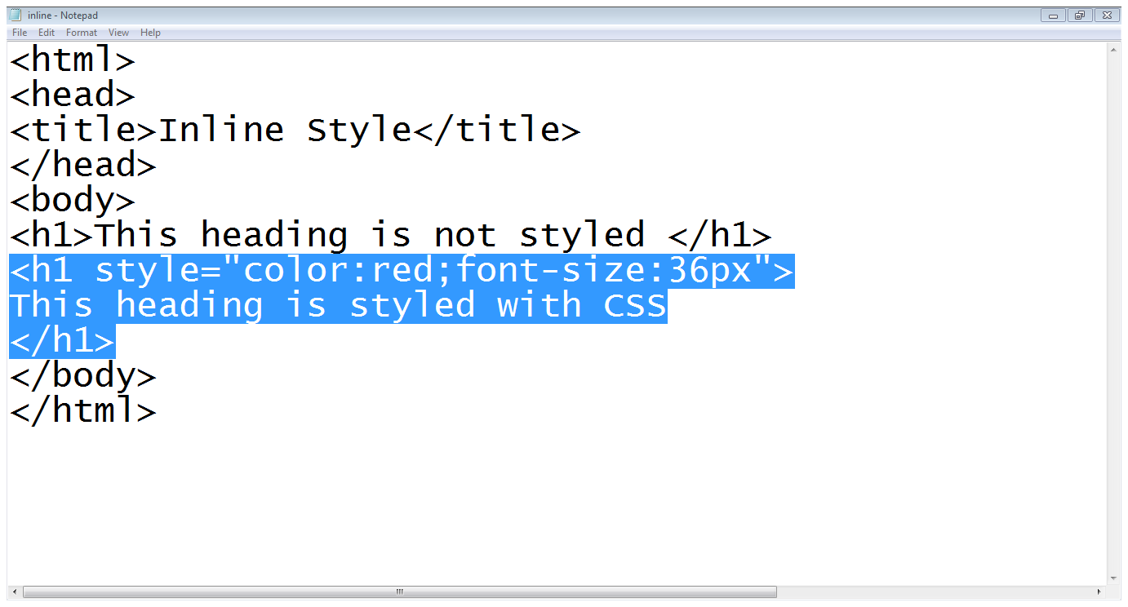
3.1 In-line Styles…
Heading with no style
Color setting
Font size setting
Style attribute

Slide 22
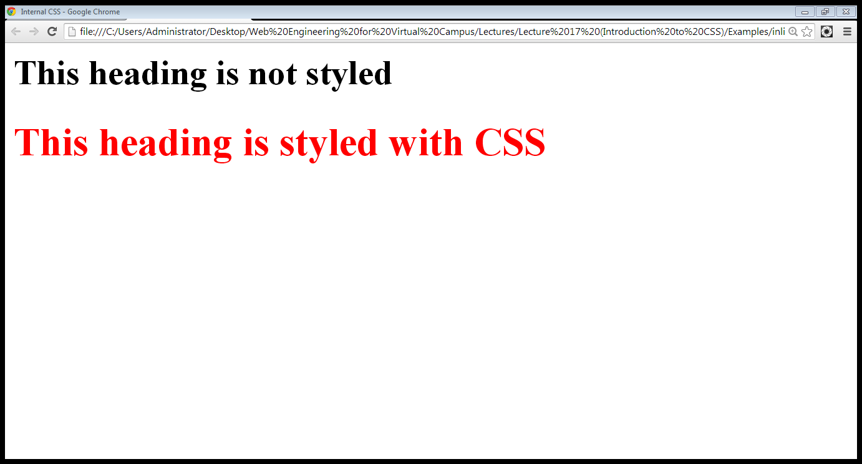
3.1 In-line Styles…
Heading with no style
CSS styled heading

Slide 23
3.1 In-line Styles
Advantage:
Useful if you only want a small amount of markup
Disadvantages:
Mixes display information into HTML
Clutters (mixed) up HTML code
Can’t use full range of CSS features since contextual selectors, for example, like lib{color:green} may not be specifiable inline.

Slide 24
3.1 In-line Styles
Disadvantages:
Handling multiple attributes
HTML: Use one or more spaces or lines to separate attributes in the same tag
CSS: Separate attributes with a single semicolon (spaces and extra lines optional)
Linking attributes with their values
HTML: attribute=“attribute-value”
CSS: attribute:attribute-value

Slide 25
3.2 Internal Styles
A style is applied to the entire HTML file
Use it when you need to modify all instances of particular element (e.g., h1) in a web page
Example
<style>
h1 {color:red; font-family:sans-serif}
</style>

Slide 26
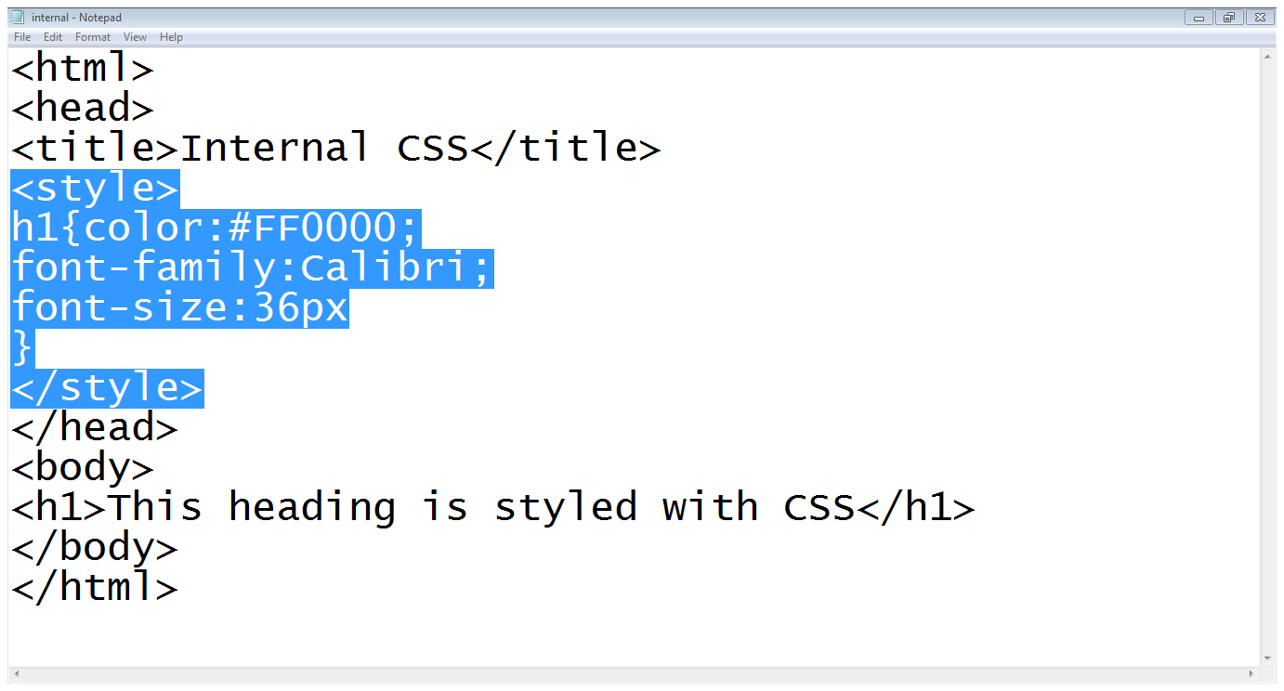
3.2 Internal Styles…
Start of style block
Color setting
Tag
Font family
Font size
End of style
Simple heading

Slide 27
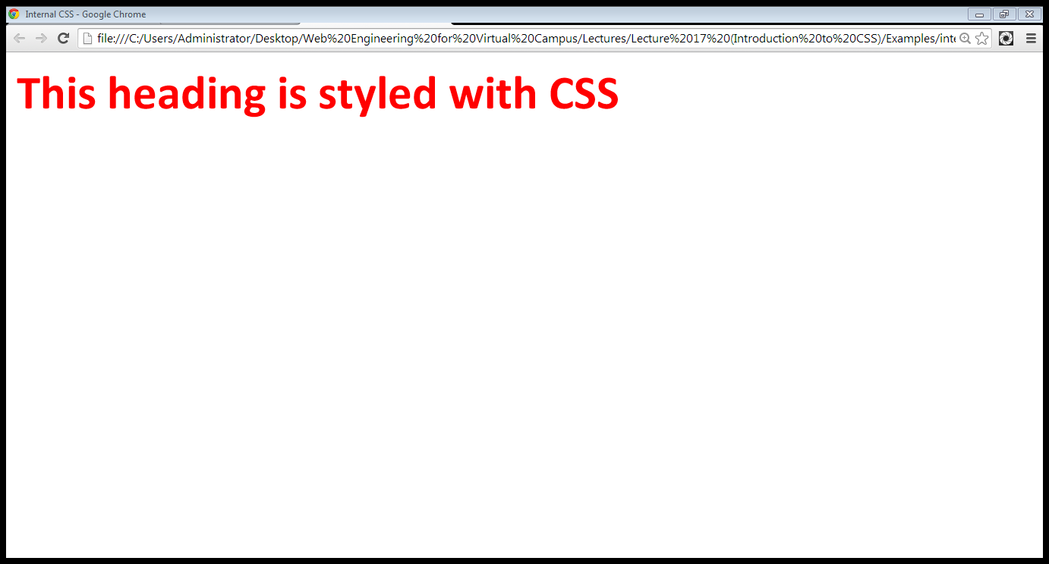
3.2 Internal Styles…

Slide 28
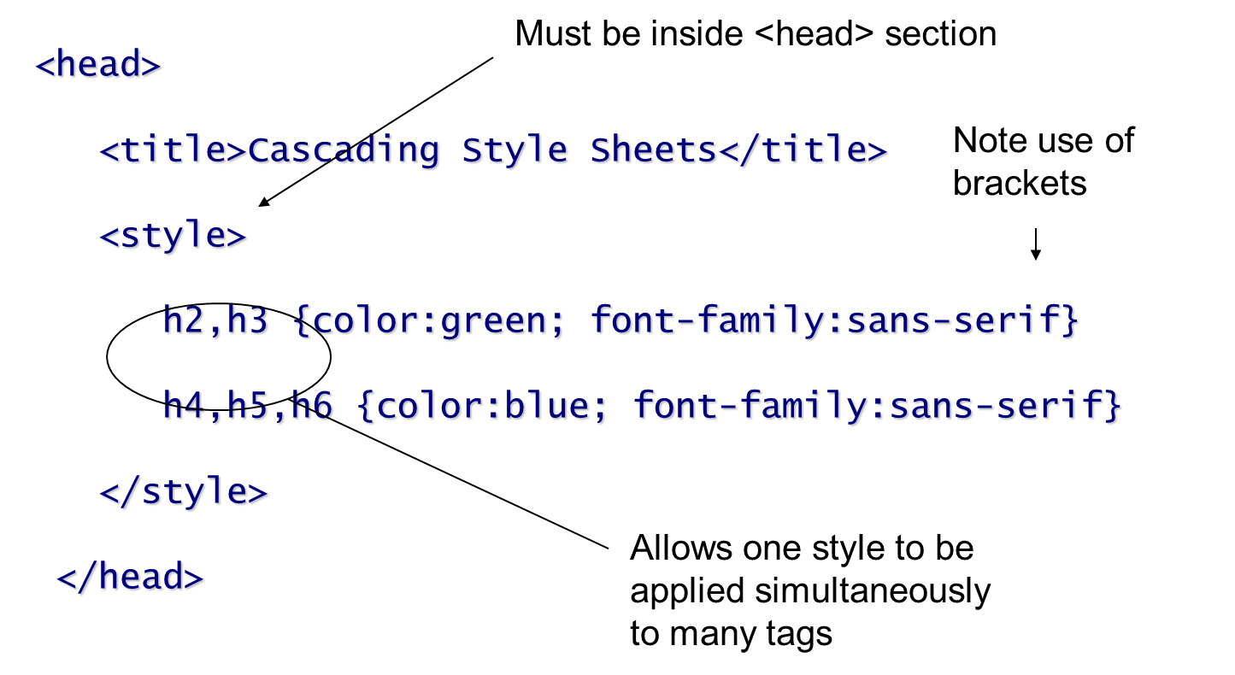
3.2 Internal Styles…

Slide 29
3.3 External Styles
An external style sheet is a text file containing the style definition (declaration)
Use it when you need to control the style for an entire web site
Advantage: allows you to apply the same style easily to multiple HTML files
A convenient way to give a site a standard “look and feel”

Slide 30
3.3 External Styles…
Open a new blank document in Notepad
Type style declarations
h1 {color:red; font-family:calibri;}
Do not include <style> tags
Save the document as <filename>.css

Slide 31
3.3 External Styles…
Open an HTML file
Between <head> and </head> add
<link href=URL rel=“relation_type” type=“link_type”>
URL is the file.css
Relation_type=“stylesheet”
Link_type=“text/css”
Save this file and the .css file in the same web server directory

Slide 32
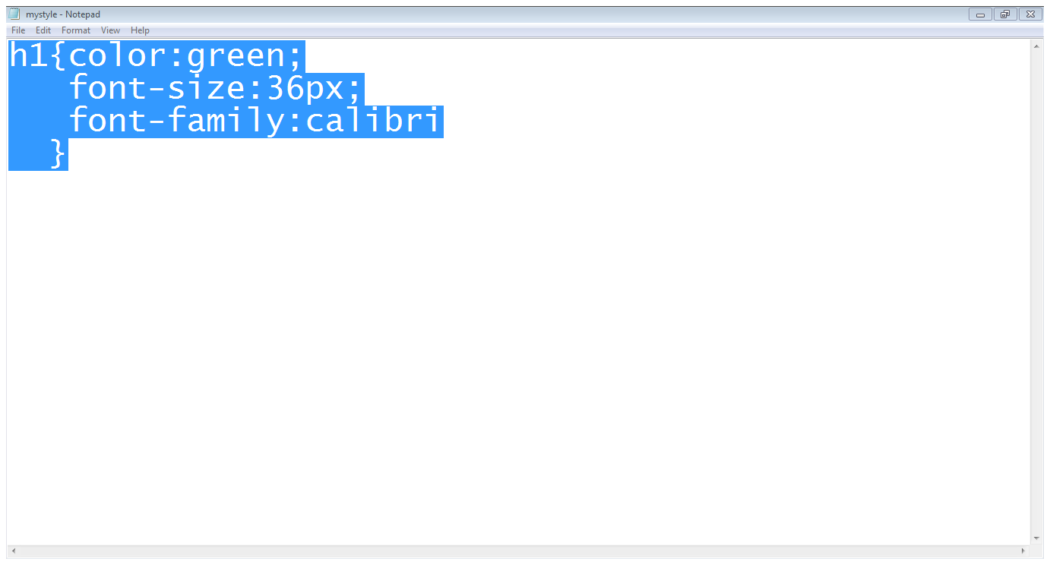
3.3 External Styles…
Style declaration
File is saved with mystyle.css name

Slide 33
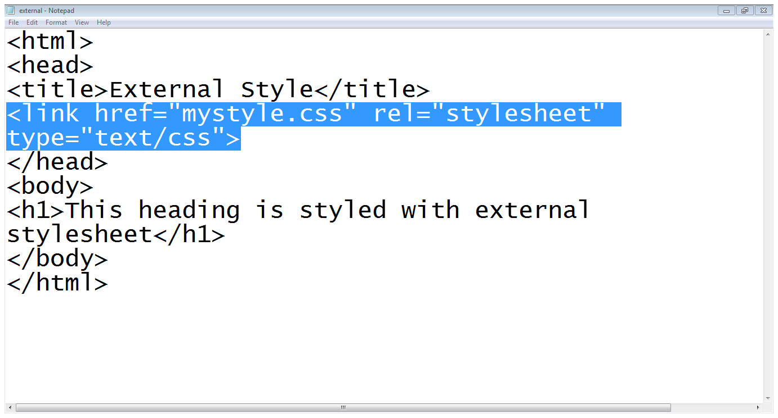
3.3 External Styles…
Style-sheet is included
Heading

Slide 34
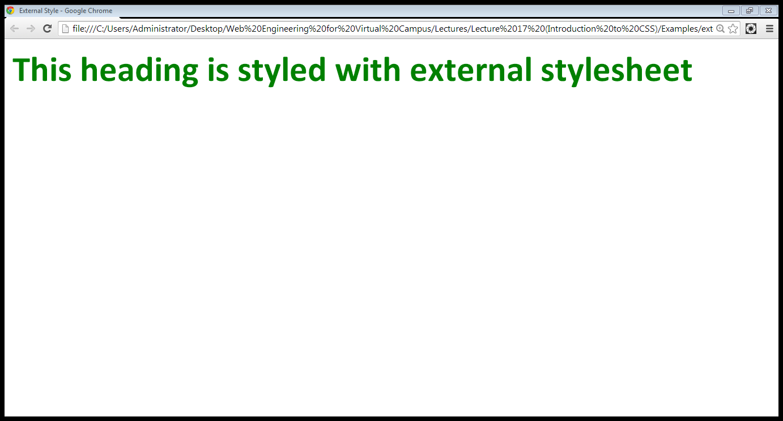
3.3 External Styles…

Slide 35
3.4 External Styles Referencing…
Reference in your HTML
<link> : HTML Tag
@import : A Command

Slide 36
3.4.1 Reference With <Link>
<link> can be used to reference external files other than a CSS
Link syntax:
<link href=“url” rel=“relation_type” type=“link_type”> … </link>
Link attributes
href: location of the external file
rel: must be “stylesheet” to tell HTML the link is for a stylesheet
type: usually “text/css”, the MIME type needed to download the file

Slide 37
3.4.1 Reference With <Link>
<head>
<title>Cascading Style Sheets</title>
<link href="css-2.css" rel="stylesheet" type="text/css" />
</head>

Slide 38
3.4.2 Reference With @import
Can be used in the <style> tag, or used in a .css file by itself as a CSS command
Essentially allows for multiple inheritance of style sheets attributes
For example, a subside style sheet may override a general site style sheet
An HTML page may override the sub site's style sheet
Can’t be used with Netscape 4.x
Supported by HTML 4.0 browsers only

Slide 39
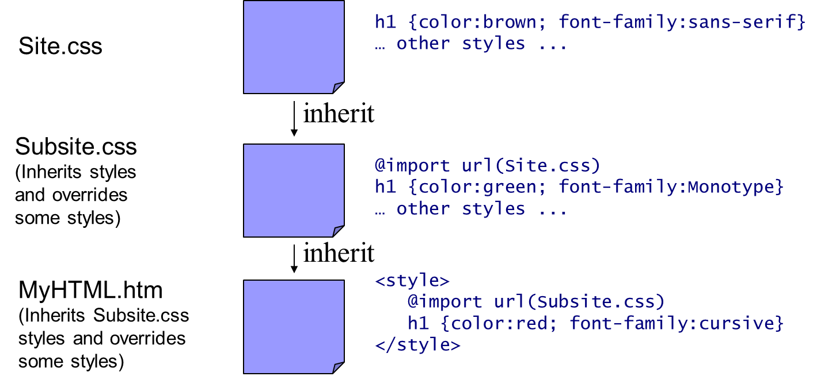
3.4.2 Reference With @import

Slide 40
4. CSS Precedence Order.
What style will be used when there is more than one style specified for an HTML element?
styles will "cascade" into a new "virtual" Style Sheet by the following rules (number four has the highest priority):
Browser default
External Style Sheet
Internal Style Sheet
Inline Style

Slide 41
5. Using Ides
Use an id to distinguish something, like a paragraph, from the others in a document
The id selector is used to specify a style for a single, unique element

Slide 42
6. Using Ides…
Create a style Id:
#iDonate {style attributes and values}
Use a style Id:
<tag ID=id_name>

Slide 43
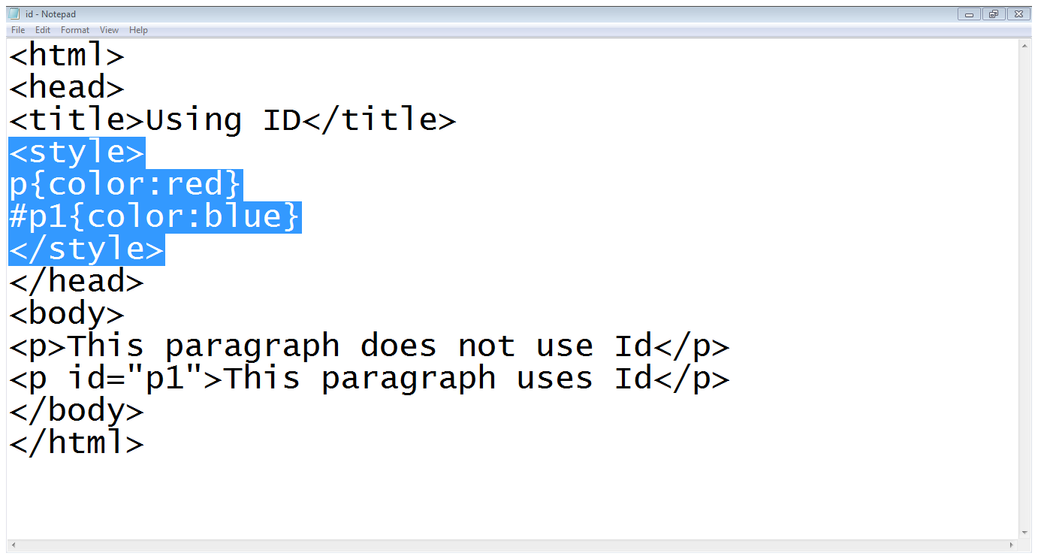
6. Using Id,s…

Slide 44
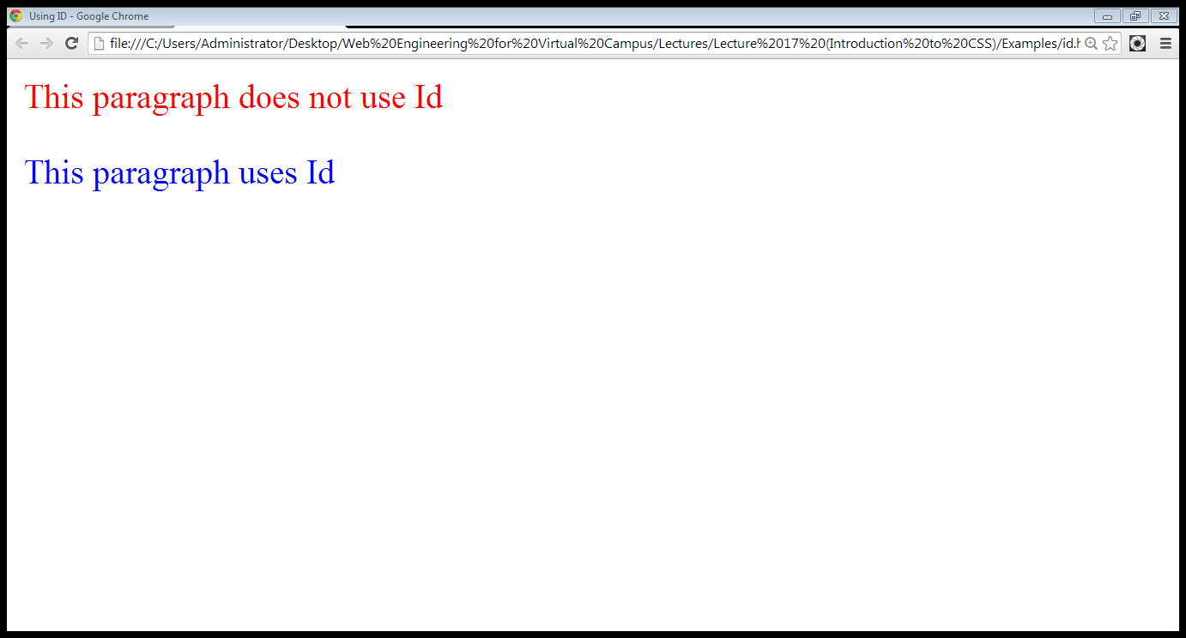
6. Using Id,s…

Slide 45
7. Using Classes
HTML and XHTML require each id be unique– therefore an id value can only be used once in a document
You can mark a group of elements with a common identifier using the class attribute

Slide 46
7. Using Classes…
To create a class
tag.class_name {style attributes} or
.class_name {style attributes}
To apply a style
<tag CLASS=class_name>
<h1 CLASS=FirstHeader>IU</h1>

Slide 47
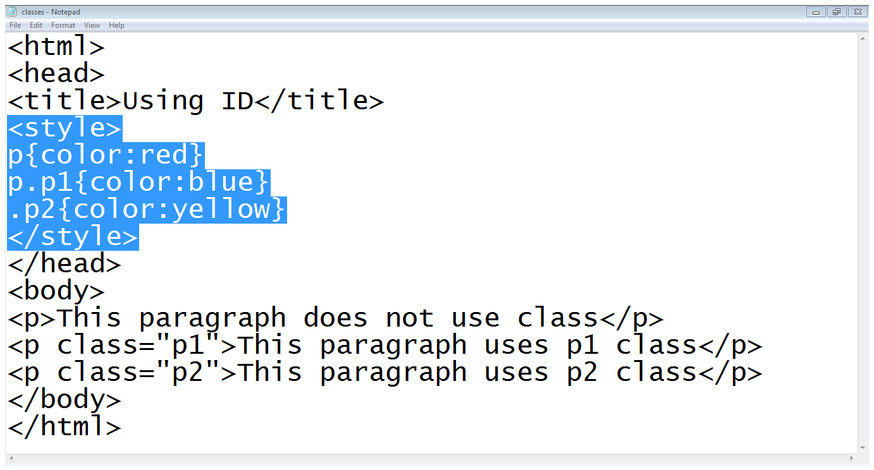
7. Using Classes…

Slide 48
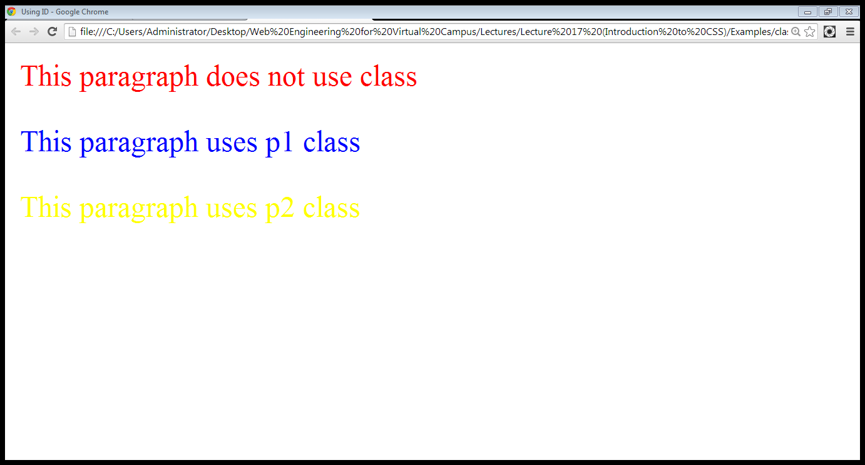
7. Using Classes…

Slide 49
8. Difference between classes and Id,s
You can’t have more than one tag with the same ID value
You can apply the same Class value to multiple document tags
Classes or Id?
use ID's for any elements that are simply used once on a page
OR
only use classes to style websites, but, when you have to use an element in JavaScript, use an identifier

Slide 50
Summary
CSS stands for Cascading Style Sheets
CSS describes how HTML elements are to be displayed on screen, paper, or in other media
CSS saves a lot of work. It can control the layout of multiple web pages all at once
External stylesheets are stored in CSS files
CSS is used to define styles for your web pages, including the design, layout and variations in display for different devices and screen sizes.

Slide 51
Summary
CSS basics
Versions of CSS
Advantages/Disadvantages of CSS
CSS writing option
External style sheet
Internal style sheet
Inline style
CSS rules
Id,s and Classes

Slide 52
THANK YOU

